Slide 1
CS697 Unsupervised Cross Lingual Alignment
Advisor: Prof. Satyadev Nandakumar
PRANJAL SINGH
10327511
Notes:
Set of rules which govern generation of a language….lexical classes are mainly set of tokens which are very similar in usage

Slide 2
Content
Motivation
What we GAIN?
Previous Work
Dataset
Introduction
Formulation
Problem
Algorithm
Scores
Evaluation
Base Results
Reference

Slide 3
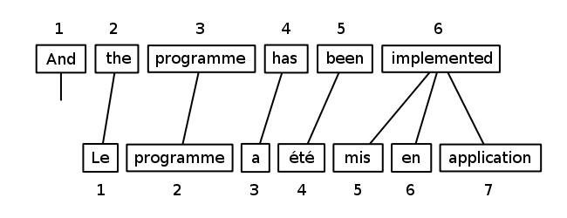
MOTIVATION
Large volume of text in all languages
Same information may not be present
Alignment problem
Source: Wikipedia
Notes:
Thus apart from being syntactical, it has semantic properties hidden in it
Syntactic words provide structure Semantic words provide meaning

Slide 4
What we gain???
Can detect inconsistencies
Same information can be broadcasted easily everywhere

Slide 5
Previous work
Cross Lingual Lexical Substitution: Apidianaki, 2011
aims at providing for a target word in context, several alternative substitute words in another language
Unsupervised
identifies the senses of words by clustering their translations according to their semantic similarity
Evaluate on SemEval-2010 CLLS Dataset

Slide 6
Previous work
DbPedia: Auer, 2008
Ongoing project
automatically extracts information from Wikipedia
normalizes the extracted information, links the information with other online data repositories
provides an interactive access.

Slide 7
dataset
Manually built corpus on Coal Scam in Hindi and English
Collected from various online Hindi and English newspaper and news channel websites such as Dainik Jagran, Hindustan, Aaj Tak, etc.
English: ~52,000 tokens
Hindi: ~36,000 tokens

Slide 8
introduction
Text:L1
Pre-processing
Topic Modelling: PLSA
Text:L2
Mapping: L1<->L2
ADIOS: Syntactic Classes
Evaluation
Notes:
LDA disturbs the structure

Slide 9
Features(nlp)
Bag of Words Model
Text (such as a sentence or a document) is represented as the bag (multiset) of its words, disregarding grammar and even word order but keeping multiplicity
L1: John likes to watch movies. Mary likes movies too.
L2: John also likes to watch football games.
{ Vector
"John": 1,
"likes": 2, L1: [1, 2, 1, 1, 2, 0, 0, 0, 1, 1]
"to": 3, L2: [1, 1, 1, 1, 0, 1, 1, 1, 0, 0]
"watch": 4,
"movies": 5,
"also": 6,
"football": 7,
"games": 8,
"Mary": 9,
"too": 10
}

Slide 10
Features(nlp)
tf-idf Model (Term Frequency Inverse Document Frequency)
tf(t,D): Raw frequency divided by the maximum raw frequency of any term in the document
idf(t,D): It is obtained by dividing the total number of documents by the number of documents containing the term, and then taking the logarithm of that quotient
tf-idf= tf(t,D) * idf(t,D)

Slide 11
ADIOS (Automatic Distillation of Structure)
ADIOS capable of learning complex syntax, generating grammatical novel sentences
Proving useful in other fields that call for structure discovery from raw data, such as bioinformatics
Composed of three main elements
A representational data structure
A segmentation criterion (MEX)
A generalization ability

Slide 12
ADIOS: the model
edge
node
(1)
where
101
cat
104
(2)
(5)
(1)
101
(2)
101
(3)
(4)
(6)
BEGIN
(1)
102
is
(2)
that
102
(3)
a
(4)
dog
(5)
102
?
(6)
END
103
(3)
(4)
104
(5)
(6)
(2)
103
(7)
(1)
(3)
(5)
and
104
horse
(6)
the
(4)
Is that a dog?

Slide 13
adios
Identifying patterns becomes easier on a graph
Sub-paths are automatically aligned

Slide 14
ADIOS
Once a pattern is identified as significant, the sub-paths it subsumes are merged into a new vertex and the graph is rewired accordingly. Repeating this process, leads to the formation of complex, hierarchically structured patterns.

Slide 15
ADIOS

Slide 16

EXAMPLE
Ref: Nayak and Mukerjee, COLING 2012

Slide 17
formulation
Have 2 corpus focussed on a single topic Z
Used PLSA and ADIOS to derive corresponding clusters in both the languages
Can serve as a ID to the corresponding lines in the two languages or as an identifier to complex expressions

Slide 18
formulation
Direct Mapping using bilingual dictionaries for same meaning tokens
Predicted Mapping using Clusters derived above
Semantic Mapping such as synonymy using Word-Net resource and POS tags in both the languages.

Slide 19
formulation
Problem reduces to a matrix solving problem
Rows contain sentences in one language and column contains those in the other language
Row is n-dimensional vector; n is the number of tokens in that sentence

Slide 20
problem
Reorder rows and columns such that scores for each of the cell of the matrix maximizes
A general representation for word-to-word alignment L for a given cross-lingual text with N words(a₁, a₂,…, a_{N}) from one language and M words (b₁, b₂,…..,b_{M}) from other language can be written as:
L = L₁,L₂,……,L_{p}
L_{p} = [a_{x1} , b_{x2} ]
x₁ is in {1,……,N}
x₂ is in {1,……,M}

Slide 21
algorithm
Items which are separated by a white space or a punctuation will be called a word. They are the ones which need to be aligned.
Any extra tokens which have no corresponding tokens in the other language will be substituted by COPY token which means, no subtraction in score for that.

Slide 22
algorithm
Sometimes two lines may mean the same thing or a part of the line may mean the same, so the two sub-parts will be said as aligned.
Alignment scores will also be given when two numbers are aligned in both languages, say for example, when dates are aligned

Slide 23
scores
Direct mapping is certainly the best alignment and should be given the maximum score
Predicted mapping take into account both semantics and syntax, its score will be less than direct mapping score

Slide 24
scores
Semantic mapping score will also be less than direct mapping and will depend on the amount of semantic similarity present
For semantic mapping, words can be extracted from English and Hindi WordNet

Slide 25
evaluation
Precision
Recall
F-Score
Precision(also called positive predictive value) is the fraction of retrieved instances that are relevant.
Recall(also known as sensitivity) is the fraction of relevant instances that are retrieved.
F-Score is the harmonic mean of precision and recall.

Slide 26
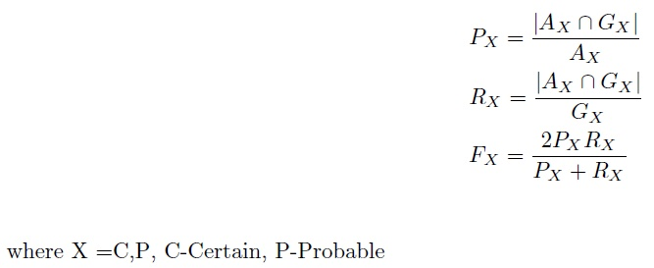
evaluation
We have alignment A derived by our algorithm and G is the Gold Standard Alignment.

Slide 27
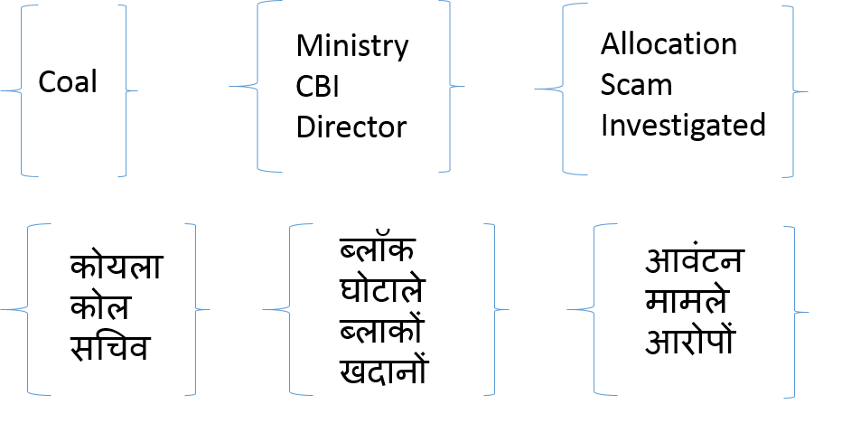
Base-results
ADIOS

Slide 28
Base-results
PLSA
[कोयला, आवंटन, कोल, जिंदल, ब्लॉक, कंपनियों, कंपनी, हिंडाल्को, ब्लाक]
[coal, cbi, the, allocation, birla, fir, block, hindalco, alleged]
[कोयला, घोटाले, सीबीआई, दर्ज, सरकार, सीबीआइ, ब्लॉक, मामले, पूर्व]
[minister, coal, prime, bjp, the, scam, government, party, issue]
[जांच, कोर्ट, कोयला, सरकार, रिपोर्ट, सीबीआई, सुप्रीम, प्रधानमंत्री, मंत्री, घोटाले]
[cbi, coal, the, court, ministry, report, probe, files, agency, government]

Slide 29
Future work
Large Corpus for better vocabulary
Include unsupervised results into an existing supervised system
Phonemes for better alignment of Nouns
N-gram clustering
Improve predicted mapping score

Slide 30
References
Marianna Apidianaki. Unsupervised cross-lingual lexical substitution. In Proceedings of the First Workshop on Unsupervised Learning in NLP, EMNLP '11, pages 13{23, troudsburg, PA, USA, 2011. Association for Computational Linguistics.
Thomas Hofmann. Unsupervised learning by probabilistic latent semantic analysis. Machine Learning, 42(1):177{196, 2001.
Heng Ji. Cross-lingual predicate cluster acquisition to improve bilingual event extraction by inductive learning. In Proceedings of the Workshop on Unsupervised and Minimally Supervised Learning of Lexical Semantics, UMSLLS '09, pages 27{35, Stroudsburg, PA, USA, 2009. Association for Computational Linguistics.
Zach Solan, David Horn, Eytan Ruppin, and Shimon Edelman. Unsupervised learning of natural languages. Proceedings of the National Academy of Sciences of the United States of America, 102(33):11629{11634, 2005.
Jorg Tiedemann. Word to word alignment strategies. In Proceedings of the 20th International Conference on Computational Linguistics, COLING '04, Stroudsburg, PA, USA, 2004. Association for Computational Linguistics.
Paola Virga and Sanjeev Khudanpur. Transliteration of proper names in cross-lingual information retrieval. In Proceedings of the ACL 2003 Workshop on Multilingual and Mixed-language Named Entity Recognition - Volume 15, MultiNER '03, pages 57{64, Stroudsburg, PA, USA, 2003. Association for Computational Linguistics.
Notes:
Inspired by cognitive notion of prototypes…

Slide 31
THANK YOU!!

