Slide 1
Word Embeddings with Word2vec
Advisor: Prof. Amitabha Mukerjee
Pranjal singh
10327511

Slide 2
Index
Part I
word2vec by Mikolov et al.(2013)
Dataset
Results (English and Hindi)
Part II (Sentiment Analysis)
Tf-idf
Dataset
Results (English and Hindi)

Slide 3
PART I

Slide 4
word2vec
Two architectures
Continuous Bag-of-Word (CBOW)
Skip Gram
CBOW: Predict the word given the context
Skip-Gram: Predict the context given the word

Slide 5
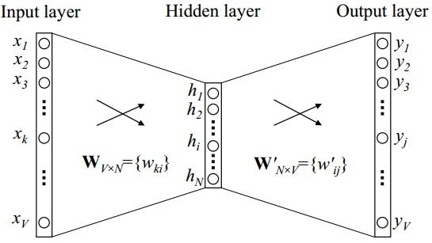
One Word Context (CBOW)
Vocabulary size is V and hidden layer size is N
Input vector is one-hot encoded vector, i.e., only one node of {x₁,…..,x_{v}} is 1 and others 0
Weights between the input layer and the output layer can be represented by a V × N matrix W

Slide 6

One Word Context (CBOW)
h = x^{T} W = v_{Wi} v_{wI} is the vector representation of the input word w_{I} u_{j} is score of each word in vocabulary and v’_{wj} is the j-th column of matrix W’

Slide 7


One Word Context (CBOW)
We then use soft-max, a log-linear classification model, to obtain the posterior distribution of words, which is a multinomial distribution

Slide 8
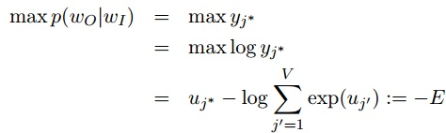

One Word Context (CBOW)
Update Equation for hidden->output weights
The training objective is to maximize the conditional probability of observing the actual output word w_{O} (denote its index in the output layer as j∗) given the input context word w_{I} with regard to the weights
Using Stochastic Gradient Descent, update equation becomes,

Slide 9

One Word Context (CBOW)
Update Equation for input->hidden weights

Slide 10
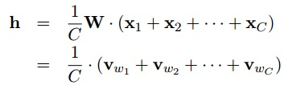
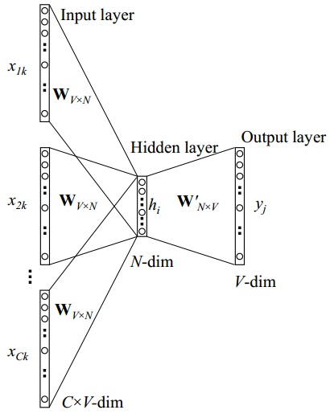
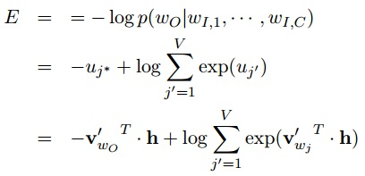
Multi Word Context (CBOW)

Slide 11

Multi Word Context (CBOW)
Update Equations
1)
2)

Slide 12
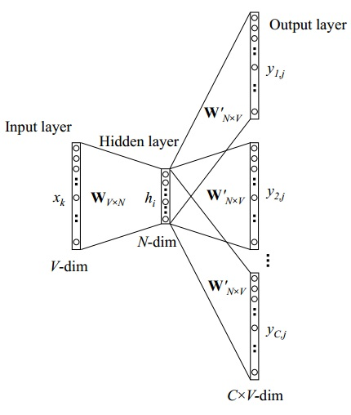

Skip-Gram Model
It is the opposite of CBOW Model
On the output layer, instead of outputing one multinomial
distribution, we are outputing C multinomial distributions.
Each output is computed using the same hidden →output matrix

Slide 13
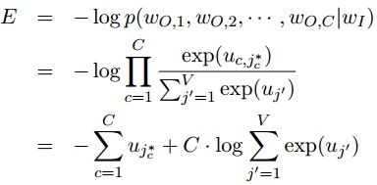
Skip-Gram Model
Loss Function

Slide 14
Optimization
Hierarchical Softmax (Morin & Bengio, 2005)
Negative Sampling (Gutmann & Hyvarinen, 2012)

Slide 15
Dataset
Hindi :Wikipedia text dump (290 MB) ~4 mins of training
23848940 words
723737 words in vocabulary
106876 words after removing words with freq<5
English: Wikipedia text dump (9.3 GB) ~3.5 hrs of training
1,703,849,452 words
13,027,758 words in vocabulary
1,778,685 words after removing words with freq<5

Slide 16
Result (English)
Odd One out
1) breakfast cereal dinner lunch
Ans: Cereal
2) eight six seven five three owe nine
Ans: owe
3) math shopping reading science
Ans: shopping

Slide 17
Result (English)
Top Similar Words
Father
1) grandfather
2) uncle
3) mother
4) father-in-law
5) brother
FRANCE
1) GERMANY
2) FRENCH
3) GREECE
4) NETHERLANDS
5) SCOTLAND
XBOX
1) XBLA
2) Xbox360
3) SmartGlass
4) 360/PS3
5) Playstation
6) Qubed
7) Kinect
scratched
1) scraped
2) rubbed
3) bruised
4) cracked
5) discarded
6) shoved
7) tripped
8) scratches
9) ripped
10) pasted
megabits
1) gigabits
2) kilobits
3) megabit
4) terabits
5) MB/s
6) Tbit/s

Slide 18
Result (Hindi)
Odd One out
1) भारत रूस मुम्बई चीन
Ans: मुम्बई
2) लड़की बेहन महिला मर्द
Ans: मर्द
3) नेता मंत्री सरकार उद्योग
Ans: उद्योग

Slide 19
Result (Hindi)
Top Similar Words
भारत
1) प्रदेश
2) तिब्बत
3) देश
4) आँध्रप्रदेश
5) लद्दाख
व्यापार
1) व्यवसाय
2) पुनर्बीमा
3) वाणिज्य
4) बैंकिंग
5) उद्योग
ओबामा
1) क्लिंटन
2) बराक
3) सीनेटर
4) राष्ट्रपति
5) उम्मीदवार

Slide 20
PART II

Slide 21
Sentiment Analysis
Sentiment analysis aims to determine the attitude of a speaker or a writer with respect to some topic or the overall contextual polarity of a document.
A basic task in sentiment analysis is classifying the polarity of a given text at the document, sentence, or feature/aspect level — whether the expressed opinion in a document, a sentence or an entity feature/aspect is positive, negative, or neutral.
(Source: Wikipedia)

Slide 22
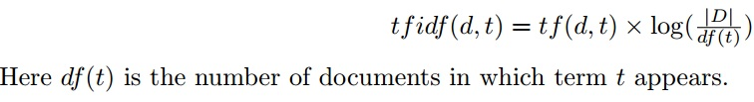
tf-idf(term frequency–inverse document frequency)
It is a numerical statistic that is intended to reflect how important a word is to a document in a collection or corpus
The tf-idf value increases proportionally to the number of times a word appears in the document, but is offset by the frequency of the word in the corpus
D is the total number of documents
tf(d,t) is the term-frequency

Slide 23
Dataset
IMDB 50,000 Movie Review Dataset(English)
Contains 25,000 Positive and 25,000 Negative reviews
25,000 training examples and 25,000 testing examples
Hindi Product Review Dataset(IIIT)
Contains 350 Positive and 350 Negative reviews
Hindi Movie Review Dataset(IITB)
Contains 127 Positive and 125 Negative reviews

Slide 24
Methodology
Trained word2vec on each dataset for respective evaluation
Features are constructed by taking average of word vectors for each review(not weighted average)
Ignored stop-words(the, a, there, etc.) in English but not Hindi(मैं, वह, ने, etc.)
Also constructed feature set by merging word vectors of Wikipedia trained word2vec(Hindi & English Wikipedia)
E.g. 300 dim.(from first training) + 200 dim.(from second training)= 500 dim. Feature vector
Used SVM implementation of libSVM in scikit

Slide 25
Train skip-gram model on Wikipedia(200 dim.)
Train skip-gram model on Review Dataset (300 dim.)
Average out word vector each review
Dataset
Pre-processing
500 dim. Feature vector(include wiki trained vectors)
300 dim. Feature vector
Classification using SVM

Slide 26
Result(English-IMDB)
Classifier | Accuracy(%)
SVM(linear) | 87.05
Random Forest(280 Trees) | 84.14
Naïve Bayes | 75.95
Logistic Regression(l1 penalty) | 86.90
k-NN(20) | 76.76
SVM(linear) with Wiki trained word vectors merged(300+200 dim) | 87.56
* Skip-gram model was trained with vector dimension as 300 and min word-count as 20

Slide 27
Result(Hindi-Product Review: IIIT)
Feature Set | Accuracy(%)
500 dimensional word vector | 78.0
500 dimensional word vector + tf-idf | 90.73
Using subjective Lexicon construction(Thesis by Piyush Arora, IIIT’13) | 79.62
Skip-gram model was trained with vector dimension as 300 and min word-count as 20
Used Linear SVM as classifier

Slide 28
Result(Hindi-Movie Review: IITB)
Feature Set | Accuracy(%)
500 dimensional word vector | 79.62
500 dimensional word vector + tf-idf | 88.13
Tf-idf & n-gram ^{[6]} | 78.14
Skip-gram model was trained with vector dimension as 300 and min word-count as 20
Used Linear SVM as classifier

Slide 29
References
Manning, W. Y. (2013). Bilingual Word Embeddings for Phrase-Based Machine Translation. Proceedings of the 2013 Conference on Empirical Methods in Natural Language Processing (EMNLP 2013), (p. 2013).
Weston, R. C. (2011). Natural Language Processing (Almost) from Scratch. Journal of Machine Learning Research, 12, 2493--2537.
Mikolov, T., Chen, K., Corrado, G. & Dean, J. (2013). Efficient Estimation of Word Representations in Vector Space. CoRR, abs/1301.3781.
Mikolov, T., Sutskever, I., Chen, K., Corrado, G. S. & Dean, J. (2013). Distributed Representations of Words and Phrases and their Compositionality. In C. Burges, L. Bottou, M. Welling, Z. Ghahramani & K. Weinberger (ed.), Advances in Neural Information Processing Systems 26 (pp. 3111--3119) .
Aditya Joshi, Balamurali A. R. and Pushpak Bhattacharyya. A Fall-back Strategy for Sentiment Analysis in Hindi: a Case Study. International Conference on Natural language Processing (ICON), Karagpur.-2010
Sarath Chandar A P, Mitesh M Khapra, Ravindran B, Vikas Raykar, Amrita Saha, "Multilingual Deep Learning". In Deep Learning Workshop at NIPS 2013.

Slide 30
Thank You!!!

Slide 31
NLP from Scratch
Built a unified architecture for tasks such as POS tagging, Chunking, NER
Compared against classical NLP benchmarks
Avoided task specific engineering
Generalize a system to handle multiple tasks

Slide 32
NLP from Scratch
Learn lookup table by back propagation
Words are mapped to d-dimensional vector using lookup table operation
Lookup table returns a matrix for a given sentence

Slide 33

NLP from Scratch
Used entire English Wikipedia to learn word embeddings (631 million words)
Tokenized using Penn Treebank Tokenizer
The total training time was about four weeks
Window size: 11 and a Hidden layer with 100 units
Objective: Seek a network that computes a higher score when given a legal phrase than when given an incorrect phrase

