Slide 1
Word Embeddings
Advisor: Prof. Amitabha Mukerjee
Pranjal singh
10327511

Slide 2
Index
Motivation
Past
Objectives
Embeddings
Earlier Work
NLP from Scratch
Bilingual Word Embeddings
Vector Space Word Representation
Dataset
Results (English and Hindi)
Conclusion and Future Work

Slide 3
Motivation
Word embeddings have the power to capture semantics
They have potential to represent syntax and semantics both
We have many sources of unsupervised raw data but not supervised data
Unsupervised techniques could greatly improve existing supervised (Collobert et al.(2013))
Leveraging large amount of data floating around, we can improve existing systems

Slide 4
Past
LSA and LDA were used to capture word embeddings(not exactly) and hence derive semantic relations
Most of the existing systems treat word as atomic units
BUT
Words also inherit meanings which can only be defined if we represent it as a vector/combination of latent words

Slide 5

Objective
To maximize probability of raw text given a context window
So for a given context window of size c:

Slide 6
Earlier Work
word2vec (Mikolov et al., 2013) learns embeddings using neural language model
Collobert & Weston, 2011 : NLP from Scratch
Bilingual Word Representations (Zou et al. al & Manning et al., 2013)

Slide 7
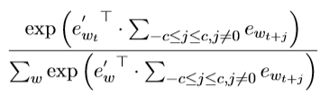

Embeddings
Word2vec
1) CBOW
Embeddings are represented by a set of latent variables and initialized randomly
Training learns these for each word w_{t} in the vocabulary
So for a given context window of size c:

Slide 8

Embeddings
Word2vec
2) Relational Constraint Model
Define R as a set of relation between two words and relations have scores associated to indicate strength
--- They do not include scores of these relations

Slide 9
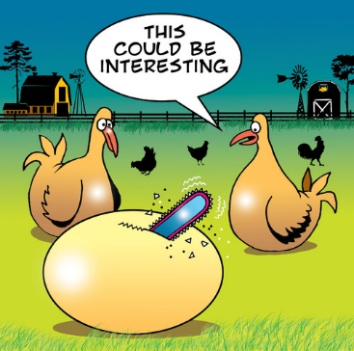
Interesting!!!!
A joint model:

Slide 10
NLP from Scratch
Tasks such as POS tagging, Chunking, NER
Compared against classical NLP benchmarks
Avoided task specific engineering
Generalize a system to handle multiple tasks

Slide 11
NLP from Scratch
Learn lookup table by back propagation
Words are mapped to d-dimensional vector using lookup table operation
Lookup table returns a matrix for a given sentence

Slide 12

NLP from Scratch
Used entire English Wikipedia to learn word embeddings (631 million words)
Tokenized using Penn Tre
The total training time was about four weeks
Window size: 11 and a Hidden layer with 100 units
Seek a network that computes a higher score when given a legal phrase than when given an incorrect phrase

Slide 13
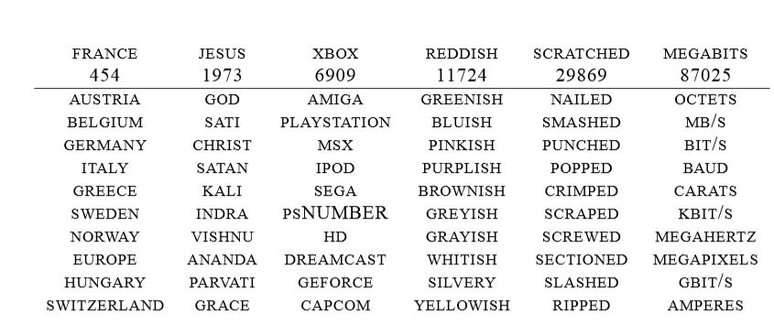
NLP from Scratch

Slide 14

Bilingual Word Embeddings
It proposes a method to learn bilingual embeddings rather than just monolingual embeddings
So it utilizes counts of MT alignments derived from Berkeley aligner to initialize monolingual embeddings of another language
They have used the same formulation as Collobert et al.(2008) to learn embeddings except that they have used global context information as in Huang et al.(2012)

Slide 15
Bilingual Word Embeddings
Their objective function captures information of both monolingual embedding and also on translation matrices, also called alignment matrices
They have trained on 100K-vocabulary word embeddings
With 500,000 iterations it took 19 days of training on 8-core machine
For phrase similarity in 2 languages, they have averaged out the word embedding vectors corresponding to each word in both phrases and then taken cosine similarity to quantize amount of semantic similarity

Slide 16
Dataset
Hindi :Wikipedia text dump (279MB)
English: Wikipedia text dump (95MB)

Slide 17
Result (English)
"boy" is to "father" as "girl" is to ...?
(Top 3)
Mother 0.6219688653945923
Grandmother 0.5560075640678406
Wife 0.5442352890968323

Slide 18
Result (English)
he his she:?
big bigger bad:?
going went being:?
'he' is to 'his' as 'she' is to 'her‘
'big' is to 'bigger' as 'bad' is to 'worse‘
'going' is to 'went' as 'being' is to 'were'

Slide 19
Result (English)
Which word doesn't go with the others?
breakfast cereal dinner lunch
cereal

Slide 20
Result (Hindi)
भारत
------------
यूक्रेन 0.488481163979
मैक्सिको 0.472263723612
फिलीपीन्स 0.461070656776
कोसोवो 0.445656210184
कैलिफौर्निया 0.438328802586
तिरुवनंतपुरम 0.437484622002
ओंटारियो 0.437374174595
सिचुआन 0.436686635017
लम्पुर 0.436174809933
वेलेस्ले 0.434365183115

Slide 21
Result (Hindi)
Odd one out
'भारत'
'रूस'
'मुम्बई'
'चीन'
'मुम्बई'

Slide 22
Result (Hindi)
x= model.most_similar(['भारत'.decode('utf8')], topn=5)
प्रदेश 0.434905201197
देश 0.434299349785
तिब्बत 0.434264868498
आन्ध्रप्रदेश 0.428886473179
लद्दाख़ 0.427965015173

Slide 23
Result (Hindi)
x= model.most_similar(['व्यापार'.decode('utf8')], topn=5)
व्यवसाय 0.671647787094
पुनर्बीमा 0.617935776711
वाणिज्य 0.612713575363
संस्थागत 0.61127692461
बैंकिंग 0.607060432434

Slide 24
Result (Hindi)
कम
0.013972 0.020021 0.005228 0.001282 -0.096880 -0.064957 -0.004378 0.057942 -0.109471 -0.052513 -0.002228 0.068519 0.117182 0.009550 0.008309 -0.035241 0.042594 0.046013 0.022055 0.033392 -0.046861 0.083555 0.003501 0.032369 -0.051409 0.042281 0.060196 0.016986 0.023544 0.014908 -0.095546 0.010151 -0.028563 -0.079369 0.045530 -0.002945 -0.023547 -0.058014 -0.038463 0.083010 -0.028450 0.018251 0.005231 -0.006079 -0.005987 -0.000233 0.066247 0.021251 -0.041221 -0.002379 0.064932 -0.080568 -0.113520 -0.053706 0.042745 0.021324 -0.086906 0.030630 -0.068239 -0.119651 0.027618 -0.029169 0.048726 -0.017188

Slide 25

Future Work
What if we ADD the embeddings???
Or
If we SUBTRACT the embeddings??
Very Big Bigger
Such phrases and words should have greater semantic similarity
Can operations such as addition/subtraction give a better insight into such relationships (applicable for Hindi also)

Slide 26
Future Work
Indian Cricketer Sachin
Infact above phrase and word may belong to same embedding

Slide 27
Future Work
The embeddings obtained could help in initializing the embeddings used in work of Collobert and Weston
Manning et al.(2013) have used semantic information to improve word embeddings
Collobert et al.(2008) have used large unlabeled data to do the same thing.
Can we use syntactic or morphological information to improve word embeddings or even produce some good word embeddings ?
Motivation
Morphologically similar words have some sought of close connection between them
e.g. morphology, phonology, etymology

Slide 28
References
Manning, W. Y. (2013). Bilingual Word Embeddings for Phrase-Based Machine Translation. Proceedings of the 2013 Conference on Empirical Methods in Natural Language Processing (EMNLP 2013), (p. 2013).
Weston, R. C. (2011). Natural Language Processing (Almost) from Scratch. Journal of Machine Learning Research, 12, 2493--2537.
Mikolov, T., Chen, K., Corrado, G. & Dean, J. (2013). Efficient Estimation of Word Representations in Vector Space. CoRR, abs/1301.3781.
Mikolov, T., Sutskever, I., Chen, K., Corrado, G. S. & Dean, J. (2013). Distributed Representations of Words and Phrases and their Compositionality. In C. Burges, L. Bottou, M. Welling, Z. Ghahramani & K. Weinberger (ed.), Advances in Neural Information Processing Systems 26 (pp. 3111--3119) .
Zheng, X., Chen, H. & Xu, T. (2013). Deep Learning for Chinese Word Segmentation and POS Tagging.. EMNLP (p./pp. 647-657), : ACL. ISBN: 978-1-937284-97-8
Sarath Chandar A P, Mitesh M Khapra, Ravindran B, Vikas Raykar, Amrita Saha, "Multilingual Deep Learning". In Deep Learning Workshop at NIPS 2013.

Slide 29
Thank You!!!

