Slide 1
EV CHARGING STATION
PERFORMANCE ANALYSIS
Power BI Dashboard Project
An interactive overview of charging sessions, revenue,
energy delivery, charger mix, and customer ratings.
Prepared by: Pranjal Sahu

Slide 2
01 | PROJECT OVERVIEW
Objective
Dataset at a glance
To analyse EV charging activity across multiple cities and understand revenue generation, energy delivery, charger usage, and session outcomes.
600 charging-session records
16 fields covering date, city, charger, customer, payment, status, energy, revenue, uptime, utilization, and rating
Data period: January 2025 to October 2026
Note: The analysis is based on the dataset provided for this project.

Slide 3
02 | KEY PERFORMANCE INDICATORS
₹205.02K
600
Total Revenue
Charging Sessions
Revenue from completed sessions
Total records in the dataset
12.49K kWh
3.87 / 5
Energy Delivered
Average Customer Rating
Sum of recorded energy delivery
Average rating across sessions

Slide 4
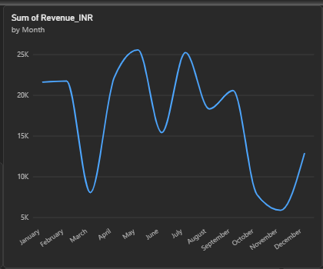
03 | MONTHLY REVENUE TREND
What the chart shows
Revenue changes noticeably from month to month.
Some months perform strongly, while others show sharp drops.
The trend helps identify periods that may need operational or marketing review.

Slide 5
04 | CITY & CHARGER ANALYSIS
Revenue by city
Sessions by charger type
Agra and Kanpur appear among the highest-revenue cities in this dataset.
Noida has the lowest revenue among the displayed cities.
City comparisons can guide where to investigate demand and station performance.
DC Fast: 268 sessions (44.67%)
AC: 256 sessions (42.67%)
Ultra Fast: 76 sessions (12.67%)
Interpretation: DC Fast and AC account for most sessions; Ultra Fast is used less frequently in this sample.

Slide 6
05 | SESSION OUTCOMES & ENERGY DELIVERY
Session status distribution
Energy delivered by charger type
Completed: 454 sessions (75.67%)
Cancelled: 87 sessions (14.50%)
Failed: 59 sessions (9.83%)
DC Fast contributes the highest total energy delivery in the chart.
AC contributes a substantial share despite longer typical charging times.
Ultra Fast has fewer sessions and lower total energy in this dataset.
Business use: monitor failed/cancelled sessions and review charger mix against customer demand.

Slide 7
06 | CUSTOMER EXPERIENCE & RECOMMENDATIONS
Customer experience
Recommended next steps
Average customer rating is 3.87 out of 5.
The score suggests generally positive ratings, but there is room for improvement.
Rating should be compared by city, station, and session status for deeper insight.
Investigate cancelled and failed sessions to identify recurring causes.
Review lower-revenue cities and stations before making expansion decisions.
Track uptime and utilization alongside revenue.
Add slicers for city, charger type, and date to support interactive analysis.
These findings are based on the available project data and should be interpreted in that context.

Slide 8
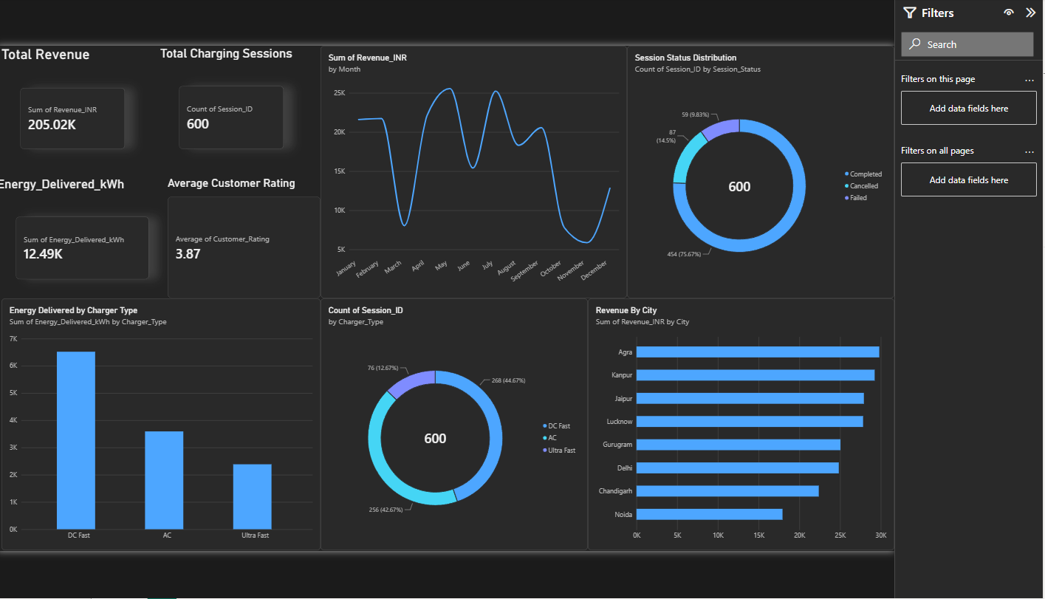
07 | FINAL POWER BI DASHBOARD

Slide 9
08 | CONCLUSION
The dashboard brings charging activity, revenue, energy delivery, charger mix, and session outcomes into one view.
It helps compare performance across cities and charger categories.
It highlights operational issues through cancelled and failed sessions.
It provides a foundation for more detailed station-level analysis.
Thank you

