Slide 1
CS772: DL4NLP Assignment Evaluation
Team 47
Shubham Nemani :- 203050011
Pranjal Saini :- 203050014
Harsh Peswani :- 203050043
March 9, 2021

Slide 2
Problem Definition
The task is of sentiment analysis in which we train the model to classify the reviews into one of the 5 classes of ratings (1 to 5). 5 being the most positive review and 1 being most negative.

Slide 3
System Architecture
Batch Size - 128 , Epochs - 10
I
N
P U
T
L
A
Y
E
R
Dropout
Dropout
Dropout
Flat
ten
INPUT
ReLU
ReLU
SOF
TMA
X
Embedding Marix
(19473 x 300)
O
U
T
P
U
T
50
25
5
29 x 300
29 x 19473
0.7
0.5
0.5

Slide 4
Table 1: Layers vs embeddings (sigmoid)
No. of hidden layers | Word2vec | GloVe | fastText
0 | 0.44 0.40 0.40 0.65 | 0.44 0.39 0.40 0.65 | 0.45 0.38 0.40 0.66
1 (l1 =250) | 0.44 0.40 0.40 0.66 | 0.45 0.39 0.40 0.66 | 0.44 0.38 0.39 0.66
2 (l1=50 , l2=25) | 0.43 0.38 0.37 0.66 | 0.42 0.41 0.40 0.63 | 0.40 0.39 0.38 0.66

Slide 5
Table 2: Data imbalance addressed (sigmoid)
 | word2vec | GloVe | fastText
undersampling | 0.45 0.39 0.41 0.60 | 0.44 0.39 0.42 0.59 | 0.43 0.45 0.44 0.58
oversampling | 0.43 0.39 0.40 0.62 | 0.44 0.39 0.41 0.64 | 0.43 0.45 0.43 0.61
Weighted Sampling | 0.42 0.40 0.41 0.56 | 0.43 0.41 0.42 0.58 | 0.44 0.42 0.43 0.60

Slide 6
Table 3: Layers vs Embeddings (ReLU)
No. of hidden layers | word2vec | GloVe | fastText
0 | 0.44 0.40 0.40 0.65 | 0.44 0.39 0.40 0.65 | 0.45 0.38 0.40 0.66
1 (l1=250) | 0.44 0.39 0.39 0.66 | 0.44 0.39 0.39 0.65 | 0.45 0.40 0.41 0.66
2 (l1=50 , l2=25) | 0.23 0.32 0.27 0.64 | 0.42 0.37 0.37 0.66 | 0.42 0.39 0.38 0.65

Slide 7
Table 4: Data imbalance addressed (ReLU)
 | word2vec | GloVe | fastText
undersampling | 0.43 0.40 0.41 0.60 | 0.45 0.40 0.42 0.59 | 0.43 0.45 0.44 0.58
oversampling | 0.43 0.39 0.40 0.61 | 0.44 0.39 0.41 0.62 | 0.40 0.45 0.44 0.61
Weighted Sampling | 0.42 0.40 0.41 0.56 | 0.44 0.41 0.42 0.58 | 0.44 0.42 0.44 0.60

Slide 8
Confusion matrix for the best model
Actual
 | 1 | 2 | 3 | 4 | 5
1 | 60.50% | 35.56% | 12.29% | 3.28% | 2.25%
2 | 16.68% | 16.98% | 12.84% | 3.06% | 0.66%
3 | 10.31% | 26.83% | 38.42% | 18.73% | 2.75%
4 | 4.72% | 12.70% | 25.91% | 37.04% | 14.96%
5 | 7.79% | 7.94% | 10.54% | 37.89% | 79.39%
Classified

Slide 9
Qualitative analysis with some examples
Example1: ‘get these much cheaper at walmart. this is expensive.’
It is a negative review but gold_test rating is 5 and our model is predicting 1.
Example2: ‘little but powerful.... need more for all of my heals’
Gold_test rating is 5 but it should be 4. Our model is predicting 4.
Example3: ‘great price but i can't wear them must have some nickel in the posts, hurt my ears’
Gold_test-1 Predicted rating- 5 (Model predicting wrong)
Example4: ‘very cute at crazy low price. don't look cheap (from normal distance) at all ... would buy again.’
Gold_test-5 Predicted rating- 1 (Model predicting wrong)

Slide 10
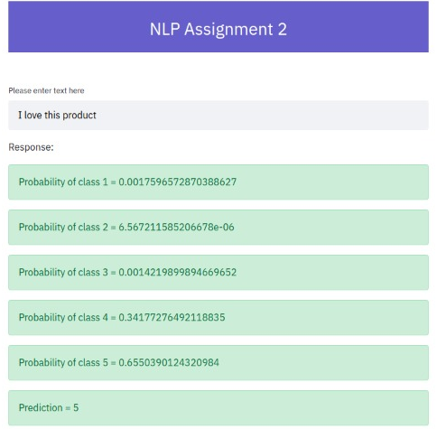
GUI screenshot/working

