Slide 1
Easy Shop
Tushar pandit - 1211219682
Pushkar ladhe - 1211222503
Mukulsingh jadhav - 1211075200
Pranjal karankar - 1211290961

Slide 2
Learning
Datasets retrieval
Sematic Data Model (Ontology)
Web Application
User Interface
Linked data generation
How do you plan to use the integrated data
Teamwork, collaboration, work distribution & responsibilities

Slide 3
Motivation
A one stop solution to compare price for products at different grocery stores
We are trying to address this and make the choices optimal and user friendly
Provide nutrition information for various products and comparing the prices

Slide 4
Datasets
Walmart (https://developer.walmartlabs.com/)
USDA (https://ndb.nal.usda.gov/ndb/doc/index)
Safeway (Manually crawled)

Slide 5
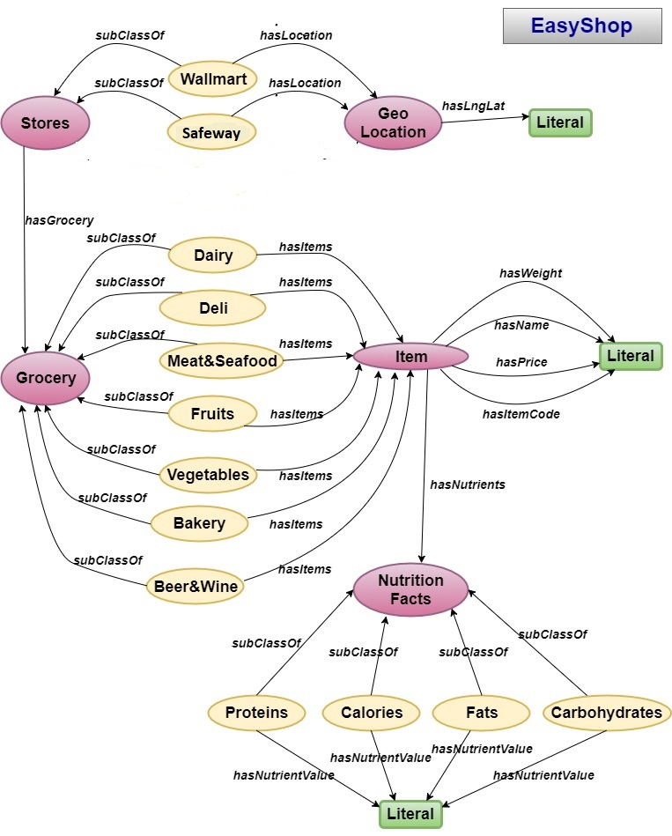
Ontology

Slide 6
Web Application
Browsing through grocery items based on product category
A web application that shows price information of products at one place
This provide user one stop to compare prices and save some bucks
Provides nutrition information about the food items

Slide 7
Web Application Design Pattern
Developing single page web application
Technologies used include HTML 5, CSS 3, Bootstrap 4
Javascript for browser centric application development
RDFs are deployed at Fuseki server
API driven application where client requests APIs provided by Fuseki server

Slide 8
Website Mockups

Slide 9
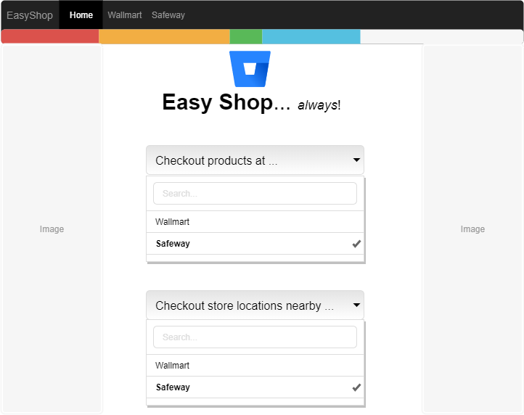

Slide 10
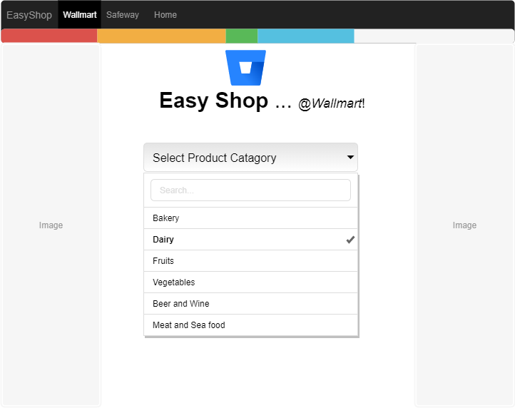

Slide 11
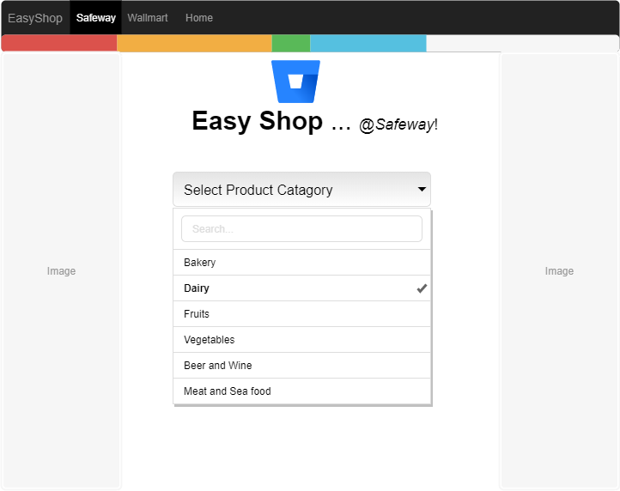

Slide 12
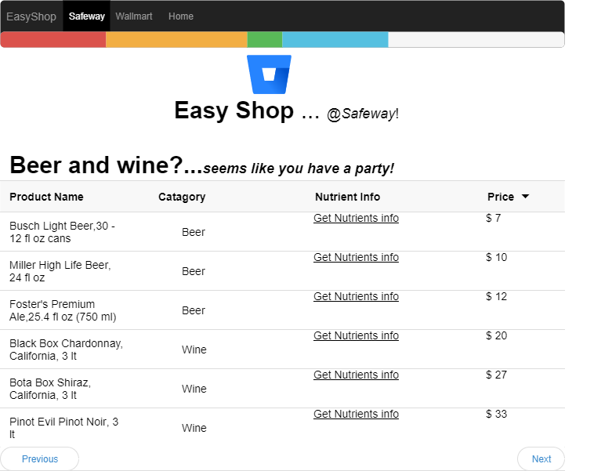

Slide 13
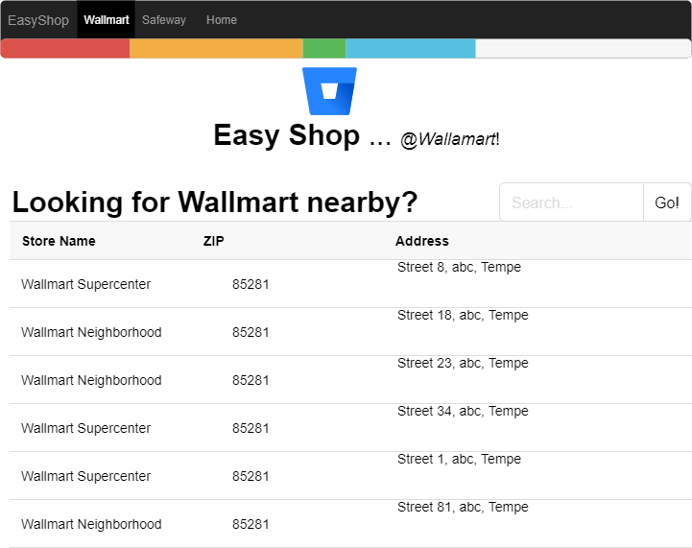

Slide 14
Linked data generation
Tool used - Google refine
Generated RDFs by feeding the owl file and CSVs to Google Refine
Total 3 RDFs Generated
Representing Products
Representing Store Location
Representing Nutrient information

Slide 15
Team and Roles
Pranjal Karankar (Team Lead) - Data Gathering and Web development
Pushkar Ladhe – Data Gathering and deploying RDF on Fuseki server, Documentation
Tushar Pandit – SPARQL, Ontology creation and RDF generation using Google refine
Mukulsingh Jadhav – SPARQL, Fuseki Server, Ontology and RDF generation using Google refine

Slide 16
Status of Project
Project Proposal – Completed
Dataset Hunting – Completed
Ontology - Completed
RDF linked data generation – Completed
Web Application Mockups and UI design –Completed
Web development – In progress
Deployment on Fuseki server – In progress

Slide 17
THANK YOU!!

