Slide 1



BUSINESS INTELLIGENCE · POWER BI & PYTHON PORTFOLIO
Superstore Sales Dashboard Analysis
Notes:
Welcome everyone. This presentation covers the end-to-end Superstore sales dashboard project, spanning Python data preprocessing, Power BI data modeling, KPI tracking, and strategic business findings.

Slide 2
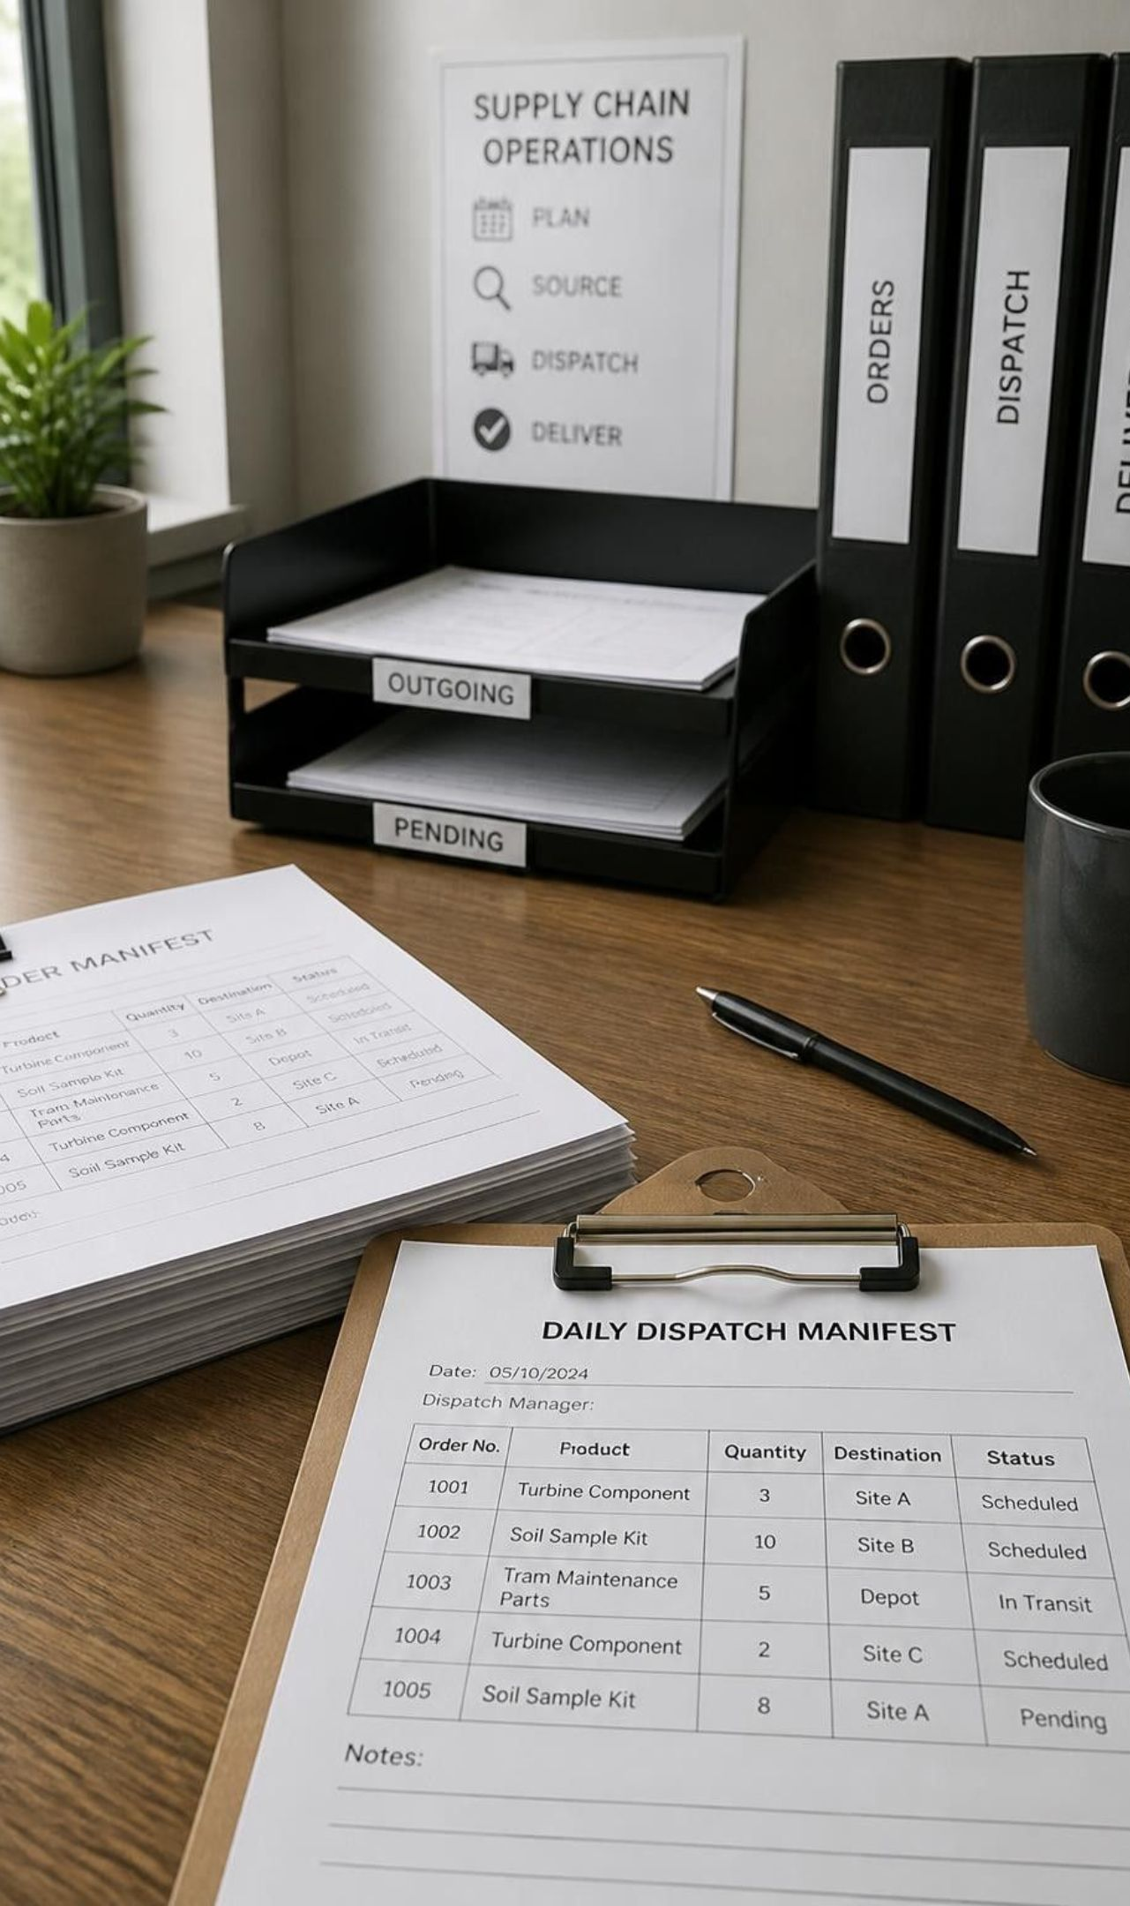
Project Overview
PROBLEM
Business problem
TARGET
Objectives
DELIVERABLES
Expected outcomes
Notes:
We begin with the core project framework: defining the underlying business problem, aligning analytical objectives, and establishing clear expected outcomes for decision makers.

Slide 3

Dataset Overview
Source
01
Columns
02
Records (9,994+)
03
Features
04
Notes:
The Superstore dataset provides commercial retail transactions exceeding 9,994 records across dimensional and numeric features.

Slide 4

Python Data Cleaning ✅
Data Cleaning Steps Performed:
01
02
03
04
Imported dataset using Pandas
Checked null values
Removed duplicates
Converted Order Date to DateTime
05
06
07
08
Fixed data types
Handled missing values
Created Year & Month columns
Prepared clean dataset for Power BI
Tools: Python, Pandas, NumPy
Notes:
A rigorous eight-step data preparation pipeline in Python cleansed missing and duplicate records, corrected data types, and engineered temporal features for downstream analysis.

Slide 5
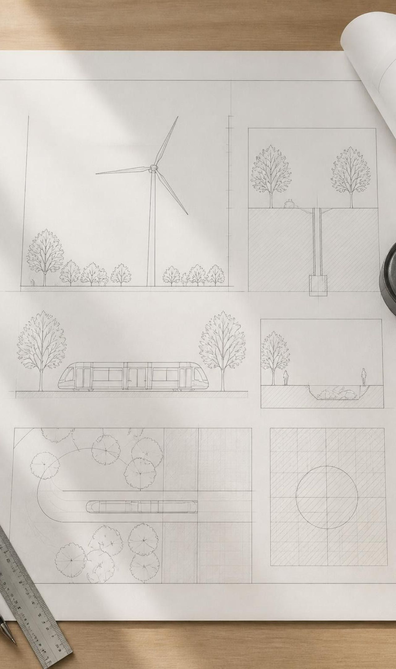
Data Modeling in Power BI
Star Schema
Date Table
Relationships
DAX Measures

Slide 6
KPI Dashboard
REVENUE
NET EARNINGS
VOLUME
INCENTIVES
2.30M
286.40K
38K
1.56K
Quantity: 38K
Discount: 1.56K
Total Sales: 2.30M
Profit: 286.40K
Notes:
These four foundational KPIs summarize executive performance across the entire dataset: 2.30M in Total Sales, 286.40K in Profit, 38K Units in Quantity, and 1.56K in Discount allowances.

Slide 7
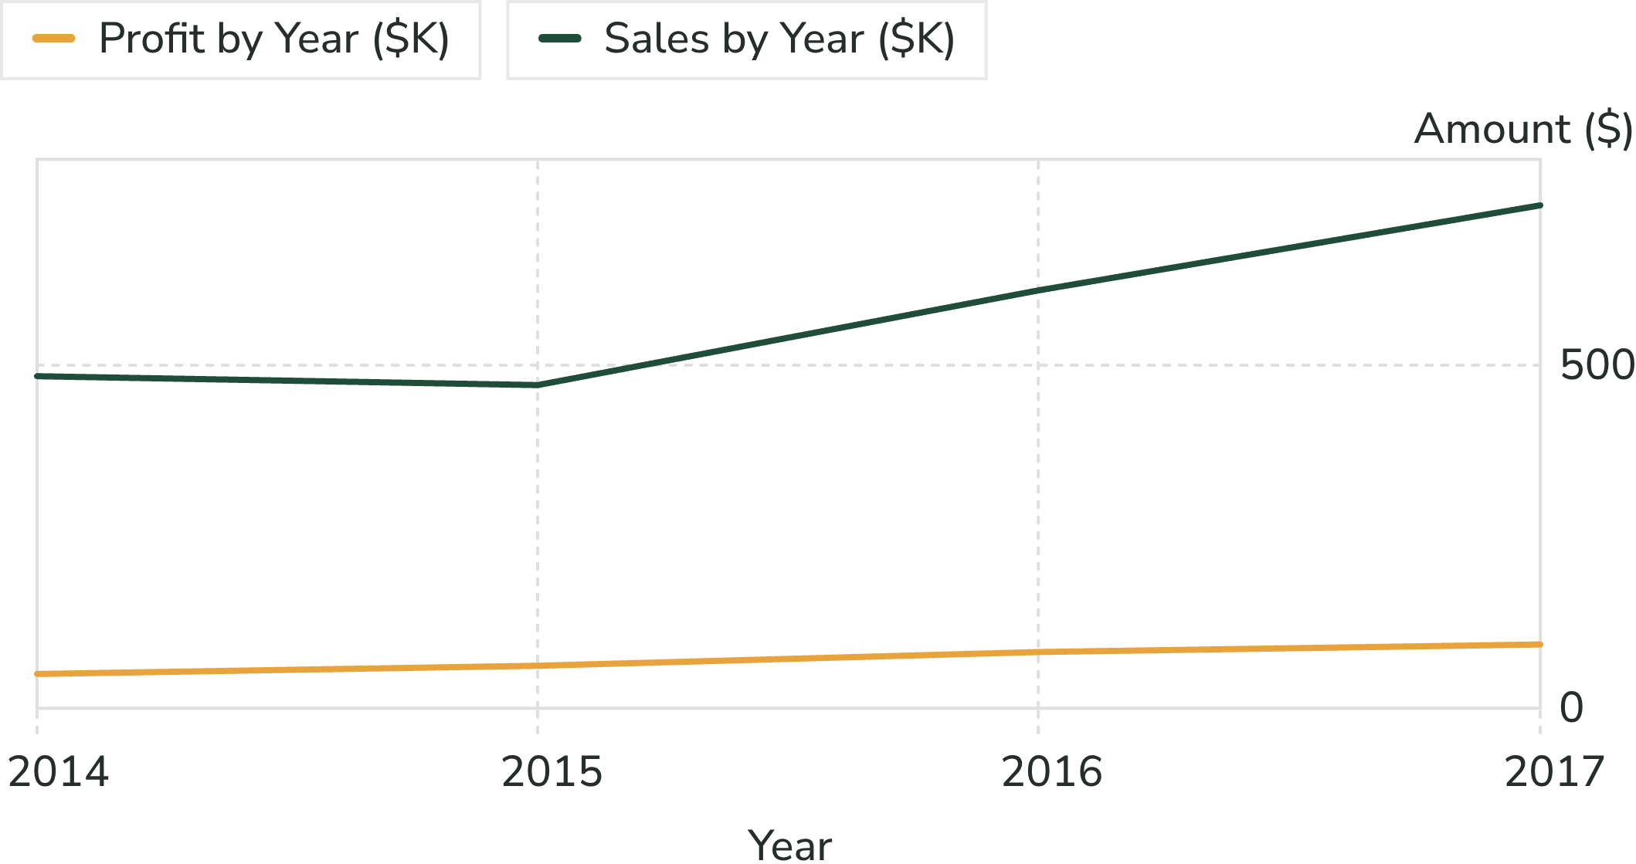
Sales Trend Analysis
Annual performance progression and growth analysis
REVENUE
Sales by Year
EARNINGS
Profit by Year
TRAJECTORY
Growth analysis
Notes:
Examining annual performance shows compounding multi-year expansion, with Sales by Year and Profit by Year reflecting strong top-line momentum across the evaluation timeline.

Slide 8
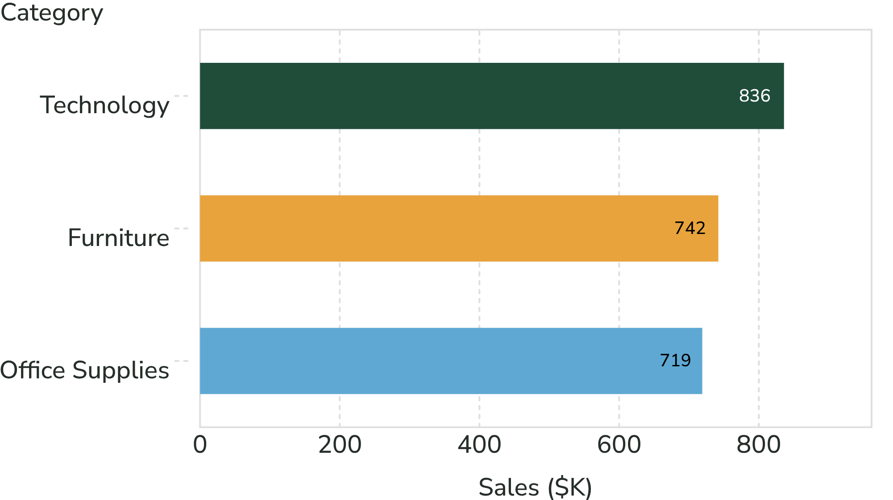
Category & Sub-Category Analysis
Breakdown by core product lines and high-margin drivers
Technology
Furniture
Office Supplies
Top Profit Sub-Categories
Notes:
Product performance evaluates Technology, Furniture, and Office Supplies, pinpointing Top Profit Sub-Categories that drive disproportionate contribution to enterprise net earnings.

Slide 9
Region & Customer Segment Analysis
GEOGRAPHIC FOOTPRINT
BUYER PROFILES
West, East, Central, South
Consumer, Corporate, Home Office
Regional sales distribution and territory coverage
Customer segment revenue mix and order volumes
Notes:
Territory analysis spans West, East, Central, and South regions, while audience segmentation tracks purchasing patterns across Consumer, Corporate, and Home Office groups.

Slide 10
Insights & Recommendations
CATEGORY
SEGMENT
GEOGRAPHY
SHIPPING
✅ Technology highest sales
✅ Consumer segment highest revenue
✅ West region best performer
✅ Standard Class most profitable
Notes:
Key takeaways confirm that Technology leads total sales, Consumer drives maximum revenue, West proves the most resilient operating region, and Standard Class delivers superior profitability.

