Slide 1
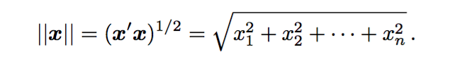
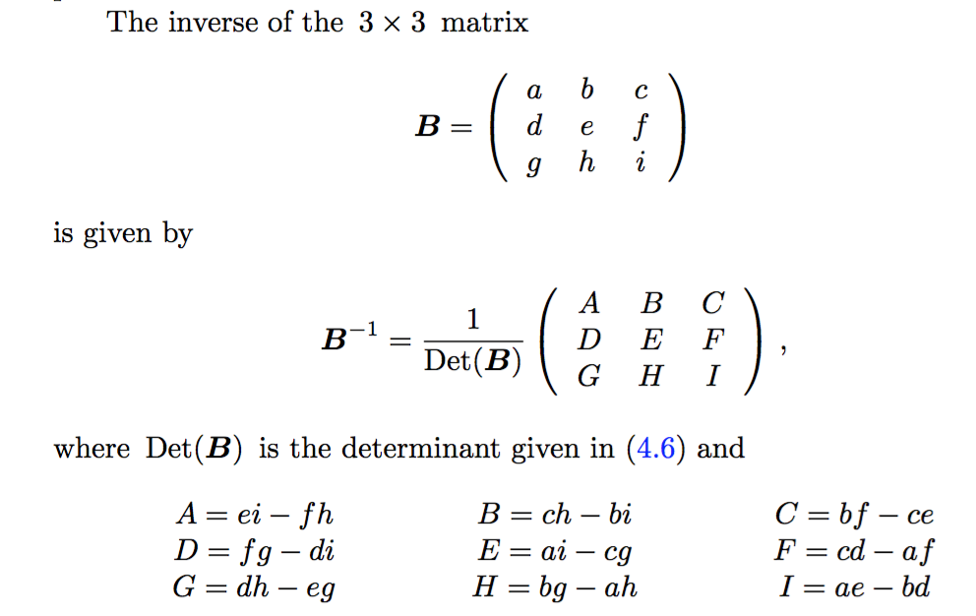
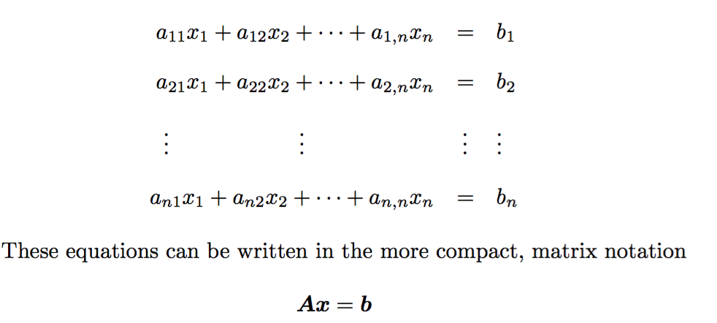
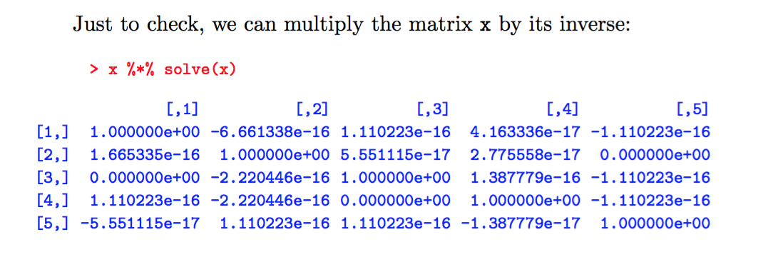
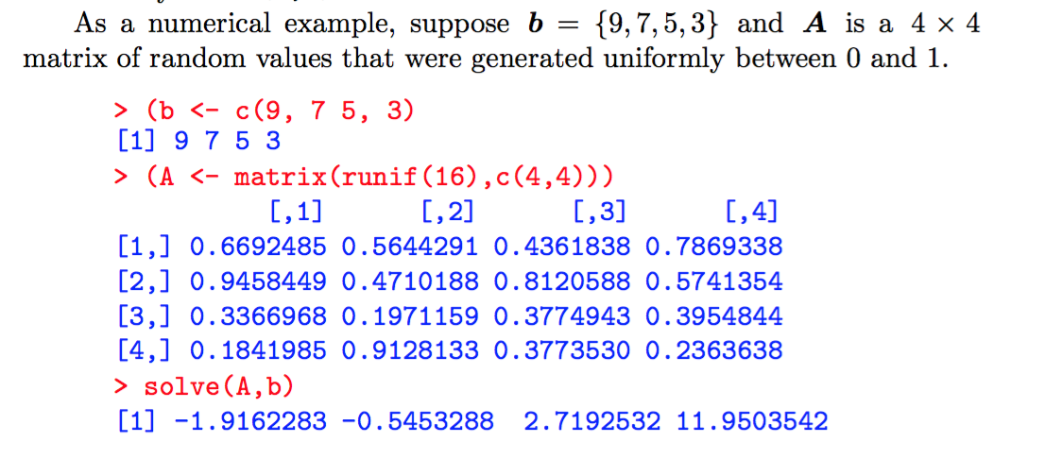
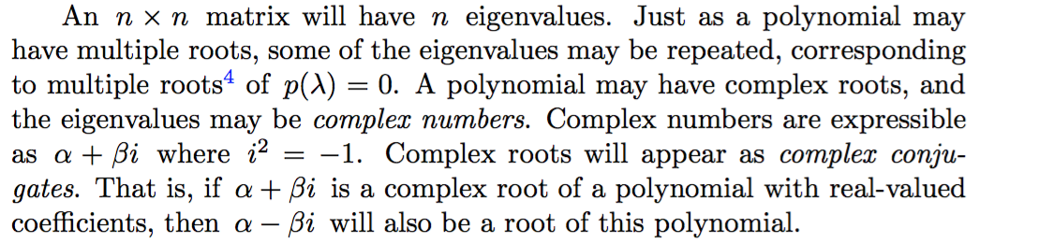
(1) Euclidean length: square root of the inner product with itself
In 2D plane that is the distance between two vectors
(3) Inverse of a 3x3 matrix
Representing equations
Due to numerical error, identity matrix have non-zero value
(2x)Solving linear equations in R

Slide 2
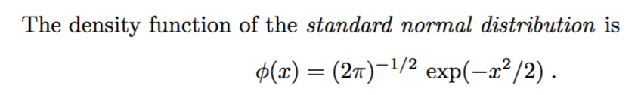
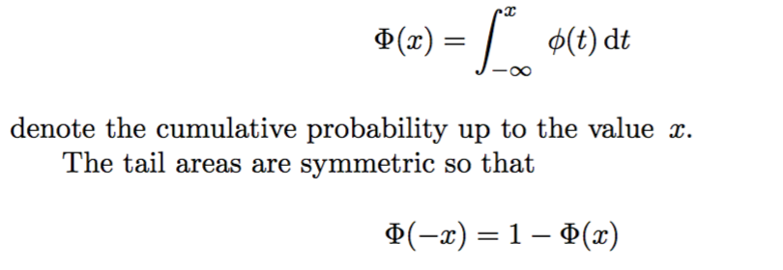
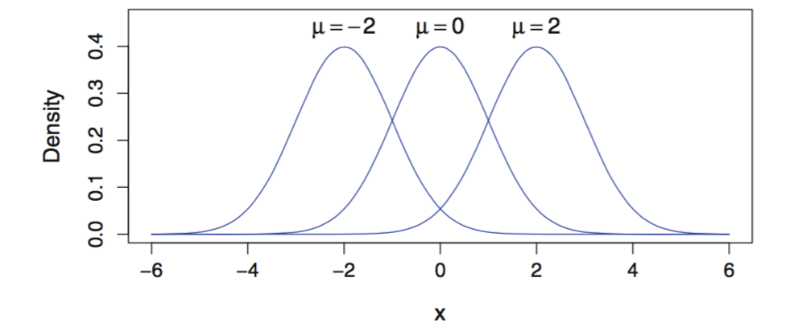
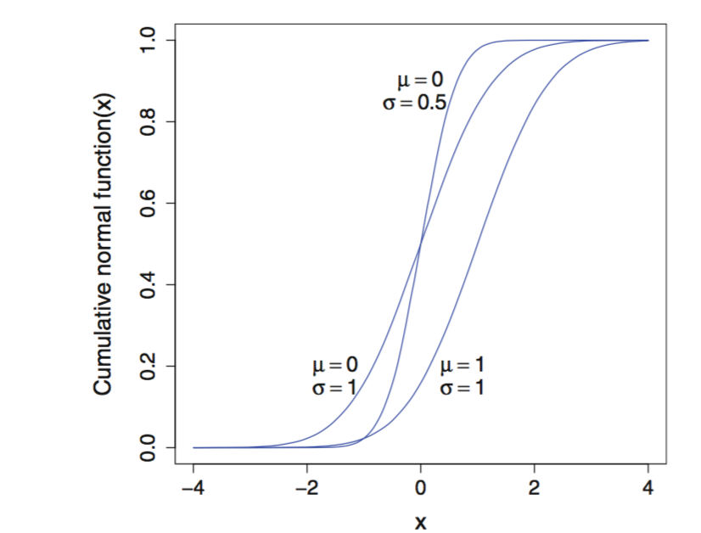
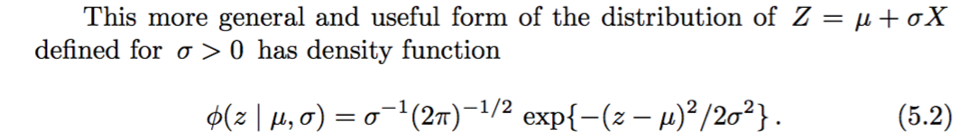
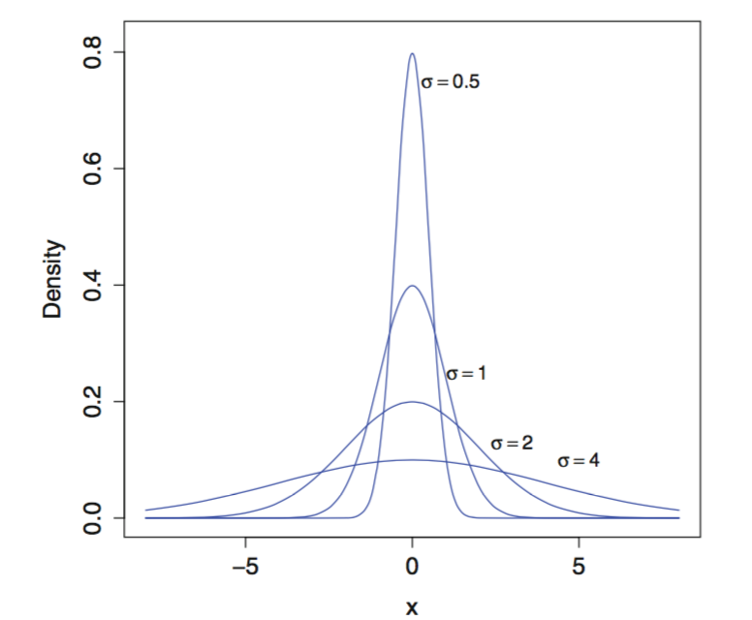
Cumulative distribution
Normal distribution density function
The cumulative normal distribution function (5.3) for means μ and standard deviations σ as given
Effect of change of sigma
Lesser value of sigma is
steeper

Slide 3
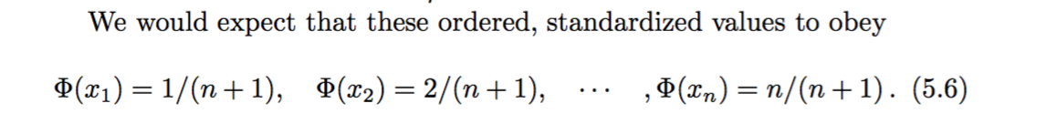
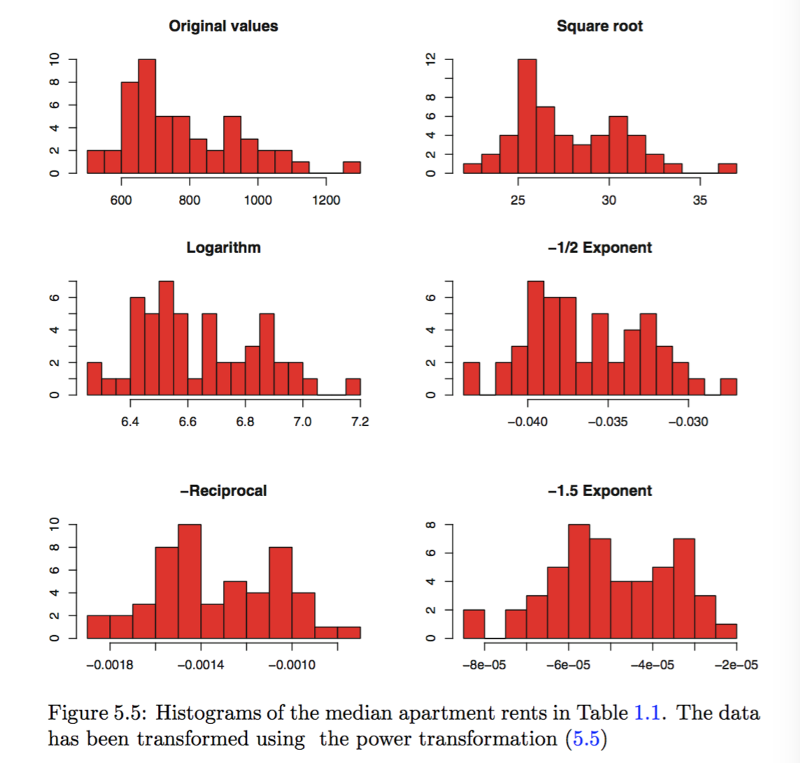
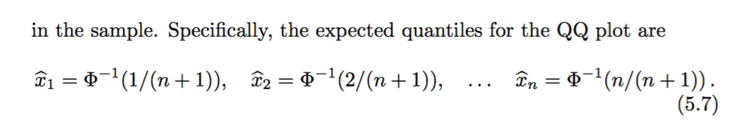
theoretical, expected sample values should be spread out evenly with all n observations having equal cumulative probabilities between each

