Slide 1
SUMMER TRAINING PRESENTATION

Slide 2

VIRTUAL MACHINE: INSTALLATION AND CONFIGURATION
Submitted by
Pranjul Singhal
171510040
Department of Computer Engineering and Applications
Institute of Engineering and Technology
GLA University
Mathura-281406,INDIA
2019

Slide 3
ACKNOWLEDGEMENT
The success and final outcome of this project required a lot of guidance and assistance from many people and I am extremely privileged to have got this all along the completion of my project. All that I have done is only due to such supervision and assistance and I would not forget to thank them. I respect and thank Mr. Binayak Prasad Gupta, for providing me an opportunity to do the project work in VMware and giving us all support and guidance, which made me complete the project duly. I am extremely thankful to him for providing such a nice support and guidance, although he had busy schedule managing the corporate affairs. I owe my deep gratitude to my team members, who took keen interest on our project work, till the completion of this project work by providing all the necessary information for developing a good system. I am thankful to and fortunate enough to get constant encouragement, support and guidance from all Teaching staffs of which helped us in successfully completing our project work.

Slide 4
CONTENT
INTRODUCTION
VIRTUALIZATION
HYPERVISOR
IP ADDRESSING
TOOLS USED
APPLICATIONS OF PROJECT
SOME GLIMPSE OF PROJECT

Slide 5
What is VMware
VMware is a company that was established in 1998 and provides different software and applications for virtualization.
It has become one of the key providers of virtualization software in the industry. VMware’s products can be categorized in two levels: desktop applications and server applications.

Slide 6
VMware Work Station
It is a hosted HYPERVISOR that runs on X64 versions of Windows and Linux operating systems
It enables users to set up virtual MACHINES (VMs) on a single physical machine
Supports bridging sharing physical disk DRIVES AND USB DEVICES
Includes the ability to group multiple virtual machines in an inventory folder

Slide 7
VIRTUALIZATION
Virtualization is the process of creating a software-based, or virtual, representation of something, such as virtual applications, servers, storage and networks.
It is the single most effective way to reduce IT expenses while boosting efficiency and agility for all size businesses.

Slide 8
BENEFITS OF VIRTUALIZATION
Reduced capital and operating costs
Minimized or eliminated downtime
Increased IT productivity, efficiency, agility and responsiveness
Faster provisioning of applications and resources
Greater business continuity and disaster recovery
Simplified data center management
Availability of a true Software Defined Data Center

Slide 9
HYPERVISOR
A hypervisor is a hardware virtualization technique that allows multiple guest operating systems (OS) to run on a single host system at the same time. The guest OS shares the hardware of the host computer, such that each OS appears to have its own processor, memory and other hardware resources.
A hypervisor is also known as a virtual machine manager (VMM).

Slide 10
TYPES OF HYPERVISOR:
Type 1 hypervisor: hypervisors run directly on the system hardware – A “bare metal” embedded hypervisor
Type 2 hypervisor: hypervisors run on a host operating system that provides virtualization services, such as I/O device support and memory management

Slide 11
VMware ESX and ESXi
* These hypervisors offer advanced features and scalability but require licensing, so the costs are higher.
* There are some lower-cost bundles that VMware offers and they can make hypervisor technology more affordable for small infrastructures.
* VMware is the leader in the Type-1 hypervisors. Their vSphere/ESXI product is available in a free edition and 5 commercial editions.

Slide 12
IP ADDRESSING
An Internet Protocol address (IP address) is a numerical label assigned to each device connected to a computer network that uses the Internet Protocol for communication.
An IP address serves two principal functions. It identifies the host, or more specifically its network interface, and it provides the location of the host in the network, and thus the capability of establishing a path to that host.

Slide 13
COMPARISON CHART BETWEEN STATIC AND DYNAMIC IP ADDRESSING
BASIS FOR COMPARISON | STATIC IP ADDRESS | DYNAMIC IP ADDRESS
Provided by | ISP (For external IP address) | DHCP
Change acquirement | Once static IP is assigned, it doesn't change. | Dynamic IP changes each time when a user connects to a network.
Security | Risk is high. | More secure than static IP address.
Device tracking | Trackable | Untraceable

Slide 14


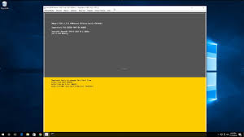
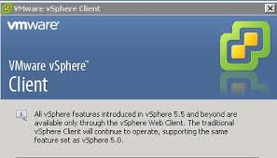
TOOLS USED
VWware workstation
VMware vSphere client
VMware ESXI
VMware viclient

Slide 15
APPLICATIONS
1. Run Old Apps
2. Access Virus-Infected Data
3. Browse in Complete Safely
4. Test Software, Upgrades, or New Configurations
5. Run Linux on Top of Windows (or vice-versa)
6. Back Up an Entire Operating System
7 . Create a personal cloud
8. Run Headless For Web Development
9. Make a Backup of Your Server For Emergencies
10. Reuse Old Hardware

Slide 16
Some Glimpse of Project

Slide 17
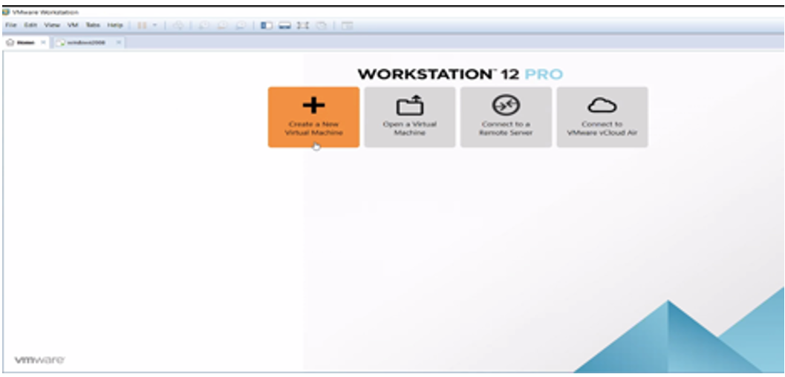
Installation of Windows server 2008

Slide 18
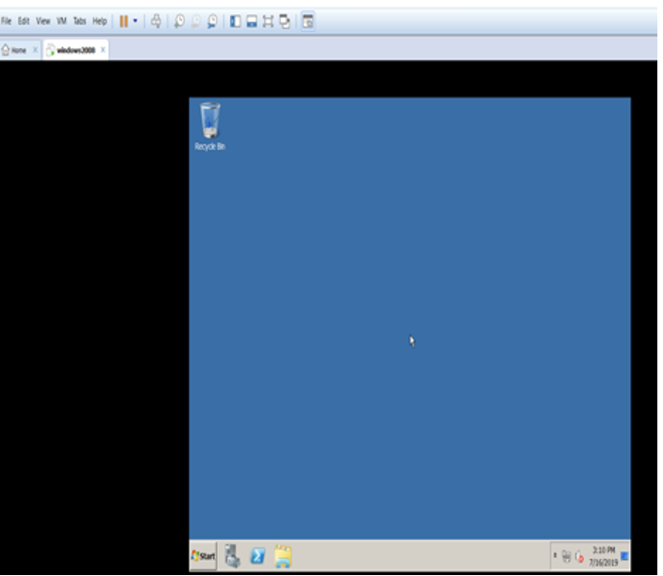
Windows server 2008 Installed

Slide 19
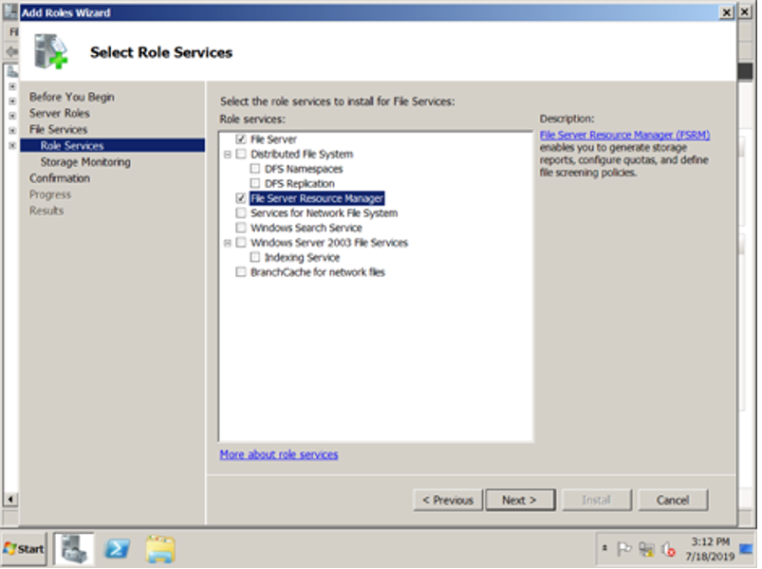
You can use FSRM to perform the following tasks

Slide 20
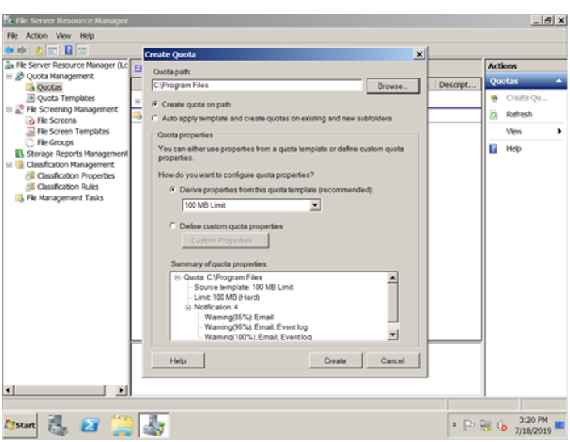
Click on “Administrative Tools” and select “File Server Resource Manager to launch the FSRM MMC (Microsoft Management Console).

Slide 21
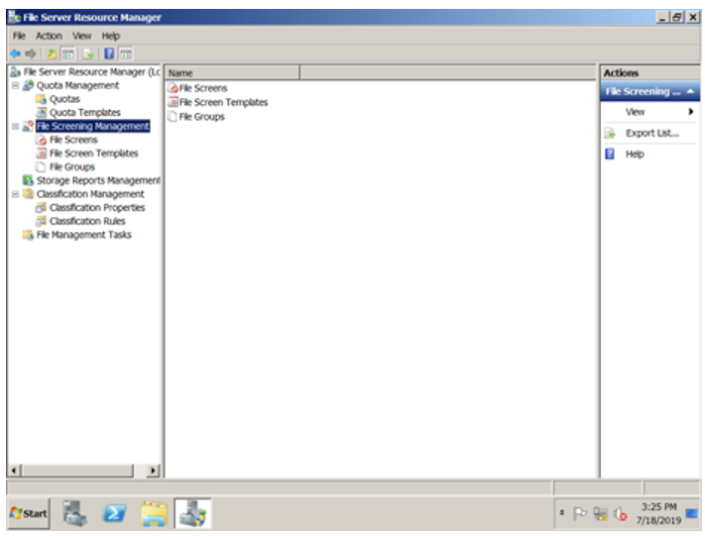
File Screening helps you restrict and/or monitor which file extensions can be used on your file server. FSRM can provide both active screening (block file with certain extensions) or passive screening (monitor file extensions without blocking).

Slide 22
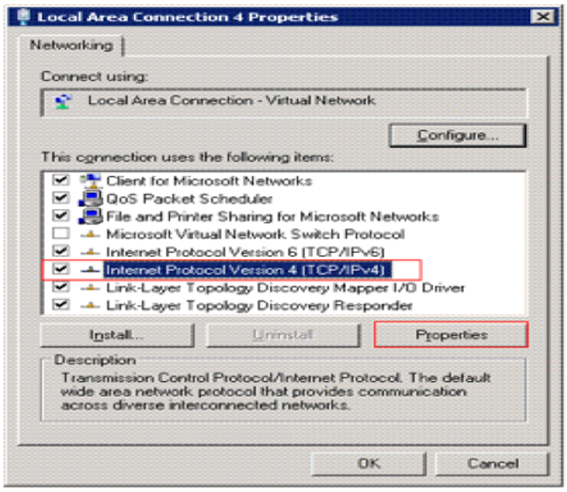
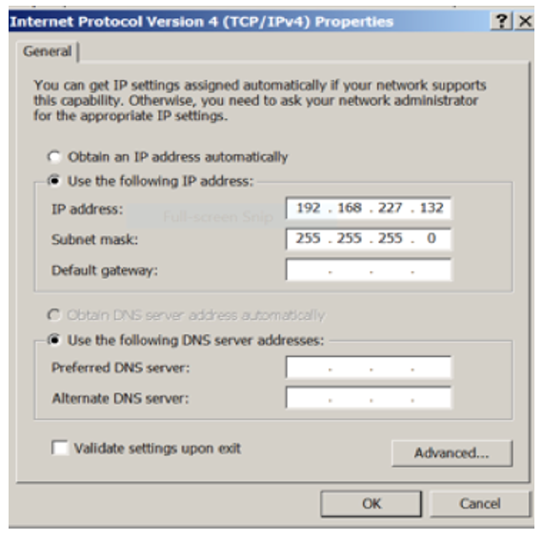
Configuring Addresses and Services

Slide 23
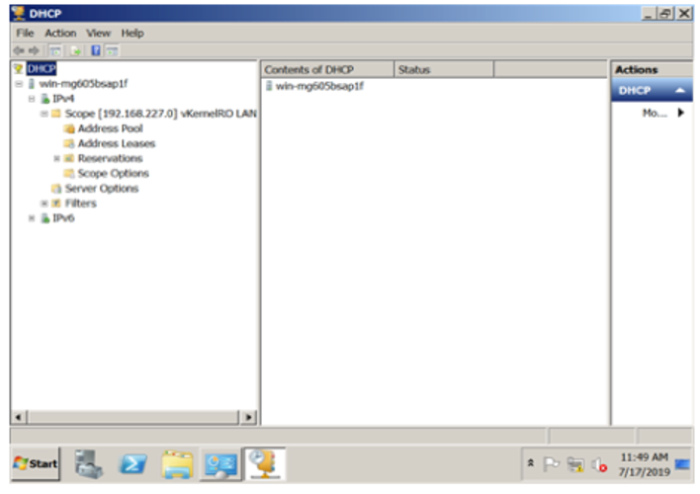
Trouble shooting the DHCP issues

Slide 24
THANK YOU

Slide 25
Any Questions?

