Slide 1
Sergey Konstantinov
DevOps School Diploma 22 stream
https://github.com/prankbox/presentation
© 2022 EPAM Systems, Inc.

Slide 2
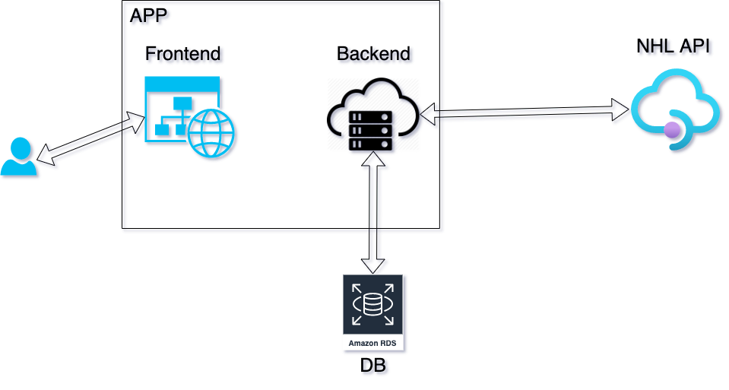
Application architecture
Task
Use NHL API
Analyze statistics of the finished season
Make a top 10 list of Swedish players, that really score
Show players statistics

Slide 3
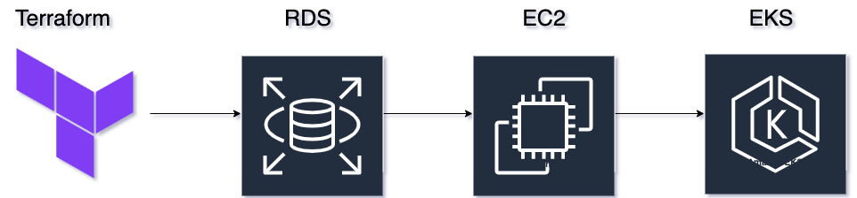
Provision Infrastructure using Terraform

Slide 4
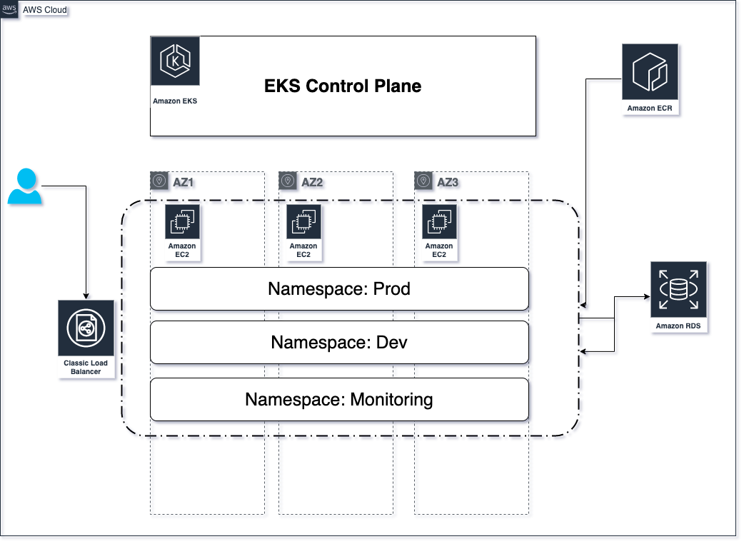
AWS Infrastructure

Slide 5
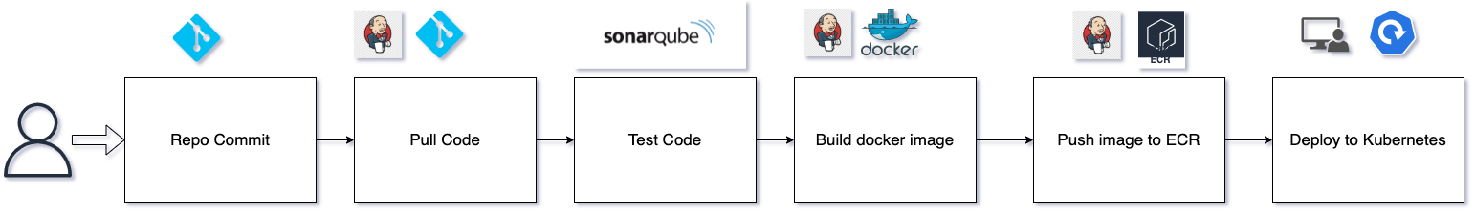
CI/CD using Jenkins and Kubernetes on AWS EKS

Slide 6
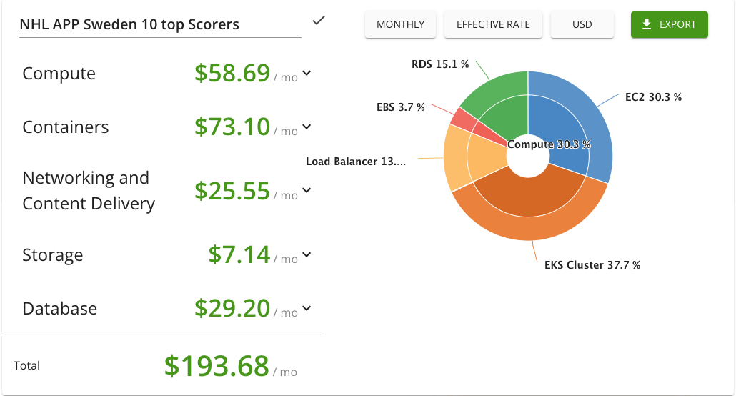
COSTS – AWS

Slide 7
THE END
Thank you for your time!

