Slide 1

A Project Report On
Image Classification Using CNN
Course Title:Machine Learning
Course Code:CS5439
Submitted To: Submitted By:
Dr. Akshay Deepak Prankur Tewari(1806158)
Ashish Ranjan Mohit Kumar(1806166)
Shah Fahad Md.Anas Shikoh(1806162)

Slide 2
Acknowledgement
We would like to express our deepest appreciation to all those who provided us the possibility to complete this project for the coursework . A special gratitude, we would extend to our mentor Dr. Akshay Deepak, for his continuous support and guidance through this learning process.
Furthermore, we would like to acknowledge the crucial role of our Phd Scholars Ashish Ranjan and Shah Fahad for their complete guidance throughout the coursework and also our families and friends for their support during these tough times, without which it would not have been possible for us to complete this project.

Slide 3
About The Paper
Convolutional Neural Networks for image classification
Authors & About the authors:
Nadia Jmour- LA.R.A Laboratory, National Engineering School of Tunis National Engineering School of Carthage Tunis, Tunisia
Sehla Zayen LA.R.A Laboratory, National Engineering School of Tunis National Engineering School of Carthage Tunis, Tunisia
Afef Abdelkrim LA.R.A Laboratory, National Engineering School of Tunis National Engineering school of Carthage Tunis, Tunisia
Abstract:
This paper describes a learning approach based on training convolutional neural networks (CNN) for a traffic sign classification system.
It presents the preliminary classification results of applying this CNN to learn features and classify RGB-D images task.
We explore the transfer learning technique called “fine tuning technique”, of reusing layers trained on the ImageNet dataset in order to provide a solution for a fourty three-class classification task of a new set of data.

Slide 4
Problem Statement
Usually, it is not evident for a driver to keep his eyes everywhere at once while driving. Being concentrated on the road, checking it, looking oncoming traffic, what’s behind him, all while trying to control his speed, can become difficult and annoying. To avoid any road accident problem, traffic sign need to be rigid, unique and clear for the driver. With the Traffic Sign classification system, the risk of warning from a potential hazard ahead can be vastly reduced. Also, with automatic classifying Traffic signs a mandatory problem of self-driving cars can be solved. The present paper aims to build a classifier system that can determine the type of the traffic sign displayed in an image, and is robust to different real-life conditions such as poor lighting or obstructions by designing an image processing algorithm. As an initial work, four types of traffic sign are used: Nonstop signs, stop sign, green light and red light. Digit image and face task classification, describe limited variation in appearance and pose. Therefore, these two domains are close to our task and the applied methods can be efficiently used to traffic sign classification task. Applications and researches on image classification, transfer learning, and deep learning are references on which our method is related and discussed below. Recent methods of image classification tasks use the bag-of-features pipeline. SIFT descriptors, are using for clustering. Spatial pooling, Histogram encoding, and recent Fisher Vector encoding, are using for feature collection. Although these representations have been given acceptable results, it is not obvious if they are optimal for the task, since it requires a lot of time and effort from experts in the specific domain. This process is difficult and expensive in terms of expertise and time. Deep learning or deep neural networks reduces the task of developing new feature extractor for every visual recognition problem. This optimization is realized by automating the phase of learning image’s representation and using graphics processing units (GPUs), suited to the application’s problem.

Slide 5
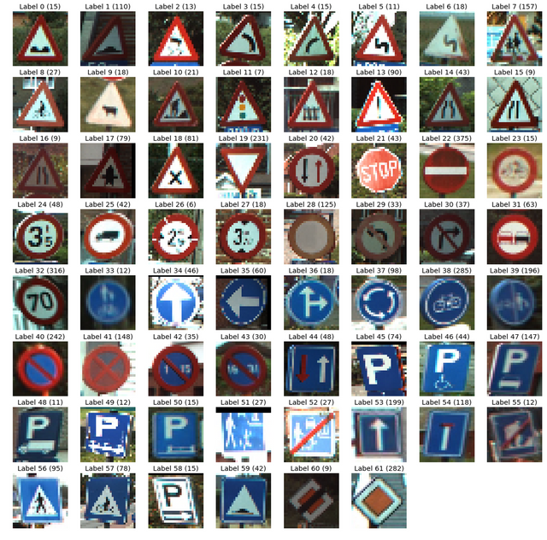
Data-Set
The dataset we used to train our custom traffic classifier is the
German Traffic Sign Recognition Benchmark(GTSRB)
Link: https://www.kaggle.com/meowmeowmeowmeowmeow/gtsrb-german-traffic-sign
A sample of the dataset can be seen in Figure

Slide 6
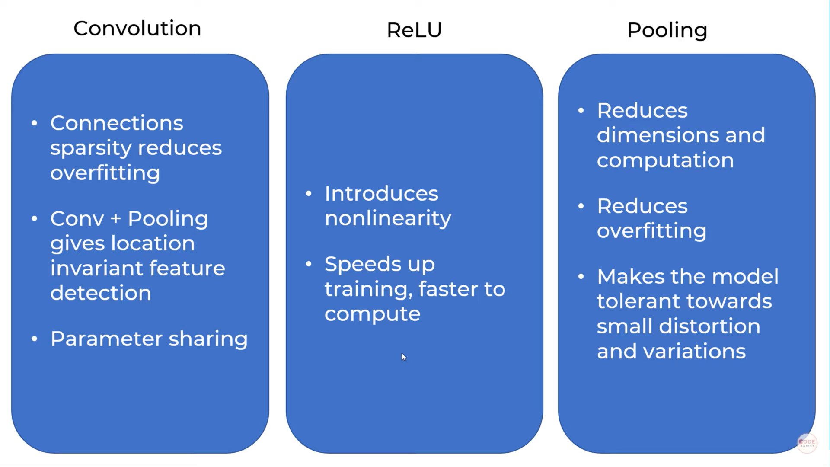
Classifier:Convolutional Neural Network

Slide 7
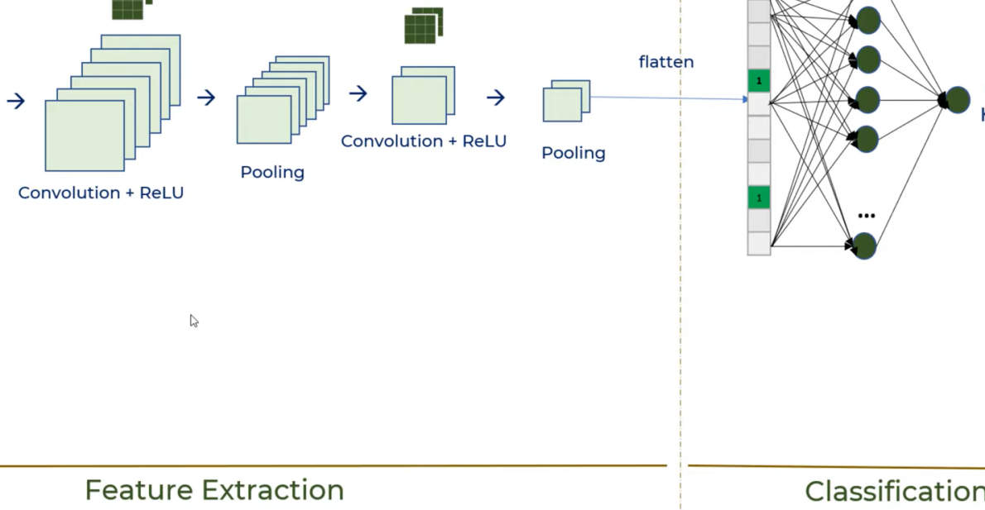
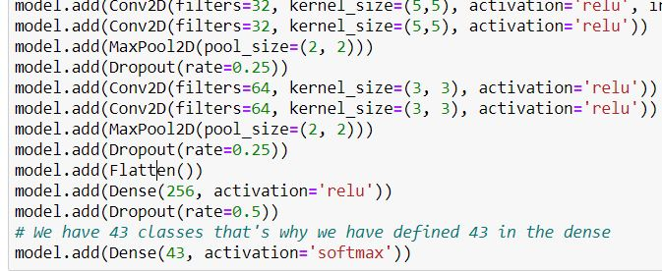
Layers
Code
Layer overview

Slide 8
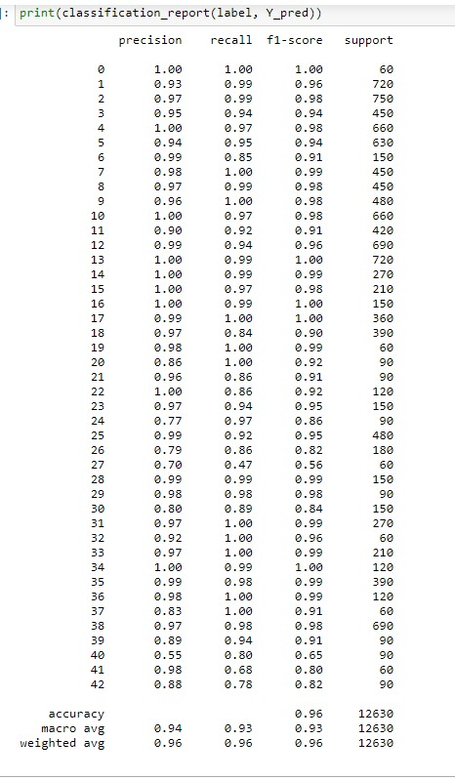
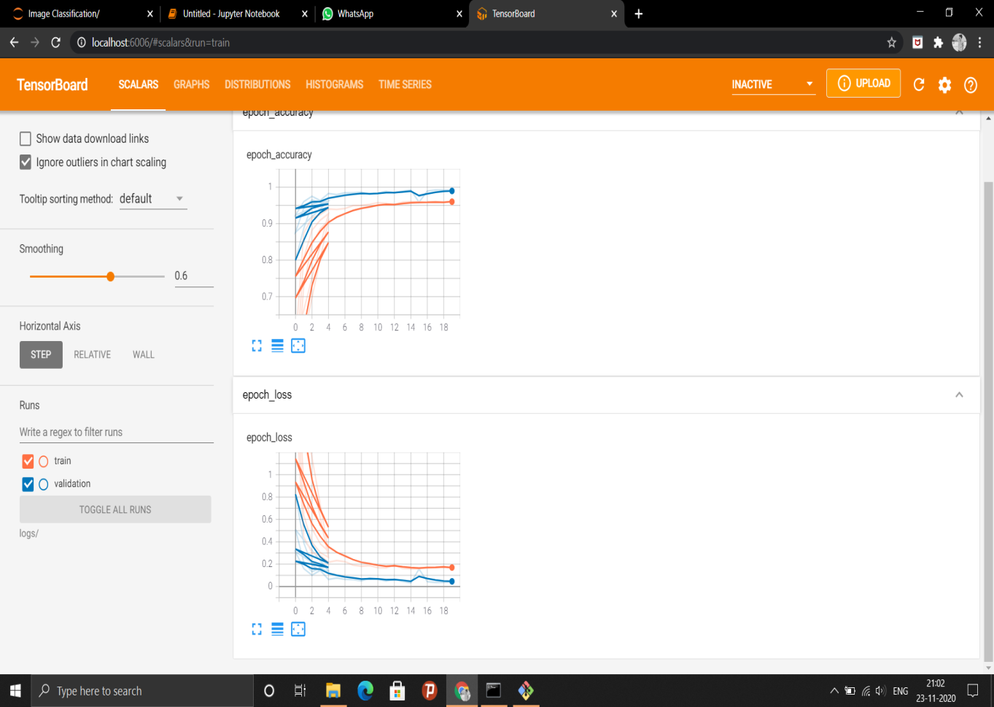
Results:

Slide 9
Code Overview
Implementing our training script
Loading our training and testing split from the GTSRB dataset
Preprocessing the images
Training our model
Evaluating our model’s accuracy
Serializing the model to disk so we can later use it to make predictions on new traffic sign data
Testing our trained model on different images

