Slide 1
Practical Design to Eurocode 2
The webinar will start at 12.30

Slide 2
Practical Design to Eurocode 2
Lecture 7 – Detailing
The webinar will start at 12.30
EC2 Section 8 - Detailing of Reinforcement - General Rules
Bar spacing, Minimum bend diameter
Anchorage of reinforcement
Lapping of bars
EC2 Section 9 – Detailing of Members and Particular Rules
Beams
Solid slabs
Tying Systems

Slide 3
Course Outline
Lecture | Date | Speaker | Title
1 | 21 Sep | Charles Goodchild | Introduction, Background and Codes
2 | 28 Sep | Charles Goodchild | EC2 Background, Materials, Cover and effective spans
3 | 5 Oct | Paul Gregory | Bending and Shear in Beams
4 | 12 Oct | Charles Goodchild | Analysis
5 | 19 Oct | Paul Gregory | Slabs and Flat Slabs
6 | 26 Oct | Charles Goodchild | Deflection and Crack Control
7 | 2 Nov | Paul Gregory | Detailing
8 | 9 Nov | Jenny Burridge | Columns
9 | 16 Nov | Jenny Burridge | Fire
10 | 23 Nov | Jenny Burridge | Foundations

Slide 4
Model Answers
for Lecture 8, Fire Design Exercise:
Column fire resistance using Method A equation 5.7

Slide 5
Design exercise : Column fire resistance
Using Equation 5.7, work out the fire resistance of a 250 x 750 column with an axial capacity of 3750kN and an axial load in cold conditions of 3500kN. The column is on the ground floor of a three storey building and the length is 4.5m. The cover is 30mm, main bars are 20mm and the links are 10mm diameter.

Slide 6

Design exercise: Column fire resistance
$$R=120{(\frac{R_{ηfi}+R_{a}+R_{l}+R_{b}+R_{n}}{120})}^{1.8}$$
μ_{fi} = R_{ηfi} =
a = R_{a} =
l_{0,fi} = R_{l} =
b’ = R_{b} =
n = R_{n} =
R = 120((R_{ηfi} + R_{a} + R_{l} + R_{b} + R_{n})/120)^{1.8} =

Slide 7
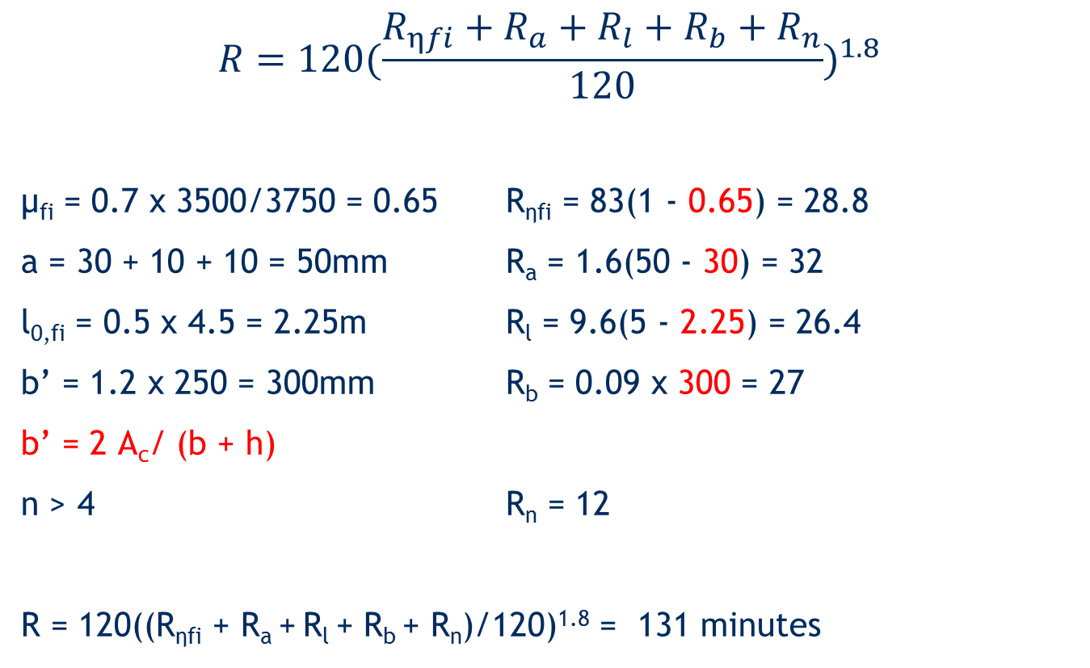
Column fire resistance: Model answer
$$R=120{(\frac{R_{ηfi}+R_{a}+R_{l}+R_{b}+R_{n}}{120})}^{1.8}$$
μ_{fi} = 0.7 x 3500/3750 = 0.65 R_{ηfi} = 83(1 - 0.65) = 28.8
a = 30 + 10 + 10 = 50mm R_{a} = 1.6(50 - 30) = 32
l_{0,fi} = 0.5 x 4.5 = 2.25m R_{l} = 9.6(5 - 2.25) = 26.4
b’ = 1.2 x 250 = 300mm R_{b} = 0.09 x 300 = 27
b’ = 2 A_{c}/ (b + h)
n > 4 R_{n} = 12
R = 120((R_{ηfi} + R_{a} + R_{l} + R_{b} + R_{n})/120)^{1.8} = 131 minutes

Slide 8
Practical Design to Eurocode 2
Model answers for Lecture 6

Slide 9
Model Answers
for Lecture 6, Deflection & Crack Control

Slide 10
Model Answers
for Lecture 6 Exercise:
Deflection & Cracking

Slide 11
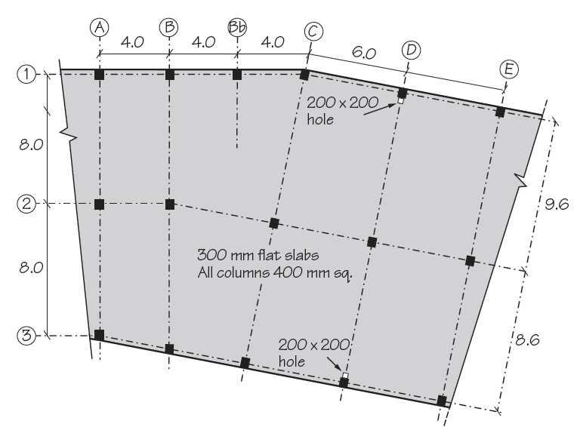
Design Exercise:
Check deflection in this column-strip span
For the same slab check the strip indicated to verify that:
deflection is OK and
the crack widths in the bottom are also limited.
As before:
A_{s,req} = 959 mm²/m B
d = 240 mm
γ_{G} = 1.25
g_{k} = 8.5 kN/m²
q_{k} = 4.0 kN/m²
f_{ck} = 30 MPa

Slide 12
Deflection
Model answer
Check: basic l/d x F1 x F2 x F3 ≥ actual l/d
1. Determine basic l/d
The reinforcement ratio, ρ = A_{s,req}/bd
= 959 x 100/(1000 x 240) = 0.40%

Slide 13
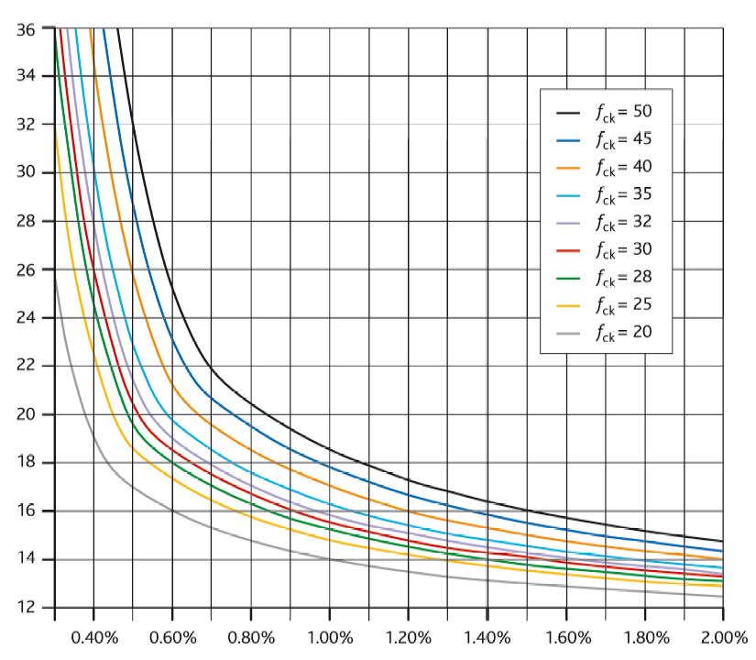
Basic Span-to-Depth Ratios (for simply supported condition)
Model answer
How To 3: Figure 5
This graph has been produced for K = 1.0
Structural System | K
Simply supported | 1.0
End span | 1.3
Interior Span | 1.5
Flat Slab | 1.2
26.0
Span to depth ratio (l/d)
0.4%
Percentage of tension reinforcement (A_{s,req’d}/bd)

Slide 14
Deflection 7.4.2 EN 1992-1-1
Model answer
Check: basic l/d x F1 x F2 x F3 ≥ actual l/d
1. Determine basic l/d
The reinforcement ratio, ρ = A_{s,req}/bd
= 959 x 100/(1000 x 240) = 0.40%
From graph basic l/d = 26.0 x 1.2 = 31.2 (K = 1.2 for flat slab)
Determine Factor F1
F1 = 1.0
3. Determine Factor F2
F2 = 1.0
For flanged sections where the ratio of the flange breadth to the rib breadth exceeds 3, the values of l/d given by Expression (7.16) should be multiplied by 0.8.
For flat slabs, with spans exceeding 8.5 m, which support partitions liable to be damaged by excessive deflections, the values of l/d given by Expression (7.16) should be multiplied by 8.5 / l_{eff} (l_{eff} in metres, see 5.3.2.2 (1)).

Slide 15
Deflection
Model answer
Steel stress under service load: use A_{s,prov}/A_{s,req} ≤ 1.5
Determine Factor F3
A_{s,req} = 959 mm² (ULS)
Assume we require H16 @ 200 c/c (1005 mm²) to control deflection
F3 = A_{s,prov} / A_{s,req} = 1005 / 959 = 1.05 ≤ 1.5
Allowable vs Actual
31.2 x 1.0 x 1.0 x 1.05 ≥ 5900 / 240
32.8 ≥ 24.5
OK!

Slide 16
Model answer
ψ Factors
Action
ψ
ψ
ψ
0
1
2
Imposed loads in buildings,
Category A : domestic, residential
0.7
0.5
0.3
Category B : office areas
0.7
0.5
0.3
Category C : congregation areas
0.7
0.7
0.6
Category D : shopping areas
0.7
0.7
0.6
Category E : storage areas
1.0
0.9
0.
8
≤
0.7
0.7
0.6
Category F : traffic area,
30 kN
Category G : traffic area, 30
0.7
0.5
0.3
–
160 kN
Category H : roofs
0.7
0
0
Snow load: H
≤
1000 m a.s.l.
0.5
0,2
0
Wind loads on buildings
0.5
0,2
0

Slide 17
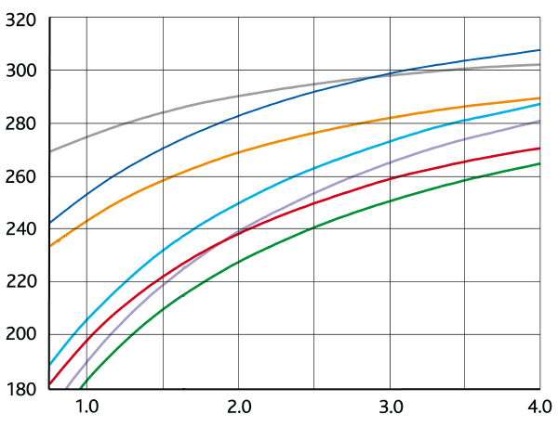
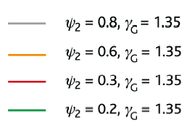
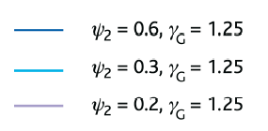
Determination of Steel Stress
Model answer
Ratio G_{k}/Q_{k} = 8.5/4.0 = 2.13
Unmodified steel stress, σ_{su}
252
Ratio G_{k}/Q_{k}

Slide 18
Crack Widths
Model answer
From graph σ_{su} = 252 MPa
σ_{s} = (σ_{su} A_{s,req}) / (δ A_{s,prov})
σ_{s} = (252 x 959) /(1.0 x 1005)
= 240 MPa
For H16 @ 200 c/c
Design meets both criteria
Maximum bar size or spacing to limit crack width
Steel stress (σ_{s}) MPa | w_{max} = 0.3 mm
 | Maximum bar size (mm) | OR | Maximum bar spacing (mm)
160 | 32 |  | 300
200 | 25 |  | 250
240 | 16 |  | 200
280 | 12 |  | 150
320 | 10 |  | 100
360 | 8 |  | 50
For loading or restraint
For loading only

Slide 19
Detailing
Lecture 7
2nd November 2016

Slide 20
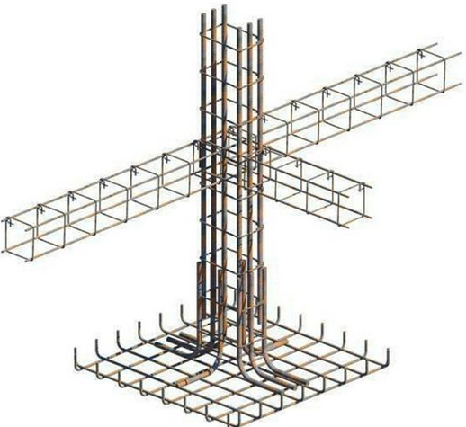
Reinforced Concrete Detailing to Eurocode 2
EC2 Section 8 - Detailing of Reinforcement - General Rules
Bar spacing, Minimum bend diameter
Anchorage of reinforcement
Lapping of bars
Large bars, bundled bars
EC2 Section 9 - Detailing of Members
and Particular rules
Beams
Solid slabs
Flat slabs
Columns
Walls
Deep beams
Foundations
Discontinuity regions
Tying Systems

Slide 21
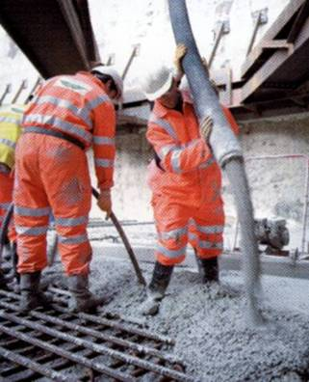
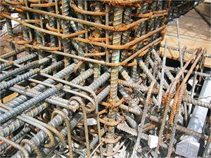
Section 8 - General Rules Spacing of bars
EC2: Cl. 8.2
Concise: 11.2
Clear horizontal and vertical distance ≥ φ, (d_{g} +5mm) or 20mm
For separate horizontal layers the bars in each layer should be located vertically above each other. There should be room to allow access for vibrators and good compaction of concrete.
Detail Min
75 mm gap
Notes:
21
Ratio of EC2/BS8110 for required mandrel size lies between 1:1.2

Slide 22
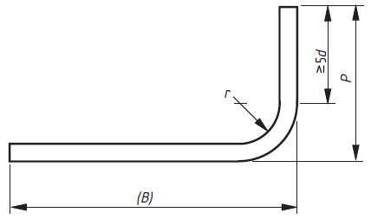
Min. Mandrel Dia. for bent bars
EC2: Cl. 8.3
Concise: 11.3
Minimum mandrel size, φ_{m}
To avoid damage to bar is
Bar dia ≤ 16mm Mandrel size 4 x bar diameter
Bar dia > 16mm Mandrel size 7 x bar diameter
The bar should extend at least 5 diameters beyond a bend
φ_{m}
BS8666 aligns
Notes:
22
Ratio of EC2/BS8110 for required mandrel size lies between 1:1.2

Slide 23
Min. Mandrel Dia. for bent bars
EC2: Cl. 8.3
Concise: 11.3
Minimum mandrel size, φ_{m}
Bearing stress inside bends
To avoid failure of the concrete inside the bend of the bar:
φ _{m,min} ≥ F_{bt} ((1/a_{b}) +1/(2 φ)) / f_{cd}
F_{bt} ultimate force in a bar at the start of a bend
a_{b} for a given bar is half the centre-to-centre distance between bars. For a bar adjacent to the face of the member, a_{b} should be taken as the cover plus φ /2
Mandrel size need not be checked to avoid concrete failure if :
anchorage does not require more than 5φ past end of bend
bar is not the closest to edge face and there is a cross bar ≥φ inside bend
mandrel size is at least equal to the recommended minimum value
Notes:
23
Ratio of EC2/BS8110 for required mandrel size lies between 1:1.2

Slide 24
Anchorage of reinforcement
EC2: Cl. 8.4

Slide 25
Ultimate bond stress
EC2: Cl. 8.4.2
Concise: 11.5
The design value of the ultimate bond stress,
f_{bd} = 2.25 η₁η₂f_{ctd}
where
f_{ctd} should be limited to C60/75
η₁ = 1 for ‘good’ and 0.7 for ‘poor’ bond conditions
η₂ = 1 for φ ≤ 32, otherwise (132- φ)/100
Notes:
25
Figure 8.1 of EC2 showing methods of anchoring bars is taken from the German practice. It may seem confusing to UK engineers.
BS8110: Where a lap occurs at the top of a section as cast and the minimum cover is less than twice the size of the lapped reinforcement, the lap length should be increased by a factor 1.4.

Slide 26
Ultimate bond stress
EC2: Cl. 8.4.2
Concise: 11.5
Good and ‘bad’ bond conditions
a) 45º ≤ α ≤ 90º c) h > 250 mm
Top is ‘poor’
Bond condition
300
b) h ≤ 250 mm d) h > 600 mm
unhatched zone – ‘good’ bond conditions
hatched zone - ‘poor’ bond conditions
Notes:
26
Figure 8.1 of EC2 showing methods of anchoring bars is taken from the German practice. It may seem confusing to UK engineers.
BS8110: Where a lap occurs at the top of a section as cast and the minimum cover is less than twice the size of the lapped reinforcement, the lap length should be increased by a factor 1.4.

Slide 27
Basic required anchorage length
EC2: Cl. 8.4.3
Concise: 11.4.3
l_{b,rqd} = (φ / 4) (σ_{sd} / f_{bd})
where
σ_{sd} = the design stress of the bar at the position from where the anchorage is measured.
For bent bars l_{b,rqd} should be measured along the centreline of the bar
EC2 Figure 8.1
Concise Fig 11.1
Notes:
27

Slide 28
Design Anchorage Length, l_{bd}
EC2: Cl. 8.4.4
Concise: 11.4.2
l_{bd} = α₁ α₂ α₃ α₄ α₅ l_{b,rqd} ≥ l_{b,min}
However: (α₂ α₃ α₅) ≥ 0.7
l_{b,min} > max(0.3l_{b,rqd} ; 10φ, 100mm)
Alpha values are in EC2: Table 8.2
To calculate α₂ and α₃ Table 8.2 requires values for:
C_{d} Value depends on cover and bar spacing, see Figure 8.3
K Factor depends on position of confinement reinforcement,
see Figure 8.4
λ = (∑A_{st} – ∑ _{Ast,min})/ A_{s} Where A_{st} is area of transverse reinf.
Notes:
28
Complexity/simplicity: There is a difficulty in finding an acceptable compromise between a simple approach and a comprehensive solution. It was considered better to provide a more comprehensive solution and allow designers to adopt a simpler, if more conservative, approach.
The anchorage and lap rules are much more complex than those of BS8110. They can be simplified but the simplifications are different for each element.

Slide 29
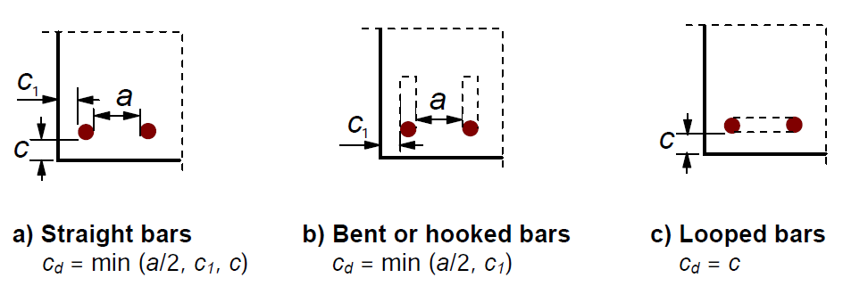
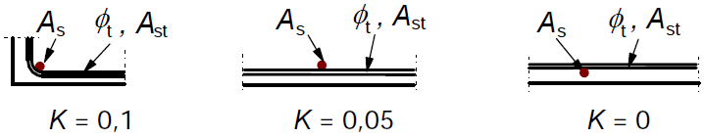
Table 8.2 - C_{d} & K factors
EC2: Figure 8.3
Concise: Figure 11.3
EC2: Figure 8.4
Beam corner bar?

Slide 30
Table 8.2 - Other than straight shapes
EC2: Figure 8.1
Concise: Figure 11.1

Slide 31
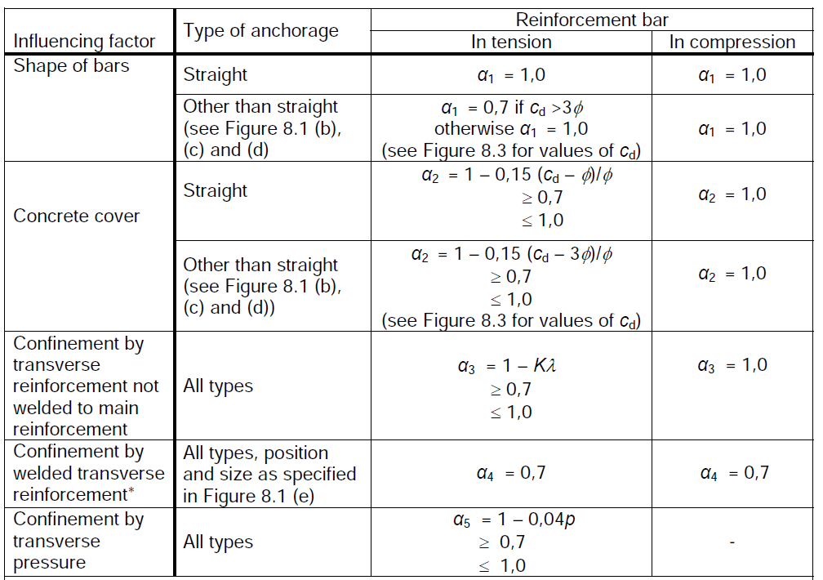
Alpha values
EC2: Table 8.2
Concise: 11.4.2
α₁
α₂
α₃
α₄
α₅

Slide 32
Anchorage of links
EC2: Cl. 8.5
Concise: Fig 11.2

Slide 33
Laps
EC2: Cl. 8.7

Slide 34
Design Lap Length, l₀ (8.7.3)
EC2: Cl. 8.7.3, Table 8.3
Concise: 11.6.2
l₀ = α₁ α₂ α₃ α₅ α₆ l_{b,rqd} ≥ l_{0,min}
α₁ α₂ α₃ α₅ are as defined for anchorage length
α₆ = (ρ₁/25)^{0,5} but between 1.0 and 1.5
where ρ₁ is the % of reinforcement lapped within 0.65l₀ from the centre of the lap
Percentage of lapped bars relative to the total cross-section area | < 25% | 33% | 50% | >50%
α₆ | 1 | 1.15 | 1.4 | 1.5
Note: Intermediate values may be determined by interpolation.
l_{0,min} ≥ max{0.3 α₆ l_{b,rqd}; 15φ; 200}
Notes:
34
α₆ provides a severe factor on the lap length. and emphasises that laps should not be placed at positions of high stress

Slide 35
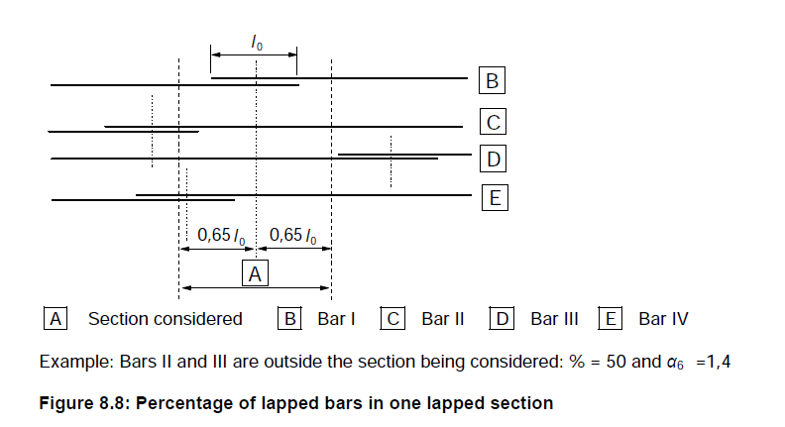
Arrangement of Laps
EC2: Cl. 8.7.3, Fig 8.8
Notes:
35

Slide 36
Worked example
Anchorage and lap lengths

Slide 37
Anchorage Worked Example
Calculate the tension anchorage for an H16 bar in the bottom of a slab:
Straight bars
Other shape bars (Fig 8.1 b, c and d)
Concrete strength class is C25/30
Nominal cover is 25mm
Assume maximum design stress in the bar

Slide 38
Anchorage Worked Example
Calculate the tension anchorage for an H16 bar in the bottom of a slab:
Straight bars
Other shape bars (Fig 8.1 b, c and d)
Concrete strength class is C25/30
Nominal cover is 25mm
Assume maximum design stress in the bar
What is the value of f_{ck}?
Answer: f_{ck}= 25 MPa

Slide 39
Bond stress, f_{bd}
f_{bd} = 2.25 η₁ η₂ f_{ctd} EC2 Equ. 8.2
η₁ = 1.0 ‘Good’ bond conditions
η₂ = 1.0 bar size ≤ 32
f_{ctd} = α_{ct} f_{ctk,0,05}/γ_{c} EC2 cl 3.1.6(2), Equ 3.16
α_{ct} = 1.0 γ_{c} = 1.5
f_{ctk,0,05} = 0.7 x 0.3 f_{ck}^{2/3} EC2 Table 3.1
= 0.21 x 25^{2/3}
= 1.795 MPa
f_{ctd} = α_{ct} f_{ctk,0,05}/γ_{c} = 1.795/1.5 = 1.197
f_{bd} = 2.25 x 1.197 = 2.693 MPa

Slide 40
Basic anchorage length, l_{b,req}
l_{b.req} = (Ø/4) ( σ_{sd}/f_{bd}) EC2 Equ 8.3
Max stress in the bar, σ_{sd} = f_{yk}/γ_{s} = 500/1.15
= 435MPa.
l_{b.req} = (Ø/4) ( 435/2.693)
= 40.36 Ø
For concrete class C25/30

Slide 41
Design anchorage length, l_{bd}
l_{bd} = α₁ α₂ α₃ α₄ α₅ l_{b.req} ≥ l_{b,min}
l_{bd} = α₁ α₂ α₃ α₄ α₅ (40.36Ø) For concrete class C25/30

Slide 42
Alpha values
EC2: Table 8.2
Concise: 11.4.2

Slide 43
Table 8.2 - C_{d} & K factors
EC2: Figure 8.3
Concise: Figure 11.3
EC2: Figure 8.4

Slide 44
Design anchorage length, l_{bd}
l_{bd} = α₁ α₂ α₃ α₄ α₅ l_{b.req} ≥ l_{b,min}
l_{bd} = α₁ α₂ α₃ α₄ α₅ (40.36Ø) For concrete class C25/30
a) Tension anchorage – straight bar
α₁ = 1.0
α₃ = 1.0 conservative value with K= 0
α₄ = 1.0 N/A
α₅ = 1.0 conservative value
α₂ = 1.0 – 0.15 (C_{d} – Ø)/Ø
α₂ = 1.0 – 0.15 (25 – 16)/16 = 0.916
l_{bd} = 0.916 x 40.36Ø = 36.97Ø = 592mm

Slide 45
Design anchorage length, l_{bd}
l_{bd} = α₁ α₂ α₃ α₄ α₅ l_{b.req} ≥ l_{b,min}
l_{bd} = α₁ α₂ α₃ α₄ α₅ (40.36Ø) For concrete class C25/30
b) Tension anchorage – Other shape bars
α₁ = 1.0 C_{d} = 25 is ≤ 3 Ø = 3 x 16 = 48
α₃ = 1.0 conservative value with K= 0
α₄ = 1.0 N/A
α₅ = 1.0 conservative value
α₂ = 1.0 – 0.15 (C_{d} – 3Ø)/Ø ≤ 1.0
α₂ = 1.0 – 0.15 (25 – 48)/16 = 1.25 ≤ 1.0
l_{bd} = 1.0 x 40.36Ø = 40.36Ø = 646mm

Slide 46
Worked example - summary
H16 Bars – Concrete class C25/30 – 25 Nominal cover
Tension anchorage – straight bar l_{bd} = 36.97Ø = 592mm
Tension anchorage – Other shape bars l_{bd} = 40.36Ø = 646mm
l_{bd} is measured along the centreline of the bar
Compression anchorage (α₁ = α₂ = α₃ = α₄ = α₅ = 1.0)
l_{bd} = 40.36Ø = 646mm
Anchorage for ‘Poor’ bond conditions, l_{bd} = ‘Good value’ /0.7
Lap length, l₀ = anchorage length x α₆

Slide 47
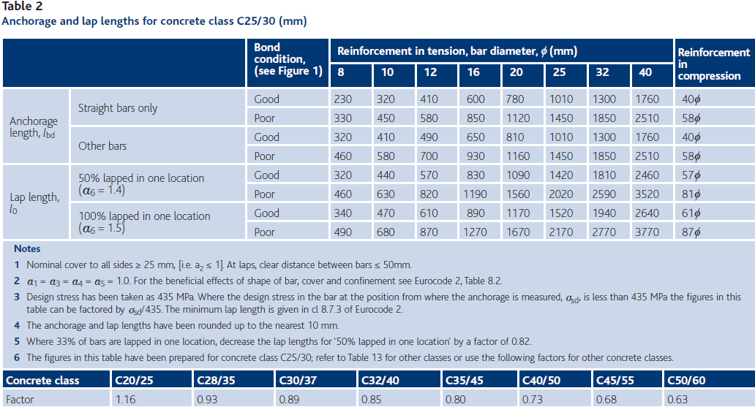
Anchorage & lap lengths
How to design concrete structures using Eurocode 2
Column lap length for 100% laps & grade C40/50 = 0.73 x 61Ф = 44.5 Ф

Slide 48
Anchorage /lap lengths for slabs
Manual for the design of concrete structures to Eurocode 2
Table 5.25: Typical values of anchorage and lap lengths for slabs
 | Bond | Length in bar diameters
 | conditions | f_{ck} /f_{cu} 25/30 | f_{ck} /f_{cu} 28/35 | f_{ck} /f_{cu} 30/37 | f_{ck} /f_{cu} 32/40
Full tension and compression anchorage length, l_{bd} | ‘good’ | 40 | 37 | 36 | 34
 | ‘poor’ | 58 | 53 | 51 | 49
Full tension and compression lap length, l₀ | ‘good’ | 46 | 43 | 42 | 39
 | ‘poor’ | 66 | 61 | 59 | 56
Note: The following is assumed: - bar size is not greater than 32mm. If >32 then the anchorage and lap lengths should be increased by a factor (132 - bar size)/100 - normal cover exists - no confinement by transverse pressure - no confinement by transverse reinforcement - not more than 33% of the bars are lapped at one place Lap lengths provided (for nominal bars, etc.) should not be less than 15 times the bar size or 200mm, whichever is greater.
Notes:
48
The values have been chosen assuming that not more than 33% of the bars are lapped. The factor of 1,15 for this may be offset by the fact that the bars are not at their full stress.

Slide 49
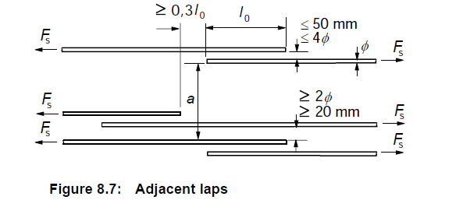
Arrangement of Laps
EC2: Cl. 8.7.2
Concise: Cl 11.6
Laps between bars should normally be staggered and not located in regions of high stress.
Arrangement of laps should comply with Figure 8.7:
All bars in compression and secondary (distribution) reinforcement may be lapped in one section.
Distance ‘a’ is used in cl 8.7.4.1 (3),
Transverse reinf.
Notes:
49

Slide 50
Transverse Reinforcement at Laps Bars in tension
Concise: Cl 11.6.4
EC2: Cl. 8.7.4, Fig 8.9
Transverse reinforcement is required in the lap zone to resist transverse tension forces.
Any Transverse reinforcement provided for other reasons will be sufficient if the lapped bar Ø < 20mm or laps< 25%
If the lapped bar Ø ≥ 20mm the transverse reinforcement should have a total area, ΣA_{st} ≥ 1,0A_{s} of one spliced bar. It should be placed perpendicular to the direction of the lapped reinforcement. Also it should be positioned at the outer sections of the lap as shown.
Figure 8.9 (a) -
bars in tension
Notes:
50
An early draft differentiated between the effect of the plane of the lapped bars. The assumption was the splitting forces are greater in the plane of the lapped bars than in the plane perpendicular to it. This has been shown not to be true. The final edition of the code assumes that the splitting forces are independent of the plane of the lapped bars.

Slide 51
Transverse Reinforcement at Laps Bars in tension
Concise: Cl 11.6.4
EC2: Cl. 8.7.4, Fig 8.9
Also, if the lapped bar Ø ≥ 20mm and more than 50% of the reinforcement is lapped at one point and the distance between adjacent laps at a section, a, ≤ 10φ , then transverse bars should be formed by links or U bars anchored into the body of the section.
Notes:
51
An early draft differentiated between the effect of the plane of the lapped bars. The assumption was the splitting forces are greater in the plane of the lapped bars than in the plane perpendicular to it. This has been shown not to be true. The final edition of the code assumes that the splitting forces are independent of the plane of the lapped bars.

Slide 52
Transverse Reinforcement at Laps Bars in compression
Concise: Cl 11.6.4
EC2: Cl. 8.7.4, Fig 8.9
In addition to the rules for bars in tension one bar of the transverse reinforcement should be placed outside each end of the lap length.
Figure 8.9 (b) – bars in compression
Notes:
52
An early draft differentiated between the effect of the plane of the lapped bars. The assumption was the splitting forces are greater in the plane of the lapped bars than in the plane perpendicular to it. This has been shown not to be true. The final edition of the code assumes that the splitting forces are independent of the plane of the lapped bars.

Slide 53
Detailing of members and particular rules
EC2 Section 9
Notes:
53
In design and detailing of precast concrete elements and structures, the following shall be considered specifically:
- transient situations (demoulding, transport, storage, erection and construction assembly)
- bearings; temporary and permanent
- connections and joints between elements

Slide 54
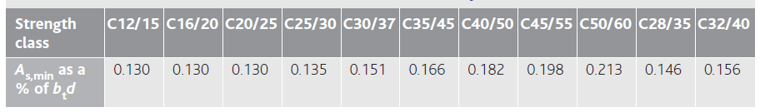
Beams
EC2: Cl. 9.2
A_{s,min} = 0,26 (f_{ctm}/f_{yk})b_{t}d but ≥ 0,0013b_{t}d
A_{s,max} = 0,04 A_{c}
Section at supports should be designed for a hogging moment ≥ 0,25 max. span moment
Any design compression reinforcement (φ) should be held by transverse reinforcement with spacing ≤15 φ
Notes:
54
The first term for A_{s,min} ensures that for higher strength concrete the minimum value is increased to avoid brittle failure
For members with unbonded tendons the ultimate bending capacity ≥ 1,15 Cracking Moment
The concept of spreading the tensile reinforcement over the whole of the effective width is new to the UK and assumes that plane sections remain plane across the flange..

Slide 55
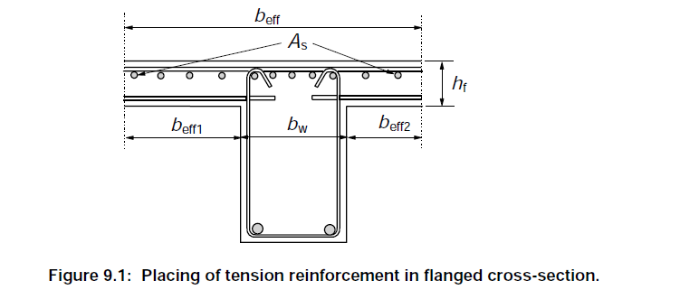
Beams
EC2: Cl. 9.2
Tension reinforcement in a flanged beam at supports should be spread over the effective width (see 5.3.2.1)
Notes:
55
The first term for A_{s,min} ensures that for higher strength concrete the minimum value is increased to avoid brittle failure
For members with unbonded tendons the ultimate bending capacity ≥ 1,15 Cracking Moment
The concept of spreading the tensile reinforcement over the whole of the effective width is new to the UK and assumes that plane sections remain plane across the flange..

Slide 56
Curtailment
EC2: Cl. 9.2.1.3
Sufficient reinforcement should be provided at all sections to resist the envelope of the acting tensile force, including the effect of inclined cracks in webs and flanges.
(2) For members with shear reinforcement the additional tensile force, ΔF_{td}, should be calculated according to 6.2.3 (7). For members without shear reinforcement ΔF_{td} may be estimated by shifting the moment curve a distance a_{l} = d according to 6.2.2 (5). This "shift rule” may also be used as an alternative for members with shear reinforcement, where:
a_{l} = z (cot θ - cot α)/2 = 0.5 z cot θ for vertical shear links
z= lever arm, θ = angle of compression strut
a_{l} = 1.125 d when cot θ = 2.5 and 0.45 d when cot θ = 1
Notes:
56
An ‘indirect’ support is one where the support flexes with the slab. A ‘direct’ support is rigid and does not flex with the slab.
‘Indirect’ support: The shift rule applies and the bar has to extend at least d beyond the face of the support.
‘direct’ support: A pinching effect occurs on the reinforcement between the load trajectory and the support. Hence the bond is increased and the anchorage is permitted to be shorter.

Slide 57
‘Shift Rule’ for Shear
Curtailment of longitudinal tension reinforcement
Horizontal component of diagonal shear force
= (V/sinθ) . cosθ = V cotθ
M/z - V cotθ/2
V/sinθ
θ
Applied
shear V
Applied
moment M
z
M/z + V cotθ/2
= (M + Vz cotθ/2)/z
∴ ΔM = Vz cotθ/2
a_{l}
dM/dx = V
∴ ΔM = VΔx ∴ Δx = z cotθ/2 = a_{l}

Slide 58
‘Shift Rule’ Curtailment of reinforcement
EC2: Cl. 9.2.1.3, Fig 9.2
Concise: 12.2.2
a_{l}
For members without shear reinforcement this is satisfied with a_{l} = d
For members with shear reinforcement: a_{l} = 0.5 z Cot θ
But it is always conservative to use a_{l} = 1.125d (for θ = 45º, a_{l} = 0.45d)
Notes:
58
Sufficient reinforcement should be provided to resist the envelope of the acting tensile force, including the effect of shear
The tensile force depends on the value of θ chosen for the shear design (see Section 6)
The tensile force should also include any axial actions

Slide 59
Anchorage of Bottom Reinforcement at End Supports
EC2: Cl. 9.2.1.4
A_{s} bottom steel at support ≥ 0.25 A_{s} provided in the span
l_{bd} is required from the line of contact of the support.
Transverse pressure may only be taken into account with a ‘direct’ support. α₅ anchorage coefficient
Notes:
59
An ‘indirect’ support is one where the support flexes with the slab. A ‘direct’ support is rigid and does not flex with the slab.
‘Indirect’ support: The shift rule applies and the bar has to extend at least d beyond the face of the support.
‘direct’ support: A pinching effect occurs on the reinforcement between the load trajectory and the support. Hence the bond is increased and the anchorage is permitted to be shorter.

Slide 60
Simplified Detailing Rules for Beams
Concise: Cl 12.2.4
How to….EC2
Detailing section
Notes:
60
An ‘indirect’ support is one where the support flexes with the slab. A ‘direct’ support is rigid and does not flex with the slab.
‘Indirect’ support: The shift rule applies and the bar has to extend at least d beyond the face of the support.
‘direct’ support: A pinching effect occurs on the reinforcement between the load trajectory and the support. Hence the bond is increased and the anchorage is permitted to be shorter.

Slide 61
Supporting Reinforcement at ‘Indirect’ Supports
Concise: Cl 12.2.8
EC2: Cl. 9.2.5
A
supporting beam with height h₁
B
supported beam with height h₂ (h₁ ≥ h₂)
Plan view
The supporting reinforcement is in addition to that required for other reasons
The supporting links may be placed in a zone beyond the intersection of beams
Notes:
61

Slide 62
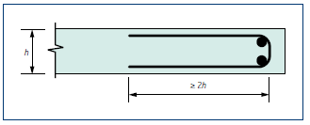
Solid slabs
EC2: Cl. 9.3
Curtailment – as beams except for the “Shift” rule a_{l} = d may be used
Flexural Reinforcement – min and max areas as beam
Secondary transverse steel not less than 20% main reinforcement
Reinforcement at Free Edges
Notes:
62

Slide 63
Detailing Comparisons
Beams | EC2 | BS 8110
Main Bars in Tension | Clause / Values | Values
A_{s,min} | 9.2.1.1 (1): 0.26 f_{ctm}/f_{yk}bd ≥ 0.0013 bd | 0.0013 bh
A_{s,max} | 9.2.1.1 (3): 0.04 bd | 0.04 bh
Main Bars in Compression
A_{s,min} | -- | 0.002 bh
A_{s,max} | 9.2.1.1 (3): 0.04 bd | 0.04 bh
Spacing of Main Bars
s_{min} | 8.2 (2): d_{g} + 5 mm or φ or 20mm | d_{g} + 5 mm or φ
S_{max} | Table 7.3N | Table 3.28
Links
A_{sw,min} | 9.2.2 (5): (0.08 b s √f_{ck})/f_{yk} | 0.4 b s/0.87 f_{yv}
s_{l,max} | 9.2.2 (6): 0.75 d | 0.75d
s_{t,max} | 9.2.2 (8): 0.75 d ≤ 600 mm 9.2.1.2 (3) or 15φ from main bar | d or 150 mm from main bar
Notes:
63

Slide 64
Detailing Comparisons
Slabs | EC2 Clause / Values | BS 8110 Values
Main Bars in Tension
A_{s,min} | 9.2.1.1 (1): 0.26 f_{ctm}/f_{yk}bd ≥ 0.0013 bd | 0.0013 bh
A_{s,max} | 0.04 bd | 0.04 bh
Secondary Transverse Bars
A_{s,min} | 9.3.1.1 (2): 0.2A_{s} for single way slabs | 0.002 bh
A_{s,max} | 9.2.1.1 (3): 0.04 bd | 0.04 bh
Spacing of Bars
s_{min} | 8.2 (2): d_{g} + 5 mm or φ or 20mm 9.3.1.1 (3): main 3h ≤ 400 mm | d_{g} + 5 mm or φ
S_{max} | secondary: 3.5h ≤ 450 mm | 3d or 750 mm
 | places of maximum moment: main: 2h ≤ 250 mm secondary: 3h ≤ 400 mm
Notes:
64

Slide 65
Detailing Comparisons
Punching Shear | EC2Clause / Values | BS 8110 Values
Links
A_{sw,min} | 9.4.3 (2):Link leg = 0.053s_{r} s_{t} √(f_{ck})/f_{yk} | Total = 0.4ud/0.87fyv
S_{r} | 9.4.3 (1): 0.75d | 0.75d
S_{t} | 9.4.3 (1): within 1st control perim.: 1.5d outside 1st control perim.: 2d | 1.5d
Columns
Main Bars in Compression
A_{s,min} | 9.5.2 (2): 0.10N_{Ed}/f_{yk} ≤ 0.002bh | 0.004 bh
A_{s,max} | 9.5.2 (3): 0.04 bh | 0.06 bh
Links
Min size | 9.5.3 (1) 0.25φ or 6 mm | 0.25φ or 6 mm
S_{cl,tmax} | 9.5.3 (3): min(12φmin; 0.6b; 240 mm) | 12φ
 | 9.5.3 (6): 150 mm from main bar | 150 mm from main bar
Notes:
65

Slide 66


Identification of bars on site Current BS 4449
Class A
Class B
Class C
www.ukcares.co.uk www.uk-bar.org

Slide 67
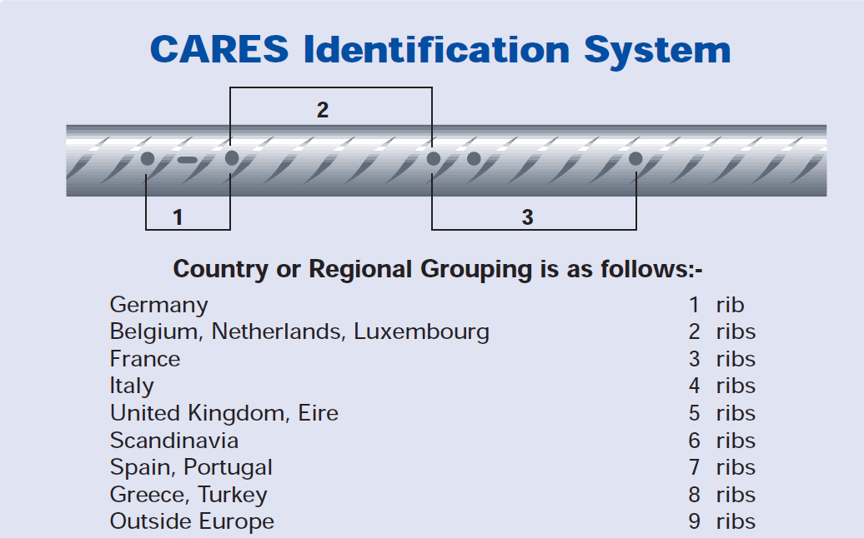
Identification on site Current BS 4449
UK CARES (Certification - Product & Companies)
Reinforcing bar and coil
Reinforcing fabric
Steel wire for direct use of for further processing
Cut and bent reinforcement
Welding and prefabrication of reinforcing steel
Notes:
UK CARES – Independent non profit making organisation regulated by the Board of Management as follows;
Association of Consulting Engineers, BAA plc , British Association for Reinforcement , Civil Engineering Contractors Association , CONSTRUCT , Construction Confederation
Highways Agency, Institution of Structural Engineers, Post-tensioning Association , Southern Water, UK Steel Association
.
A – Ribs parallel leaning in same direction
B – “ ribs leaning right followed by 2 ribs leaning left…………...repeated.
C – 1 Ribs leaning right at steep angle followed by 1 rib leaning right at shallower angle………………….. repeated

Slide 68
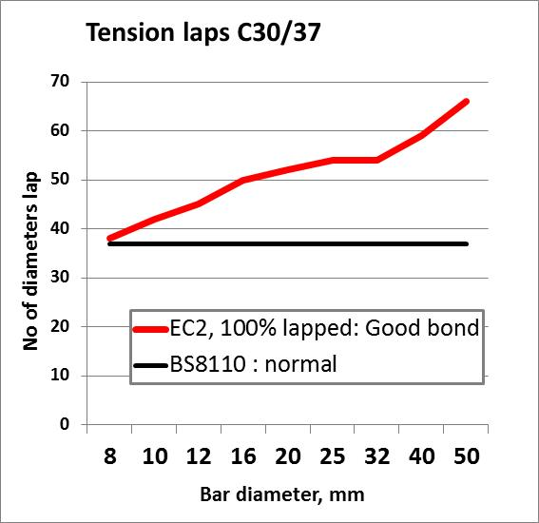
Detailing Issues
EC2 Clause | Issue | Possible resolve in 2017?
8.4.4.1 | Lap lengths
Table 8.3 | α₆ varies depending on amount staggered | α₆ should always = 1.5. Staggering doesn’t help at ULS
8.7.2(3) & Fig 8.7 | 0.3 l_{o} gap between ends of lapped bars is onerous. | For ULS, there is no advantage in staggering bars( fib bulletin Mar 2014). For SLS staggering at say 0.5 l_{o} might be helpful.
Notes:
68

Slide 69
Detailing Issues
EC2 Clause | Issue | Possible resolve in 2017?
Table 8.2 | α₂ for compression bars | Should be the same as for tension. Initial test suggests α₂ = 0.7
Table 8.2 | α₂ for bent bars | Currently, anchorage worse than for straight bars
8.7.4.1(4) & Fig 8.9 | Requirements for transverse bars are impractical | Requirement only makes 10-15% difference in strength of lap (Corrigendum 1 no longer requires transverse bars to be between lapped bar and surface.)
Fig 9.3 | l_{bd} anchorage into support | May be OTT as compression forces increase bond strength. Issue about anchorage beyond CL of support
6.4 | Numbers of perimeters of punching shear links | Work of CEN TC 250.SC2/WG1/TG4
Notes:
69

Slide 70
Tying systems

Slide 71
Tying systems
Peripheral ties (9.10.2.2) & NA: F_{tie,per} = (20 + 4n₀) ≤ 60kN
where n₀ is the number of storeys
Internal ties (including transverse ties) (9.10.2.3) & NA : F_{tie,int} = ((g_{k} + q_{k}) / 7.5 )(l_{r}/5)F_{t} ≥ F_{t} kN/m where (g_{k} + q_{k}) is the sum of the average permanent and variable floor loads (kN/m²), l_{r} is the greater of the distances (m) between the centres of the columns, frames or walls supporting any two adjacent floor spans in the direction of the tie under consideration and F_{t} = (20 + 4n₀) ≤ 60kN. Maximum spacing of internal ties = 1.5 l_{r}
Horizontal ties to columns or walls (9.10.2.4) & NA : F_{tie,fac} = F_{tie,col} ≥ (2 F_{t} ≤ (l_{s} /2.5)F_{t}) and ≥ 3% of N_{Ed}
N_{Ed} = the total design ultimate vertical load carried by the column or wall at that level. Tying of external walls is only required if the peripheral tie is not located within the wall. F_{tie,fac} in kN per metre run of wall, F_{tie,col} in kN per column and l_{s} is the floor to ceiling height in m.
Notes:
Internal Ties: EC2 and BS8110 have a completely different basis for the calculation of tying requirements - EC2 is based on the length of end span, BS8110 is based on the number of storeys. The UK National Annex has chosen the BS 8110 values.
Vertical Ties: Vertical Ties: The difference between EC2 and BS8110 is minimal. BS8110 says it must carry the maximum design accidental load from any floor supported by the column. EC2 says it must carry just the floor below that part of the column being considered.

Slide 72
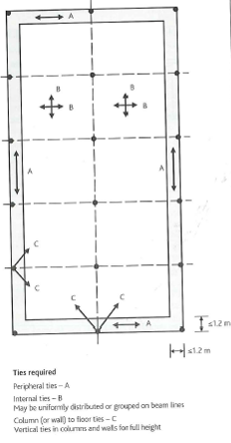
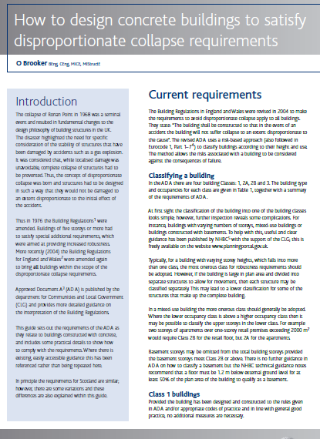
Tying Systems
Internal Ties: EC2 specifies a 20kN/m requirement which is significantly less than BS8110.
UK NA requirements similar to BS 8110

Slide 73
Tying Systems
Vertical ties (9.10.2.5): In panel buildings of 5 storeys or more, ties should be provided in columns and/or walls to limit damage of collapse of a floor. Normally continuous vertical ties should be provided from the lowest to the highest level. Where a column or wall is supported at the bottom by a beam or slab accidental loss of this element should be considered.
Continuity and anchorage ties (9.10.3): Ties in two horizontal directions shall be effectively continuous and anchored at the perimeter of the structure. Ties may be provided wholly in the insitu concrete topping or at connections of precast members.
Notes:
Internal Ties: EC2 and BS8110 have a completely different basis for the calculation of tying requirements - EC2 is based on the length of end span, BS8110 is based on the number of storeys. The UK National Annex has chosen the BS 8110 values.
Vertical Ties: Vertical Ties: The difference between EC2 and BS8110 is minimal. BS8110 says it must carry the maximum design accidental load from any floor supported by the column. EC2 says it must carry just the floor below that part of the column being considered.

Slide 74
Exercise Lecture 9
Lap length for column longitudinal bars

Slide 75
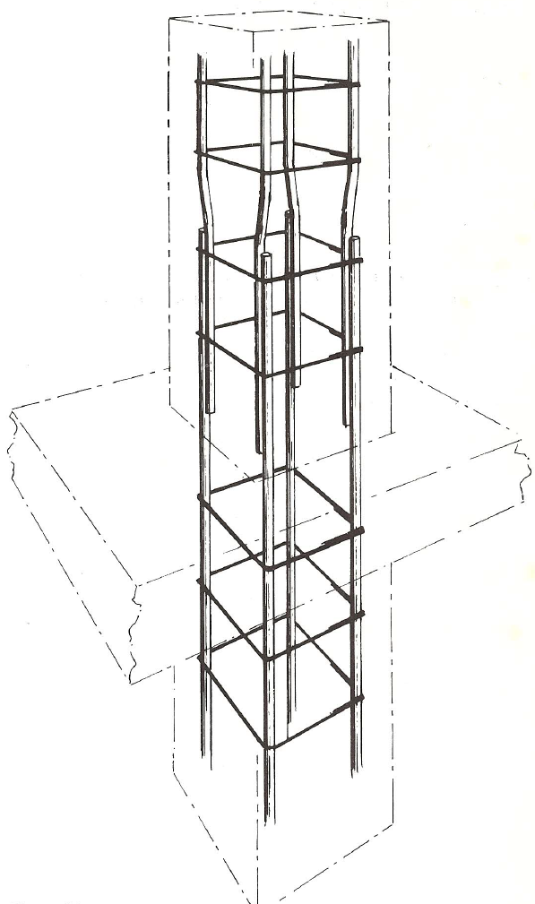

Column lap length exercise
H25’s
Design information
C40/50 concrete
400 mm square column
45mm nominal cover to main bars
Longitudinal bars are in compression
Maximum ultimate stress in the bars is 390 MPa
Lap
Exercise:
Calculate the minimum lap length using EC2 equation 8.10:
H32’s

Slide 76
Column lap length exercise
Procedure
Determine the ultimate bond stress, f_{bd} EC2 Equ. 8.2
Determine the basic anchorage length, l_{b,req} EC2 Equ. 8.3
Determine the design anchorage length, l_{bd} EC2 Equ. 8.4
Determine the lap length, l₀ = anchorage length x α₆

Slide 77
Working space

Slide 78
Working space

Slide 79
Model Answers
Lecture 7 Exercise:
Lap length for column longitudinal bars

Slide 80
Column lap length exercise
H25’s
Design information
C40/50 concrete
400 mm square column
45mm nominal cover to main bars
Longitudinal bars are in compression
Maximum ultimate stress in the bars is 390 MPa
Lap
Exercise:
Calculate the minimum lap length using EC2 equation 8.10:
H32’s

Slide 81
Column lap length exercise
Procedure
Determine the ultimate bond stress, f_{bd} EC2 Equ. 8.2
Determine the basic anchorage length, l_{b,req} EC2 Equ. 8.3
Determine the design anchorage length, l_{bd} EC2 Equ. 8.4
Determine the lap length, l₀ = anchorage length x α₆

Slide 82
Solution - Column lap length
Determine the ultimate bond stress, f_{bd}
f_{bd} = 2.25 η₁ η₂ f_{ctd} EC2 Equ. 8.2
η₁ = 1.0 ‘Good’ bond conditions
η₂ = 1.0 bar size ≤ 32
f_{ctd} = α_{ct} f_{ctk,0,05}/γ_{c} EC2 cl 3.1.6(2), Equ 3.16
α_{ct} = 1.0 γ_{c} = 1.5
f_{ctk,0,05} = 0.7 x 0.3 f_{ck}^{2/3} EC2 Table 3.1
= 0.21 x 40^{2/3}
= 2.456 MPa
f_{ctd} = α_{ct} f_{ctk,0,05}/γ_{c} = 2.456/1.5 = 1.637
f_{bd} = 2.25 x 1.637 = 3.684 MPa

Slide 83
Solution - Column lap length
Determine the basic anchorage length, l_{b,req}
l_{b,req} = (Ø/4) ( σ_{sd}/f_{bd}) EC2 Equ 8.3
Max ultimate stress in the bar, σ_{sd} = 390 MPa.
l_{b,req} = (Ø/4) ( 390/3.684)
= 26.47 Ø
For concrete class C40/50

Slide 84
Solution - Column lap length
Determine the design anchorage length, l_{bd}
l_{bd} = α₁ α₂ α₃ α₄ α₅ l_{b,req} ≥ l_{b,min} Equ. 8.4
l_{bd} = α₁ α₂ α₃ α₄ α₅ (26.47Ø) For concrete class C40/50
For bars in compression α₁ = α₂ = α₃ = α₄ = α₅ = 1.0
Hence l_{bd} = 26.47Ø

Slide 85
Solution - Column lap length
Determine the lap length, l₀ = anchorage length x α₆
All the bars are being lapped at the same section, α₆ = 1.5
A lap length is based on the smallest bar in the lap, 25mm
Hence,
l₀ = l_{bd} x α₆
l₀ = 26.47 Ø x 1.5
l₀ = 39.71 Ø = 39.71 x 25
l₀ = 993 mm

Slide 86
Course Outline
Lecture | Date | Speaker | Title
1 | 21 Sep | Charles Goodchild | Introduction, Background and Codes
2 | 28 Sep | Charles Goodchild | EC2 Background, Materials, Cover and effective spans
3 | 5 Oct | Paul Gregory | Bending and Shear in Beams
4 | 12 Oct | Charles Goodchild | Analysis
5 | 19 Oct | Paul Gregory | Slabs and Flat Slabs
6 | 26 Oct | Charles Goodchild | Deflection and Crack Control
7 | 2 Nov | Paul Gregory | Detailing
8 | 9 Nov | Jenny Burridge | Columns
9 | 16 Nov | Jenny Burridge | Fire
10 | 23 Nov | Jenny Burridge | Foundations

Slide 87
End of Lecture 7
Notes:
87

Slide 88
End of Lecture
Email: pgregory@concretecentre.com
Notes:
88

