Slide 1
AI in social Engineering and Phishing Campaigns
Behavior-based url detection tool
Presented by: Pranav, Atul & Zaid
Internship: Digisuraksha cybersecurity internship 2025

Slide 2
What is social engineering?
Definition: A manipulation technique that exploits human error to gain private information, access, or valuables.
Types:
Phishing – fake emails/websites
Baiting – luring with free offers/media
Pretexting – posing as authority (e.g., IT support)
Tailgating – physically following someone into restricted areas
Goal: Trick users into making security mistakes.

Slide 3
What is phishing?
A type of social engineering attack that tricks users into revealing sensitive data (e.g., passwords, bank details).
Delivery methods:
Emails (most common)
Fake websites
Text messages (smishing)
Phone calls (vishing)
Example: "Your account has been locked. Click here to verify.”

Slide 4
How ai is used in cybersecurity
Anomaly detection: Detects behavior that deviates from the norm.
Spam/phishing filters: ML algorithms flag suspicious emails.
Threat intelligence: AI scans forums/dark web for leaked data.
Automation: Speeds up incident response with AI bots.

Slide 5
How ai is misused by attackers
Natural Language Generation (NLG):
AI writes personalized, grammatically correct phishing emails.
Voice cloning:
Mimics real people (e.g., CEOs) using deep learning.
Automated target profiling:
Scrapes public data from social media to craft tailored attacks.
Chatbots:
Fake customer support bots lure victims into giving credentials.

Slide 6
Rise of ai-driven phishing attacks
Growth: Over 500 million phishing attacks in 2023.
AI accelerates phishing:
Faster, cheaper, more personalized.
Harder to detect because emails appear more “human”.
Low barrier: Attackers use AI without deep technical skills.

Slide 7
Limitations of traditional security
Keyword filters fail when AI-generated content avoids spam triggers.
Static blacklists can’t keep up with fast-changing domains.
User training is often forgotten or ignored.
Legacy antivirus tools lack behavioral analysis features.

Slide 8
Consequences of ai-enhanced phishing
Financial loss: $10.3 billion in phishing losses (FBI IC3, 2022)
Reputation damage: Customer trust collapses after data breaches.
Data theft: Access to corporate systems and IP leaks.
Nation-state risk: Attacks on government and infrastructure.

Slide 9
Using ai to counter phishing
Email anomaly detection:
Scans sender behavior, writing style, timing patterns.
Phishing simulators:
AI generates fake attacks for training purposes.
Neural networks:
Classify emails and websites based on visual or structural features.

Slide 10
Phishing url and domain analysis with ai
Key indicators AI analyses:
Misspelled domains (e.g., "go0gle.com")
HTTPS usage and certificate info
Number of redirects or hidden links
Techniques:
Logistic regression, Random Forest, or deep learning (CNNs) for URL classification
Data Sources:
PhishTank, Kaggle datasets

Slide 11
Deepfake voice phishing attack
Case: UK energy firm tricked into sending €220,000.
How: Voice-cloning software mimicked CEO’s voice.
Impact: Money transferred to attacker’s account in Hungary.
Insight: Audio AI makes vishing more believable and dangerous.

Slide 12
What’s the tool about?
This is a machine learning–based URL classification tool designed to detect and categorize suspicious or harmful web links by analyzing their structure.
It uses feature extraction techniques to convert a URL into numerical data, then feeds it into a trained model to classify the URL into one of four categories:
✅ Benign – Safe to visit
⚠️ Phishing – Fake websites trying to steal credentials
🚫 Defacement – Websites whose content has been maliciously altered
🛑 Malware – Sites that try to install harmful software

Slide 13
Why was this tool made?
Cyber threats are growing
Every day, users unknowingly click on dangerous links leading to phishing or malware. This tool helps prevent attacks before they happen.
It's practical and impactful
The tool can be used in the real world — in email filters, browsers, or cybersecurity apps — making it more than just a theory project.
Applies machine learning to real problems
This project allowed me to apply ML practically in cybersecurity — feature extraction, model training, and prediction, all in one pipeline.
Simple, fast, and effective
It works quickly with just a URL input, needs no large system, and provides accurate results using a lightweight Random Forest model.
Educational and expandable
It’s a great learning base for beginners and can be extended further — with URL reputation APIs, deep learning, or threat intelligence databases.

Slide 14
Who can use it & Where it can be used?
Individual users
General internet users can paste a suspicious URL and check if it's safe before clicking.
Students and learners
Cybersecurity students can study how ML models detect malicious URLs.
Analysts
Quickly classify suspicious links found in phishing emails, logs, or social engineering attempts.
Developers & engineers
Can integrate it into Web applications (to validate user-submitted URLs), APIs or bots that interact with third party links.
Educators and trainers
Can use this tool to demonstrate phishing techniques and train users on how to identify harmful URLs.

Slide 15
How does it work?
File 2: train_model.py
Trains a Random Forest model using a dataset of labelled URLs.
Extracts features using extract_features.py.
Splits the data, trains the model, evaluates accuracy.
Saves the trained model as model.pkl.
File 3: check_url.py
Loads the saved model.
Takes a new URL input.
Extracts features using extract_features.py.
Predicts if the URL is:
Benign
Phishing
Defacement
Malware
File 1: extract_features.py
Converts a URL into numerical features like:
URL length
Use of https
Number of subdomains
Suspicious words (like “login”, “bank”)

Slide 16
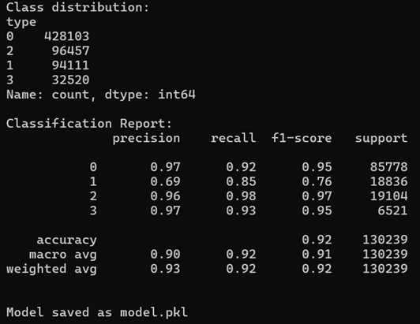
Code/tool implementation
Developed using Python + Scikit-learn (No LINUX dependencies)
Trained classifier to label URLs into 4 behavior types
Exported as REST API and GUI CLI app
Lightweight enough for real-time detection

Slide 17
Feature engineering insights
Extracted 30+ features from URLs, e.g.:
🔗 Length, . count, special characters
🧠 Entropy of domain
🌐 Use of suspicious keywords (e.g., “login”, “update”)
Recursive Feature Elimination (RFE) used to select top features
Top 5 impactful features shown to have >80% predictive contribution

Slide 18
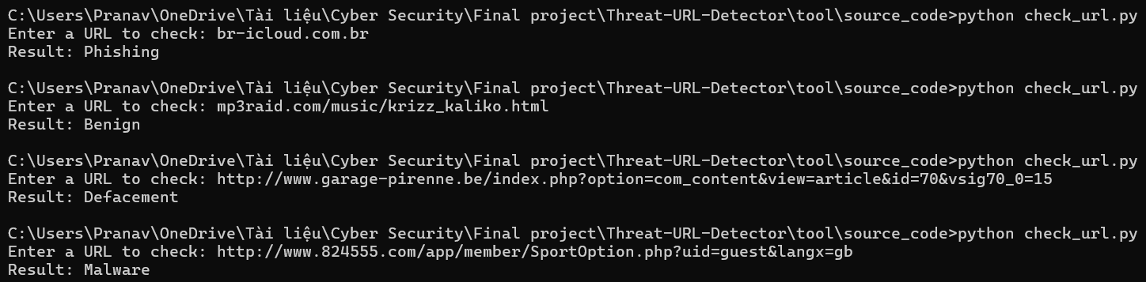
Code/tool demonstration
Input: train_model.py (Generates report)
Input: User enters or pastes a URL
Output: Classification result with probability scores
Optional logging and alert system

Slide 19
Future enhancements
Visual Spoof Detection
Compare page screenshots to detect fake brand logos.
User Feedback Learning
Improve accuracy using reinforcement from user input.
Browser Extension Integration
Detect phishing attempts in real-time while browsing.
Threat Intelligence APIs
Enrich URL analysis with data from OpenPhish, VirusTotal, etc.

Slide 20
Thank you
Project: AI in Phishing & URL Behavior Detection
GitHub: https://github.com/prannaw/Threat-URL-Analyzer
YouTube demo: https://youtu.be/SzvPzcSCwio

