Slide 1
AI in social Engineering and Phishing Campaigns
Behavior-based url detection tool
Presented by: Pranav, Atul & Zaid
Internship: Digisuraksha cybersecurity internship 2025

Slide 2
What is social engineering?
Definition: A manipulation technique that exploits human error to gain private information, access, or valuables.
Types:
Phishing – fake emails/websites
Baiting – luring with free offers/media
Pretexting – posing as authority (e.g., IT support)
Tailgating – physically following someone into restricted areas
Goal: Trick users into making security mistakes.

Slide 3
What is phishing?
A type of social engineering attack that tricks users into revealing sensitive data (e.g., passwords, bank details).
Delivery methods:
Emails (most common)
Fake websites
Text messages (smishing)
Phone calls (vishing)
Example: "Your account has been locked. Click here to verify.”

Slide 4
How ai is used in cybersecurity
Anomaly detection: Detects behavior that deviates from the norm.
Spam/phishing filters: ML algorithms flag suspicious emails.
Threat intelligence: AI scans forums/dark web for leaked data.
Automation: Speeds up incident response with AI bots.

Slide 5
How ai is misused by attackers
Natural Language Generation (NLG):
AI writes personalized, grammatically correct phishing emails.
Voice cloning:
Mimics real people (e.g., CEOs) using deep learning.
Automated target profiling:
Scrapes public data from social media to craft tailored attacks.
Chatbots:
Fake customer support bots lure victims into giving credentials.

Slide 6
Rise of ai-driven phishing attacks
Growth: Over 500 million phishing attacks in 2023.
AI accelerates phishing:
Faster, cheaper, more personalized.
Harder to detect because emails appear more “human”.
Low barrier: Attackers use AI without deep technical skills.

Slide 7
Limitations of traditional security
Keyword filters fail when AI-generated content avoids spam triggers.
Static blacklists can’t keep up with fast-changing domains.
User training is often forgotten or ignored.
Legacy antivirus tools lack behavioral analysis features.

Slide 8
Consequences of ai-enhanced phishing
Financial loss: $10.3 billion in phishing losses (FBI IC3, 2022)
Reputation damage: Customer trust collapses after data breaches.
Data theft: Access to corporate systems and IP leaks.
Nation-state risk: Attacks on government and infrastructure.

Slide 9
Using ai to counter phishing
Email anomaly detection:
Scans sender behavior, writing style, timing patterns.
Phishing simulators:
AI generates fake attacks for training purposes.
Neural networks:
Classify emails and websites based on visual or structural features.

Slide 10
Phishing url and domain analysis with ai
Key indicators AI analyses:
Misspelled domains (e.g., "go0gle.com")
HTTPS usage and certificate info
Number of redirects or hidden links
Techniques:
Logistic regression, Random Forest, or deep learning (CNNs) for URL classification
Data Sources:
PhishTank, Kaggle datasets

Slide 11
Deepfake voice phishing attack
Case: UK energy firm tricked into sending €220,000.
How: Voice-cloning software mimicked CEO’s voice.
Impact: Money transferred to attacker’s account in Hungary.
Insight: Audio AI makes vishing more believable and dangerous.

Slide 12
Awareness through ai-based tools
AI-enabled browsers/extensions:
Warn users in real time about malicious links
AI chatbots:
Train users by simulating social engineering conversations
Interactive phishing quizzes:
Real-time feedback on user decisions powered by AI

Slide 13
IBM-x force simulation
AI-generated phishing emails tested on 1,000 employees.
Findings:
60% more effective than human-written emails.
People clicked faster when email content was personalized.
Lesson: AI can weaponize personalization at scale.

Slide 14
Google safe browsing (ai-based url protection)
Scans 100B+ URLs daily for malware and phishing.
Uses ML models to detect malicious link behavior.
Flags phishing websites in real-time in Chrome & Android.
Protects over 4 billion devices.

Slide 15
Strengthening ai defences
Federated learning: Train models without exposing user data.
Explainable AI (XAI): Clarifies why a URL or email was flagged.
Behavioral AI: Predicts suspicious user/device actions.
Hybrid models: Combine rule-based and ML models for accuracy.

Slide 16
Broader user of ai for user protection
AI assistants: Voice-enabled alerts about phishing risks.
Personal security dashboards: AI insights on risky behaviors.
Community-sourced learning: AI learns from attack patterns shared across systems.
Dynamic phishing simulations: AI evolves with attacker strategies.

Slide 17
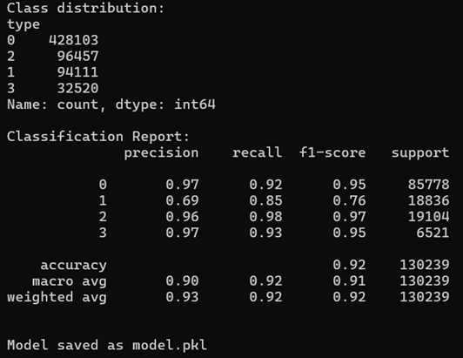
Code/tool implementation
Developed using Python + Scikit-learn (No LINUX dependencies)
Trained classifier to label URLs into 4 behavior types
Exported as REST API and GUI CLI app
Lightweight enough for real-time detection

Slide 18
Feature engineering insights
Extracted 30+ features from URLs, e.g.:
🔗 Length, . count, special characters
🧠 Entropy of domain
🌐 Use of suspicious keywords (e.g., “login”, “update”)
Recursive Feature Elimination (RFE) used to select top features
Top 5 impactful features shown to have >80% predictive contribution

Slide 19
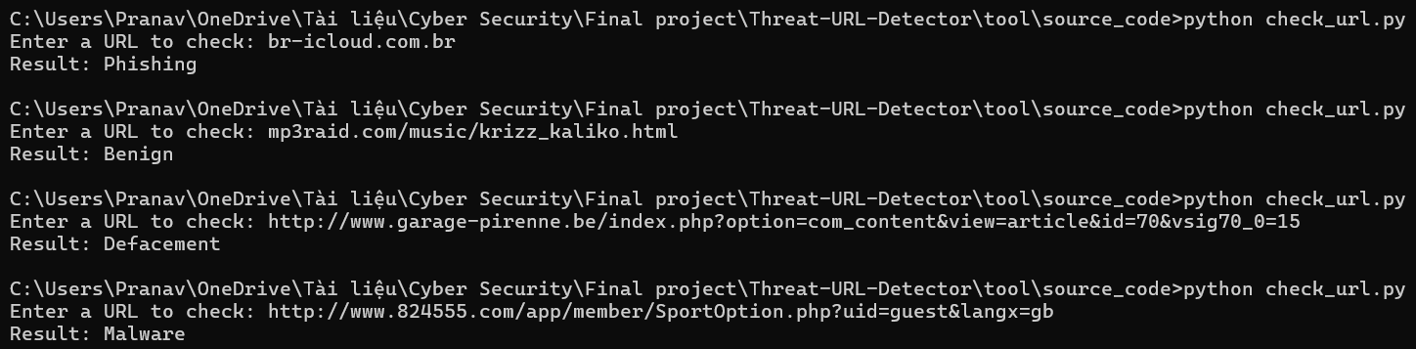
Code/tool demonstration
Input: train_model.py (Generates report)
Input: User enters or pastes a URL
Output: Classification result with probability scores
Optional logging and alert system

Slide 20
Model comparison & justification
Tried multiple models: Random Forest, XGBoost, and Logistic Regression
Random Forest chosen for:
High accuracy (~96%)
Low training time
Interpretability (feature importance)
XGBoost gave slightly better precision on phishing class but was slower
Result & Observations:
Accuracy: ~96.4% with Random Forest
Confusion matrix shows strong true positive rates
XGBoost slightly better on phishing detection but heavier

Slide 21
Future enhancements
Visual Spoof Detection
Compare page screenshots to detect fake brand logos.
User Feedback Learning
Improve accuracy using reinforcement from user input.
Browser Extension Integration
Detect phishing attempts in real-time while browsing.
Threat Intelligence APIs
Enrich URL analysis with data from OpenPhish, VirusTotal, etc.

Slide 22
Thank you
Project: AI in Phishing & URL Behavior Detection
GitHub: https://github.com/prannaw/Threat-URL-Analyzer
YouTube demo: https://youtu.be/SzvPzcSCwio

