Slide 1
AI in social Engineering and Phishing Campaigns
Behavior-based url detection tool
Presented by: Pranav, Atul & Zaid
Internship: Digisuraksha cybersecurity internship 2025

Slide 2
What is social engineering?
Definition: A manipulation technique that exploits human error to gain private information, access, or valuables.
Types:
Phishing – fake emails/websites
Baiting – luring with free offers/media
Pretexting – posing as authority (e.g., IT support)
Tailgating – physically following someone into restricted areas
Goal: Trick users into making security mistakes.

Slide 3
What is phishing?
A type of social engineering attack that tricks users into revealing sensitive data (e.g., passwords, bank details).
Delivery methods:
Emails (most common)
Fake websites
Text messages (smishing)
Phone calls (vishing)
Example: "Your account has been locked. Click here to verify.”

Slide 4
How ai is used in cybersecurity
Anomaly detection: Detects behavior that deviates from the norm.
Spam/phishing filters: ML algorithms flag suspicious emails.
Threat intelligence: AI scans forums/dark web for leaked data.
Automation: Speeds up incident response with AI bots.

Slide 5
How ai is misused by attackers
Natural Language Generation (NLG):
AI writes personalized, grammatically correct phishing emails.
Voice cloning:
Mimics real people (e.g., CEOs) using deep learning.
Automated target profiling:
Scrapes public data from social media to craft tailored attacks.
Chatbots:
Fake customer support bots lure victims into giving credentials.

Slide 6
Rise of ai-driven phishing attacks
Growth: Over 500 million phishing attacks in 2023.
AI accelerates phishing:
Faster, cheaper, more personalized.
Harder to detect because emails appear more “human”.
Low barrier: Attackers use AI without deep technical skills.

Slide 7
Limitations of traditional security
Keyword filters fail when AI-generated content avoids spam triggers.
Static blacklists can’t keep up with fast-changing domains.
User training is often forgotten or ignored.
Legacy antivirus tools lack behavioral analysis features.

Slide 8
Consequences of ai-enhanced phishing
Financial loss: $10.3 billion in phishing losses (FBI IC3, 2022)
Reputation damage: Customer trust collapses after data breaches.
Data theft: Access to corporate systems and IP leaks.
Nation-state risk: Attacks on government and infrastructure.

Slide 9
Using ai to counter phishing
Email anomaly detection:
Scans sender behavior, writing style, timing patterns.
Phishing simulators:
AI generates fake attacks for training purposes.
Neural networks:
Classify emails and websites based on visual or structural features.

Slide 10
Phishing url and domain analysis with ai
Key indicators AI analyses:
Misspelled domains (e.g., "go0gle.com")
HTTPS usage and certificate info
Number of redirects or hidden links
Techniques:
Logistic regression, Random Forest, or deep learning (CNNs) for URL classification
Data Sources:
PhishTank, Kaggle datasets

Slide 11
Awareness through ai-based tools
AI-enabled browsers/extensions:
Warn users in real time about malicious links
AI chatbots:
Train users by simulating social engineering conversations
Interactive phishing quizzes:
Real-time feedback on user decisions powered by AI

Slide 12
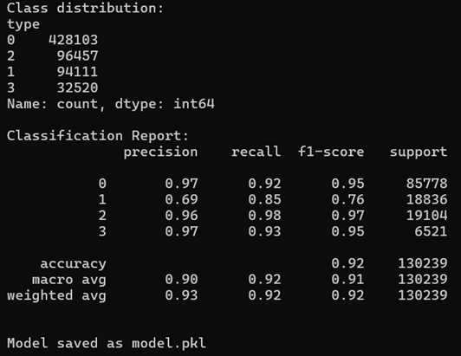
Code/tool implementation
Developed using Python + Scikit-learn (No LINUX dependencies)
Trained classifier to label URLs into 4 behavior types
Exported as REST API and GUI CLI app
Lightweight enough for real-time detection

Slide 13
Feature engineering insights
Extracted 30+ features from URLs, e.g.:
🔗 Length, . count, special characters
🧠 Entropy of domain
🌐 Use of suspicious keywords (e.g., “login”, “update”)
Recursive Feature Elimination (RFE) used to select top features
Top 5 impactful features shown to have >80% predictive contribution

Slide 14
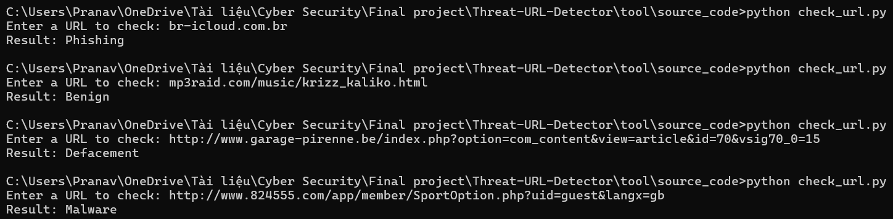
Code/tool demonstration
Input: train_model.py (Generates report)
Input: User enters or pastes a URL
Output: Classification result with probability scores
Optional logging and alert system

Slide 15
Model comparison & justification
Tried multiple models: Random Forest, XGBoost, and Logistic Regression
Random Forest chosen for:
High accuracy (~96%)
Low training time
Interpretability (feature importance)
XGBoost gave slightly better precision on phishing class but was slower
Result & Observations:
Accuracy: ~96.4% with Random Forest
Confusion matrix shows strong true positive rates
XGBoost slightly better on phishing detection but heavier

Slide 16
Deepfake voice phishing attack
Case: UK energy firm tricked into sending €220,000.
How: Voice-cloning software mimicked CEO’s voice.
Impact: Money transferred to attacker’s account in Hungary.
Insight: Audio AI makes vishing more believable and dangerous.

Slide 17
IBM-x force simulation
AI-generated phishing emails tested on 1,000 employees.
Findings:
60% more effective than human-written emails.
People clicked faster when email content was personalized.
Lesson: AI can weaponize personalization at scale.

Slide 18
Google safe browsing (ai-based url protection)
Scans 100B+ URLs daily for malware and phishing.
Uses ML models to detect malicious link behavior.
Flags phishing websites in real-time in Chrome & Android.
Protects over 4 billion devices.

Slide 19
Strengthening ai defences
Federated learning: Train models without exposing user data.
Explainable AI (XAI): Clarifies why a URL or email was flagged.
Behavioral AI: Predicts suspicious user/device actions.
Hybrid models: Combine rule-based and ML models for accuracy.

Slide 20
Broader user of ai for user protection
AI assistants: Voice-enabled alerts about phishing risks.
Personal security dashboards: AI insights on risky behaviors.
Community-sourced learning: AI learns from attack patterns shared across systems.
Dynamic phishing simulations: AI evolves with attacker strategies.

Slide 21
Thank you
Project: AI in Phishing & URL Behavior Detection
GitHub: http://github.com/prannaww

