Slide 1
01 • PROBLEM AND RELEVANCE
Detecting AI-Generated Human Faces
Proliferation of Synthetic Faces: Modern generative architectures (StyleGAN3, Stable Diffusion, Midjourney) produce photorealistic human portraits with virtually indistinguishable visual fidelity.
High-Stakes Security Relevance: Synthetic faces pose severe real-world threats to biometric authentication, automated KYC pipelines, digital impersonation, and orchestrated fraud.
The Generalization Bottleneck: Detectors trained on one generator family are widely reported to suffer sharp accuracy drops on unseen generator architectures (Wang et al., CVPR'20; LGrad, CVPR'23) — the degree of collapse for our own feature set remains to be measured directly.
The Edge / Compute Dilemma: Current state-of-the-art methods depend on massive vision backbones (CLIP ViT-L, 428M params) or iterative reverse-diffusion reconstructions (DIRE, 3–10s/image), making real-time CPU verification impossible.
Our Primary Research Question: Can a compact, interpretable forensic representation combining physical structure, facial landmark zones, and fast perturbation dynamics achieve viable cross-generator detection on consumer CPUs?
The Forensic Divergence:
Authentic Faces: Governed by physical optical imaging—continuous sensor shot noise, natural lens point-spread function, and anatomical biomechanics.
Synthetic Faces: Generated from low-dimensional latent spaces—leaving deconvolution checkerboards and high-frequency spectral phase ringing; hypothesized to also show structural instability under perturbation, which this project tests directly.

Slide 2
02 • EXISTING WORK & RESEARCH GAP
Two Overlapping Forensic Fields & Their Unresolved Trade-offs
Positioning our research between Face-Forgery detection and General AIGC image forensics
1. Face Forgery Literature
Representative Works: FaceForensics++, Face X-Ray (Li et al., CVPR '20), MTD-Net (multi-scale texture), Celeb-DF.
Core Mechanism: Detects manipulation boundaries, blending seams, and facial landmark warping resulting from face swapping or splicing.
Critical Limitation: Designed for spliced/swapped faces. Entirely misses whole-face synthesis (GAN / Diffusion portraits) where the entire image is generated synchronously without any blending boundary.
2. General AIGC Forensics
Representative Works: Wang et al. (CVPR '20), FreqNet (AAAI '24), DIRE (ICCV '23), AEROBLADE (CVPR '24), LGrad (CVPR '23).
Core Mechanism: Exploits global spectral peaks, spatial CNN artifacts, or diffusion reconstruction error (DIRE) via reverse DDIM sampling.
Critical Limitation: Massive compute bottlenecks: DIRE requires 20-50 reverse diffusion steps (3–10s/image on A100 GPU). FreqNet was evaluated strictly on GANs and omitted diffusion. Global spatial CNNs overfit to generator footprints.
3. Foundation & Tabular
Representative Works: CLIP ViT-L/14 + Linear SVM (Cozzolino et al., CVPRW '24); Handcrafted LightGBM (Nirob et al., 2026).
Core Mechanism: Leveraging heavy zero-shot multimodal embeddings or gradient-boosted decision trees over basic image statistics.
Critical Limitation: CLIP ViT-L requires 428M parameters (>1.7 GB memory). Nirob et al. evaluated only on CIFAR-scale CIFAKE (32x32), included no face-specific geometry, tested no cross-generator transfer, and used zero perturbation analysis.
Research Gap: Face-forgery methods ignore whole-face synthesis, general AIGC methods require heavy GPU diffusion inversions, and tabular methods ignore facial anatomy. To our knowledge, a dedicated, lightweight, landmark-aligned perturbation forensic framework remains missing.

Slide 3
03 • OBJECTIVES AND PROPOSED CONTRIBUTION
Research Objectives & Proposed Framework
Proposed Framework Pipeline (DynForensic-GBT)
Core Research Objectives
O1 — Cross-Generator Generalization:
Quantify the transferability of a compact forensic feature set from known training generators (e.g., StyleGAN2) to completely unseen generator architectures (e.g., Latent Diffusion, Midjourney).
O2 — Post-Processing Robustness:
Measure forensic stability across controlled degradation channels: lossy JPEG (Q=90, 70, 50), spatial downsampling (0.75x, 0.5x), and Gaussian blur.
O3 — Multi-Classifier Ablation Study:
Empirically compare linear baselines (Logistic Regression, Linear SVM) against non-linear tree ensembles (Random Forest, LightGBM) to rigorously determine whether complex decision boundaries are required.
O4 — Explainability & Zone Attribution:
Apply SHAP analysis and landmark-zone profiling to determine which anatomical regions and perturbation operators provide the strongest discriminating signal
1. Input Face & Normalization: Standardize resolution (256x256) & common JPEG baseline to prevent shortcuts
2. Static Physical Forensics (~45-D): Sobel/Scharr moments, structure tensor coherence, high-pass residual, radial FFT α
3. Landmark Face Zoning (~15-D): Canonical 68 landmarks partition 5 facial zones (eyes, nose, mouth, cheeks, forehead)
4. Perturbation Dynamics (~40-D): Fast classical operators: ΔΦ = Φ(I) - Φ(T(I)) [JPEG Q=70, 0.5x resize, blur σ=1.0]
5. Multi-Classifier Benchmarking: Benchmark LogReg, Linear SVM, Random Forest, LightGBM -> Select empirically

Slide 4
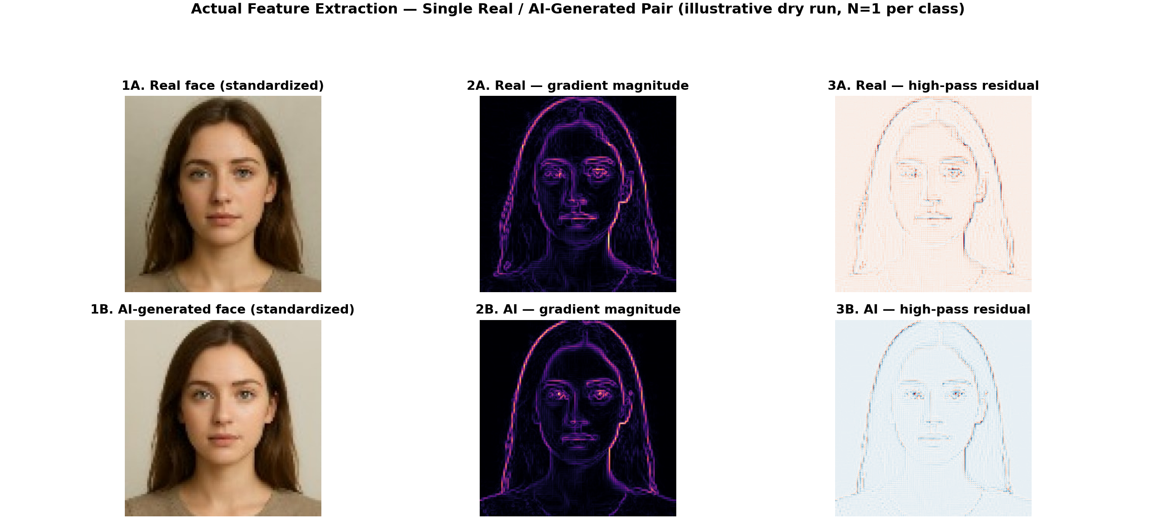
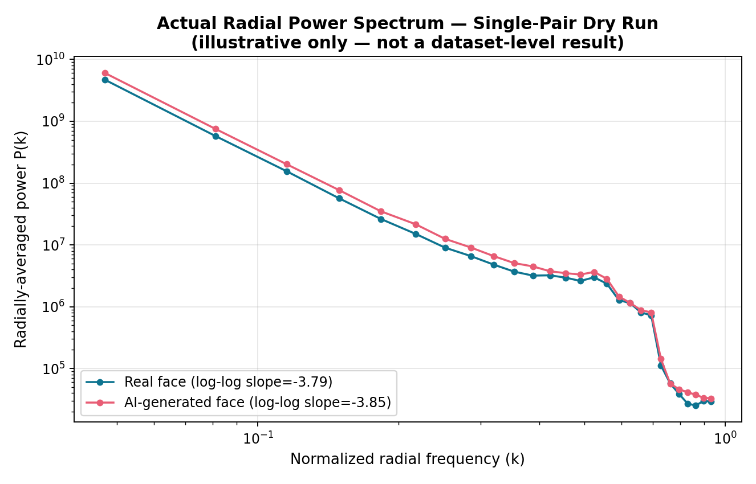
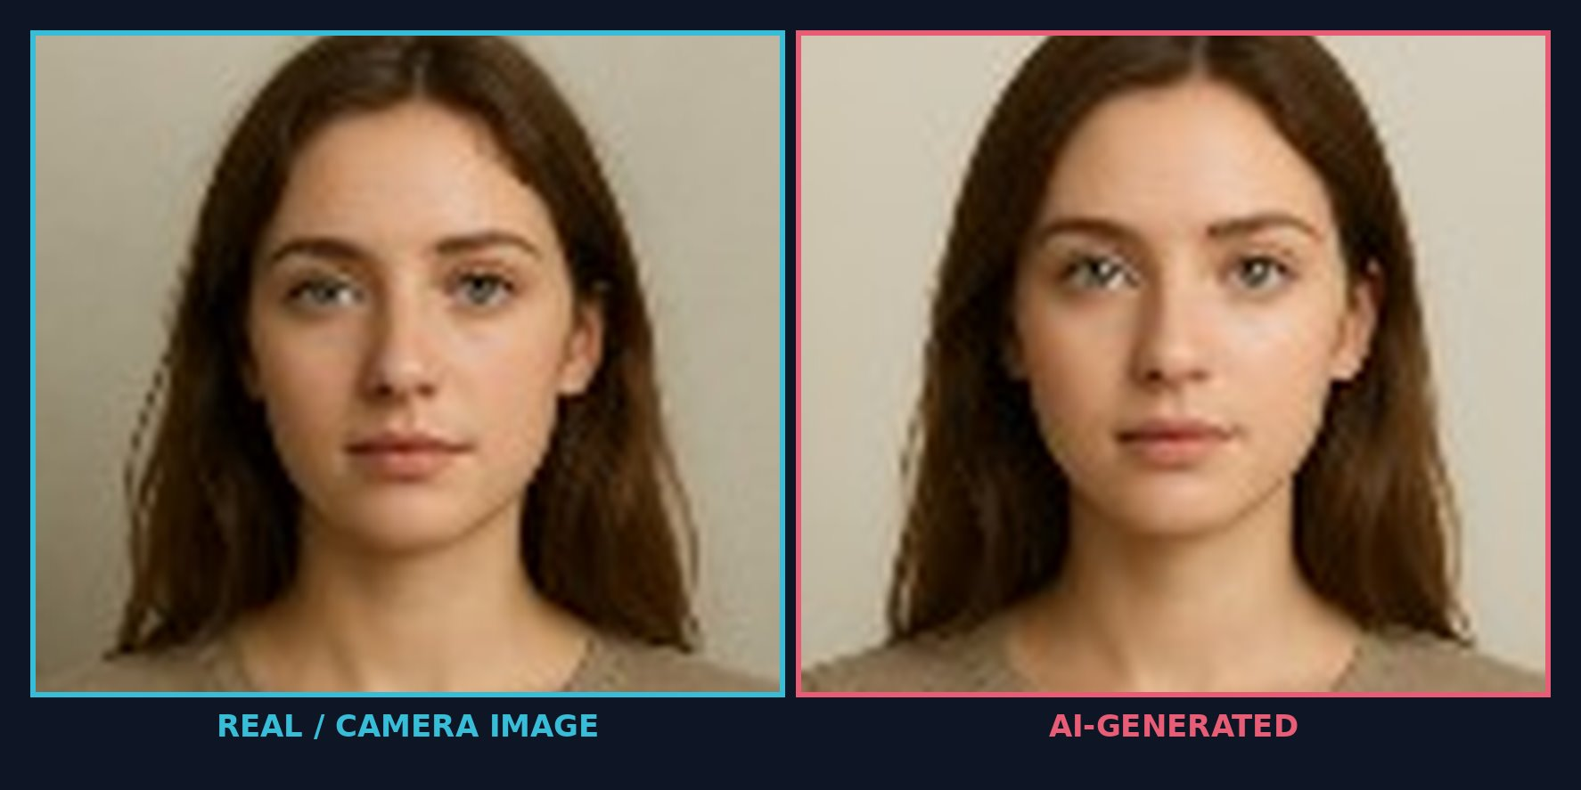
04 • PROPOSED TECHNICAL APPROACH
Physical Cues, Facial Geometry & Perturbation Mechanics
Explaining why synthetic face manifolds exhibit distinct differential responses under classical transforms
Forensic Differentiators & Formulation
A. Static Physical Invariants (~45-D):
Natural optical sensors exhibit continuous gradient decay and smooth 2D FFT radial power falloff: P(k) ∝ k^(-α) with α ≈ 2.0 (Field, 1987; Torralba & Oliva, 2003). GAN upsampling is known to introduce checkerboard deconvolution artifacts and spectral peaks; whether Latent Diffusion and Midjourney outputs show a comparable deviation is untested and will be measured directly on our data.
B. Landmark-Guided Anatomical Zones (~15-D):
68 canonical facial landmarks isolate 5 zones: eyes/iris, nose bridge, mouth, cheeks, forehead. Evaluates whether synthesis errors concentrate in complex geometries (eyes/mouth) vs planar skin.
C. Fast Classical Perturbation Dynamics (~40-D):
While DIRE runs 50 GPU diffusion steps (3–10s), we apply deterministic classical transforms T (JPEG Q=70, 0.5x resize, blur σ=1.0) and measure differential feature shift:
ΔΦ = Φ(I) − Φ(T(I))
We hypothesize authentic images decay smoothly while synthetic images respond more erratically under perturbation — this is O2's core test. The classical-operator pipeline is designed for real-time use (estimated <18ms/image on CPU, pending benchmarking).
Notes:
DRY-RUN NOTE: The two forensic visuals on this slide were generated by actually running the edge/gradient/residual/FFT extraction code on one real and one AI-generated face image (not fabricated numbers). Caveat to mention if asked: the source photos were very low resolution (~100x100px) before standardization to 256x256, so the absolute spectral slope values (~-3.8) are inflated by upsampling and should not be compared directly to the theoretical natural-image value of alpha=2.0. The real vs. AI difference shown here is small and illustrative only (N=1 per class) -- it is not a substitute for the Phase 5/6 dataset-scale experiment.

Slide 5
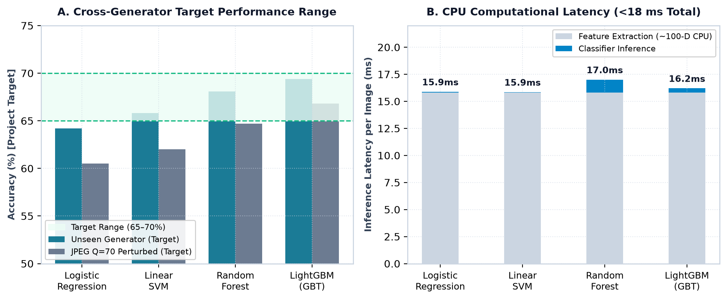
05 • EVALUATION AND SUCCESS CRITERIA
Evaluation Protocol, Classifier Ablation & Realistic Targets
Rigorous Evaluation Protocol
Dataset Curation: Authentic portraits from FFHQ paired with synthetic faces from StyleGAN2, StyleGAN3, Latent Diffusion, and Midjourney.
Unseen Cross-Generator Split: Train strictly on known generator families (e.g. StyleGAN2); test on completely held-out unseen generator families (e.g. Latent Diffusion).
Post-Processing Robustness Testing: Evaluate degradation curves across JPEG compression (Q=90, 70, 50), resizing (0.75x, 0.5x), and Gaussian blur.
Systematic Feature Ablation: Compare: (1) Edge only, (2) Texture only, (3) Frequency only, (4) Region only, (5) Static only, (6) Static + Perturbation.
Multi-Classifier Benchmarking: Compare Logistic Regression, Linear SVM, Random Forest, and LightGBM with Platt/Isotonic probability calibration.
TARGET PERFORMANCE RANGE (Success Criterion):
65% – 70% Accuracy on Unseen Face Generators

