Slide 1

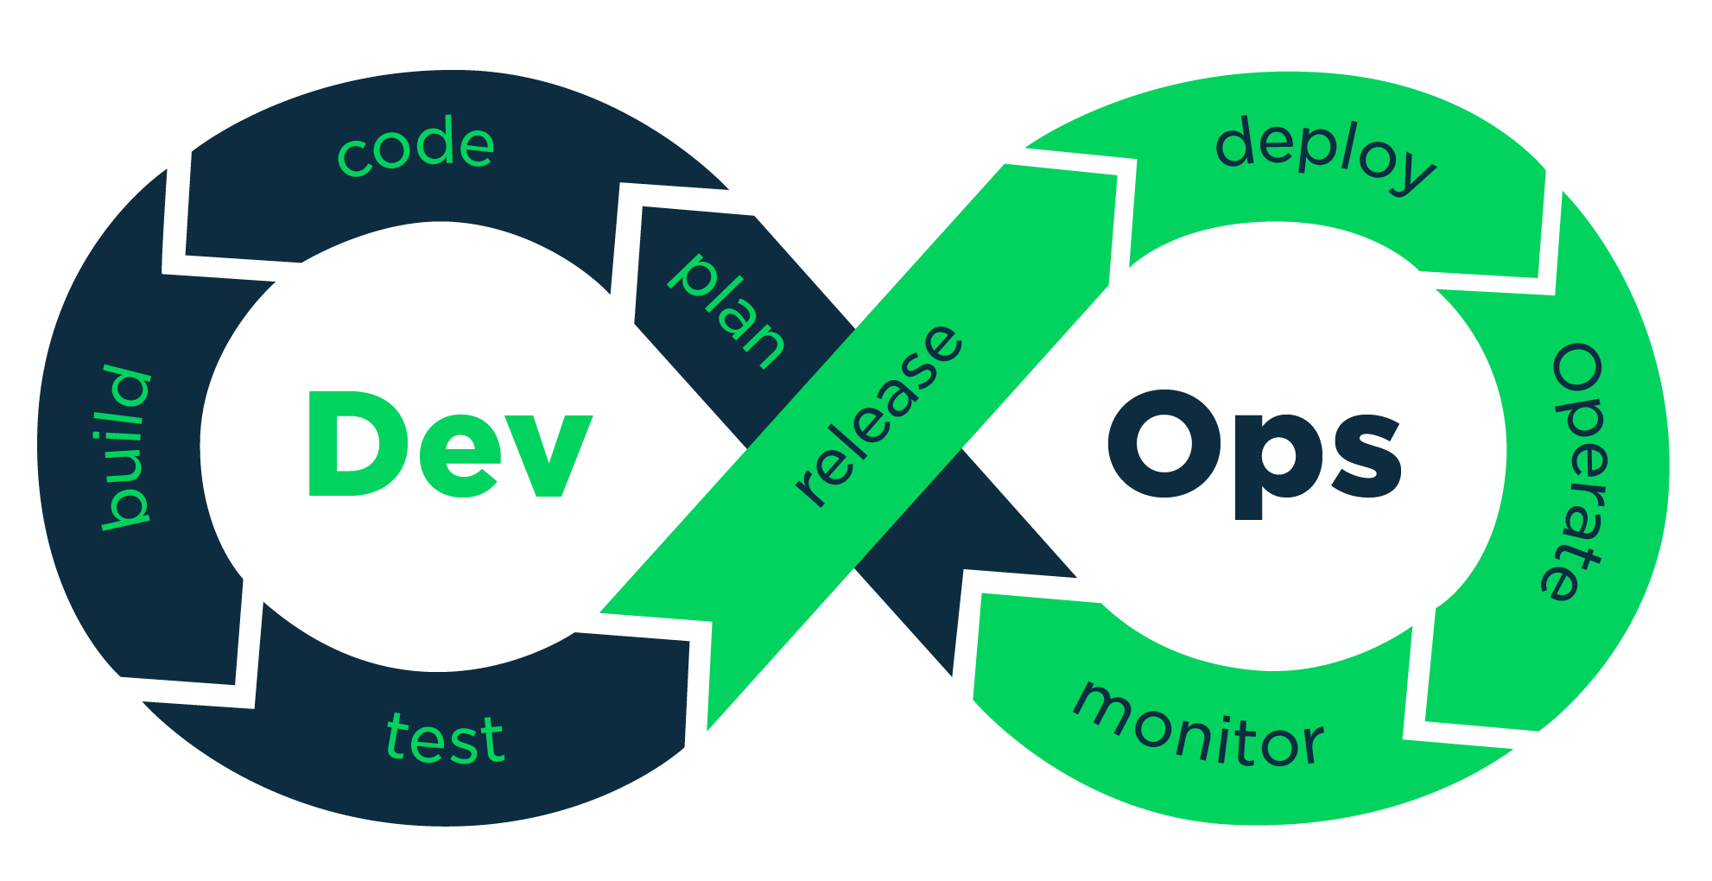
Welcome !

Slide 2
Course : DevOps with cloud computing (AWS)
Introduction to Git
Date – 23rd Jan 2024
Trainer – Niranjan Dive

Slide 3
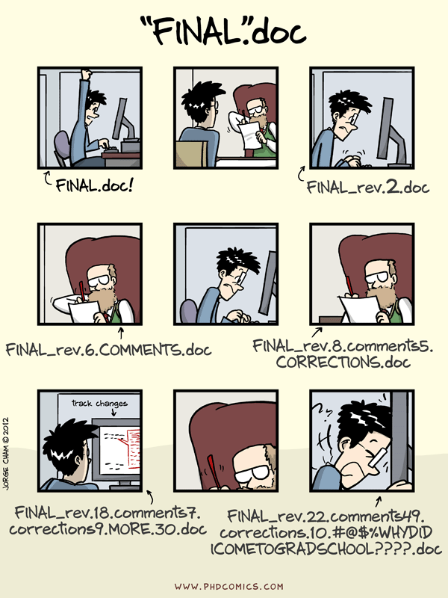
Why Git?

Slide 4
Version Control
Why track/manage different versions of code?
Backup: Undo or refer to old work.
Collaborate: Work in parallel with teammates.
Having a streamlined process of software development.

Slide 5
Version Control Systems (VCSs)
Help you track/manage/distribute revisions
Standard in modern development
Examples:
Revision Control System (RCS)
Concurrent Versions System (CVS)
Subversion (SVN)
Git

Slide 6
Version Control Hosting Services
Enable sharing version control repos
Internet/Web based
Examples:
SourceForge
Bitbucket
GitLab
GitHub

Slide 7
What is Git?
Git is a Version Control System or VCS. VCS is basically software designed to record changes within one or more files over time. It allows us to undo or to cancel all made or pending changes within one or more files.

Slide 8


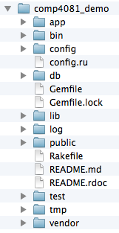
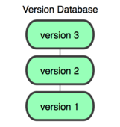
Git and GitHub
You
GitHub
Working Dir
Local
Repos
Remote
Repos

Slide 9
GitHub
DEVELOPER 1
Remote
Repos
DEVELOPER 2
DEVELOPER 3

Slide 10
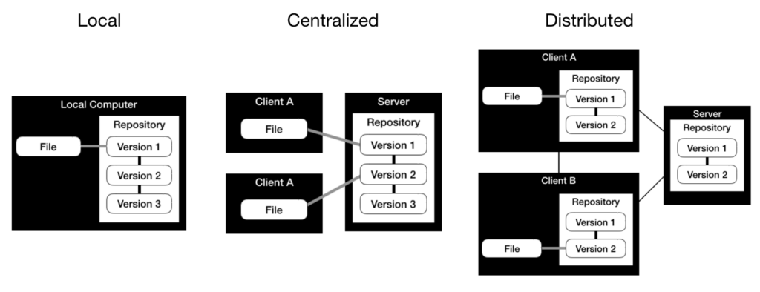
Types of VCS

Slide 11
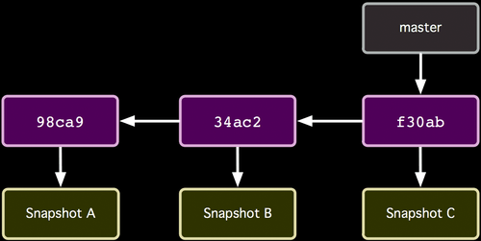
Repo Organization
Commits (from oldest to newest; hashes as commit IDs)
http://git-scm.com/book/

Slide 12
Repo Organization
Snapshot of all files at each commit
http://git-scm.com/book/

Slide 13
Repo Organization
Branch (last commit)
http://git-scm.com/book/

Slide 14
Local repos also have...
HEAD
Current Version in Working Dir
http://git-scm.com/book/

Slide 15
Local Repo Operations
You
init
add/commit
log
switch/checkout
branch
merge
Working Dir
Local
Repos

Slide 16
How commit works...
Before
HEAD
http://git-scm.com/book/

Slide 17
How commit works...
After
HEAD
http://git-scm.com/book/

Slide 18
Remote Repo Operations
You
GitHub
Working Dir
Local
Repos
Remote
Repos
clone
push
pull
fetch
remote

