Slide 1
Magic Tee (Hybrid Tee) Formation and Analysis
18EC2021 Microwave and Optical Communication| IIIrd Internal Project
Done by
Chrish Zeyeden - URK23EC1036
Pranov Raghavendhra - UTK23EC1001
Shivabalan - URK23EC1055
Joel Jones - URK23EC1017
Notes:
Introduce the project title and the team. One line: we modelled and analysed a magic tee, a four-port waveguide junction, in MATLAB.

Slide 2
Introduction and Objective
What is a Magic Tee?
Objective
Four-port waveguide junction
Combines an E-plane tee and an H-plane tee
Also called a hybrid tee
Model the ideal and non-ideal S-matrix in MATLAB
Verify reciprocity, unitarity and isolation
Visualise the 3D geometry and power distribution
Notes:
A magic tee joins an E-plane tee and an H-plane tee at one point. Our objective is to model it as an S-matrix, check its properties, and visualise it.

Slide 3
Structure and Ports
Port 3
H-arm (Sum)
Port | Name | Role
1 | Collinear arm | Input / output
2 | Collinear arm | Input / output
3 | H-arm | Sum port
4 | E-arm | Difference port
Junction
Port 1
Collinear
Port 2
Collinear
Top view. Port 4 leaves the plane of the page (E-plane stub).
Port 4
E-arm (Difference)
Notes:
Ports 1 and 2 are the collinear arms. Port 3 is the H-arm and gives the sum. Port 4 is the E-arm and gives the difference.

Slide 4
Working Principle and S-Matrix
Excitation | Result
Input at Port 3 | Equal split to Ports 1 and 2, in phase. Port 4 isolated
Input at Port 4 | Equal split to Ports 1 and 2, 180° out of phase. Port 3 isolated
Input at Port 1 | Equal split to Ports 3 and 4
Ports 1 and 2 together | Sum at Port 3, difference at Port 4
S = (1/√2) ×
0 | 0 | 1 | 1
0 | 0 | 1 | −1
1 | 1 | 0 | 0
1 | −1 | 0 | 0
Reciprocal (symmetric)
Lossless (unitary)
Isolated: S12 = S34 = 0
Notes:
Walk through the four cases, then show the ideal S-matrix. Rows and columns are Ports 1 to 4. The matrix is symmetric, unitary, and Ports 1-2 and 3-4 are isolated.

Slide 5
MATLAB Implementation
Define
parameters
Ideal
S-matrix
Non-ideal
S-matrix
Verify
properties
Power
distribution
Plots and
results
WR-90, 10 GHz
Textbook 4×4 matrix
Loss, isolation, mismatch
Symmetry, unitarity, passivity
5 excitation cases
6 figures
Non-ideal effects modelled (assumed values, not measured)
Insertion loss
Finite isolation
Port mismatch
Notes:
The code is one function with local helpers. It builds the ideal matrix, a non-ideal version, checks the properties, computes power for five excitations and plots six figures. The non-ideal values are assumptions, not measurements.

Slide 6
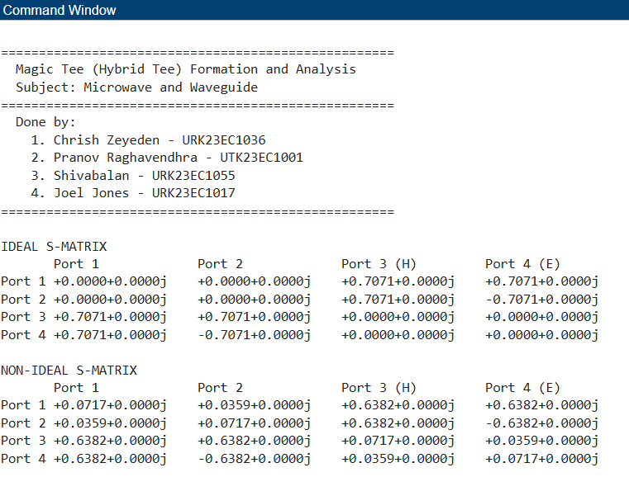
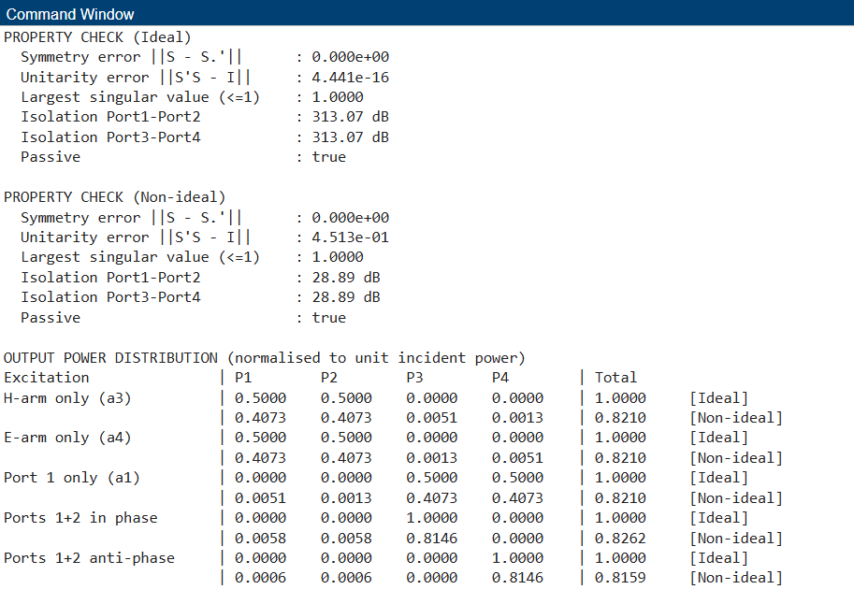
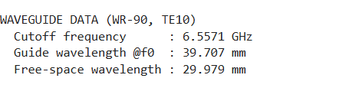
MATLAB Command Window Output
Command Window, part 1
Command Window, part 2
Notes:
Show the console output. Point out: ideal unitarity error is about 1e-16; non-ideal unitarity error is 0.45 because the model has loss; both are passive. Power table: ideal total power is 1, non-ideal is about 0.82.

Slide 7
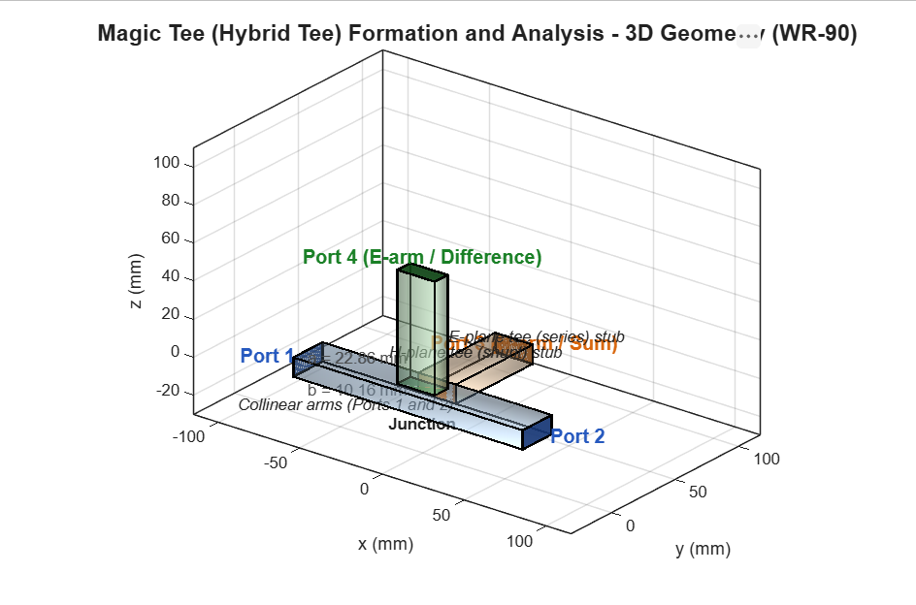
3D Geometry
WR-90 waveguide
a = 22.86 mm, b = 10.16 mm
H-arm (Port 3)
On the narrow wall, in the H-plane
E-arm (Port 4)
On the broad wall, in the E-plane
Notes:
The 3D model uses true WR-90 cross-section. The H-arm attaches to the narrow wall and the E-arm to the broad wall. Arm lengths are only for display.

Slide 8
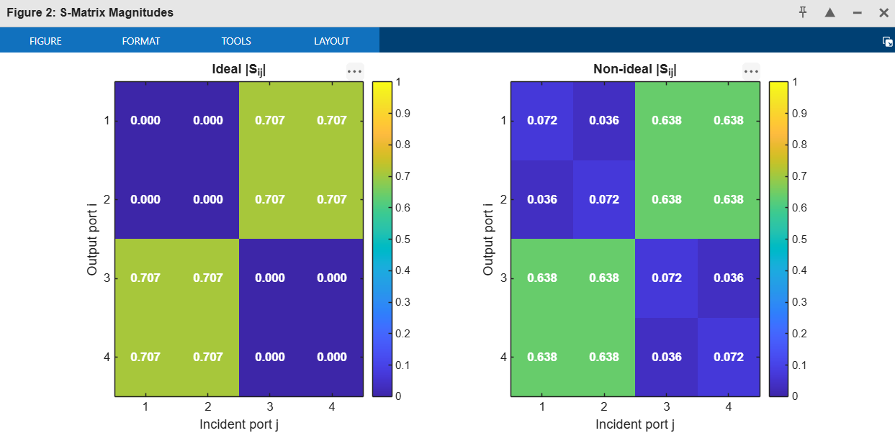
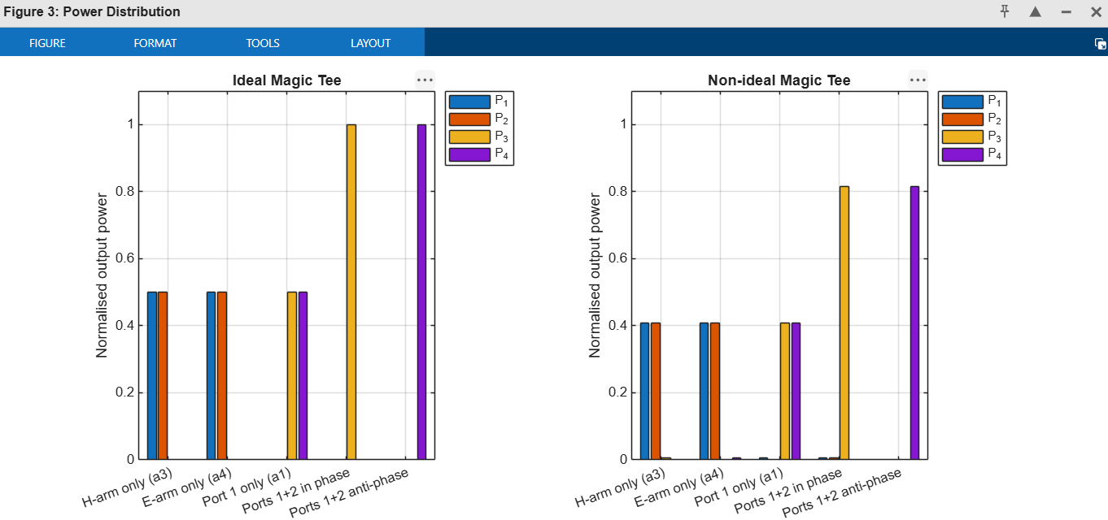
S-Matrix and Power Distribution
Ideal |S| = 0.707 (equal 3 dB split). Non-ideal adds small leakage terms.
In phase gives all power at Port 3. Anti-phase gives all power at Port 4.
Notes:
Left: magnitude heat map of the S-matrix, ideal versus non-ideal. Right: output power for each excitation. Non-ideal outputs are lower because of loss.

Slide 9
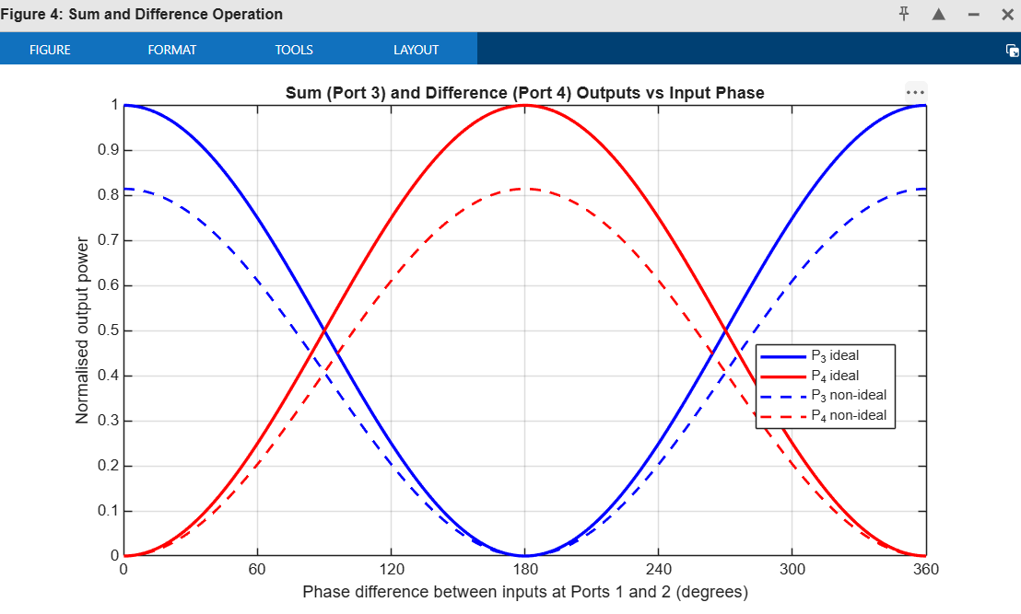
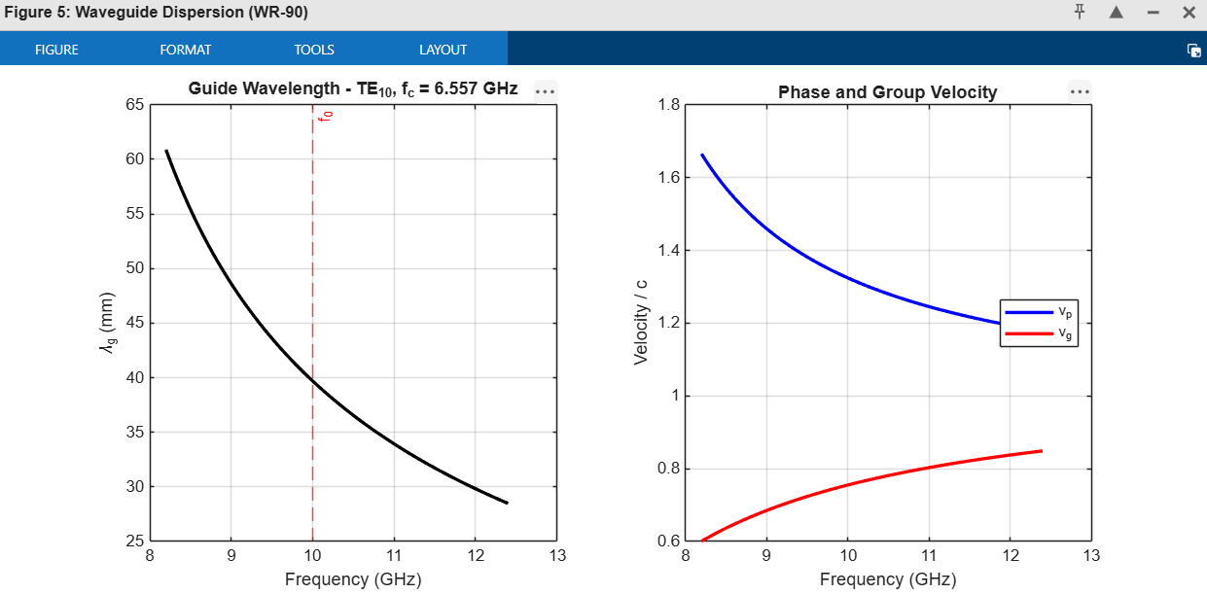
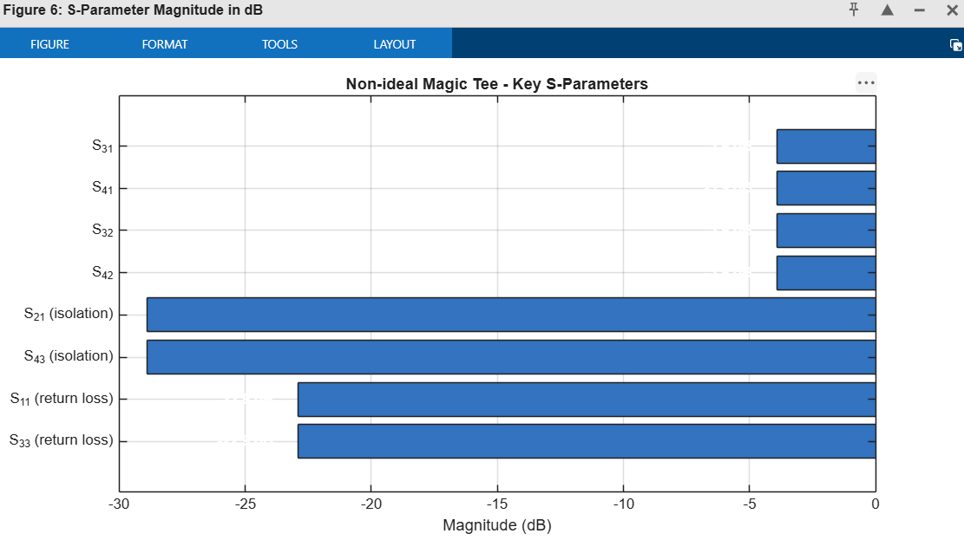
Sum-Difference Behaviour and Waveguide Data
Port 3 peaks at 0° and Port 4 at 180° input phase difference.
Notes:
Left: sweeping the input phase difference swaps power between Port 3 and Port 4. Top right: WR-90 cutoff is 6.557 GHz, guide wavelength at 10 GHz is 39.7 mm. Bottom right: key S-parameters in dB.

Slide 10
Conclusion
Conclusion
Applications
Limitations and Future Work
Ideal S-matrix verified: symmetric and unitary
Sum at Port 3 and difference at Port 4 confirmed
Non-ideal model shows lower output and finite isolation
Power divider and combiner
Balanced mixer
Duplexer
Impedance bridge
Monopulse radar comparator
Non-ideal values are assumed, not measured
S-matrix is circuit-level, not derived from geometry
Next step: validate in HFSS or CST
Notes:
Summarise: the ideal model behaves exactly as theory predicts. State the limitation openly: non-ideal values are assumed and the next step is a field-solver comparison.

