Slide 1
Dashboard Design — Superstore Analysis
Data Analyst Internship | Task 3
Pranav k a
pranoxv@gmail.com

Slide 2
Objective of the Task
Content:
Design an interactive dashboard to help business stakeholders.
Identify key metrics like Sales, Profit, and Discount impact.
Derive insights to improve business decisions.

Slide 3
Dashboard Overview
Content:
Dataset: Sample Superstore (Kaggle)
Tools Used: Tableau Public
KPI Focus:
Total Sales
Total Profit
Profit by Region and Sub-Category
Impact of Discounts on Profit

Slide 4
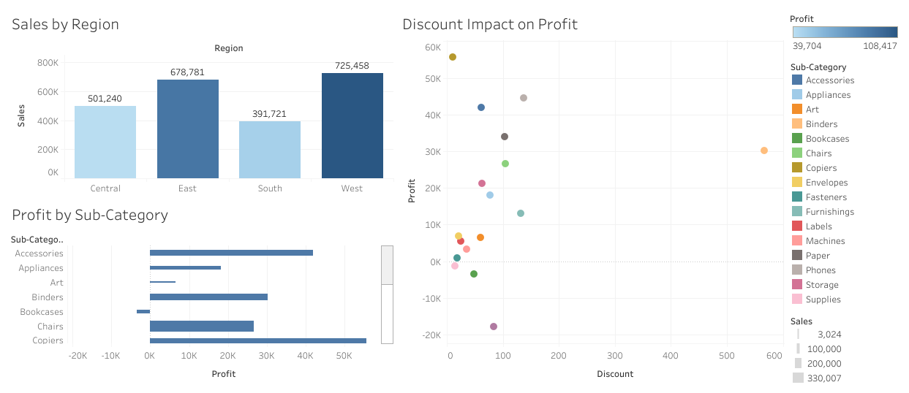
Superstore Business Overview

Slide 5
Chart-wise Insights
Sheet | Insight
Sales & Profit by Region | West and East regions perform best in Sales and Profit.
Discount vs Profit (Scatter) | High discounts negatively impact profit in certain sub-categories.
Profit by Sub-Category | Some sub-categories (like Tables, Bookcases) have low or negative profits.

Slide 6
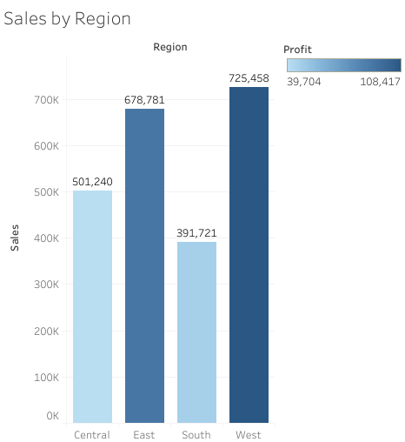

Slide 7
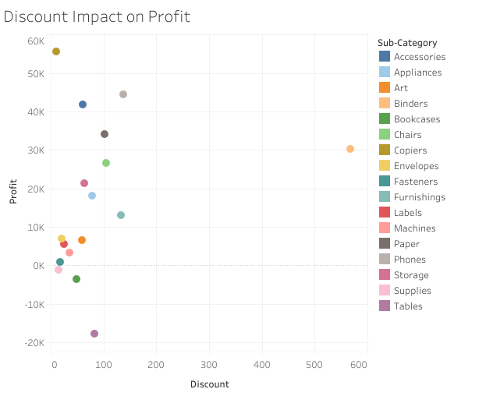

Slide 8
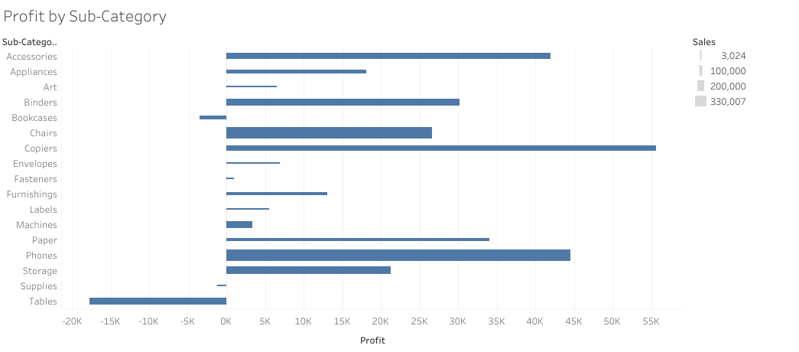

Slide 9
Key Findings
Bullet Points:
✅ West & East regions are most profitable.
✅ High discounts reduce profitability in some products.
✅ Focus required on unprofitable sub-categories like Tables and Bookcases.
✅ Office Supplies has consistent profit with low discount sensitivity.

Slide 10
Conclusion
The dashboard offers clarity on which regions and products perform well.
Helps in making data-driven decisions on discount strategies and product focus.
Enables business managers to optimize profit.

