Slide 1
The SmartChatBot
Pranoy Kovuri

Slide 2
Motivation
U.S. health care spending grew 5.8 percent in 2015, reaching $3.2 trillion or $9,990 per person.
For Mental health alone is a 200 Billion dollar industry, this shows the potential for NLP here
Almost 50% percent of college students self report symptoms of depression and anxiety, and there are long wait times for counselling service in universities.
NLP could help here create anti-depression chat bots like Woebot

Slide 3
Also there are other reasons:
Wouldn’t it be wonderful when someone can answer any question you have on the essay you are reading or wiki article you want to understand?
It would be similar to our friend who has mastered a topic and tell us answers for our questions
Imagine the boost is productivity once we will access to expert systems for any given topic.

Slide 4
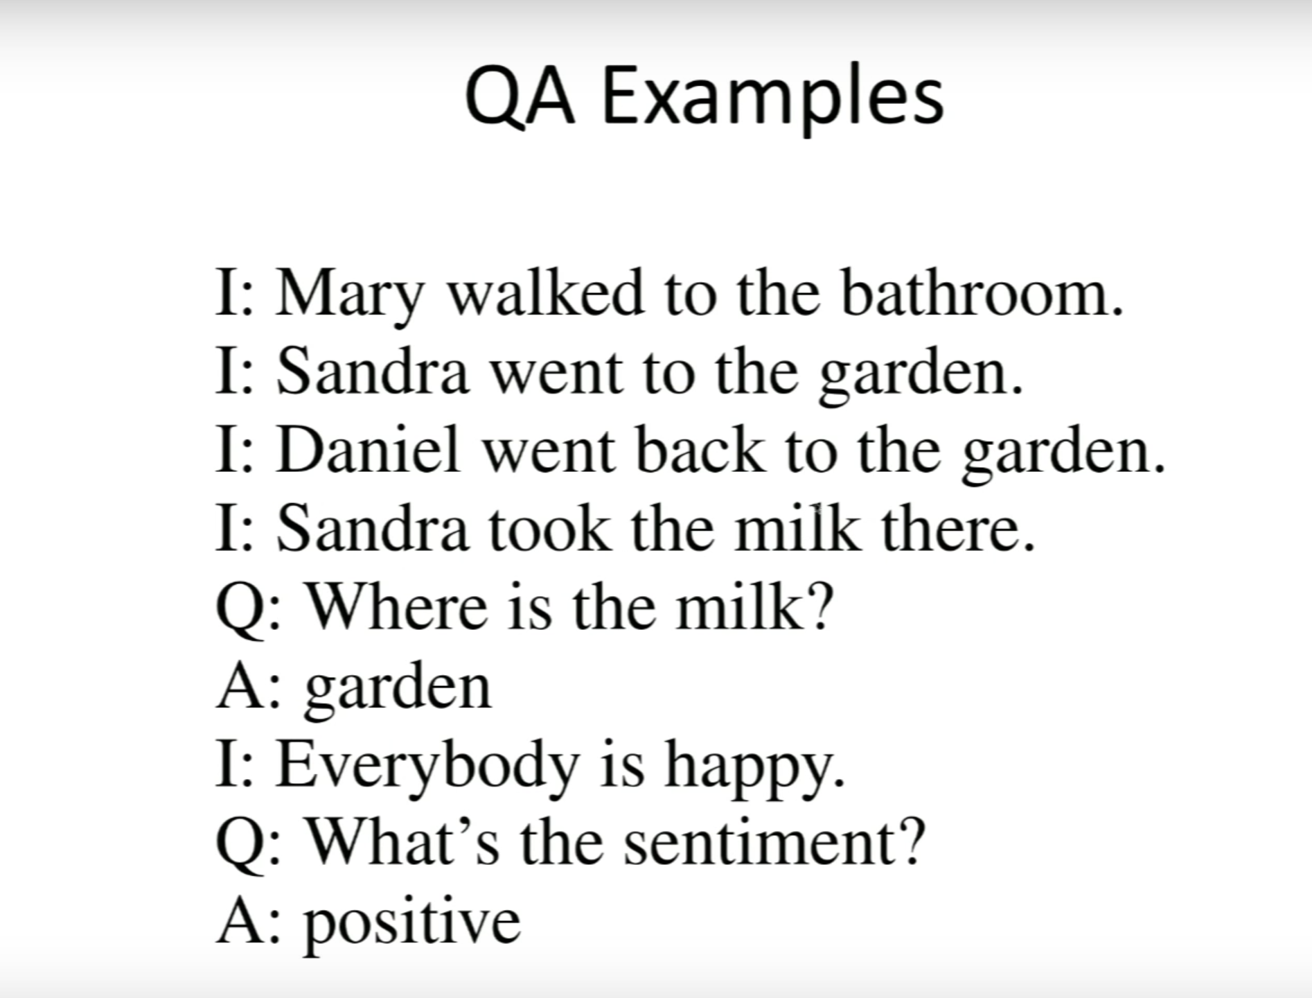
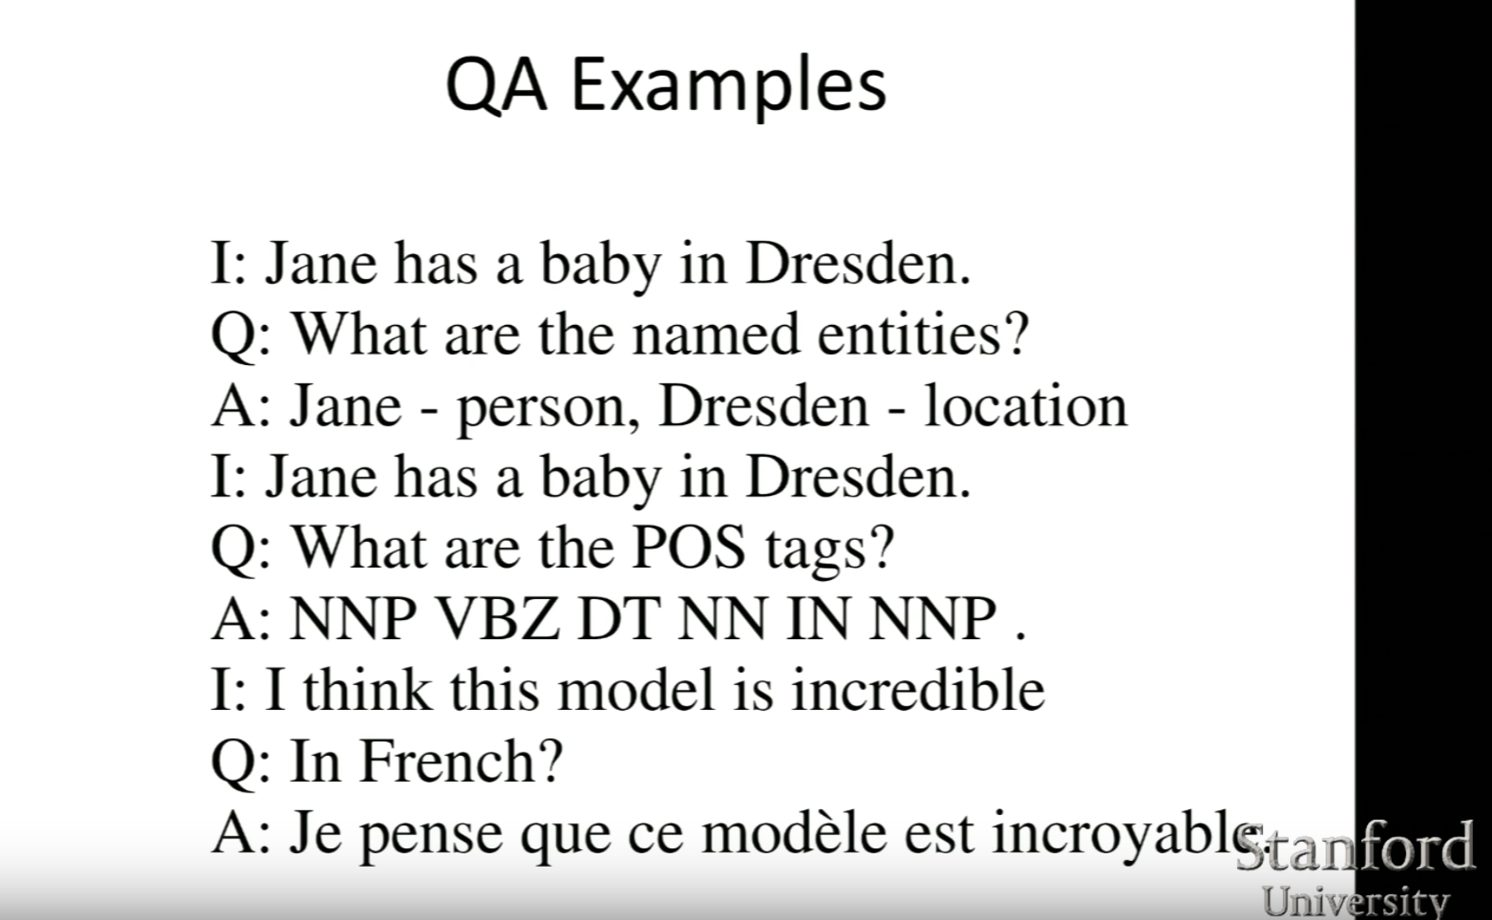
Example Task on Babi Synthetic Data Set from Facebook
One Supporting Fact

Slide 5
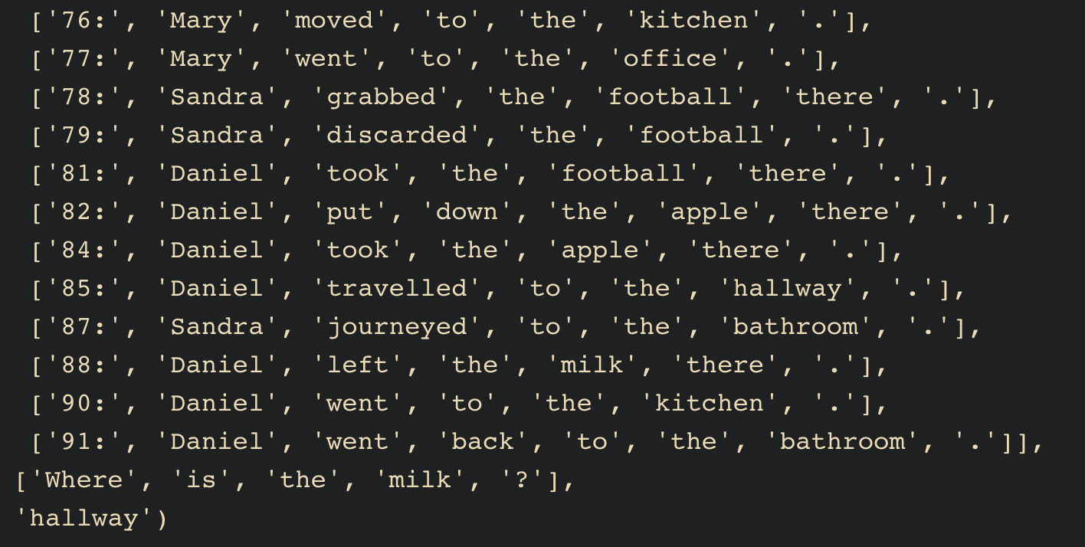
2 and N supporting facts Type Questions

Slide 6
Goal
A joint model for general QA

Slide 7
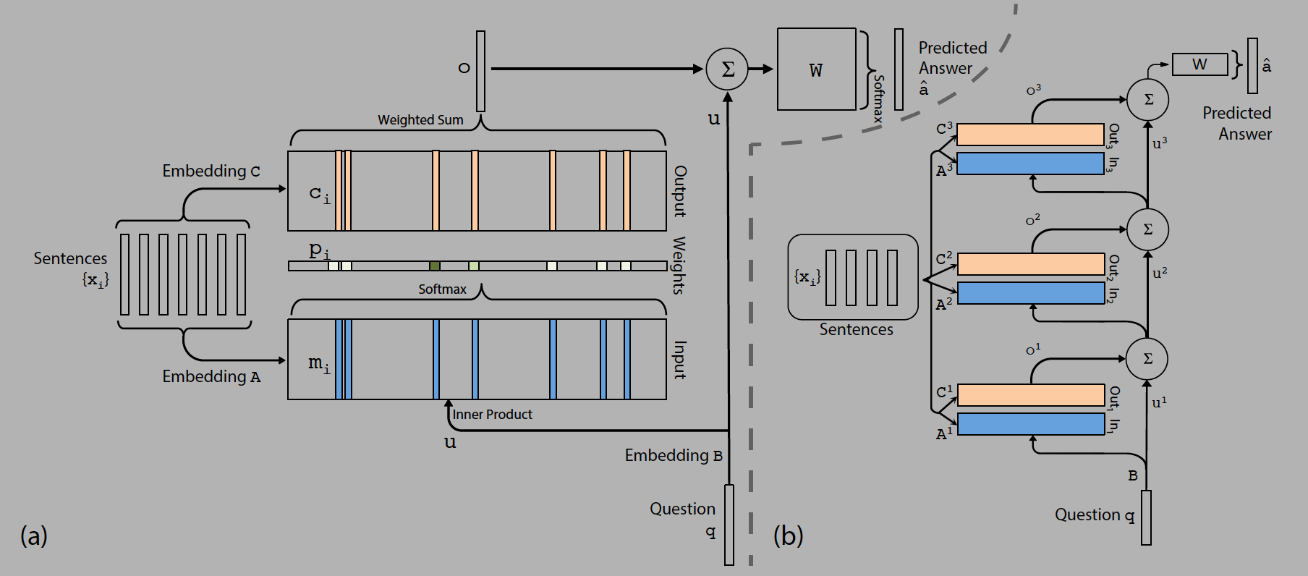
Memory Networks is the state of the Art in Language Tasks, they help in common architecture for many different tasks. Although common models for all tasks is still a struggle.
Motivation from the hippocampus function in the brain. It is able to retrieve temporal state that are triggered by some response like a sound or a sight. This can be related to database queries

Slide 8
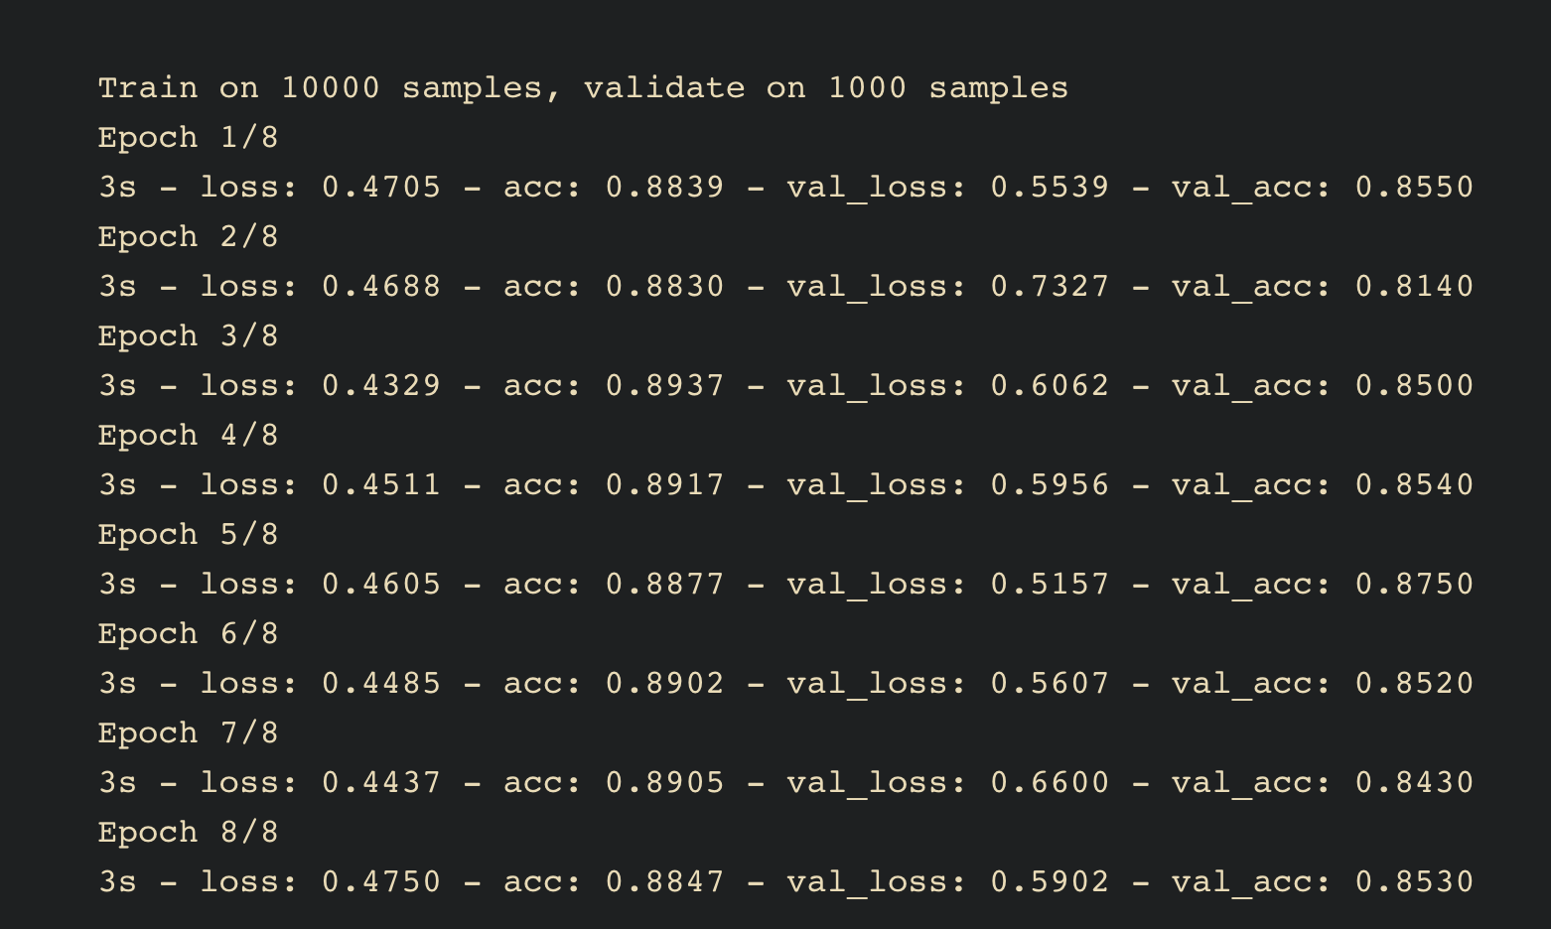
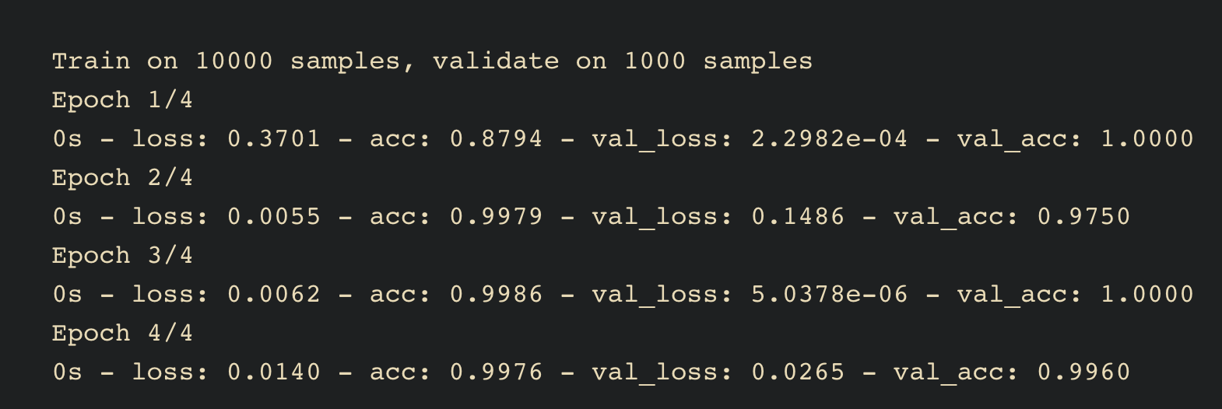
Results
Two Supporting Fact 85.3% Accuracy
Single Supporting Fact 99.6% Accuracy

Slide 9
Other more advanced methods
End to End Memory Networks
Dynamic Memory Networks, Currently I am working on this model.
Neural Turing Machine
Differentiable Neural Computer
Recurrent Entity Networks
Dynamic Coattention Networks

Slide 10
Terminology
Git
Dynamic Memory Networks
LSTMs
Deep Learning
NLP
Attention Networks

Slide 11
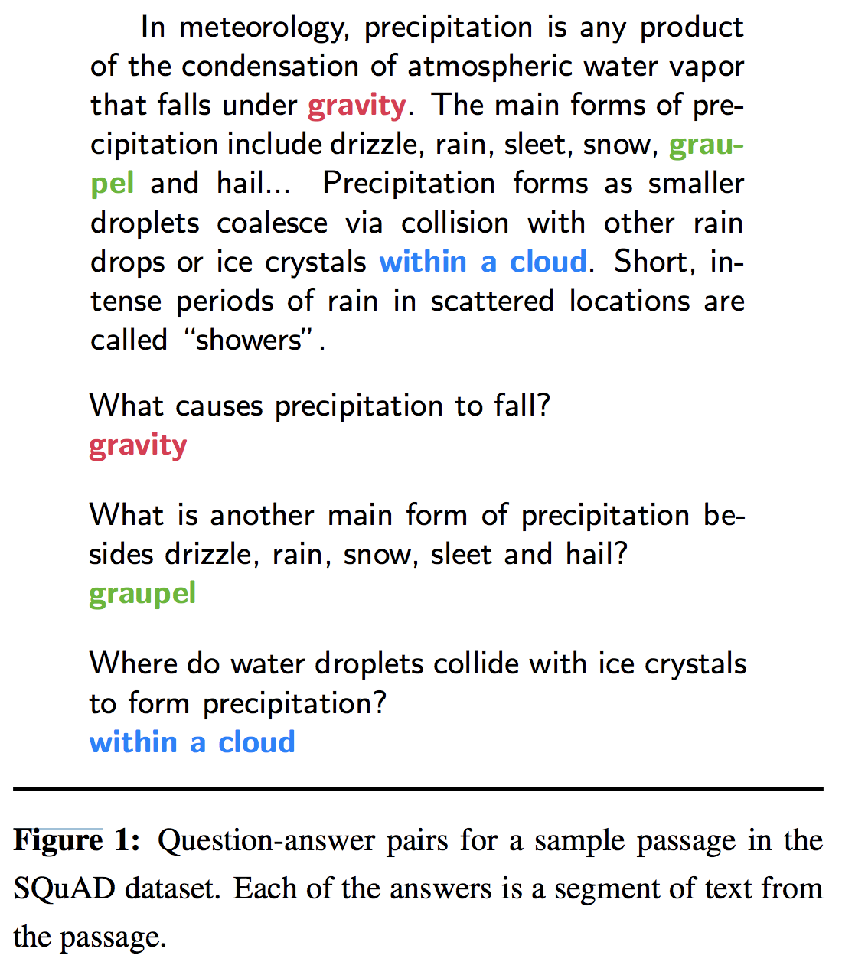
Currently Working on Stanford SQUAD DataSet

Slide 12
Online Implementation in JavaScript
http://yerevann.com/dmn-ui/#/.
https://ethancaballero.pythonanywhere.com/

Slide 13
In the words of Professor Andrew ng. Speech recognition revolutionized 6 years back with end to end models and thus leading to siri alexa. Computer vision flipped around 4 years back with ImageNet, alexNet and Yanlecunn LeNet. NLP is revolutionizing now and has great capability for creating flourishing applications both for health care and other industries.
We as Machine Learning Engineering NOW! Lets be a part of this!

Slide 14
Questions?

