Slide 1


Lets GIT it
~~Pranoy Patra

Slide 2


Why GIT?
We are Unorganised in nature. Isn’t it?
Now thinks about Developers 😢
They have to handle a large number of files
and they have to update it continuously☹️
It is very difficult for them to remember the changes 😢

Slide 3


Hey !
I Am Here To Help You
Git : Git is a distributed version control system
Now we can use Git to solve our problem to organize files properly
Lets see the Benefits

Slide 4
Benefits of Git
Easily recover files
Who introduced issue and when
Rollback to previously working state

Slide 5
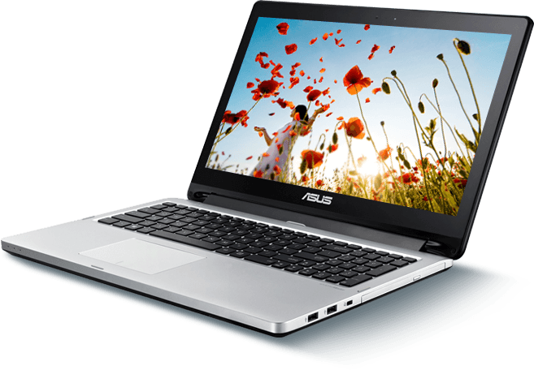

History of VCS( Version Control System )
Local VCS
Uses DB to keep track of updates
Can track files & Rollback
If you loose your hard disk you loose everything
Centralized VCS
Uses Remote Server to keep data
Can track files & Rollback
Better than Local VCS
Anyone who have access can contribute to the project
If Server affected you may loose the previous versions of your code
Distributed VCS
Same as Centralize VCS +
In every users computer previous versions of the projects will store

Slide 6
What is GitHub
GitHub is a website which hosts Git Repositories

Slide 7
Features of Git
Captures Snapshorts not Differences
Light weight
Almost Every operations is local
You can work without internet until you need to push the files
Git has Integrity
When you transfer files from your computer to Remote server or vice versa then Git takes care of your files using CheeckSum method.
Your files should be safe and not to be changed by Hacker
Git generally only ads data
As frequent you change datas in repository your .git folder’s size will increase
CheeckSum Method:
Every Files has its Unique Fingerprint
( SHA1 value).So if the file changes the value of fingerprint will change it doesn’t matters how small the change is.
So if two fingerprints are same
( When Sending & When Receiving) then we we will sure that we have received our original files

Slide 8
Install Git on Local System
Download Git
Choose your system comfortable version
And download it
You will get Git Bash and Git GUI with it

Slide 9
Some Useful Linux Commands
To open folder cd “folder_path or name”
Back cd
See Folder and Files list ls
Paste Shift+insert
Present work directory pwd
To create an empty file touch “filename.txt”

Slide 10
Git – Three Stage Architecture
Working Directory
Staging Area
Git Directory
(.git Folder)
Checkout the Project
Stage Files
Commit

Slide 11
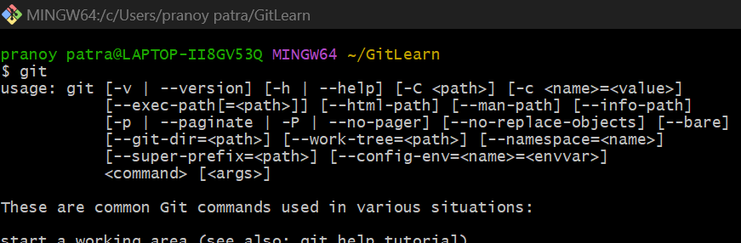
Git Bash Commands
git (It will gives you an overview)
git status (To check the status of git )
config (Configure git for first time or update user datas)
git config --global user.name=“Your Name” (Set your name)
git config --global user.email=“Your mail id” (Set your mail)
git config user.name (Show your name)
git config user.email (Show your Email id)
git init (To initialize Git by making .git folder)
git add –a (To Track All Files)
git add . (To Track All Files)
git add “filename” (To Track a single Files)

Slide 12
git commit –m “Your Massage” (To Commit Staged Files)
git log (To see the logs of your Commits with details)
rm –rf .git (To remove .git folder)(Be carefull about it , it will delete all your previous versions)

Slide 13
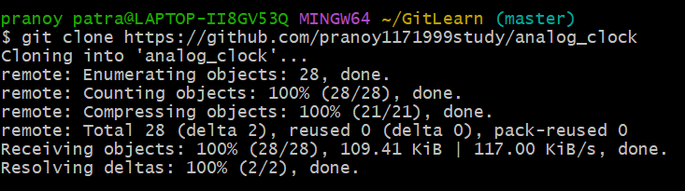
Clone a Repository
You will Clone the Project from Remote Server to Your Local Computer
Open your GitBash and type the Command
git clone “url of repository”
Or git clone “url of repository” “coustom name”

Slide 14
Git – File Status LifeCycle
Untracked
Unmodified
Modified
Staged
Add or Remove
Edit Files
Stage Files
Commit

Slide 15
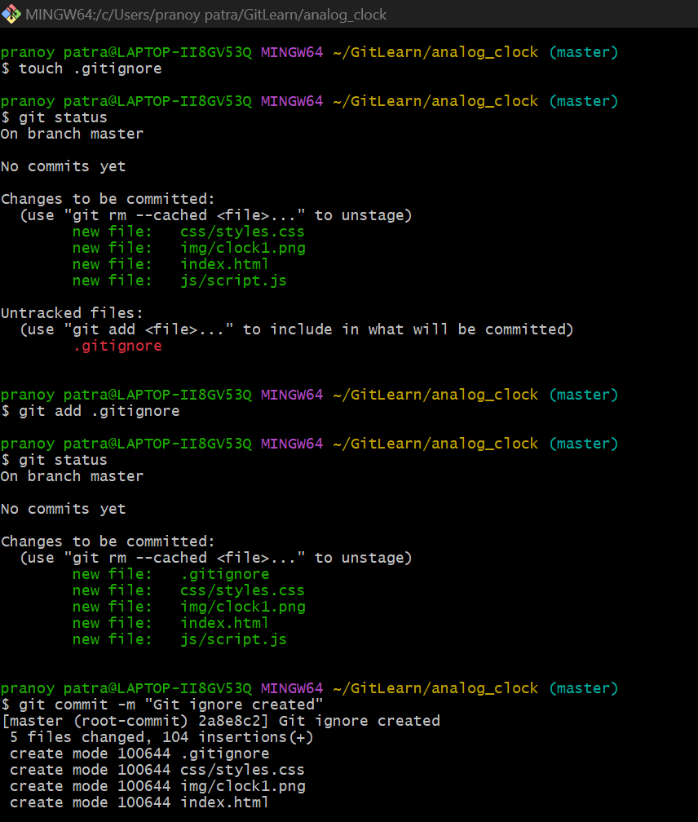
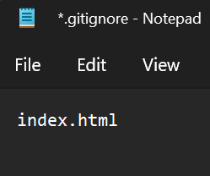
Git .gitignore
If you don’t want to track your all files (like app.log,etc)
.gitignore is here to help you
Generate .gitignore file
touch .gitignore
Writes some files or folders inside it(Whoom to be ignored)
Ex: app.log,error.log..
Add .gitignore to stage and Commit
git add .gitignore
Git commit –m “custom massage”

Slide 16
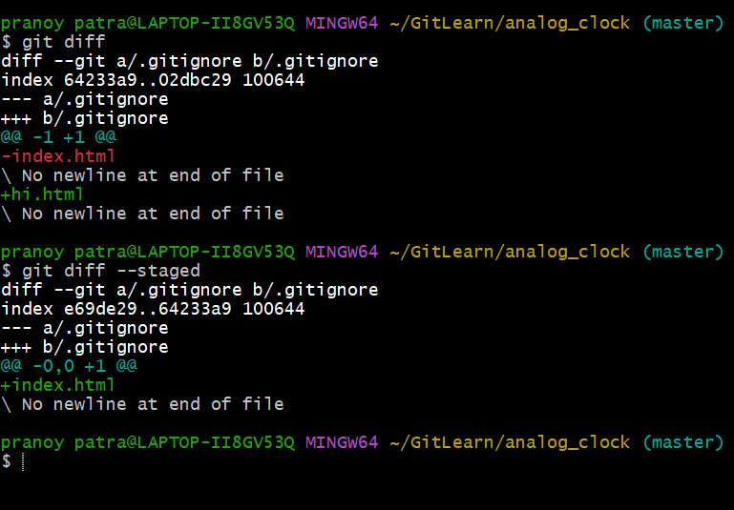
Git diff
Git diff will compare all the differences between your Working Directory (or last Commit)& Staging Area
git diff ( Compare Working Directory & Staging Area )
git diff –staged ( Compare Last Commit & Staging Area)

Slide 17
Some More Comments
Skipping Staging area and Commit
git commit –a –m “Cousom Massage”
Remove & Rename
git rm “file.txt” (To Delete)
git mv “file.txt” “newNeme.txt” (To Rename)
Untrack a File
git rm --catched “file.txt”

Slide 18
Git Log
You can see all your project logs here (All commits..)
(Press q to exit)
git log ( Show all Logs )
git log –p ( Show all Details Line by Line )
git log –p -n ( Show all Details of n (1,2,3..n) commits)
git log --stat ( Show Stat in short )
git log --preety =1 ( Show all commits (1 commit in 1 line) )
git log --preety =sort ( Show Commits in Short )
=full(( Show Commits in Full )
git log –since=n.days ( Show commits of last n days)
=n.weeks ( Show commits of last n weeks)
=n.months ( Show commits of last n months)
=n.years ( Show commits of last n years)

Slide 19
Git Log –-preety Formating
git log --preety = format : “ format specifiers ”//use like output in C/C++
Format Specifiers:
%H
commit hash
%h
abbreviated commit hash
%T
tree hash
%t
abbreviated tree hash
%P
parent hashes
%p
abbreviated parent hashes
%an
author name
Example : “%H ~~~ %an” it will represents Commit Hash ~~~ Author Name
Explore More Specifiers
Click here

Slide 20
Unstaging and Unmodified Files
git restore --staged “file name” ( to Unstage a File )
git checkout – “file name” ( Unmodify File (Match to Last Commit) )**Be Careful you will Loose Current File
git checkout –f ( Set Working Directory to the last Commit , all Files and we will loose our current edits)

Slide 21
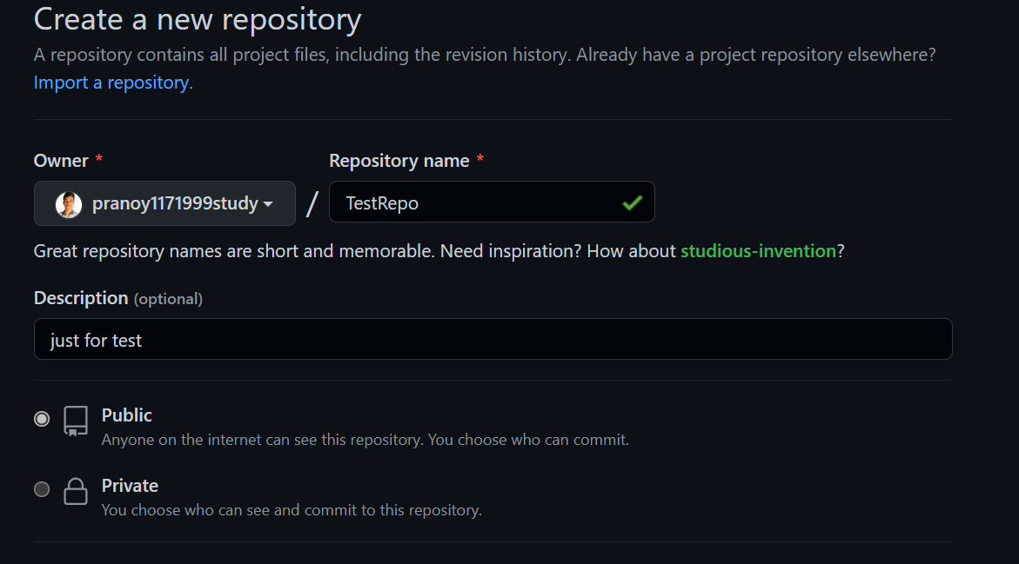
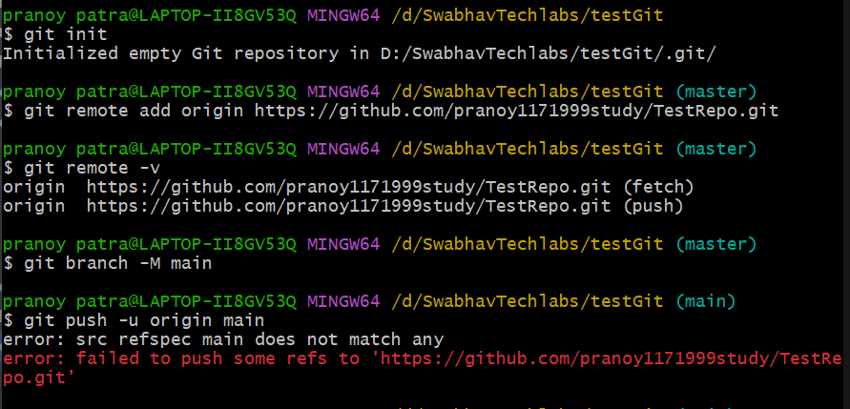
Working with Remote Repositories
Create a Repositories in GitHub
Add your GitHub repo’s Origin to your Local Project
git remote add origin https://github.com/pranoy1171999study/TestRepo.git
To check Remote Name : git remote
To see fetch & push url : git remote –v
Now Select the Branch : git branch -M main
Now Can we Push our local directly to the GitHub repo?🤔
Answer is No 😢.We have to give the access of GitHub Repo to your local Git.Actualy this is good otherwise someone who know your origin can push anything in your repo😊.

Slide 22
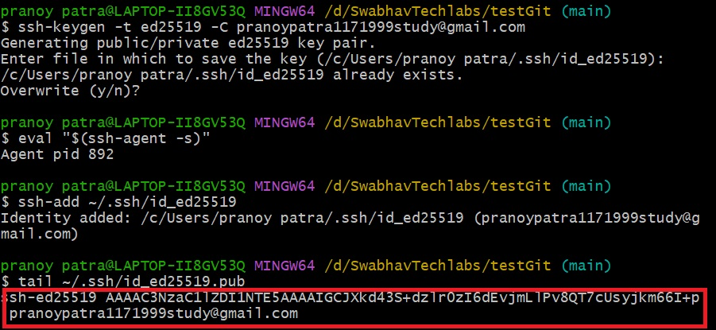
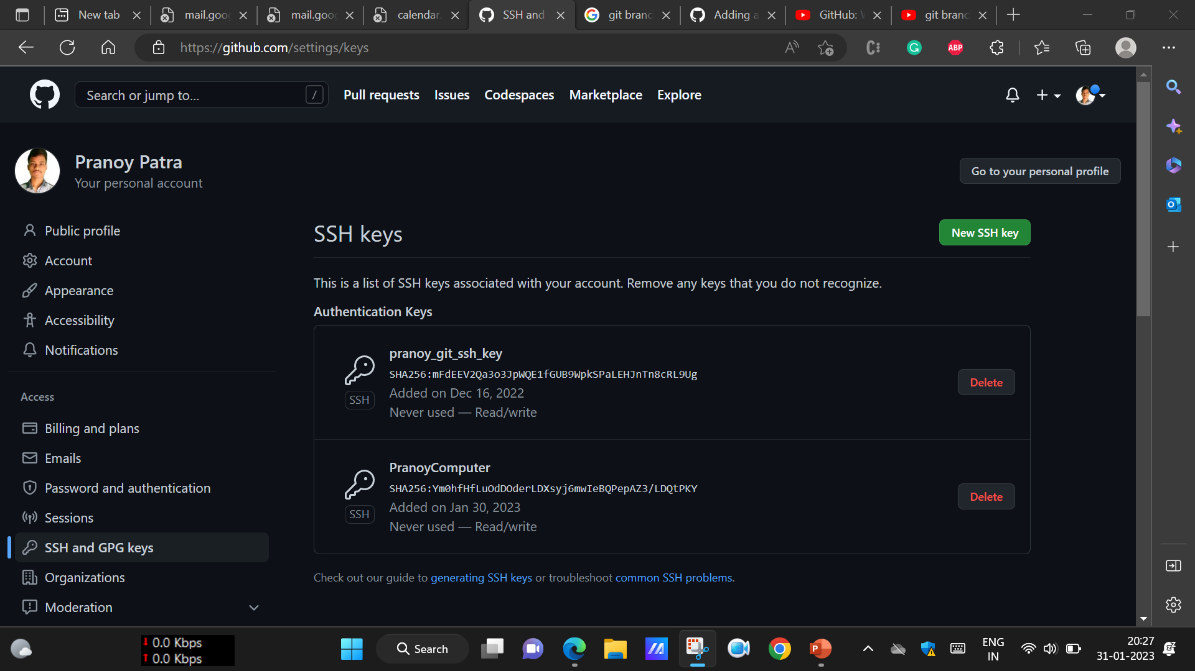
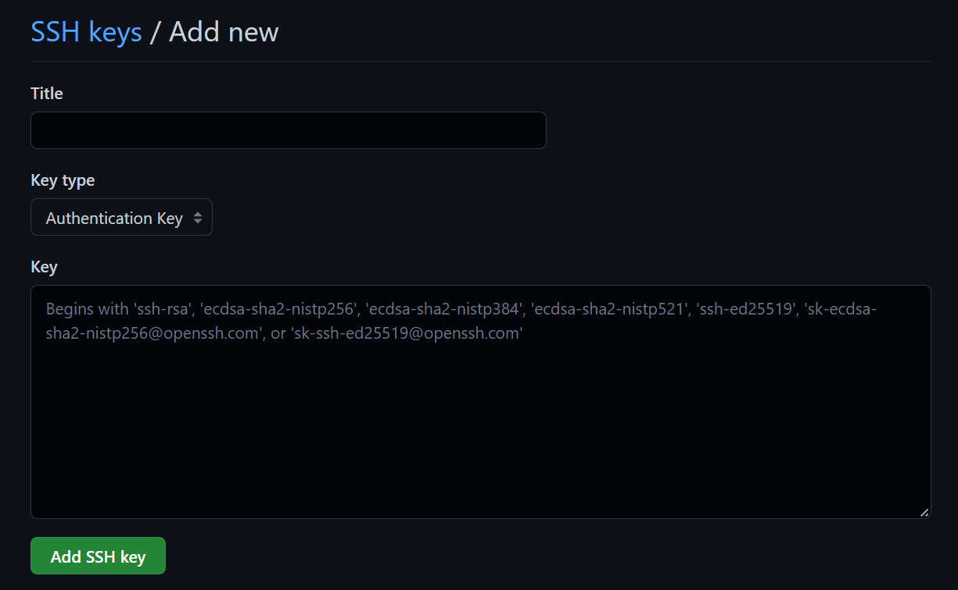
Now What is the Solution Then? How to give Access ?😢
For this we have to goto GitHub and add our local Git’s SSH Key in it
Step 1: Generate SSH key in Git Bash
->ssh-keygen -t ed25519 -C "your_email@example.com" (Generate SSH Key)
-> eval "$(ssh-agent -s)" (Run SSH agent)
->ssh-add ~/.ssh/id_ed25519 (Add your SSH Private Key to SSH Agent)
->tail ~/.ssh/id_ed25519.pub (See your SSH Key)
Step 2 :Open GitHub & add new SSH Key( Local Git’s SSH Key)(In the Pic Red portion)
GitHub Website ->Click on Profile Icon-> Settings->SSH & GPG Keys -> New SSH Key
give a title & paste the SSH Key & add it

Slide 23
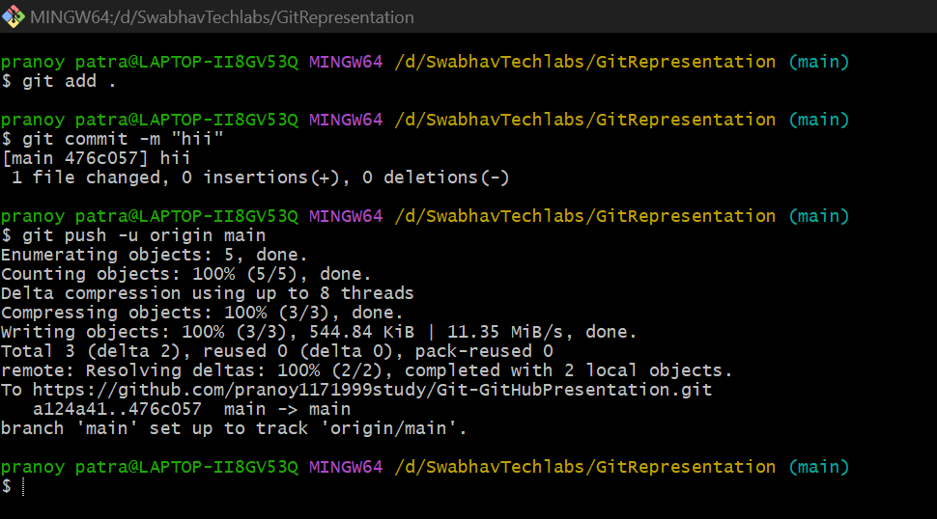
Push Project to GitHub
Now go to GitBash and run the Commands
git commit (Commit your changes)
git push –u origin main (Push main Branch to origin)
😊⭐Your Files are Uploaded Successful to GitHub😊⭐

Slide 24
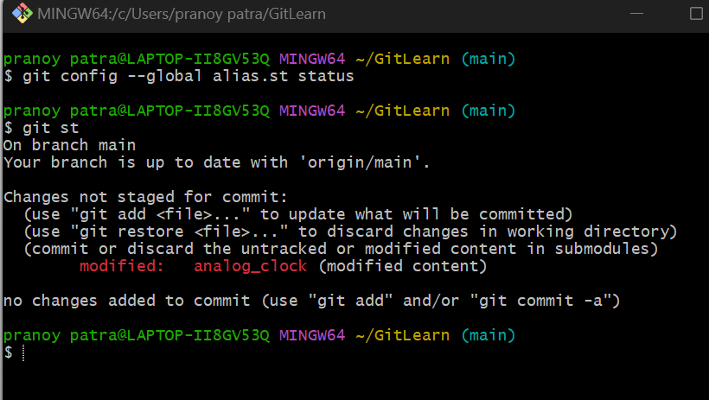
Git Alias
What is Git Alias?😢
Git Alias is nothing but a feature provided by Git to make your custom sortcuts
Ie, You can set some custom command for any Git Bash command
Ex: git confing --global alias.st status
(Now you can use “git st” instead of git “git status”)

Slide 25
Branches in Git
You can create a branch any time from any branch & do different different tasks & testing on them , after that you also can marge this branch with main(Production Branch)
branch y
branch x
y marged with main
main branch
branch z

Slide 26
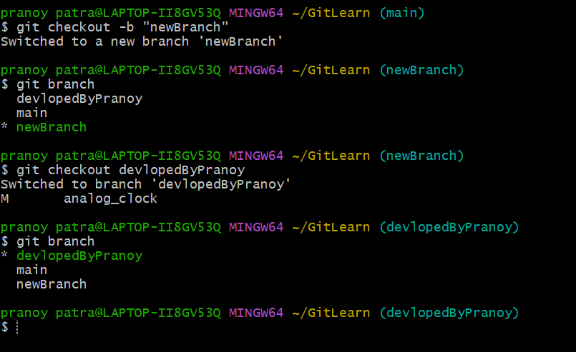
Create a Branch
git checkout –b “new branch name” (Create a branch with given name)
git branch (See all available branches)
git checkout “Branch name” (Go to any branch)
**when you will switch branches your folders and files will change in memory w.r.t your current branch

