Slide 1
Lung and Liver disease classification

Slide 2
Index
Abstract
Introduction
Literature review
Existing Method
Disadvantages
Proposed method
Block Diagram
Advantages
Implementation
Modules
Algorithms
Architecture
UML diagrams
Class Diagram
Sequence Diagram
Collaboration Diagram
Deployment Diagram
Activity Diagram
Component Diagram
ER
Results
Conclusion
Future Scope
Hardware and Software Requirements
References

Slide 3
Abstract
Worldwide, lung illness is a prevalent occurrence. These include pneumonia, asthma, TB, fibrosis, chronic obstructive pulmonary disease, and others. The early detection of lung illness is crucial.
Liver cancer is a type of cancer that starts in the liver. Cancer starts when cells in the body begin to grow out of control, here we are trying to train the model with the existing data so that we can help patients in early detection.
For this, a variety of machine learning and image processing models have been created. For the purpose of predicting lung disease and liver cancer , we use deep learning approaches, such as MobileNet and Resnet

Slide 4
introduction
Information retrieval is a fundamental approach for identifying information highlights, propensities, and structures in enormous datasets, as well as for communicating acknowledged recognitions motivated by the cause or circumstance of certain settings. Information mining also allows the guess of future procedures possible by revealing the example and advancements in the dataset.
Lung disease is among the leading diseases that cause mortality worldwide. Most cases of lung diseases and liver cancer are detected when the disease is in the advanced stages. Therefore the development of systems and methods that enable faster and early diagnosis will play a vital role in the world today. Computer Aided Diagnosis (CADx) systems play such a role and are currently being expanded. This study explores the potential of using deep learning features from pre-trained deep learning architectures to provide rich and robust features.

Slide 5
LITERATURE SURVEY
SL NO | Journal type with year | Authors | Title | Outcomes
01 | 2018, IEEE | Joel Than Chia Ming Norliza Mohd Noor Omar Mohd Rijal Rosminah M. Kassim Ashari Yunus | Lung Disease Classification Using Different Deep Learning Architectures and Principal Component Analysis | First for any image we need to convert RGB image into gray scale image. This is done just because Hu moments shape descriptor and Haralick features can be calculated over single channel only. Therefore, it is necessary to convert RGB to gray scale before computing Hu moments and Haralick features.
02 | 2019, ISSN | L. Anand, V. Neelanarayanan | Liver Disease Classification using Deep Learning Algorithm | classification of lung and liver diseases using diseased images of liver and lung. However, there is still no efficient and effective commercial solution that can be used to identify the diseases. In our work, we used two different DL models for the detection of lung and liver diseases using healthy- and diseased images of organs.
03 | 2017, Researchgate | Andrew G. Howard Menglong Zhu Bo Chen Dmitry Kalenichenko | MobileNets: Efficient Convolutional Neural Networks for Mobile Vision Applications | Infinite possibilities of deep-learning for real-time applications, complete with case studies, Mobile Net is examples of state-of-the-art pre-trained CNN models that do an excellent work of classification images. When compared to other architectures, the Mobile net was found to be better at extracting discriminative features from images
04 | 2020, ScienceDirect | Devvi Sarwinda Radifa Hilya Paradisa Alhadi Bustamam Pinkie Anggia | Deep Learning in Image Classification using Residual Network (ResNet) Variants for Detection of Colorectal Cancer | This paper investigates a deep learning method in image classification for the detection of colorectal cancer with ResNet architecture. The exceptional performance of a deep learning classification incites scholars to implement them in medical images. In this study, we trained ResNet-18 and ResNet-50 on colon glands images.

Slide 6
Existing method
In the existing there are no methods implemented to check or detect the diseases in lung or liver. The only way is to do the process manually in the labs and study by the experts which consumes a lot of time and more human effort sometimes experts availability and time constraint in emergency situation.

Slide 7
disadvantages
Time consuming
More human effort

Slide 8
PROPOSED SYSTEM
In purposed method we are performing the classification of either the image is lung or liver Disease identification using Convolution Neural Network (CNN) (Mobile Net) and resnet of deep learning along with the deep learning methods. As image analysis based approaches for lung and liver Disease detection. Hence, proper classification is important for the lung and liver disease that which will be possible by using our proposed method.

Slide 9
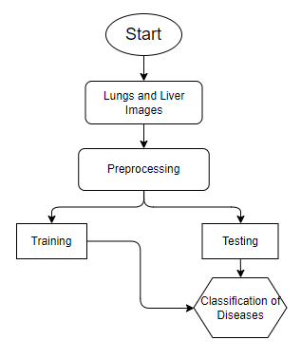
BLOCK DIAGRAM

Slide 10
Advantages:
Accurate classification
Less complexity
High performance
Easy Identification

Slide 11
IMPLEMENTATION
First we have taken the Lung and Liver Diseases images.
Load the dataset into and Preprocessing .
Here split the data in to train data and test data.
After splitting apply the Mobile Net and Resnet algorithm Respectively and fit the train data and test data.
We got the best accuracy score for Mobile Net.
Later, the entire work is done with Django framework
User can view the home, about ,upload page and Results.

Slide 12
Modules
System
User
1. System:
1.1 Create Dataset:
The dataset containing images of the lung and liver images with the seven different classes which are to be classified is split into training and testing dataset with the test size of 30-20%.
1.2 Pre-processing:
Resizing and reshaping the images into appropriate format to train our model.
1.3 Training:
Use the pre-processed training dataset is used to train our model using CNN based transfer learning Mobile Net and Resnet algorithm.
1.4 Classification:
The results of our model is display of classified lung and liver images.

Slide 13
Modules
2. User:
2.1 Check accuracy
The user can check for the training accuracy of the model.
2.2 Upload Image
The user has to upload an image which needs to be classified.
2.3 View classified output
The classified image results are viewed by user.
2.4 View predicted diseases
The predicted diseases of classified lung and liver are viewed by user.

Slide 14
ALGORITHM
MOBILE NET:
Mobile Net uses depth wise separable convolutions. It significantly reduces the number of parameters when compared to the network with regular convolutions with the same depth in the nets. This results in lightweight deep neural networks
A depth wise separable convolution is made from two operations.
Depthwise convolution.
Point wise convolution.
Mobile Net is a class of CNN that was open-sourced by Google, and therefore, this gives us an excellent starting point for training our classifiers that are insanely small and insanely fast.

Slide 15
ALGORITHM
ResNet50:
ResNet50 is a convolutional neural network which has a depth of 50 layers. It was build and trained by Kaiming He, Xiangyu Zhang, Shaoqing Ren, and Jian Sun in their 2015 and you can access the model performance results on their paper, titled Deep Residual Learning for Image Recognition. This model is also trained on more than 1 million images from the ImageNet database. Just like VGG-19, it can classify up to 1000 objects and the network was trained on 224x224 pixels colored images. Here is brief info about its size and performance:

Slide 16
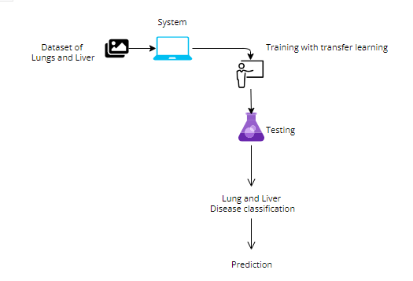
ARCHITECTURE

Slide 17
UML DIAGRAMS
A use case diagram in the Unified Modeling Language (UML) is a type of behavioral diagram defined by and created from a Use-case analysis. Its purpose is to present a graphical overview of the functionality provided by a system in terms of actors, their goals (represented as use cases), and any dependencies between those use cases. The main purpose of a use case diagram is to show what system functions are performed for which actor. Roles of the actors in the system can be depicted.

Slide 18
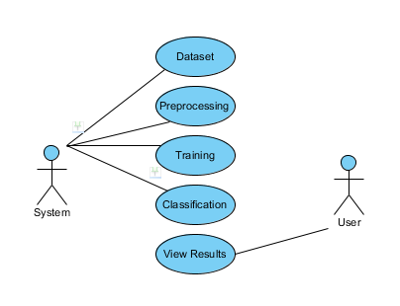

Slide 19
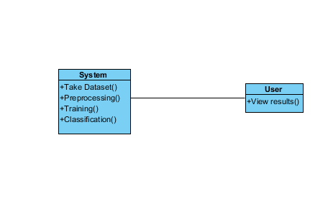
CLASS DIAGRAM
In software engineering, a class diagram in the Unified Modeling Language (UML) is a type of static structure diagram that describes the structure of a system by showing the system's classes, their attributes, operations (or methods), and the relationships among the classes. It explains which class contains information

Slide 20
SEQUENCE DIAGRAM
A sequence diagram in Unified Modeling Language (UML) is a kind of interaction diagram that shows how processes operate with one another and in what order. It is a construct of a Message Sequence Chart. Sequence diagrams are sometimes called event diagrams, event scenarios, and timing diagrams.

Slide 21
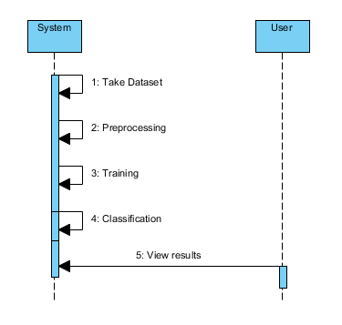

Slide 22
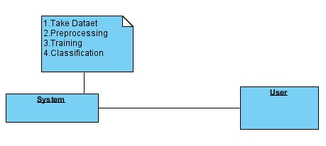
COLLABORATION DIAGRAM
In collaboration diagram the method call sequence is indicated by some numbering technique as shown below. The number indicates how the methods are called one after another. We have taken the same order management system to describe the collaboration diagram. The method calls are similar to that of a sequence diagram. But the difference is that the sequence diagram does not describe the object organization where as the collaboration diagram shows the object organization

Slide 23
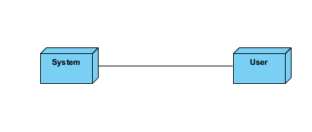
DEPLOYMENT DIAGRAM
Deployment diagram represents the deployment view of a system. It is related to the component diagram. Because the components are deployed using the deployment diagrams. A deployment diagram consists of nodes. Nodes are nothing but physical hardware used to deploy the application

Slide 24
ACTIVITY DIAGRAM
Activity diagrams are graphical representations of workflows of stepwise activities and actions with support for choice, iteration and concurrency.
In the Unified Modeling Language, activity diagrams can be used to describe the business and operational step-by-step workflows of components in a system.
An activity diagram shows the overall flow of control.

Slide 25
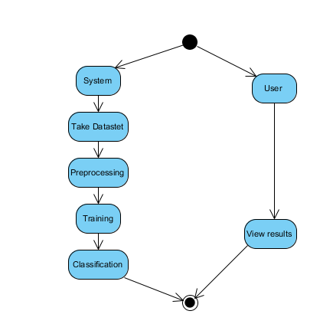

Slide 26
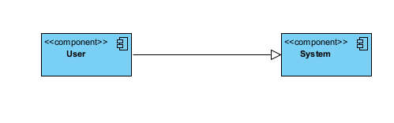
COMPONENT DIAGRAM
A component diagram, also known as a UML component diagram, describes the organization and wiring of the physical components in a system.
Component diagrams are often drawn to help model implementation details and double-check that every aspect of the system's required functions is covered by planned development.

Slide 27
ER DIAGRAM
An Entity–relationship model (ER model) describes the structure of a database with the help of a diagram, which is known as Entity Relationship Diagram (ER Diagram).
An ER diagram shows the relationship among entity sets. An entity set is a group of similar entities and these entities can have attributes.
In terms of DBMS, an entity is a table or attribute of a table in database, so by showing relationship among tables and their attributes, ER diagram shows the complete logical structure of a database.

Slide 28
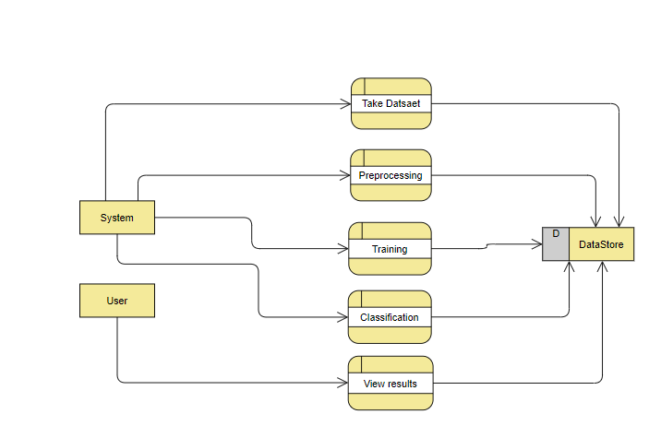

Slide 29
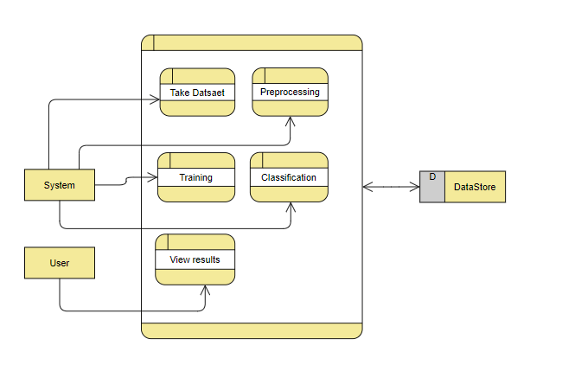

Slide 30
CONCLUSION
In this project we have successfully classified the images of Identification of lungs and liver disease, or its healthy using the deep learning and machine learning. Here, we have considered the dataset of lungs and liver images which will be of different types (healthy or disease) and trained using Mobile Net, Resnet along with some transfer learning method. After the training we have tested by uploading the image and classified it.

Slide 31
FUTURE SCOPE
This can be utilized in future to classify the types of different lung and liver diseases easily that which can tend to easy Prediction of diseases in early stages and can take the initial medications, precautions and take measures.

Slide 32
HARDWARE AND SOFTWARE REQUIREMENTS
H/W Specifications:
Processor : I5/Intel Processor
RAM : 8GB (min)
Hard Disk : 128 GB
S/W Specifications:
Operating System : Windows 10
Server-side Script : Python 3.6
IDE : PyCharm, Jupyter notebook
Libraries Used : Numpy, IO, OS, Flask, Keras, pandas, tensorflow

Slide 33
references
N. H. Lung, B. Institute, and others, “Disease statistics,” NHLBI Fact Book, Fisc. Year 2012, p. 35, 2012.
“Malaysia: Lung Disease. In World Health Rankings,” 2012. [Online]. Available: http://www.worldlifeexpectancy.com/malaysi lung-disease.
Y. Jiang, R. M. Nishikawa, R. A. Schmidt, C. E. Metz, M. L. Giger, and K. Doi, “Improving breast cancer diagnosis with computer aided diagnosis,” Acad. Radiol., vol. 6, no. 1, pp. 22–33, 1999.
K. Doi, “Computer-aided diagnosis in medical imaging: Historical review, current status and future potential,” Comput. Med. Imaging Graph., vol. 31, no. 4–5, pp. 198–211, 2007.

Slide 34
Thank you

