Slide 1
Lung cancer using deep learning

Slide 2
Index
Abstract
Introduction
Literature review
Existing Method
Disadvantages
Proposed method
Block Diagram
Advantages
Implementation
Modules
Algorithms
Architecture
UML diagrams
Class Diagram
Sequence Diagram
Collaboration Diagram
Deployment Diagram
Activity Diagram
Component Diagram
ER
Results
Conclusion
Future Scope
Hardware and Software Requirements
References

Slide 3
Abstract
Lung diseases are indeed the lung-affecting diseases which impair the respiratory mechanism. Lung cancer has been one of the leading causes of mortality in humans worldwide. Early detection can enhance survival chances amid humans. If the condition is diagnosed in time, the average survival rates for people with lung cancer rise from 14 to 49 percent
While computed tomography (CT) is far more effective than X-ray, a thorough diagnosis includes multiple imaging approaches to support each other. A deep neural network for detecting lung cancer from CT images is developed and evaluated. For the classification of the lung image as normal or malignant, a densely connected convolution neural network (CNN) and adaptive boosting algorithm was used

Slide 4
introduction
Lung cancers have been identified as one of the world's most serious causes of death [1]. It is among the most malignant tumors that can affect human wellbeing. Its death rate scores among all tumor deaths, and is also the top killer towards male and female cancer death [2-3]. There have been nearly 1.8 million fresh cases of lung cancer annually (13 percent among all cancers), 1.6 million deaths worldwide (19.4 percent among all cancers). Lung cancer is a proliferation of expanding and developing irregular cells into a tumour. Of the other forms of cancer, the death rate of lung cancer is the greatest
Cigarette smoke induces an approximate 85 percent of cases of lung cancer in males and 75 percent in females. Lung cancer is amongst the most terrible illnesses in the developing countries, with a death rate of 19.4 percent. Lung cancer is among the most dangerous cancer worldwide, with lowest success rate following diagnosis, with a steady rise in casualty count per year [4-6]. Advantages of Fuzzy logic in the earlier predictions will lead to result oriented analysis

Slide 5
LITERATURE SURVEY
SL NO | Journal type with year | Authors | Title | Outcomes
01 | 2018, IEEE | Joel Than Chia Ming Norliza Mohd Noor Omar Mohd Rijal Rosminah M. Kassim Ashari Yunus | Lung Disease Classification Using Different Deep Learning Architectures and Principal Component Analysis | First for any image we need to convert RGB image into gray scale image. This is done just because Hu moments shape descriptor and Haralick features can be calculated over single channel only. Therefore, it is necessary to convert RGB to gray scale before computing Hu moments and Haralick features.
02 | 2019, ISSN | L. Anand, V. Neelanarayanan | Liver Disease Classification using Deep Learning Algorithm | classification of lung and liver diseases using diseased images of liver and lung. However, there is still no efficient and effective commercial solution that can be used to identify the diseases. In our work, we used two different DL models for the detection of lung and liver diseases using healthy- and diseased images of organs.
03 | 2017, Researchgate | Andrew G. Howard Menglong Zhu Bo Chen Dmitry Kalenichenko | MobileNets: Efficient Convolutional Neural Networks for Mobile Vision Applications | Infinite possibilities of deep-learning for real-time applications, complete with case studies, Mobile Net is examples of state-of-the-art pre-trained CNN models that do an excellent work of classification images. When compared to other architectures, the Mobile net was found to be better at extracting discriminative features from images
04 | 2020, ScienceDirect | Devvi Sarwinda Radifa Hilya Paradisa Alhadi Bustamam Pinkie Anggia | Deep Learning in Image Classification using Residual Network (ResNet) Variants for Detection of Colorectal Cancer | This paper investigates a deep learning method in image classification for the detection of colorectal cancer with ResNet architecture. The exceptional performance of a deep learning classification incites scholars to implement them in medical images. In this study, we trained ResNet-18 and ResNet-50 on colon glands images.

Slide 6
Existing method
In the existing there are methods implemented to classify lung disesase classification in deep learning. In method we are performing the classification of lung cancer identification using vgg16 of deep learning along with the Machine learning methods. As image analysis based approaches for classification of medical images

Slide 7
disadvantages
Time consuming
More human effort

Slide 8
PROPOSED SYSTEM
In purposed method we are performing the classification of either the image is lung cancer or normal identification using Mobile net and CNN of deep learning along with the Machine learning methods. As image analysis based approaches for medical lung classification and authentication. Hence, proper classification is important for the lung dataset that which will be possible by using our proposed method. Block diagram of proposed method is shown below.

Slide 9
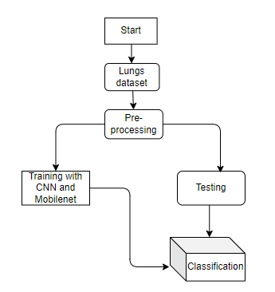
BLOCK DIAGRAM

Slide 10
Advantages:
Accurate classification
Less complexity
High performance
Easy Identification

Slide 11
IMPLEMENTATION
First we have taken the Lung Cancer images.
Load the dataset into and Preprocessing .
Here split the data in to train data and test data.
After splitting apply the Mobile Net and CNN algorithm Respectively and fit the train data and test data.
We got the best accuracy score for Mobile Net.
Later, the entire work is done with Django framework
User can view the home, about ,upload page and Results.

Slide 12
Modules
System
User
1. System:
1.1 Create Dataset:
The dataset containing images of the lung images with the seven different classes which are to be classified is split into training and testing dataset with the test size of 30-20%.
1.2 Pre-processing:
Resizing and reshaping the images into appropriate format to train our model.
1.3 Training:
Use the pre-processed training dataset is used to train our model using CNN based transfer learning Mobile Net and CNN algorithm.
1.4 Classification:
The results of our model is display of classified lung images.

Slide 13
Modules
2. User:
2.1 Check accuracy
The user can check for the training accuracy of the model.
2.2 Upload Image
The user has to upload an image which needs to be classified.
2.3 View classified output
The classified image results are viewed by user.
2.4 View predicted diseases
The predicted diseases of classified lungs are viewed by user.

Slide 14
ALGORITHM
MOBILE NET:
Mobile Net uses depth wise separable convolutions. It significantly reduces the number of parameters when compared to the network with regular convolutions with the same depth in the nets. This results in lightweight deep neural networks
A depth wise separable convolution is made from two operations.
Depthwise convolution.
Point wise convolution.
Mobile Net is a class of CNN that was open-sourced by Google, and therefore, this gives us an excellent starting point for training our classifiers that are insanely small and insanely fast.

Slide 15
ALGORITHM
CNN
A convolutional neural network (CNN or convnet) is a subset of machine learning. It is one of the various types of artificial neural networks which are used for different applications and data types. A CNN is a kind of network architecture for deep learning algorithms and is specifically used for image recognition and tasks that involve the processing of pixel data.
There are other types of neural networks in deep learning, but for identifying and recognizing objects, CNNs are the network architecture of choice. This makes them highly suitable for computer vision (CV) tasks and for applications where object recognition is vital, such as self-driving cars and facial recognition

Slide 16
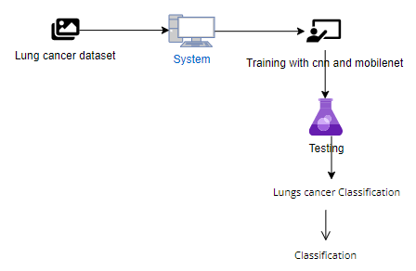
ARCHITECTURE

Slide 17
UML DIAGRAMS
A use case diagram in the Unified Modeling Language (UML) is a type of behavioral diagram defined by and created from a Use-case analysis. Its purpose is to present a graphical overview of the functionality provided by a system in terms of actors, their goals (represented as use cases), and any dependencies between those use cases. The main purpose of a use case diagram is to show what system functions are performed for which actor. Roles of the actors in the system can be depicted.

Slide 18
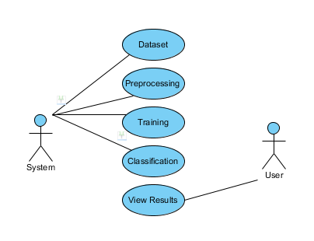

Slide 19
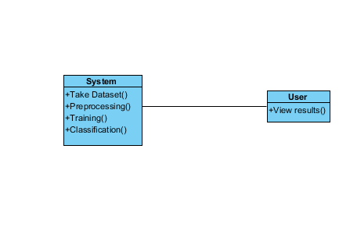
CLASS DIAGRAM
In software engineering, a class diagram in the Unified Modeling Language (UML) is a type of static structure diagram that describes the structure of a system by showing the system's classes, their attributes, operations (or methods), and the relationships among the classes. It explains which class contains information

Slide 20
SEQUENCE DIAGRAM
A sequence diagram in Unified Modeling Language (UML) is a kind of interaction diagram that shows how processes operate with one another and in what order. It is a construct of a Message Sequence Chart. Sequence diagrams are sometimes called event diagrams, event scenarios, and timing diagrams.

Slide 21
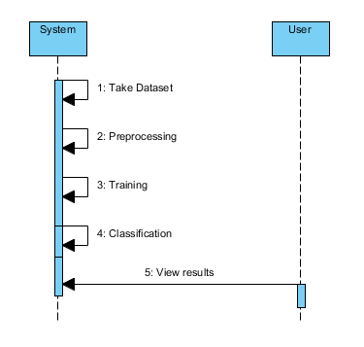

Slide 22
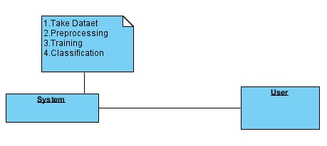
COLLABORATION DIAGRAM
In collaboration diagram the method call sequence is indicated by some numbering technique as shown below. The number indicates how the methods are called one after another. We have taken the same order management system to describe the collaboration diagram. The method calls are similar to that of a sequence diagram. But the difference is that the sequence diagram does not describe the object organization where as the collaboration diagram shows the object organization

Slide 23
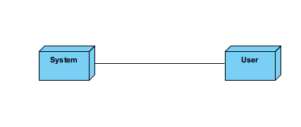
DEPLOYMENT DIAGRAM
Deployment diagram represents the deployment view of a system. It is related to the component diagram. Because the components are deployed using the deployment diagrams. A deployment diagram consists of nodes. Nodes are nothing but physical hardware used to deploy the application

Slide 24
ACTIVITY DIAGRAM
Activity diagrams are graphical representations of workflows of stepwise activities and actions with support for choice, iteration and concurrency.
In the Unified Modeling Language, activity diagrams can be used to describe the business and operational step-by-step workflows of components in a system.
An activity diagram shows the overall flow of control.

Slide 25
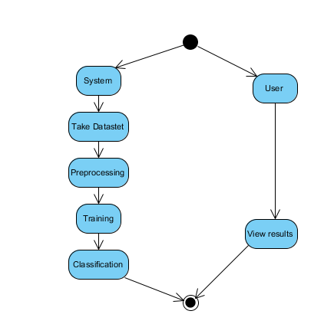

Slide 26
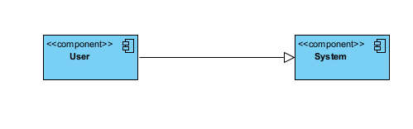
COMPONENT DIAGRAM
A component diagram, also known as a UML component diagram, describes the organization and wiring of the physical components in a system.
Component diagrams are often drawn to help model implementation details and double-check that every aspect of the system's required functions is covered by planned development.

Slide 27
ER DIAGRAM
An Entity–relationship model (ER model) describes the structure of a database with the help of a diagram, which is known as Entity Relationship Diagram (ER Diagram).
An ER diagram shows the relationship among entity sets. An entity set is a group of similar entities and these entities can have attributes.
In terms of DBMS, an entity is a table or attribute of a table in database, so by showing relationship among tables and their attributes, ER diagram shows the complete logical structure of a database.

Slide 28
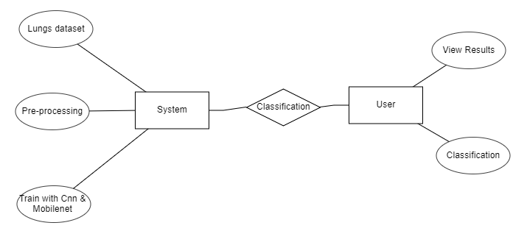

Slide 29
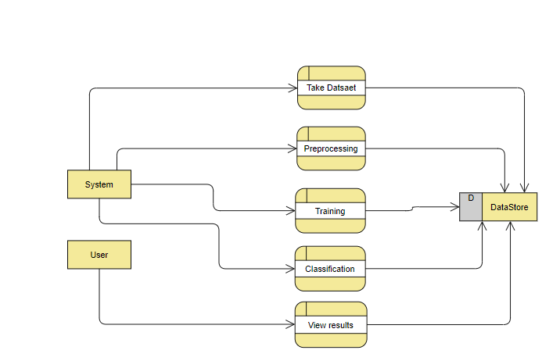

Slide 30
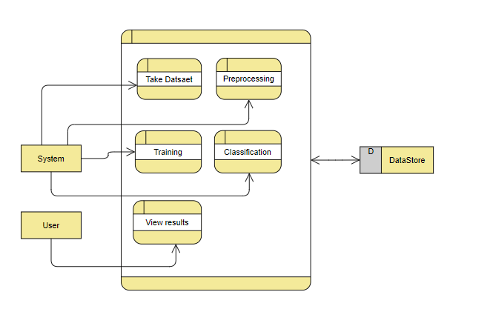

Slide 31
Results
In this application, we have considered the dataset lungs with the multi-classes and trained using Mobile Net, CNN algorithm along with Deep learning.
In the testing the image is uploaded and the image is classified.

Slide 32
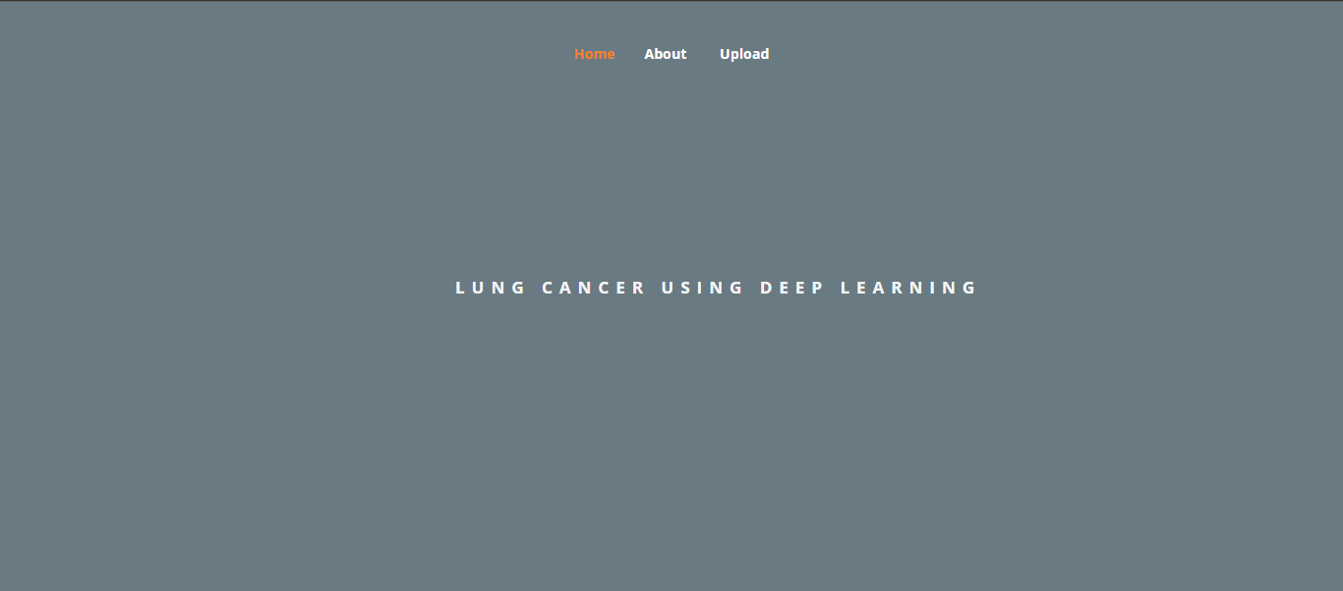

Results and discussion
Home page

Slide 33
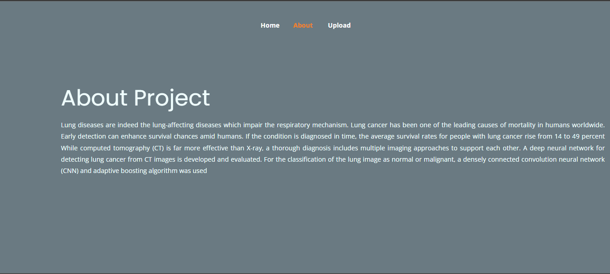
About

Slide 34
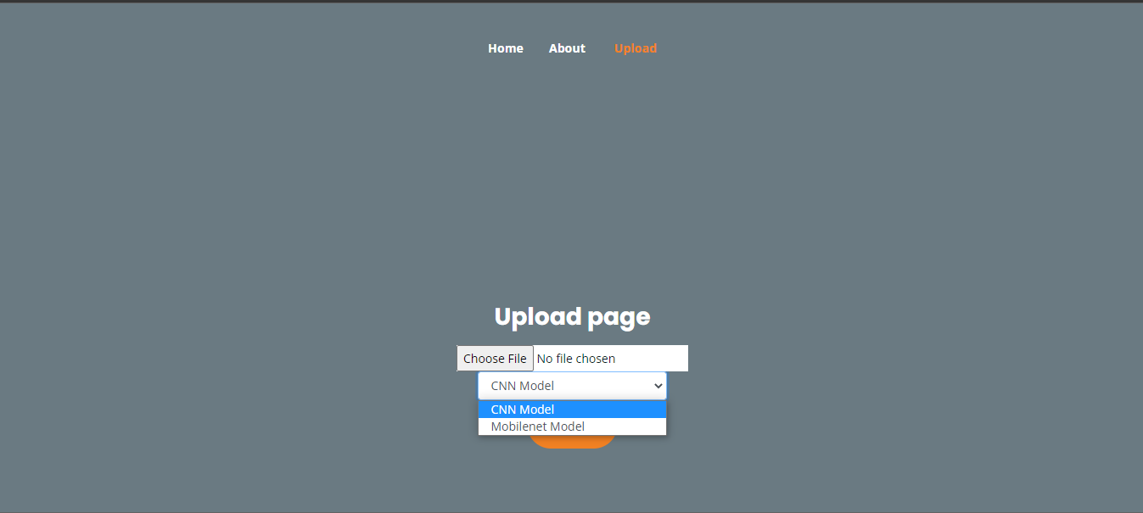
Upload

Slide 35
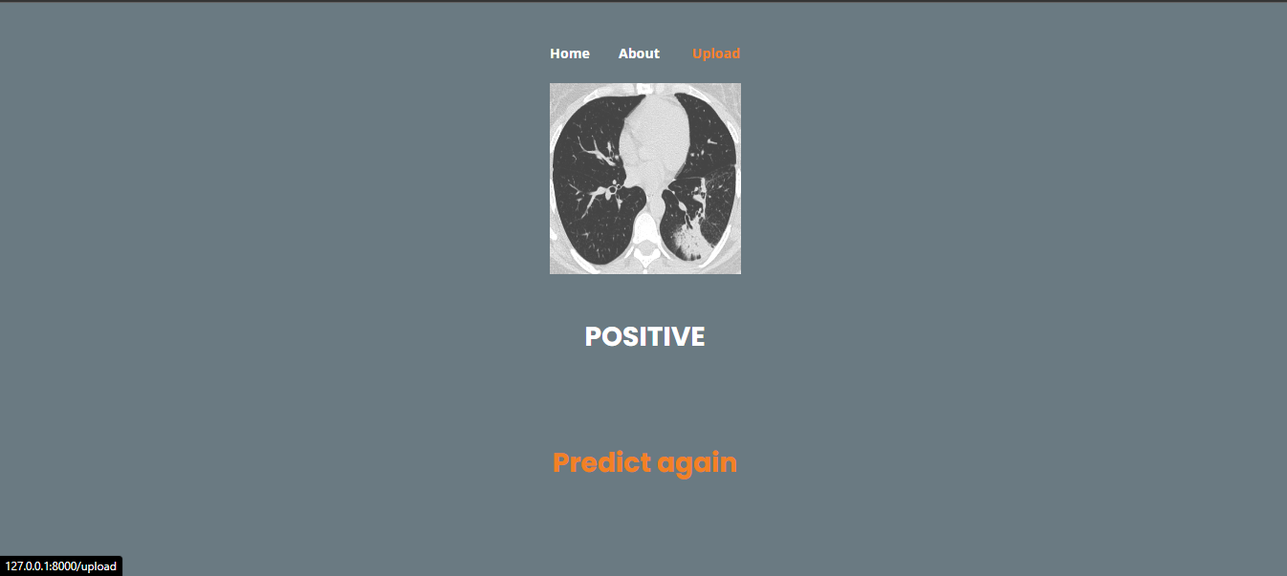
Result

Slide 36
CONCLUSION
In this project we have successfully classified the images of Identification of lungs and liver disease, or its healthy using the deep learning and machine learning. Here, we have considered the dataset of lungs and liver images which will be of different types (healthy or disease) and trained using Mobile Net, Resnet along with some transfer learning method. After the training we have tested by uploading the image and classified it.

Slide 37
FUTURE SCOPE
This can be utilized in future to classify the types of different lungs easily that which can tend to easy Prediction of diseases in early stages and can take the initial medications, precautions and take measures.

Slide 38
HARDWARE AND SOFTWARE REQUIREMENTS
H/W Specifications:
Processor : I5/Intel Processor
RAM : 8GB (min)
Hard Disk : 128 GB
S/W Specifications:
Operating System : Windows 10
Server-side Script : Python 3.6
IDE : PyCharm, Jupyter notebook
Libraries Used : Numpy, IO, OS, Flask, Keras, pandas, tensorflow

Slide 39
references
N. H. Lung, B. Institute, and others, “Disease statistics,” NHLBI Fact Book, Fisc. Year 2012, p. 35, 2012.
“Malaysia: Lung Disease. In World Health Rankings,” 2012. [Online]. Available: http://www.worldlifeexpectancy.com/malaysi lung-disease.
Y. Jiang, R. M. Nishikawa, R. A. Schmidt, C. E. Metz, M. L. Giger, and K. Doi, “Improving breast cancer diagnosis with computer aided diagnosis,” Acad. Radiol., vol. 6, no. 1, pp. 22–33, 1999.
K. Doi, “Computer-aided diagnosis in medical imaging: Historical review, current status and future potential,” Comput. Med. Imaging Graph., vol. 31, no. 4–5, pp. 198–211, 2007.

Slide 40
Thank you

