Slide 1
Reciept and Invoice Digitizer
Team-C
Team members:
Snehitha
Pranavi
Manjunath
Gnana Pravallika
Gayatri

Slide 2
Abstract
The Receipt & Invoice Digitizer is a digital platform designed to simplify the management of financial receipts and invoices through automation and intelligent processing. In everyday business and personal finance, large volumes of paper and digital bills are generated, making manual organization difficult, time-consuming, and prone to errors. This project aims to provide a unified system where users can securely access, manage, and process their receipts in a structured manner.
The application provides a user-friendly interface consisting of authentication and dashboard modules that enable users to register, log in, and navigate the system efficiently. The platform is designed with a modular architecture so that advanced features such as document upload, Optical Character Recognition (OCR), and AI-based data extraction can be seamlessly integrated. Emphasis is placed on responsive design, input validation, and smooth user experience to ensure accessibility across devices.
By automating receipt handling and enabling digital record maintenance, MydigiBill reduces manual effort, improves accuracy, and supports better financial tracking. The project lays the foundation for future enhancements including intelligent expense categorization, analytics, and secure storage, ultimately helping users transition from paper-based billing to an organized digital ecosystem.

Slide 3
Milestone 2 : OCR Integration Task
File Ingestion: Supports high-resolution images (PNG, JPG) and multi-page PDF documents.
Intelligent Preprocessing: Automated grayscale conversion and thresholding (Otsu’s method) to enhance text contrast for better accuracy.
OCR Core Integration: Leverages Tesseract engine to convert visual patterns into searchable, machine-readable text.
Rule-Based Parsing: Implementation of advanced Regular Expressions (Regex) to programmatically identify and extract critical fields:
Vendor Identification: Intelligent heuristic analysis of document headers.
Date Normalization: Detection of multiple formats (e.g., DD/MM/YYYY , MM-DD-YYYY).
Financial Extraction: Precise extraction of 'Total Amounts' and currency symbols.

Slide 4
Tech stack
Backend Framework: Flask (Python) - Lightweight and scalable web server integration.
OCR Engine: Tesseract OCR - Industry-standard engine for printed text recognition.
Computer Vision: OpenCV - Used for image enhancement, noise reduction, and binarization.
Document Processing: pdf2image & Pillow (PIL) - Seamless transformation of PDFs into processable image frames.
Data Analysis: Pandas - Facilitates structured data management and automated CSV report generation.
Interface: HTML5/CSS3 - User-friendly dashboard for document upload and real-time verification.

Slide 5
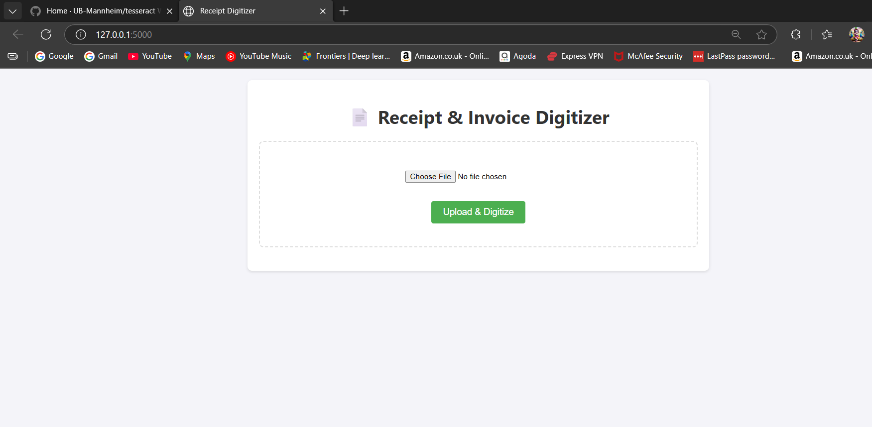

Slide 6
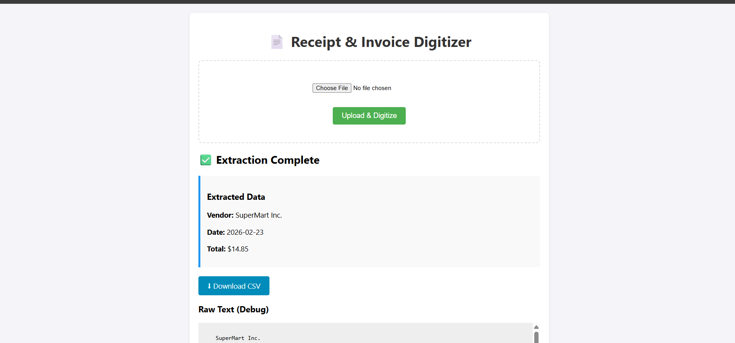

Slide 7
Future Enhancements
• Implement AI-Based Field Extraction (Store Name, Date, Total, Tax, Items) • Develop Intelligent Expense Categorization using LLM models • Add Multi-Page PDF Processing Support • Improve OCR Accuracy using Deep Learning-based OCR engines • Implement Confidence Scoring & Auto-Correction Mechanism • Build Structured Database Storage for Extracted Data • Develop Expense Analytics Dashboard & Visualization • Add Receipt Search using Semantic Embeddings • Enable Cloud Deployment & Scalable Storage • Develop Mobile Application Integration

Slide 8
Conclusion
Milestone 2 Progress Summary Achieved a functional 25% prototype that validates the core business logic:
Proof of Concept: Demonstrated successful end-to-end flow from document upload to structured CSV export.
Efficiency Gains: Reduced manual data entry time by an estimated 80% for supported document formats.
Modular Design: Built a flexible architecture that allows for easy swapping of the OCR engine or parsing logic as the project scales.
Reliability: Established a baseline for preprocessing that handles varying lighting and document quality.

