Slide 1

Basic Details of the Team and Problem Statement
SIH 2026
INTERNAL NOMINATION ROUND
Title of Project
PinPoint — Automated signal parameter extraction from .IQ/.WAV captures
Problem Statement
SIH26147 · Automated model for analysis of .IQ and .wav files along with signal parameter extraction.
Theme
NTRO / Software
Team Name
PinPoint
Team Number
[FILL IN]
Team Leader
Dev Ariwala
Institute
Thapar Institute of Engineering & Technology
Contact
[FILL IN]
12 SEPTEMBER 2026

Slide 2
BACKGROUND
TODAY’S ANALYST WORKFLOW
01
HOW CAPTURES ARE READ TODAY
SDRs record raw IQ. Analysts open each capture and read the spectrogram by hand.
INPUT
Raw .iq / .sigmf / .wav capture
02
END USER
↓
RF / SIGINT analyst doing first-pass triage of HF / VHF / UHF captures.
ANALYST (MANUAL)
Opens spectrogram, reads signals by eye
03
DATA VOLUME
↓
≈576 GB/hr
REPORT
of IQ from one 20 MS/s channel (160 MB/s)
Hand-written signal parameters
576 GB/hr computed: 20 MS/s × 8 bytes (complex float32) = 160 MB/s × 3,600 s.

Slide 3
PROBLEM STATEMENT
SIH26147 · NTRO · SOFTWARE
“Automated model for analysis of .IQ and .wav files along with signal parameter extraction.”
WHY IT’S STILL UNSOLVED
01
CLOSED & LICENSED
02
VIEWERS, NOT REPORTS
03
CONFIDENT MISLABELS
Commercial tools: PROCITEC go2signals, Rohde & Schwarz CA-series.
Open tools (GNU Radio, IQEngine) give viewers or building blocks, not file-to-parameters.
Deep-learning classifiers trained on synthetic data can confidently mislabel unseen signals.
Sources: vendor product pages; GNU Radio; IQEngine [6]; O’Shea et al. [5].

Slide 4
OBJECTIVES
WHAT WE DELIVER, AND HOW WE KNOW
OBJECTIVE
EXPECTED OUTCOME
01
Blind detection + pulse timing
Burst list with pulse width (PW) and PRI
02
Centre frequency, bandwidth, SNR, symbol rate
Each value with measured error bars
03
Tiered modulation label
Label with confidence, or abstention
04
SigMF-annotated output
Opens directly in IQEngine

Slide 5
PROPOSED SOLUTION
FILE IN, SIGNAL CARD OUT
Drop in an unknown RF capture, get back a signal card: every parameter with its confidence and the SNR range where it was validated.
01
CALIBRATED PARAMETERS
02
HONEST ABSTENTION
03
STANDARDS-NATIVE
Every value carries a measured error bar.
“Not reliably estimated” where the method stops working.
SigMF output for existing RF tools.

Slide 6
NOVELTY AND SHOW STOPPER
MEASURED VALIDITY ENVELOPE
01
THE WEDGE
Each output field carries its validated SNR range and abstains outside it.
02
EXPLAINABLE CORE
IQEngine built-in detector
MATLAB deep-learning example
PinPoint
Classical DSP. CNN used only as a comparison.
Parameters
Detection boxes
Modulation label
Full signal card
Confidence
—
Softmax score
Per field
03
SHOW-STOPPER DEMO
Abstention
—
—
Yes
Unseen file → annotated spectrogram + signal card in seconds. Pure noise → “unclassified”.
SigMF output
Yes
—
Yes
Open & offline
Open source
Licensed
Yes
[FILL IN] Verify competitor cells against current public documentation.
Scope: angle of arrival cannot be measured from a single-channel file.

Slide 7
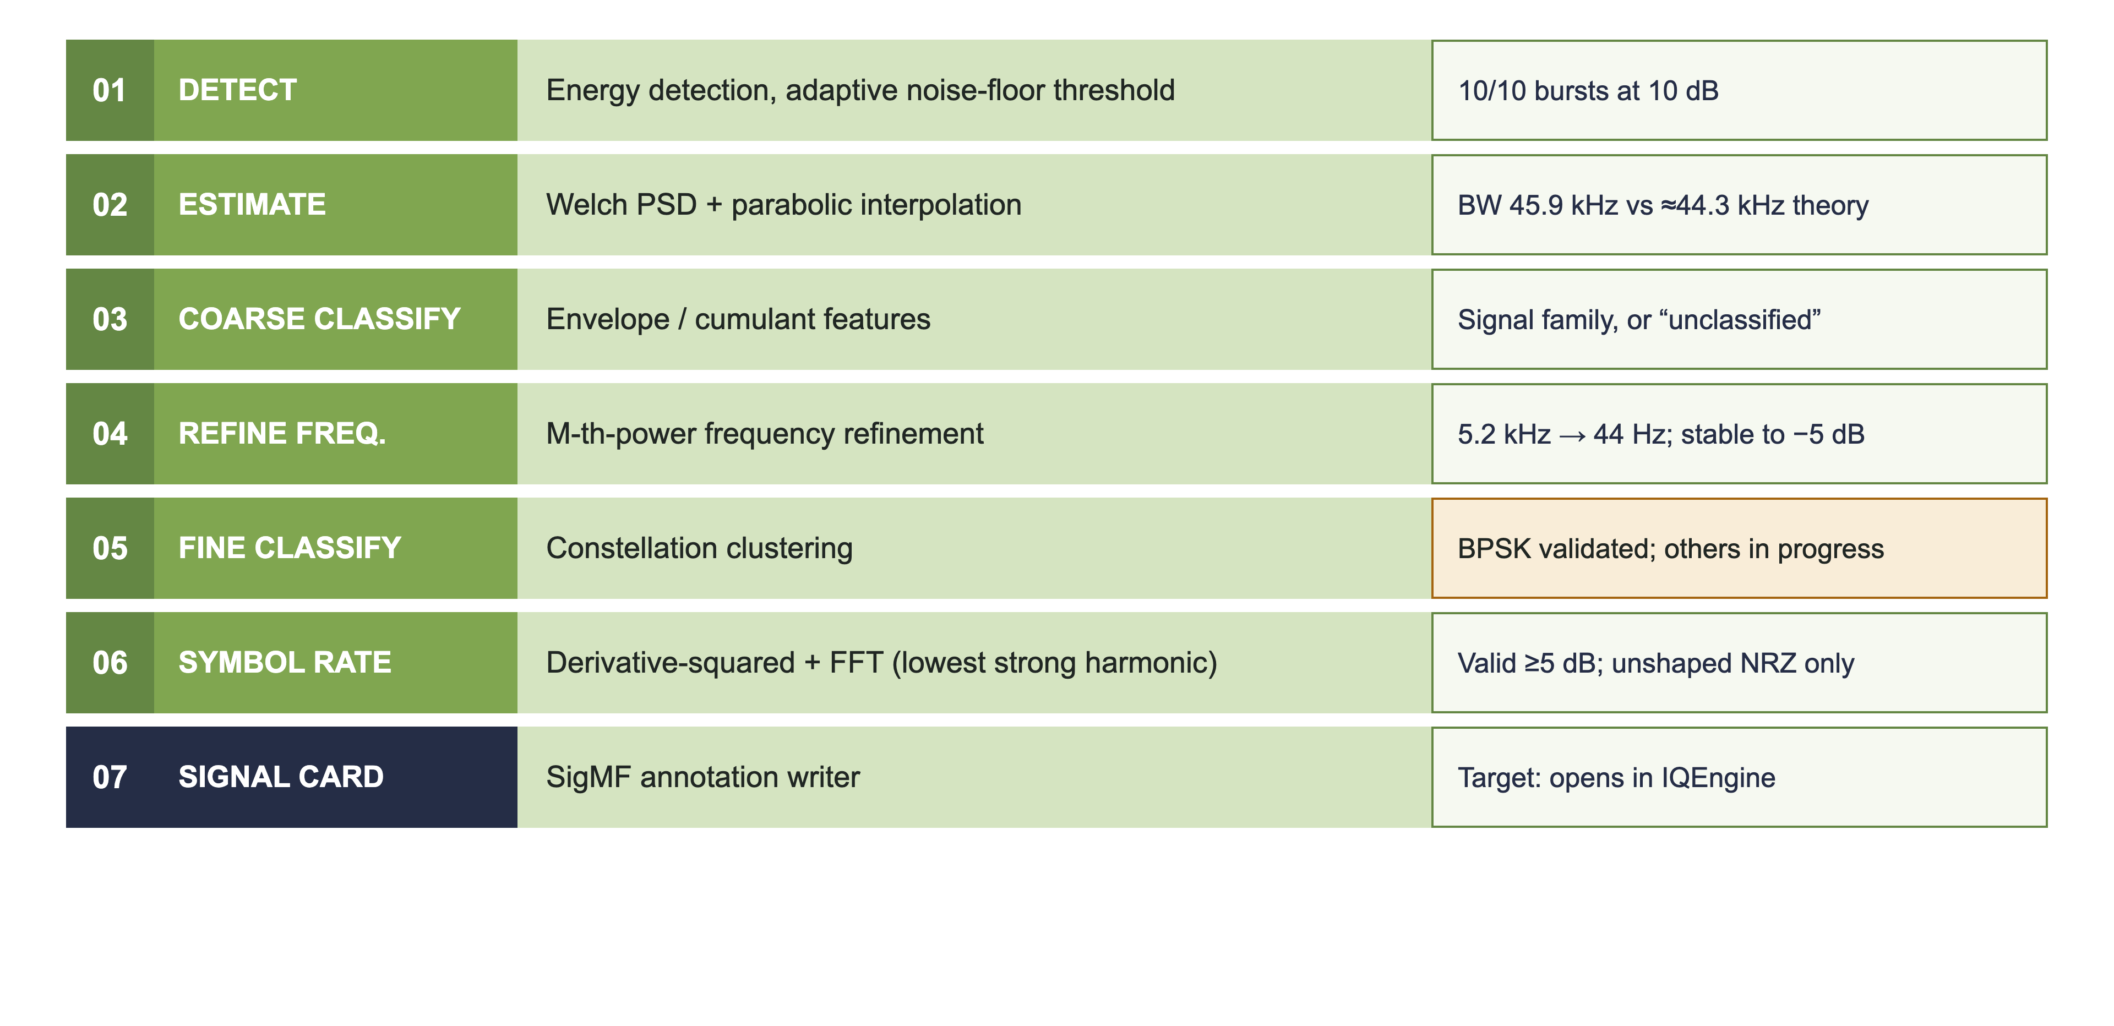
METHODOLOGY
STAGE · TECHNIQUE · VALIDITY
Validity notes: synthetic test signal, team Monte Carlo (N=100 for frequency and symbol rate).

Slide 8
TECH STACK AND BUDGET
OPEN-SOURCE, OFFLINE, CPU-ONLY
01
CORE
Python
NumPy
SciPy
scikit-learn
Matplotlib
sigmf
BUDGET
₹0
02
OPTIONAL
GNU Radio
IQEngine plugin
Open-source. Runs offline on a CPU laptop. No hardware.

Slide 9
DELIVERABLE / EXPECTED OUTCOME
WHAT THE JUDGES CAN RUN
01 · TOOL
02 · CARD
03 · SIGMF
04 · IMAGE
05 · PROOF
CLI + notebook
.json
.sigmf-meta
.png
report
Run on any capture
Per-file signal card
Annotations
Annotated spectrogram
Accuracy-vs-SNR curves, confusion matrix
ROADMAP
Desktop app · streaming · GPU · frequency-hopping characterisation

Slide 10
TEAM ROLE
TEAM PINPOINT · TIET
Member
Branch · Yr
DSP detection & estimation
Classification
Validation & testing
SigMF output & integration
Demo & deck
Dev Ariwala (Leader)
CSE · 3rd
[ASSIGN]
[ASSIGN]
[ASSIGN]
[ASSIGN]
[ASSIGN]
Shashvat Mishra
CE · 3rd
[ASSIGN]
[ASSIGN]
[ASSIGN]
[ASSIGN]
[ASSIGN]
Pranshu Sharma
CE · 3rd
[ASSIGN]
[ASSIGN]
[ASSIGN]
[ASSIGN]
[ASSIGN]
Suryansh Chauhan
CE · 3rd
[ASSIGN]
[ASSIGN]
[ASSIGN]
[ASSIGN]
[ASSIGN]
Paryag Kakkar
CSE · 3rd
[ASSIGN]
[ASSIGN]
[ASSIGN]
[ASSIGN]
[ASSIGN]
Shreya Gupta
CE · 3rd
[ASSIGN]
[ASSIGN]
[ASSIGN]
[ASSIGN]
[ASSIGN]
CSE = Computer Science and Engineering · CE = Computer Engineering

Slide 11
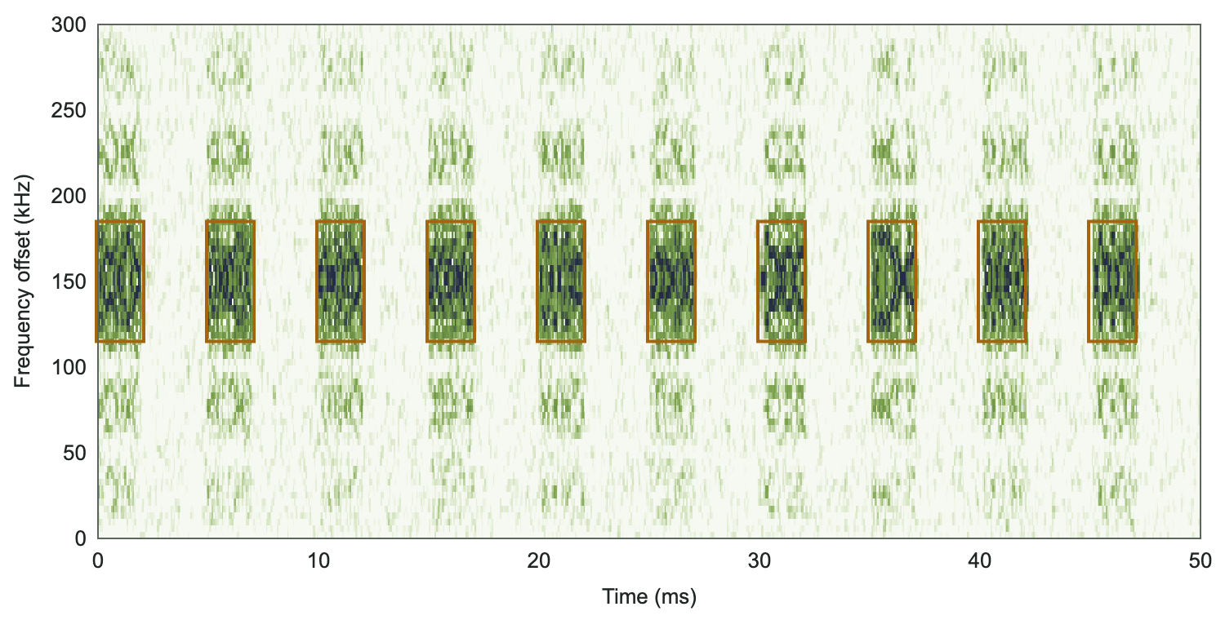
OUTCOME 1: PIPELINE OUTPUT
SPECTROGRAM + SIGNAL CARD
SIGNAL CARD
Bursts
10 / 10
PRI
4.998 ms (5.00)
Burst width
2.029 ms (2.00)
SNR
9.99 dB (10.0)
−3 dB BW
45.9 kHz (≈44.3)
Centre-freq error
5.2 kHz → 44 Hz
Symbol rate
valid ≥ 5 dB
Modulation
BPSK
(true / theory values in brackets)
Detected burst
BPSK · 1 MS/s · 150 kHz offset · 50 kSym/s · 10 dB SNR
Synthetic test signal — pipeline output. Synthetic test signal, team Monte Carlo. Centre-freq error: mean abs, N=100.

Slide 12
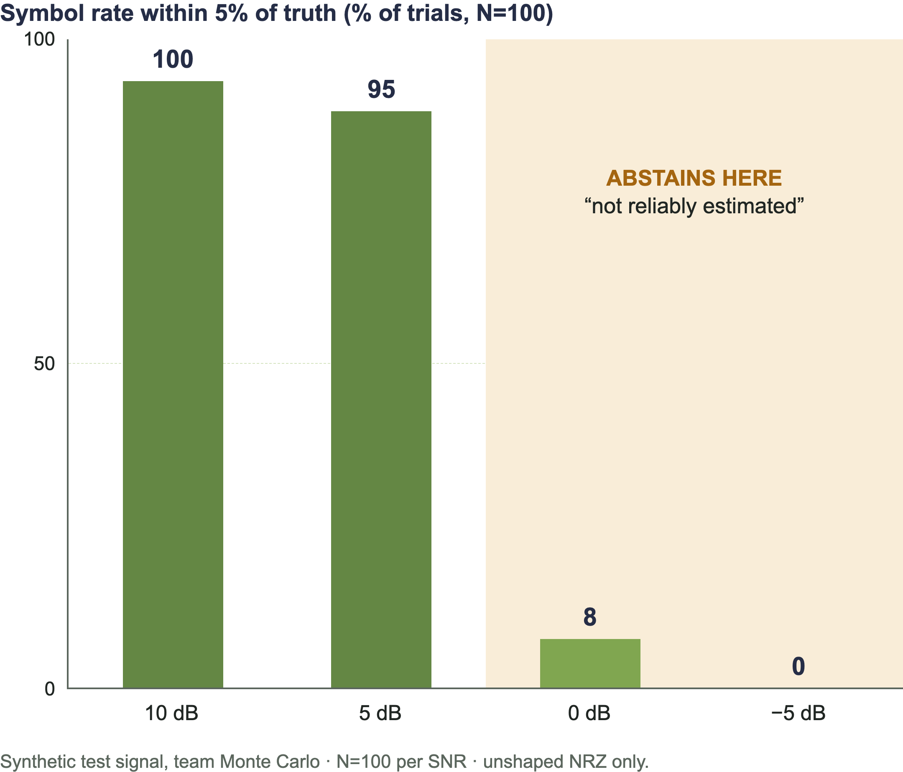
OUTCOME 2: HONEST ABSTENTION
SYMBOL RATE VS SNR
Below ~5 dB the tool reports “not reliably estimated” instead of a wrong number.
example.sigmf-meta · annotation
{
"core:sample_start": 0,
"core:sample_count": 2000,
"core:label": "BPSK",
"pinpoint:snr_db": 9.99,
"pinpoint:bw_3db_hz": 45900,
"pinpoint:symbol_rate":
"not reliably estimated"
}
Illustrative snippet; field names follow SigMF [1].

Slide 13
REFERENCES
SOURCES FOR EXTERNAL CLAIMS
1
SigMF — Signal Metadata Format specification. sigmf.org
2
A. Swami, B. M. Sadler, “Hierarchical digital modulation classification using cumulants,” IEEE Trans. Commun., 2000.
3
R. Tandra, A. Sahai, “SNR walls for signal detection,” IEEE J. Sel. Topics Signal Process., 2008.
4
D. C. Rife, R. R. Boorstyn, “Single-tone parameter estimation from discrete-time observations,” IEEE Trans. Inf. Theory, 1974.
5
T. J. O’Shea, T. Roy, T. C. Clancy, “Over-the-air deep learning based radio signal classification,” IEEE JSTSP, 2018.
6
IQEngine. github.com/IQEngine/IQEngine

Slide 14
Thank You
Team PinPoint · SIH26147
REPO
github.com/pranshu1141-sharma/Pinpoint

