Slide 1
CARELANE
AI-assisted healthcare guidance, booking
and queue estimation
Software Engineering Project · Mid-Semester Evaluation
Mayank Kalra · Pranshu Sharma · Shashwat Mishra
Thapar Institute of Engineering and Technology | September 2026
Notes:
Source: C:/Users/HP/Downloads/SE (14).pdf, PDF pages 1.

Slide 2
One connected patient journey
Patients often move between separate tools for guidance, doctor search, booking and visit status.
01
02
03
04
05
Describe symptoms
Find specialty
Choose doctor
Book a slot
Track the queue
Carelane links these steps in a local research prototype.
CARELANE · UCS503P
02
Notes:
Source: C:/Users/HP/Downloads/SE (14).pdf, PDF pages 3–4.

Slide 3
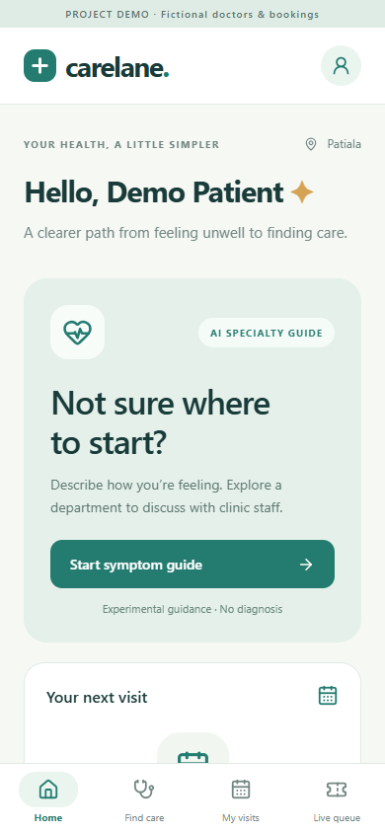
What works in the current prototype
Symptom-based specialty guidance
Fictional doctor and clinic search
Slot booking, cancellation and check-in
Simulated queue progression and wait estimate
Local React Native / Expo app
CARELANE · UCS503P
03
Notes:
Source: C:/Users/HP/Downloads/SE (14).pdf, PDF pages 3, 7, 12–13. The directory and queue are fictional or simulated.

Slide 4
System architecture
Specialty model
TF-IDF + LR
Research pipeline
Saved models and metrics
feed local inference
React Native / Expo
Patient app
FastAPI backend
JSON / HTTP
SQLite
Sessions + visits
Client
Service layer
CatBoost queue
wait estimate
CARELANE · UCS503P
04
Notes:
Source: C:/Users/HP/Downloads/SE (14).pdf, PDF pages 5–6. Architecture is the implemented local prototype.

Slide 5
UML use case diagram
CARELANE SYSTEM
Get specialty
guidance
Search
doctors
Book
appointment
Patient
Demo desk
Patient actions
Queue control
Manage
visit
View live
queue
Advance demo
queue
CARELANE · UCS503P
05
Notes:
Source: C:/Users/HP/Downloads/SE (14).pdf, PDF pages 8. The actors and use cases match the report.

Slide 6
Activity diagram: patient visit
Create demo
session
Enter symptoms
Get specialty
guidance
Search doctor
Book slot
Continue only if the user selects a doctor and an available slot.
Complete visit
View queue
Check in
Demo desk advances the queue after check-in.
CARELANE · UCS503P
06
Notes:
Source: C:/Users/HP/Downloads/SE (14).pdf, PDF pages 9. Simplified activity flow; booking and queue use demo data.

Slide 7
UML class diagram
Session
────────────────
sessionId
tokenHash
createdAt
Appointment
────────────────
appointmentId
doctorId
slot, status
Doctor
────────────────
doctorId
name
department, clinic
Queue
────────────────
patientsAhead
activeDoctors
waitingTime
CareService
────────────────
getGuidance()
bookAppointment()
checkIn()
SpecialtyModel
────────────────
loadModel()
predict()
rank()
CARELANE · UCS503P
07
Notes:
Source: C:/Users/HP/Downloads/SE (14).pdf, PDF pages 8. Conceptual classes from the report, not a generated ORM schema.

Slide 8
Iterative software development life cycle
1 Requirements
2 Design
3 Implementation
Patient workflow and scope
Client, API, data model
Models, app, booking
4 Testing
5 Evaluation
6 Improvement
Backend and browser
ML and queue metrics
Data, security, device tests
Repeat as evidence and requirements change
CARELANE · UCS503P
08
Notes:
Source: C:/Users/HP/Downloads/SE (14).pdf, PDF pages 9–10. The current prototype has completed initial implementation and evaluation; improvement continues.

Slide 9
Model training and datasets
Specialty guidance
Queue estimation
1,053 retained symptom records
12,150 simulated visits over 90 days
Nine specialty classes
Chronological 60 / 15 / 15 day split
673 train, 168 validation, 212 test
CatBoostRegressor on queue state features
TF-IDF + Logistic Regression and DistilBERT
MAE used for model selection
The clinical dataset is small and labels are mapped from conditions. Queue data is simulated.
CARELANE · UCS503P
09
Notes:
Source: C:/Users/HP/Downloads/SE (14).pdf, PDF pages 6. Training methods and dataset sizes from the report.

Slide 10
Specialty classification results
96.70%
95.75%
TF-IDF + Logistic Regression
test accuracy
DistilBERT
test accuracy
Test macro-F1
0.9683
0.9596
Both models reached 100% top-three accuracy on the retained test partition.
CARELANE · UCS503P
10
Notes:
Source: C:/Users/HP/Downloads/SE (14).pdf, PDF pages 11. Experimental research metrics; not clinical performance.

Slide 11
Simulated queue estimation
Mean absolute error on the test set
6.378 min
5.464 min
Simple baseline
CatBoost
14.34% lower MAE
Measured only within the first-come, first-served simulation.
CARELANE · UCS503P
11
Notes:
Source: C:/Users/HP/Downloads/SE (14).pdf, PDF pages 12.

Slide 12
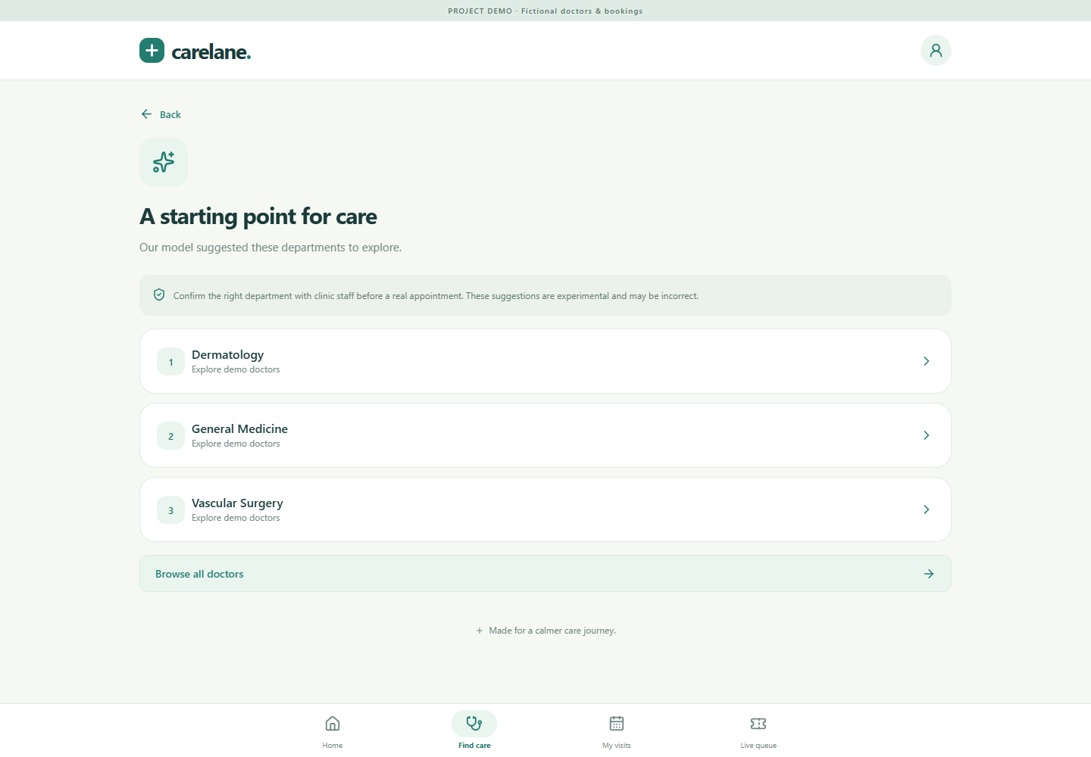
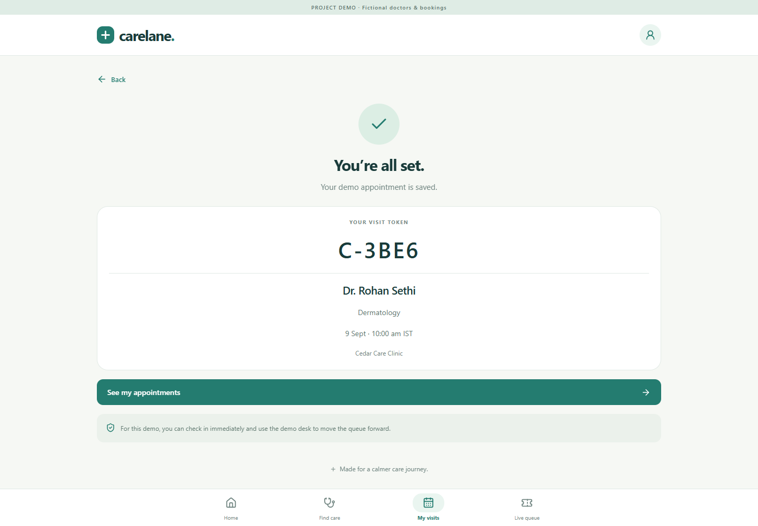
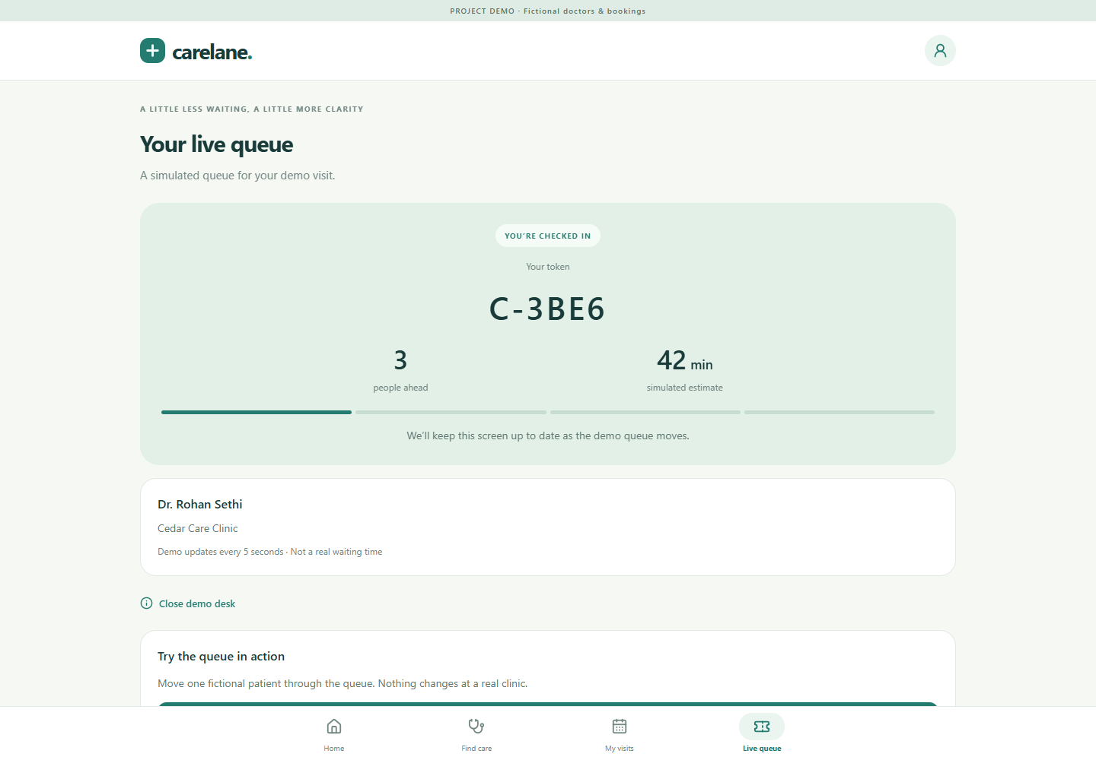
Application workflow in the demo
Guidance
Booking
Live queue
CARELANE · UCS503P
12
Notes:
Source: C:/Users/HP/Downloads/SE (14).pdf, PDF pages 7, 12. Screenshots are from the saved local app verification.

Slide 13
Verification and current limits
Verified
Still required
Four backend tests passed
Independent clinical validation
Nine browser checks passed
Real providers and operational queue data
TypeScript, web and Android JS exports completed
Production security and privacy assessment
Booking ownership and slot contention checked
Physical Android testing and signed build
CARELANE · UCS503P
13
Notes:
Source: C:/Users/HP/Downloads/SE (14).pdf, PDF pages 11–14. The Android export is not a signed APK or physical-device test.

Slide 14
Carelane: next development cycle
An integrated local prototype is working.
The next stage is governed real-world validation.
Clinician-reviewed data and external evaluation
Operational queue data and richer workflow rules
Authentication, audit, device testing and signed release
Current model metrics describe an experiment, not clinical readiness.
CARELANE · UCS503P
14
Notes:
Source: C:/Users/HP/Downloads/SE (14).pdf, PDF pages 13–14.

