Slide 1
Data Science Project on “Payment Fraud Detection”
Pranshu Joshi pranshujoshi2004@gmail.com

Slide 2
Contents:
Data Science Project Report
Data Description
Data Analysis and Preprocessing
Basic Analyses
Correlation Heatmap
Predictive Modelling
Conclusion
Appendix

Slide 3
Data Science Project Report
Predictive Analysis on E-commerce Transactions
The objective of this project is to perform predictive analysis on e-commerce transactions data to identify patterns and predict transaction outcomes.
The dataset contains information about e-commerce transactions, including account age, number of items purchased, payment method, and transaction outcome.
Back to main slide

Slide 4
Data Description
The dataset consists of the following columns:
accountAgeDays: Age of the account in days.
numItems: Number of items purchased in the transaction.
localTime: Local time of the transaction.
paymentMethod: Payment method used for the transaction.
paymentMethodAgeDays: Age of the payment method in days.
label: Binary label indicating the transaction outcome (0: Not fraudulent, 1: Fraudulent).
Back to main slide

Slide 5
Data Analysis and Preprocessing:
Data Cleaning: The dataset was checked for missing values, and rows with missing values were dropped to ensure data integrity.
Feature Engineering: The 'localTime' column was converted to datetime format, and hour and minute features were extracted from it. Categorical variables were encoded using one-hot encoding.
Exploratory Data Analysis (EDA): Pairplot and correlation heatmap were generated to visualize relationships between variables and identify patterns in the data.
Exploratory Data Analysis (EDA):
Pairplot: The pairplot provided visualizations of pairwise relationships between variables, allowing us to observe trends and identify potential correlations.
Correlation Heatmap: The correlation heatmap visualized the correlation between different variables, helping us understand the strength and direction of relationships.
Back to main slide

Slide 6
All the basic analyses for the payment fraud detection are as follows:
Generated by scikit-learn
Back to main slide

Slide 7
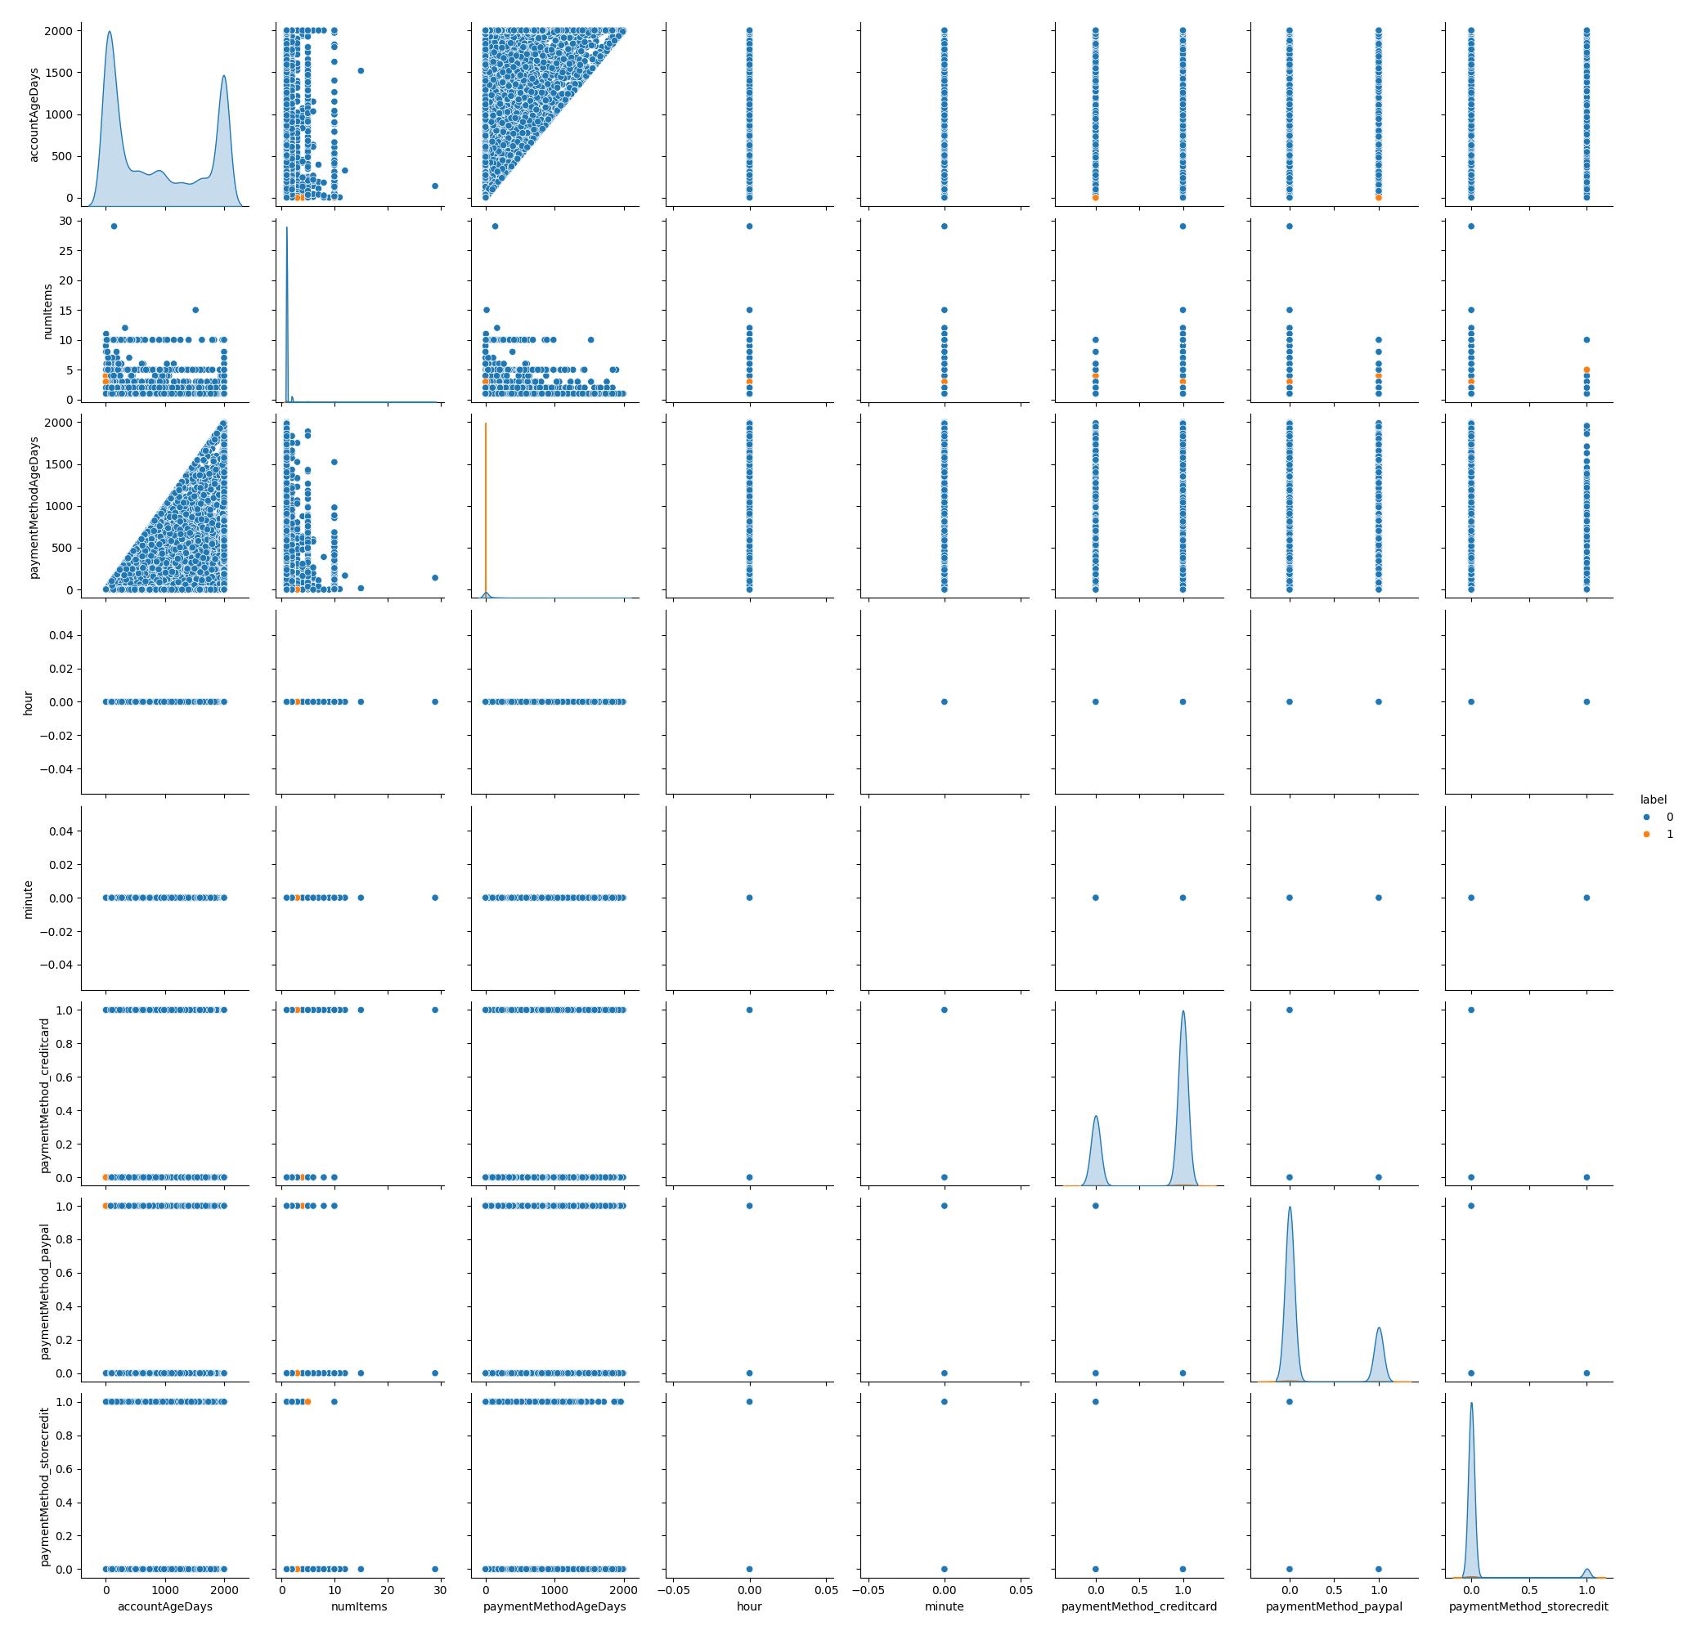

Slide 8
On the next slide is the correlation heatmap of the aforementioned analysis.
Generated by scikit-learn
Back to main slide

Slide 9
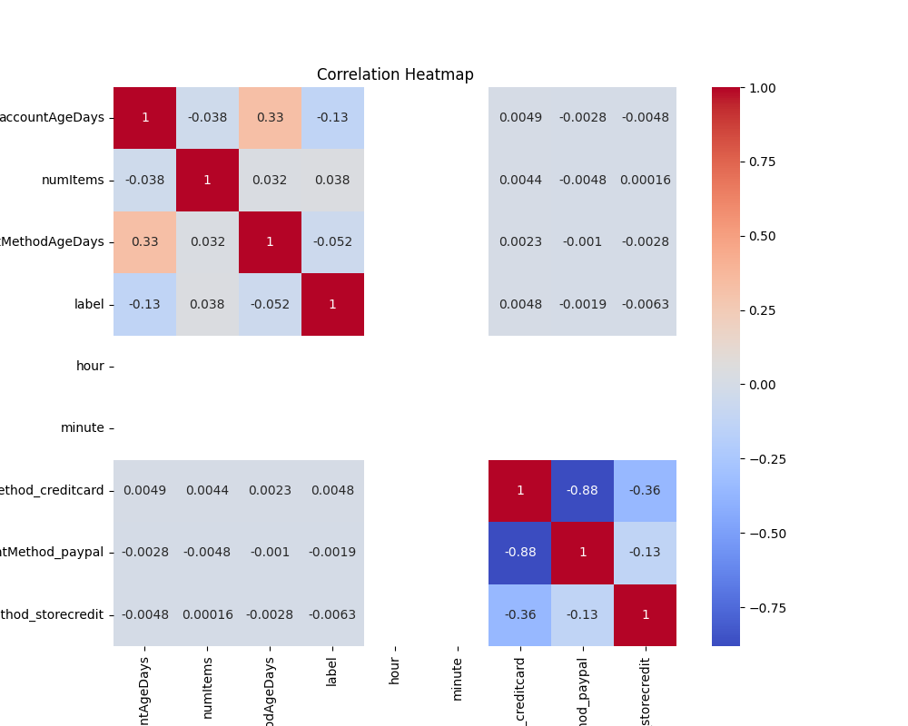

Slide 10
Predictive Modelling:
Data Splitting: The dataset was split into training and test sets to train and evaluate the predictive model.
Feature Scaling: Features were scaled using StandardScaler to standardize the range of feature values.
Model Building: A Random Forest Classifier model was built and trained on the training data to predict transaction outcomes.
Model Evaluation: The model's performance was evaluated using accuracy scores and a classification report, which provided insights into its predictive capabilities.
Back to main slide

Slide 11
Conclusion:
In conclusion, this project successfully analyzed e-commerce transactions data, performed exploratory data analysis, and built a predictive model to identify fraudulent transactions. The insights gained from this analysis can be valuable for fraud detection and prevention in e-commerce platforms.
Back to main slide

Slide 12
Appendix
Project Code
Basic Analyses
Correlation Heatmap
Back to main slide

