Slide 1

Efficient Information Retrieval System using Stack Overflow data.
Team Members:
Gajender Sharma - 21111028
Kajal Sethi - 21111033
Pranshu Sahijwani - 21111048
Utkarsh Srivastava - 21111063

Slide 2
NEED FOR THE PROJECT
Efficient Information Retrieval is one of the most sought after topics in the field of Natural Language processing.
Due to large amount of data generated/available, developing a system for efficient information retrieval is utmost important.
Uniqueness – low computational/server cost. And easily deployable and very scalable.
Issues that we will address - latency in search results when the dataset is very large

Slide 3
We aim to deliver
Low latency in providing search results even with large dataset.
IR system with high precision and recall rate.
An IR system with low computational/server cost.
Easily deployable and scalable IR system.

Slide 4

INTRODUCTION
Stack Overflow serves as a platform for users to ask and answer questions. It features questions and answers on a wide range of topics in computer programming and is visited by anyone in computer science field on daily basis.
We have built an efficient information retrieval system that work on a subset of Stack Overflow data which uses the concept of inverted index to gives top results of any query asked, in less than 1 second time.
Notes:
Stack Overflow serves as a platform for users to ask and answer questions, and, through membership and active participation, to vote questions and answers up or down. It features questions and answers on a wide range of topics in computer programming and is visited by anyone in the computer science field on daily basis

Slide 5

Dataset
The dataset consists of 10% of Stack Overflow programming Q&A website data(12,00,000 Questions).
This dataset is organized into three tables (csv's).
Questions - contains the title, body, creation date, closed date (if applicable), score, and owner ID for all non-deleted Stack Overflow questions whose Id is a multiple of 10.
Answers - contains the body, creation date, score, and owner ID for each of the answers to these questions. The ParentId column links back to the Questions table.
Tags - contains the tags on each of these questions
Link to dataset: StackSample: 10% of Stack Overflow Q&A | Kaggle

Slide 6
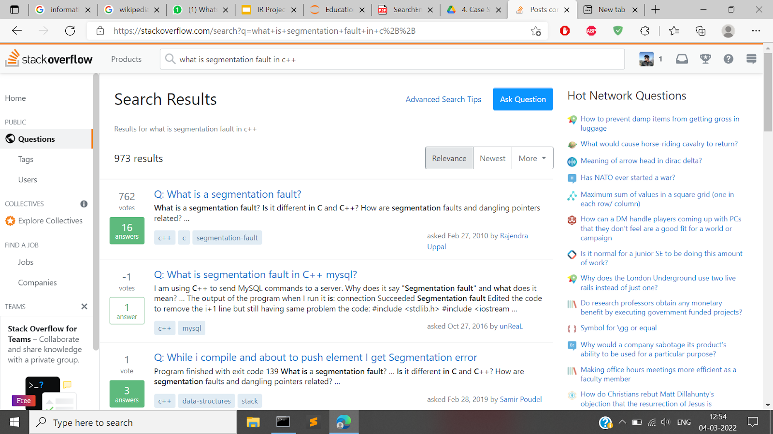
Sample search in Stack Overflow

Slide 7

Preprocessing
The following steps were done to clean the data.
Remove HTML tags.
Remove stopwords.
Remove punctuations.
Fill NA values.
Summarized question body.
Vectorized question body using Google Encoder.
Concatenated question.csv and answer.csv.

Slide 8
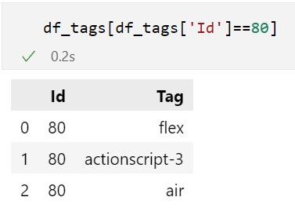
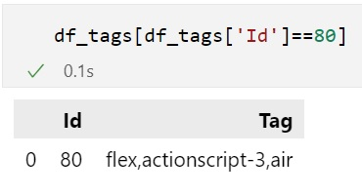
Data Preprocessing

Slide 9
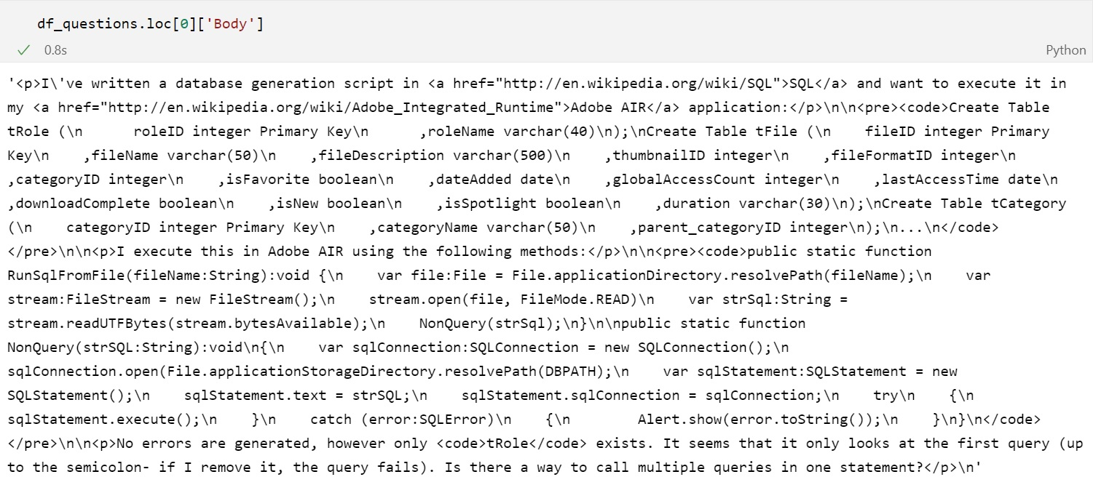
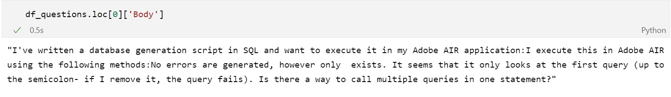

Slide 10


Slide 11
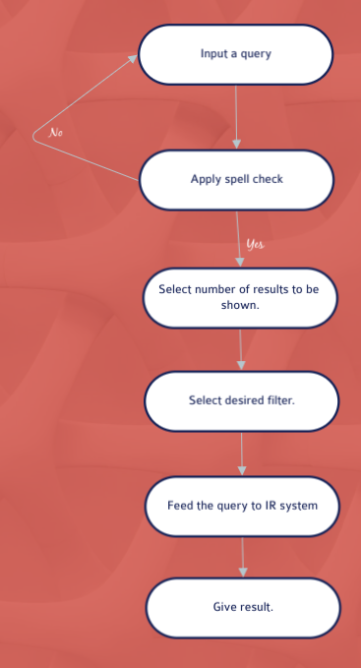
I/O WORKFLOW FOR USER QUERY PROCESSING

Slide 12
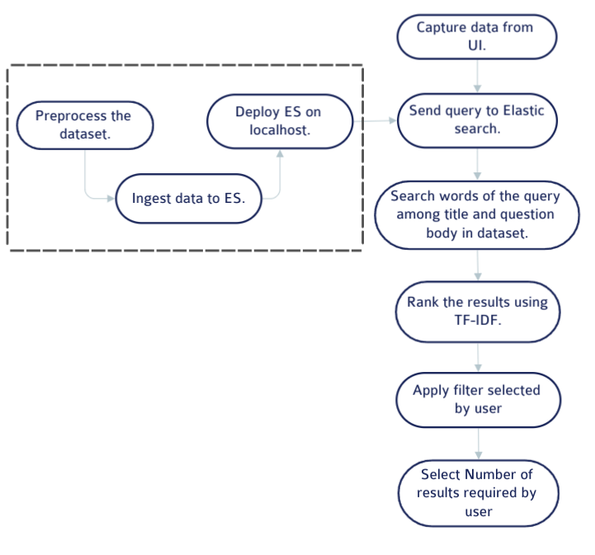
Already done
Flow chart for backend

Slide 13
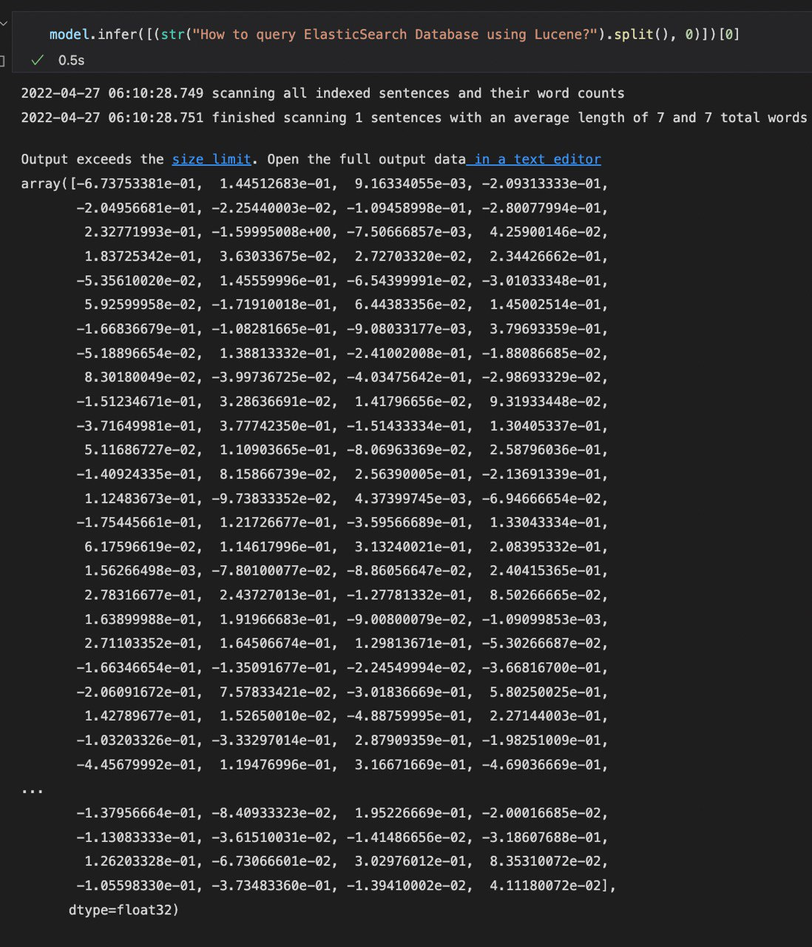
Methodology
The project consisted of the following parts.
Cleaning, preprocessing the data.
Installing Elastic-Search, Kibana, Logstash in standalone mode
Adding sentence vectors for Question Titles using Glove-300 embeddings.
Ingesting the data into elastic search, indexing it using Tf-Idf, Vector Space Models etc.
Developed front end to interact the Elastic Database using the Python API and calculating score using the cosine similarity
Processing and displaying the results as per the user's request.

Slide 14
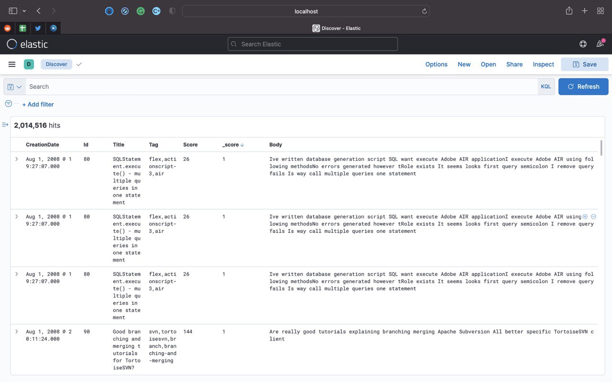
Data in elastic search

Slide 15

Results
Top 10/50/100/all queries are processed by the IR system we developed.
Average time taken by a query ranges between 5 to 20 milliseconds.
The system has high recall and precision rate.
The system is easily scalable and can also work efficiently with larger dataset.
The IR system is easily deployable on website using Streamlit.
The IR system is memory friendly, that is, the computational cost is low as Elastic Search has been used for inverted index.

Slide 16
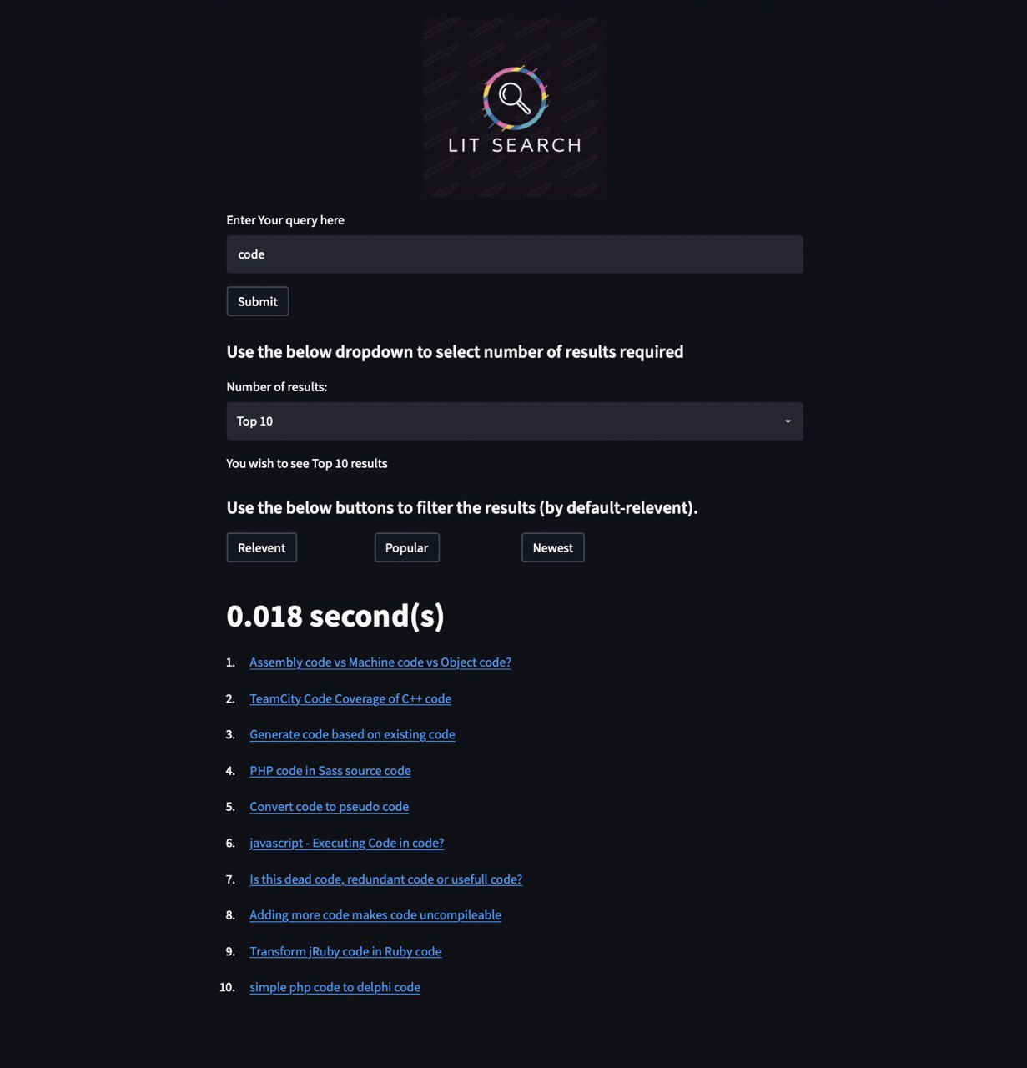
Final Demo of the UI

Slide 17
Challenges:
Ingesting sentence vectors into Elastic-Search (JSON Serialization issues)
Data was taking too much space on our system’s RAM so we worked our dataset in chunks of 2 lakhs rows at a time.
Most challenging part was to vectorize the question’s title and tags for a particular question for the quick search so that most relevant words in questions body is used but not the whole paragraph which we resolved using Glove model.
Communication between Elastic-Search and Python is not so fluent

Slide 18
Thank You.

