Slide 1
Extraction and Analysis of National Institutional Ranking Framework Data
Group - 34
Team members:
Chabil Kansal(chabilk21@iitk.ac.in) 21111022
Kajal Sethi(kajals21@iitk.ac.in) 21111033
Pranshu Sahijwani(pranshus21@iitk.ac.in) 21111048
Sharanya Saha(sharanya21@iitk.ac.in) 21111056
Utkarsh Srivastava(utkarshs21@iitk.ac.in) 21111063

Slide 2
Introduction
The National Institutional Ranking Framework (NIRF) was approved by the MHRD and launched by Honourable Minister of Human Resource Development on 29th September 2015. This framework outlines a methodology to rank institutions across the country. A lot of information is published by the board but it is not given any analytical form which could help in doing an analytical comparison between multiple institutes. Therefore we aim to extract the data present on the website in PDF format and do various sorts of analysis on the data.

Slide 3
Data Source :
National Institutional Ranking Framework(NIRF Official Website)
This framework outlines a methodology to rank institutions across the country. The parameters broadly cover “Teaching, Learning and Resources,” “Research and Professional Practices,” “Graduation Outcomes,” “Outreach and Inclusivity,” and “Perception”
We have considered doing analytics on the ranking data provided by NIRF for last three years:
NIRF India Rankings 2021: Overall
NIRF India Rankings 2020: Overall
NIRF India Rankings 2019: Overall
NOTE: The data provided here is in the PDF format, which we have used to do further preprocessing
and analytics.

Slide 4
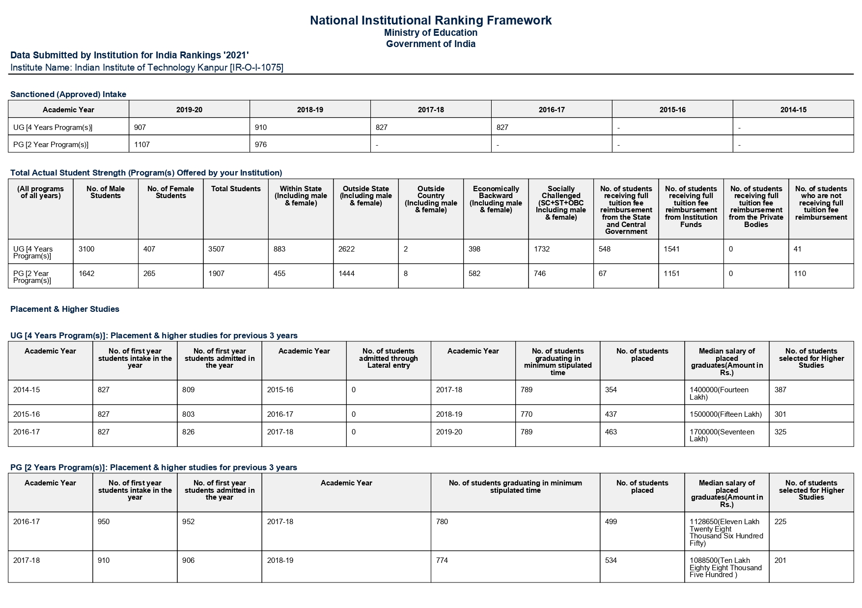
Data Format
Each college has a separate PDF file
Multiple tables in a PDF file
Tables dimension non-uniform
Sample Snapshot of NIRF Tables

Slide 5
Data extraction
300 PDF files(each corresponding to top 100 colleges of 2021, 2020, 2019) were processed
Common tables were determined, i.e. tables present in each of the 100 colleges for a particular year
Final dataset was created, consisting of csv files for different parameters across top colleges over last three years

Slide 6
Major Challenges:
Retrieving cross page tables
Extraction of single lined tables
Inconsistency in the PDF format over the years
Different number of tables in the PDFs
Large numbers of NA values and NULL characters
Spelling mismatches in college names

Slide 7
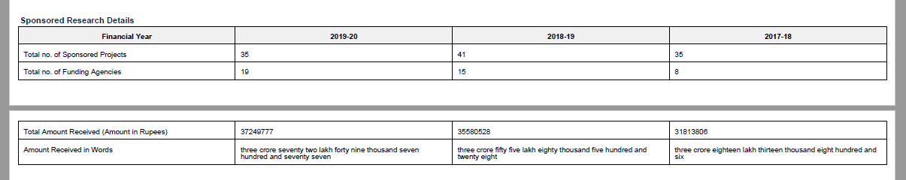
Solutions to Challenges Faced
Problem: Cross Page Tables
Solution: Used all possible string combinations which could be occurring in last row of 1st table and first row of 2nd table.

Slide 8
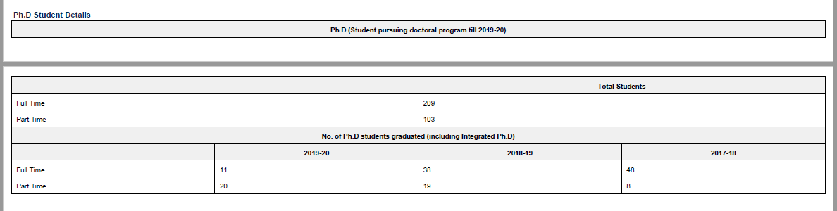
Solutions to Challenges Faced
Problem: Mismatched number of columns in cross page tables
Solution: Made a dictionary to extract relevant details and later added to a dataframe explicitly.

Slide 9
Solutions to Challenges Faced
Problem: Table consisting of a single line only.
Solution: Used PyPDF to extract PDF in text format and then used text matching to extract required row.

Slide 10
Dataset Cleaning and Pre-processing :
Colleges not consistent were dropped from analysis
College names were corrected manually (College name varies over the years, for example: ISM Dhanbad is mentioned as IIT ISM Dhanbad and IIT (Indian School of Mines, Dhanbad)
Tables having mismatching number of columns were extracted using dictionaries in Python

Slide 11
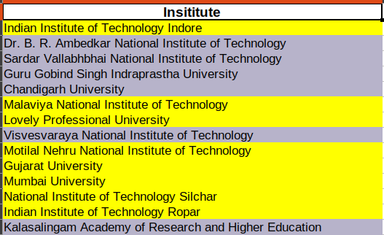
Analysis of consistency of Institutes in NIRF Rankings
List of the institutes which do not appear in Top 100 for the three consecutive years.
Present in 2020 and 2021
Only Present in 2021

Slide 12
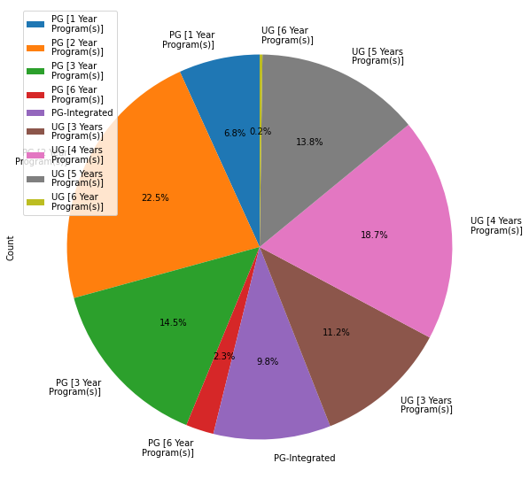
How frequently a program is conducted in the top institutes.
We have counted the unique programs and then found how many institutes conduct each of the courses.

Slide 13
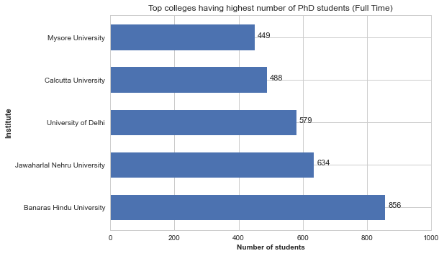
Average number of PhD students over last 3 years.
The total number of PhD students in a college is also indicative of how much research is supported and funded by the institutes.

Slide 14
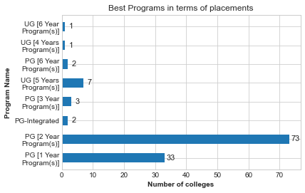
Best Program in terms of percentage of students getting placed
No. of students placed
X 100
No. of students graduated

Slide 15
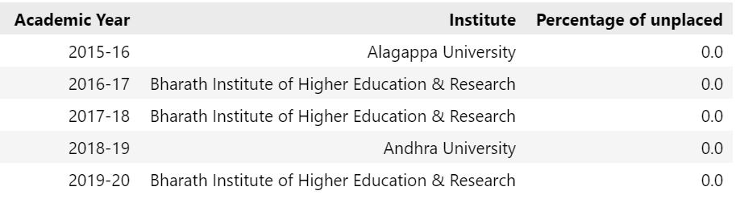
Percentage of students unplaced

Slide 16
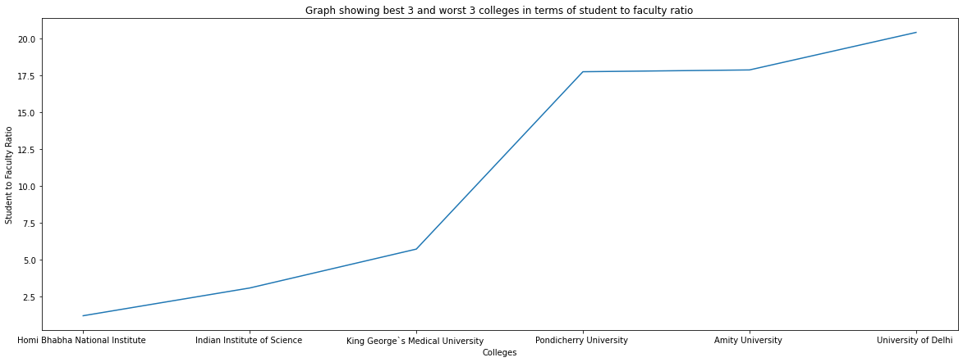
Analysis of Student to Faculty Ratio
The Graph shows the best and worst institutes in terms of student to faculty ratio.

Slide 17
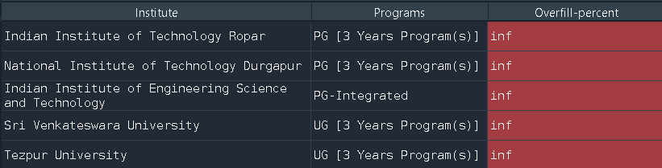
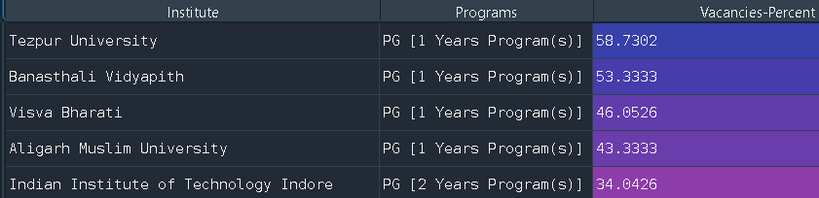
Analysis of programs in various colleges that either overfill or have vacant seats
Top5 programs with highest overfill percentage.png

Slide 18
MILESTONES ACHIEVED
Exploring different project ideas
Presented the idea to professor
Worked on report and presentation
September
October
November
Decided on the project idea and looked for relevant dataset
Worked on cleaning and preprocessing the PDFs
Performed the analytics on the processed data

Slide 19
Thank you
max growth
Feedback is welcome :).

