Slide 1
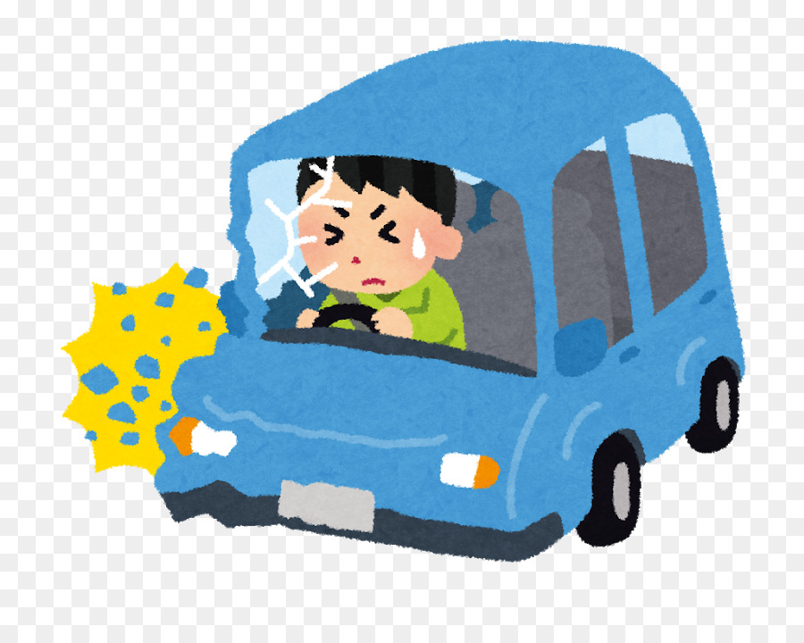
SAFE VEHICLE
TEAM: Falcon
Members:
Gajender Sharma
Kajal Sethi
Pranshu Sahijwani
Shivam Tripathi

Slide 2
Objective
Drowsiness of the driver is one of the leading causes for car accidents today
Observe the behaviour of the driver and send alerts
Prevent potential accidents
Shortcomings of Current Systems
Proposed Functionalities
Analyzes Behaviour
Alerts Driver and Sends Notification to Relatives and Nearby Hospitals
Records Location using GPS
Seat Belt and Face mask detection
Additional: Crash Sensor to Measure Intensity of the Accident
Doesn’t Track Behaviour
Doesn’t Record Crash Intensity
Frequently Raises False Alarm

Slide 3
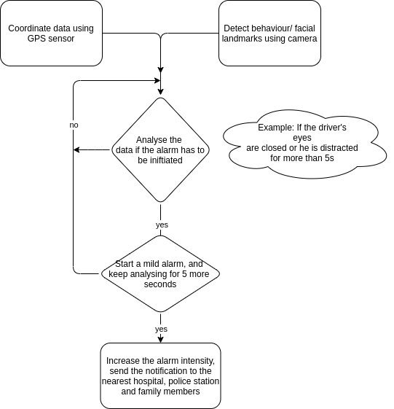
Workflow
Hardware Required
Raspberry Pi or Intel Edison
GPS Sensor
Camera or IR Sensor
Speaker
Crash or FSR Sensor
Accelerometer

Slide 4
References
Bakar, Auni Syahirah Abu, et al. "IOT—Eye Drowsiness Detection System by Using Intel Edison with GPS Navigation." Proceedings of the 10th National Technical Seminar on Underwater System Technology 2018. Springer, Singapore, 2019
Future scope
Observing the pulses of the driver to detect any kind of abnormality with the driver.
Gradually decrease the speed of the vehicle with turning the hazard lights on.

