Slide 1
Use Case Title- Predicting Crop Yields & Weather Impact (Agriculture & Disaster Management)
Team Name- InnoVentures

Slide 2
Team Introduction
Team Name: InnoVentures
Team Lead: Priyanshi Srivastava
Team Members: Pranshu Agrahari, Pragya Sharma, Gunjan Srivastava, Utkarsh Singh
About the Team: We are a group of students and developers passionate about applying technology to solve real-world challenges in agriculture. Our team brings together practical coding experience, problem-solving skills, and an understanding of rural and farming ecosystems.
🧠 We work on AI and ML models for tasks like plant disease detection, crop recommendation, and yield prediction.
💻 We develop full-stack applications with technologies like Flask, Firebase, REST APIs, and frontend frameworks.
🌱 We focus on making our solutions simple, localized, and farmer-friendly.
📢 We aim to bridge the digital divide by creating tools that empower farmers with timely insights and actionable guidance.

Slide 3
Talk about your problem
Agriculture in India is highly dependent on climatic conditions. Unpredictable rainfall, temperature spikes, floods, and droughts can severely impact crop productivity. Farmers, especially in rural areas, often lack access to advanced tools that can help them make informed decisions about when to sow, irrigate, or harvest their crops.
This leads to:
Reduced crop yields
Increased economic losses
Delayed disaster responses by authorities
Our problem is to build a system that predicts crop yields and highlights weather-related risks, so that:
Farmers can take preventive action .
Authorities can plan and mitigate disasters (like droughts or floods).
Agricultural productivity is optimized through early warnings and data-driven insights.

Slide 4
Talk about how you used GenAI to solve the problem. Give examples
We used IBM’s Watsonx.ai and GenAI models hosted on IBM Cloud to analyze large datasets and generate intelligent insights.
GenAI Usage Highlights:
1. Data Understanding and Enhancement (Preprocessing Assistance)
We used GenAI models to assist in cleaning, preprocessing, and summarizing datasets.
Given raw CSV data (soil type, rainfall, crop yield, etc.), we used GenAI to automatically detect missing values, suggest imputations, and create derived features like:
“Rainfall deviation from average”
“Crop stress index”
2. Time-Series Crop Yield Prediction Using GenAI Models
We trained AI models on historical agricultural data using time-series prediction algorithms available in IBM Watsonx.ai.
GenAI helped in automatically selecting the best model (e.g., ARIMA, LSTM, Prophet) for predicting yields based on historical trends, soil conditions, and climate data.
Example:
In Karnataka, using 10 years of paddy production data and monthly rainfall patterns, the model predicted that due to a 30% drop in rainfall, the yield may reduce by 18%.
3. GenAI Chatbot for Real-Time Farmer Support
We implemented a GenAI-powered chatbot using IBM Watson Assistant, trained on:
Crop information
Soil needs
Weather patterns
Fertilizer recommendations
Example:
Farmer: “What crop is best for July in Maharashtra?” Bot: “Based on expected rainfall and soil, soybean and cotton are suitable crops for July in your area.”

Slide 5
Explain the user experience of your application
We designed a user-centric web and mobile app for both farmers and government authorities. The experience focuses on simplicity, speed, and relevance.
Farmer Interface:
Enter location and crop details
See:
Voice assistant support for rural users.
A simple card-based layout with:
Current weather conditions
Crop-specific yield predictions
Today's alerts (rain warning, pest alerts, etc.)
Personalized suggestions
Example:
“Good morning, Ramesh! 🌤️ Light rainfall expected today. Your cotton crop yield is expected to be normal. Please irrigate only in the evening.”
Chatbot Support (Optional Integration)
Farmers can ask a GenAI chatbot: “Which crop is better for August?” “How do I protect wheat from rust disease?” “Will it rain this week?”

Slide 6
More about “Explain the user experience of your application”
Government Schemes Section
PM-KISAN
PMFBY
PMKSY
Soil Health Card
Kisan Credit Card (KCC)
eNAM
PKVY
MIDH
RAFTAAR
AIF
YouTube Playlists Section (We have given farming tips playlist which could help farmers easily for their crop production )
Farming Playlist
Agri & Farming Videos
Global Ag Videos

Slide 7
Explain the power of your application
FEATURES | Description
AI-powered Prediction | Predicts crop yield based on environmental data
Weather Impact Analysis | Flags yield risks due to extreme weather (drought, flood)
Model Retraining | Improves over time using new data
Disease Detection | Detects crop diseases from leaf images to enable early diagnosis and reduce yield loss
Crop Recommendation | Recommends the best-suited crop based on soil, weather, and past patterns to improve yield and sustainability.
Yield Prediction | Forecasts expected crop yield based on local soil, weather, and farming practices to help in planning
Soil Recommender | Suggests nutrients and soil amendments when a mismatch between crop and soil is detected.
Chatbot | Provides instant answers to farmer queries in local languages.
Voice Assistant | Allows hands-free interaction with the app, enabling accessibility for non-literate farmers.

Slide 8
Explain the potential (future use cases) of your application
Our system can evolve into a national-level smart agriculture solution. Some high-impact future use cases include:
Advanced Crop Planning
Farmers can simulate yield for different crops and choose the best one for the season.
Integration with Government Schemes
Can be linked with crop insurance schemes like PMFBY.
Automated claim generation during natural disasters.
IoT and Drone Integration
Combine with drones and smart sensors for hyper-local crop health analysis.
Global Agri-Trade Forecasting
Exporters can analyze which regions will produce surplus/deficit for a crop and plan logistics.
AI-assisted Decision Making for Policymakers
Governments can track vulnerable districts in real-time and allocate resources effectively.

Slide 9
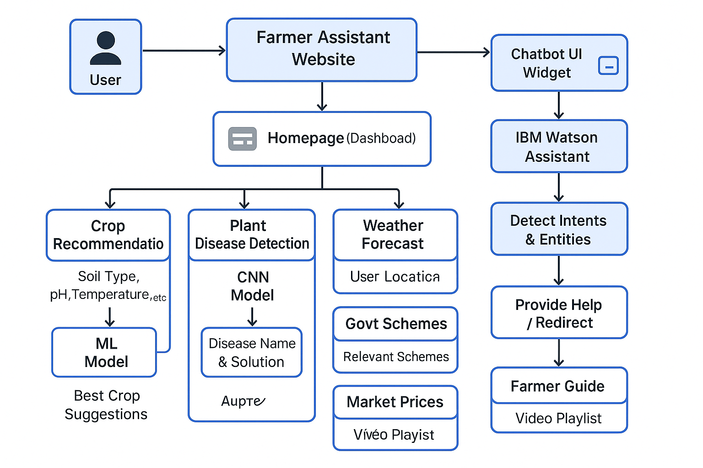
Data Flow Diagram

Slide 10
Thank You

