Slide 1
Use Case Title- AI-Powered Citizen Grievance redressal System
Team Name- Trishul

Slide 2
Team Introduction
Team Name: Trishul
Project title: Computer Vision and Machine Learning based State-of-the-Art Methodology for Enhancing
Women’s Safety
Team Lead: Pranshu Agrahari
Team Members: Priyanshi Srivastava, Pragya Sharma, Gunjan Srivastava, Kshitij Gupta
About the Team:
We are a group of students and developers dedicated to harnessing cutting-edge technology to tackle
critical real-world problems, such as improving women’s safety through enhanced surveillance
systems. Our team combines practical coding experience, problem-solving skills, and machine
learning, computer vision, and real-time analytics to create a system that ensures timely and
accurate threat detection, whether urban or rural, for maximum impact on women’s safety

Slide 3
1. Talk about your problem
Women’s safety remains a major concern across many cities and rural areas, especially during night hours or in isolated locations. Traditional safety apps are reactive — they rely on the user pressing a panic button or making a call, which might not always be possible in high-stress or emergency situations.
Growing Threat to Women's Safety
In recent years, crimes against women in public spaces have seen a concerning rise — including harassment, stalking, assault, and abduction. Many of these incidents occur in isolated locations, busy public areas, or during night hours when human monitoring is limited or delayed.
Limitations in Existing Surveillance Systems:
Most current surveillance systems are passive and reactive:
Manual Monitoring: CCTV footage needs to be watched by operators 24/7, which is not scalable or reliable.
Delayed Response: By the time a threat is detected (often after an incident has occurred), it’s too late to prevent it.
No Real-Time Alerts: Current systems don’t raise alarms unless manually triggered or observed.
Lack of Context Awareness: Existing cameras cannot interpret human behavior — they only record.
Problem in One Line:
There is no intelligent, real-time, autonomous system capable of identifying and preventing potential threats to women's safety in public spaces through behavioral analysis, gesture recognition, and automated alerts.
Real-Life Scenarios Highlighting the Problem:
A woman being followed at night on a bus stop goes unnoticed because the CCTV is just recording, not analyzing.
A child being abducted in a public park — no real-time detection, no alert to nearby police.
A woman signaling distress in a crowd but unable to shout or call — the gesture goes unnoticed by cameras.

Slide 4
2. Talk about how you used GenAI to solve the problem. Give examples
We integrated Generative AI (GenAI) on IBM Cloud to:
a. Feature Extraction & Scene Understanding
GenAI, through pre-trained ML models, extracts features like:
Object Detection: Detect people, weapons, or abnormal objects.
Motion Detection: Sudden running or falling down.
Pose Estimation: Detect fighting or struggle postures.
Facial Expression Analysis: Identify fear, panic, or aggression.
Sign Recognition: Recognize gestures for help (e.g., waving hands).
b. Natural Language Alert Generation
Once GenAI identifies a threat, it automatically generates alerts like:
"Suspicious crowd gathering detected near Sector 5 Metro Station. Potential threat to lone female individual.“
c. Human Operator Feedback
GenAI learns from human feedback and refines predictions.
It gets better over time by reinforcement learning from labeled anomalies and false positives.
d. Voice Command Generation:
If the person shouts or speaks words like “help” or “no”, GenAI recognizes intent and automatically sends help alerts.
e. Smart Chatbot Assistant:
We used IBM Watson Assistant with GenAI to answer queries like:
“Where is the nearest police station?” “I feel unsafe. What should I do?”

Slide 5
3. Explain the user experience of your application
End-to-End Flow Based on Diagram:
Input: City Surveillance Cameras
Installed in public places — streets, parks, transit stations.
Video Analysis System
Feeds are pre-processed using background subtraction to isolate people/objects.
AI-Powered Feature Extraction
CV models extract posture, gestures, facial cues, motion, and more.
ML Model Analysis
Uses a combination of pre-trained models and real-time data to analyze context.
Smart Decision Logic
Based on anomaly detection, crowd behavior, and gesture recognition.
Action: Alert Triggering
If the alert threshold is met, the system sends alerts to:
Central Police Hub
Nearest Police Patrol
(Optional) Emergency contacts or guardian apps

Slide 6
4. Explain the power of your application
Core Strengths:
AI-driven Predictive Alerts
Uses camera and sensor data to detect danger before the user reacts.
IBM Cloud Integration
Real-time APIs for video analysis, natural language generation, and chatbot support.
24/7 Monitoring
Can be deployed at home, public transport, offices, or public areas.
Automated Reporting
Auto-generates report logs with timestamp, location, and media — helpful for legal proof.
Proactive & Automated Safety
System doesn’t wait for someone to raise an alarm.
Crowd Behavior Monitoring
Detects riots, mob aggression, or unusual crowd movements.
Centralized Law Enforcement Dispatch
Smart alert routing based on GPS coordinates and urgency.
Scalable & Trainable System
With GenAI and feedback loops, the model continuously improves in accuracy.

Slide 7
5. Explain the potential (future use cases) of your application
This real-time surveillance system can revolutionize public safety across domains:
Future Use Cases:
Public Transportation
Monitor buses, metros, and stations to prevent harassment or robbery.
Alert control rooms instantly in case of violence or drugging incidents.
Corporate & Educational Campuses
Install in offices and colleges to track unauthorized entries, sexual harassment, or bullying.
Smart Cities
Integrate with smart traffic lights, emergency booths, and municipal surveillance.
Hospitals & Hostels
Monitor corridors and entry points in women’s hostels, wards, or night duty zones.
Vearable Safety Devices
Combine with smart glasses or badges to offer a first-person view for real-time threat detection
.
National Security Dashboards
Government can use the data for:
Crime heatmaps
Predictive policing
Disaster management

Slide 8
Use of AI
AI in Action:
Computer Vision: Analyzes live video feeds for detecting objects (people, vehicles) and potential threats.
Object Detection: Identifies and classifies objects, reducing false positives by understanding context..
Pose & Gesture Recognition: Recognizes distress gestures (e.g., raised hands, aggressive body movements) for immediate action.
Facial Expression Analysis: Analyzes facial cues to assess emotional states (fear, aggression) that indicate danger.
How AI Solves the Problem:
Behavioral Analysis: AI distinguishes between normal and abnormal behavior, flagging suspicious activities.
Machine Learning: Continuously improves threat detection with ongoing learning from real-world data.
Context-Aware Alerts: Sends intelligent alerts based on contextual understanding of detected events.
Privacy-First Design: Ensures data privacy and complies with ethical standards (anonymization, no personal data storage).
Reduced Human Dependency: Automates threat detection and alerting, reducing reliance on human monitoring.

Slide 9
Future possibilities- Scaling and Evolving the Solution
Advanced Emotion Recognition: Incorporating deeper emotional analysis to identify panic, stress, or fear signals in individuals.
Predictive Analytics: Using historical data to predict potential hotspots for safety risks and prevent crimes before they happen.
Integration with Smart Cities: Seamlessly integrating our system into broader smart city frameworks, enhancing urban surveillance and safety infrastructure.
Global Scalability: Extending the system to work across diverse environments, including rural, urban, and even remote areas with low infrastructure, while maintaining efficiency and reliability.
Continuous Learning and Improvement: Implementing self-learning algorithms to adapt to evolving threat patterns and improve detection accuracy over time

Slide 10
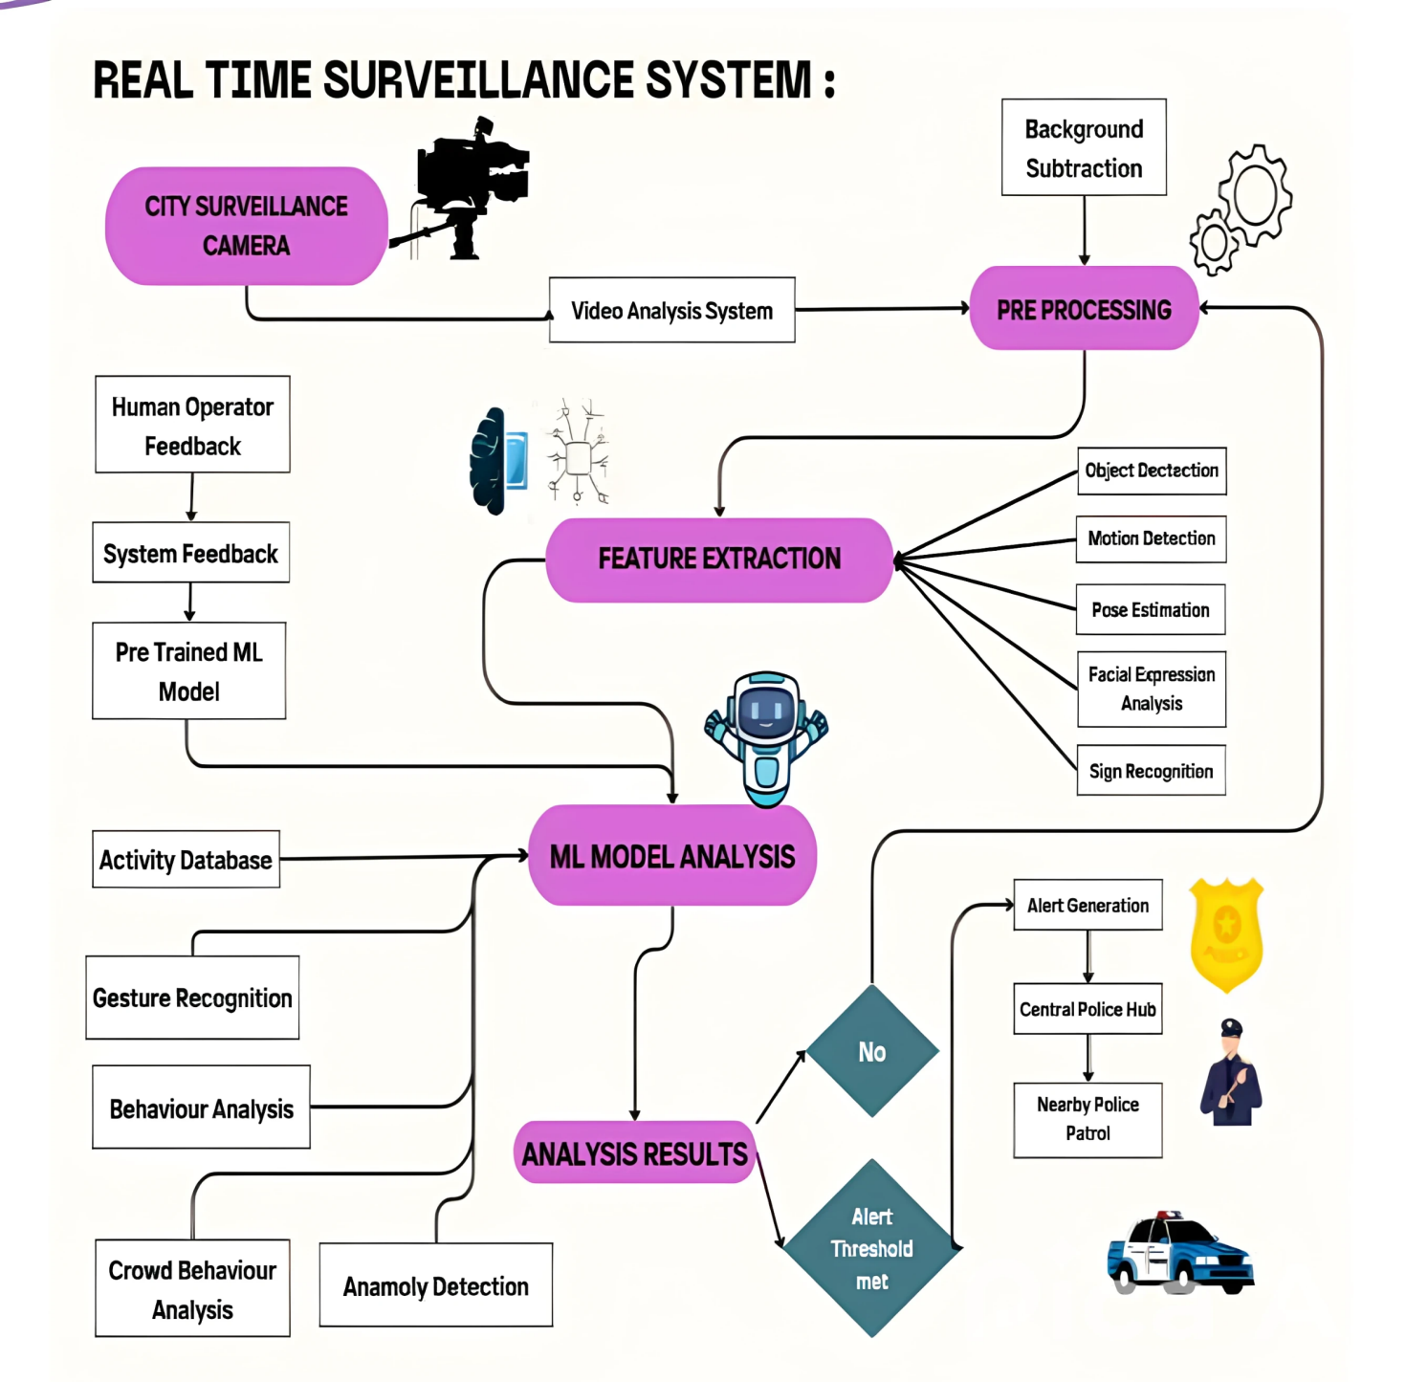
Data Flow Diagram & Components
SOFTWARE REQUIREMENT
Python (JUPYTER NB, Google Colab)
Libraries Used: cv2, geocoder, matplotlib, mediapipe, numpy, os, sklearn, tensorflow, time, and twilio.
Machine Learning & Deep Learning: Sequential model, LSTM
ReLU activation, Adam optimizer, categorical cross-entropy loss, etc.
HARDWARE REQUIREMENT
Internet of Things (IOT)
Graphic Processing Unit (GPU)
surveillance systems: Cameras, Sensors, GPS Sensors, etc.

Slide 11
Thank You

