Slide 1

BMS COLLEGE OF ENGINEERING
(Autonomous Institute, Affiliated to VTU, Belagavi)
DEPARTMENT OF MACHINE LEARNING
(UG Program: B.E. in Artificial Intelligence and Machine Learning)
Course : Python Programming
Course Code: 22AM4AEPPM
S.I.R.I.U.S.
Phase -2: Python Project Presentation
Date: Oct. 11, 2023
Presented By,
Student Name & USN :
Pacharne Kaushal Yogesh - 1BM21AI080
Pranshu Arora - 1BM21AI091
Priyanshu Prasad - 1BM21AI096
Ryan Gupta - 1BM21AI107
Semester & Section: 4B
Batch Number:
Faculty In-Charge:
Seemanthini k Gowda
Assistant Professor
Department of Machine Learning
BMS College of Engineering

Slide 2
Agenda
Abstract
Introduction
Requirements
Tools and technology
Architecture
Workflow/Working Principles
Conclusion

Slide 3
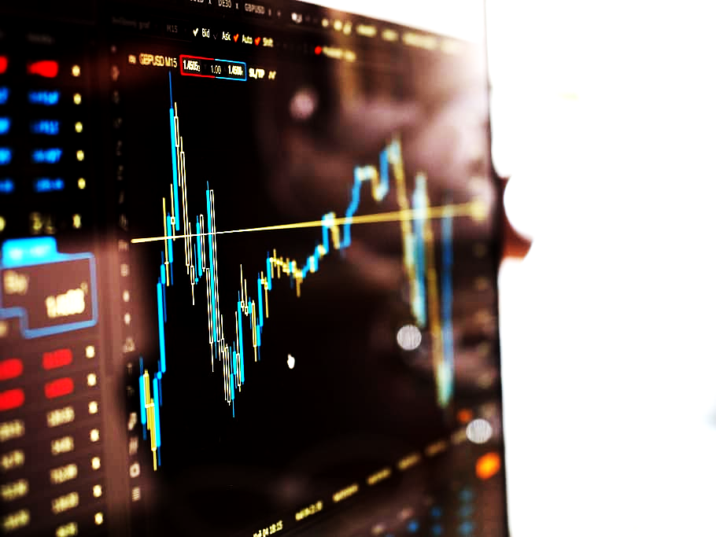
Abstract
In the rapidly evolving landscape of finance, the fusion of investment decisions and artificial intelligence requires innovative solutions. Traditional stock prediction methods often fall short due to market complexities. This report introduces S.I.R.I.U.S. (Stock Intelligent Real-time Investment Understanding System), an AI-driven virtual assistant designed to revolutionize investment strategies. Our objective is to create a versatile system that addresses multiple real-world investment challenges.
S.I.R.I.U.S. employs advanced machine learning algorithms and real-time data to construct predictive models, surpassing traditional analysis. The system's unique pattern recognition capabilities empower it to navigate intricate market trends. It goes beyond prediction, offering risk assessment and decision support, forming a comprehensive toolkit for diverse investor needs.
Our research bridges the gap between cutting-edge AI and investment practices. S.I.R.I.U.S. aims to transform conventional approaches into sophisticated, data-driven decisions, empowering investors to make informed choices in a volatile market. The innovative contributions of this research lie in the inception of S.I.R.I.U.S. as an intelligent stock market companion that transcends predictive functions. The virtual assistant's multifaceted attributes encompass pattern comprehension, risk evaluation, and decision facilitation, constituting a comprehensive toolkit catering to the diverse needs of investors.

Slide 4
Introduction
S.I.R.I.U.S. (Stock Intelligent Real-time Investment Understanding System) is a cutting-edge solution that leverages AI and data analysis to provide intelligent investment insights.
S.I.R.I.U.S. uses a variety of AI techniques, including machine learning, natural language processing, and sentiment analysis, to analyze vast amounts of data, including historical market data, news headlines, social media posts, and economic data. This data is used to identify patterns and trends that can be used to predict future stock prices and identify investment opportunities.
In addition to providing predictive insights, S.I.R.I.U.S. can also be used to assess risk, create personalized investment recommendations, and track the performance of investments. S.I.R.I.U.S. is a powerful tool that can help investors make more informed and profitable investment decisions.

Slide 5

Introduction
Artificial intelligence (AI) and machine learning (ML) are playing an increasingly important role in addressing the challenges and improving the accuracy of decision-making in a dynamic financial market environment.
Here are some of the ways in which AI and ML are being used in finance:
Predictive analytics: AI and ML can be used to analyze historical data to identify patterns and trends that can be used to predict future events, such as stock prices or interest rates.
Risk management: AI and ML can be used to identify and manage risks, such as the risk of default on a loan or the risk of a market crash.
Fraud detection: AI and ML can be used to detect fraudulent activity, such as credit card fraud or money laundering.
Customer service: AI and ML can be used to automate customer service tasks, such as answering questions and resolving problems.
Compliance: AI and ML can be used to help financial institutions comply with regulations, such as those governing anti-money laundering and insider trading.

Slide 6
Requirement
S.I.R.I.U.S. is designed with several key requirements in mind. Functionally, it must be capable of real-time data processing from various sources, including financial market data streams, news outlets, and social media platforms. It should offer accurate prediction capabilities, aiding in identifying market trends. Furthermore, risk assessment is crucial, ensuring that investors are informed about potential pitfalls. Non-functionally, S.I.R.I.U.S. needs to be scalable to accommodate increasing data volumes, reliable to instill user confidence, and secure to protect sensitive financial information.
Functional requirements of S.I.R.I.U.S.:-
Real-time data processing
Prediction accuracy
Risk assessment
User-friendly interface
Scalability
Security
Non-functional requirements of S.I.R.I.U.S.:-
Scalability
Reliability
Security
Availability
Maintainability
Usability

Slide 7
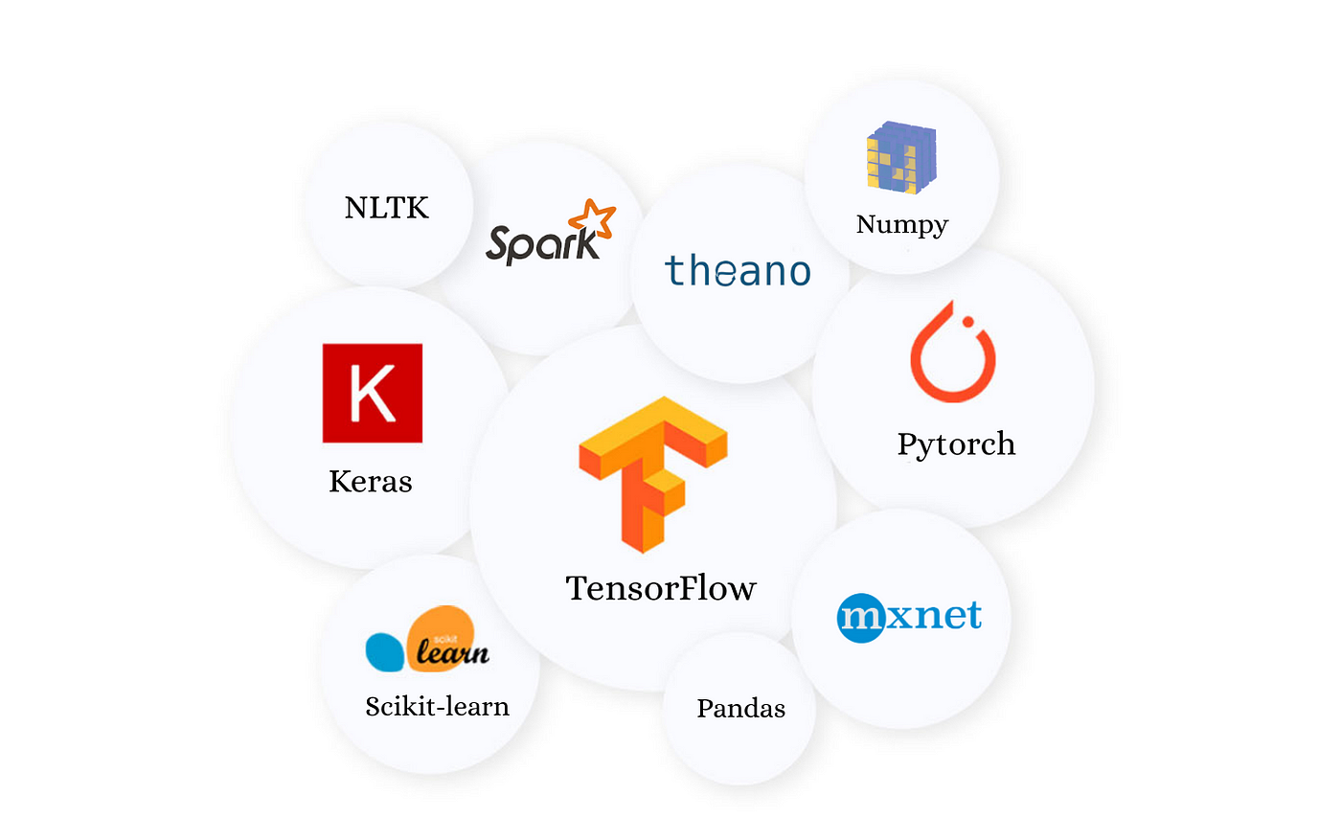
Tools And Technology
The foundation of S.I.R.I.U.S. lies in a carefully chosen set of tools and technologies. Python, a versatile programming language, is employed for its robust ecosystem and data analysis capabilities. TensorFlow and scikit-learn, popular machine learning libraries, form the backbone of predictive modeling.
TensorFlow: It is used for a variety of tasks, including image classification, natural language processing, and speech recognition.
scikit-learn: It is known for its ease of use and its wide range of features. scikit-learn is often used for tasks such as classification, regression, and clustering.
Keras: Keras is a high-level API for TensorFlow that makes it easy to build and train deep learning models.
PyTorch: PyTorch is often used for tasks such as image classification and natural language processing.
MatPlotLib: MatPlotLib is a comprehensive library for creating static, animated and interactive visualizations in Python.

Slide 8
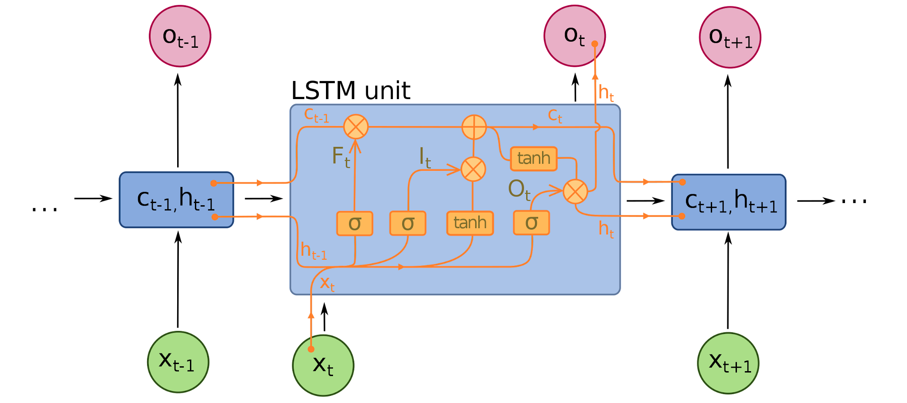
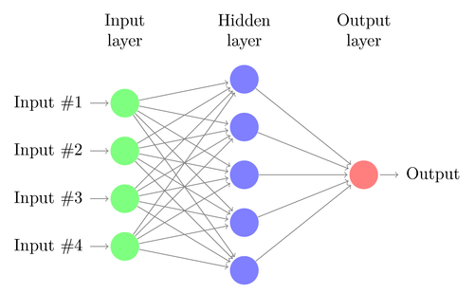
Architecture
S.I.R.I.U.S. follows a robust architecture, encompassing data preprocessing, AI model creation, and prediction generation. The architecture consists of:
Forget Gate: LTM goes to forget gate and it forgets information that is not useful.
Learn Gate: Event ( current input ) and STM are combined together so that necessary information that we have recently learned from STM can be applied to the current input.
Remember Gate: LTM information that we haven’t forget and STM and Event are combined together in Remember gate which works as updated LTM.
Use Gate: This gate also uses LTM, STM, and Event to predict the output of the current event which works as an updated STM.

Slide 9
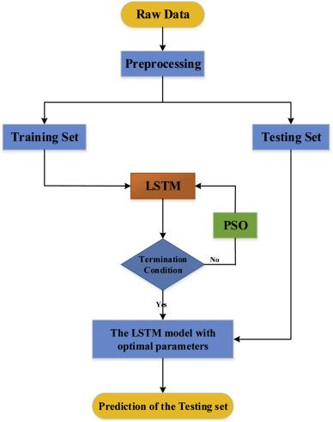
Workflow/Working Principles
Data Collection: Historical stock data is obtained from various sources.
Data Preprocessing: Data is scaled to a uniform range for model training.
Model Building: LSTM neural network is constructed for sequence prediction.
Model Training: The model learns patterns from historical data to predict future prices.
Prediction: Using the trained model, stock prices are predicted for a given time frame.
Visualization: Real and predicted prices are plotted for visual comparison.

Slide 10
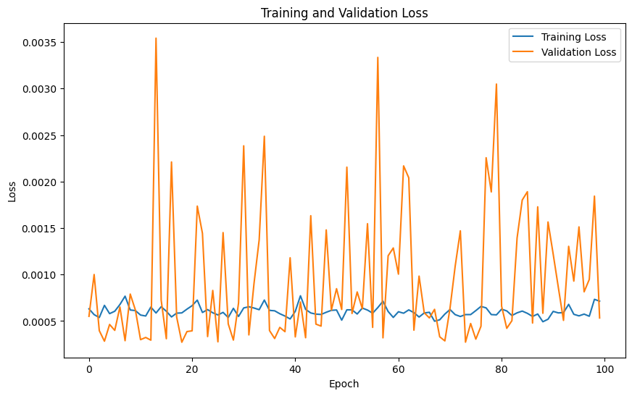
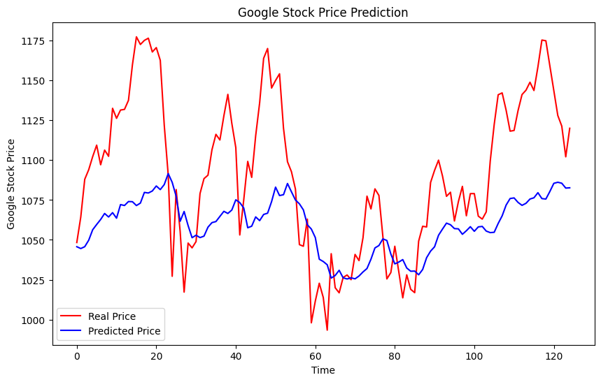
Conclusion
S.I.R.I.U.S. represents a significant advancement in stock market prediction. By amalgamating AI with financial markets, it offers investors a powerful tool for making informed decisions. The journey from conceptualization to implementation showcases the potential of AI in transforming investment strategies.

Slide 11
Thank you !

