Slide 1
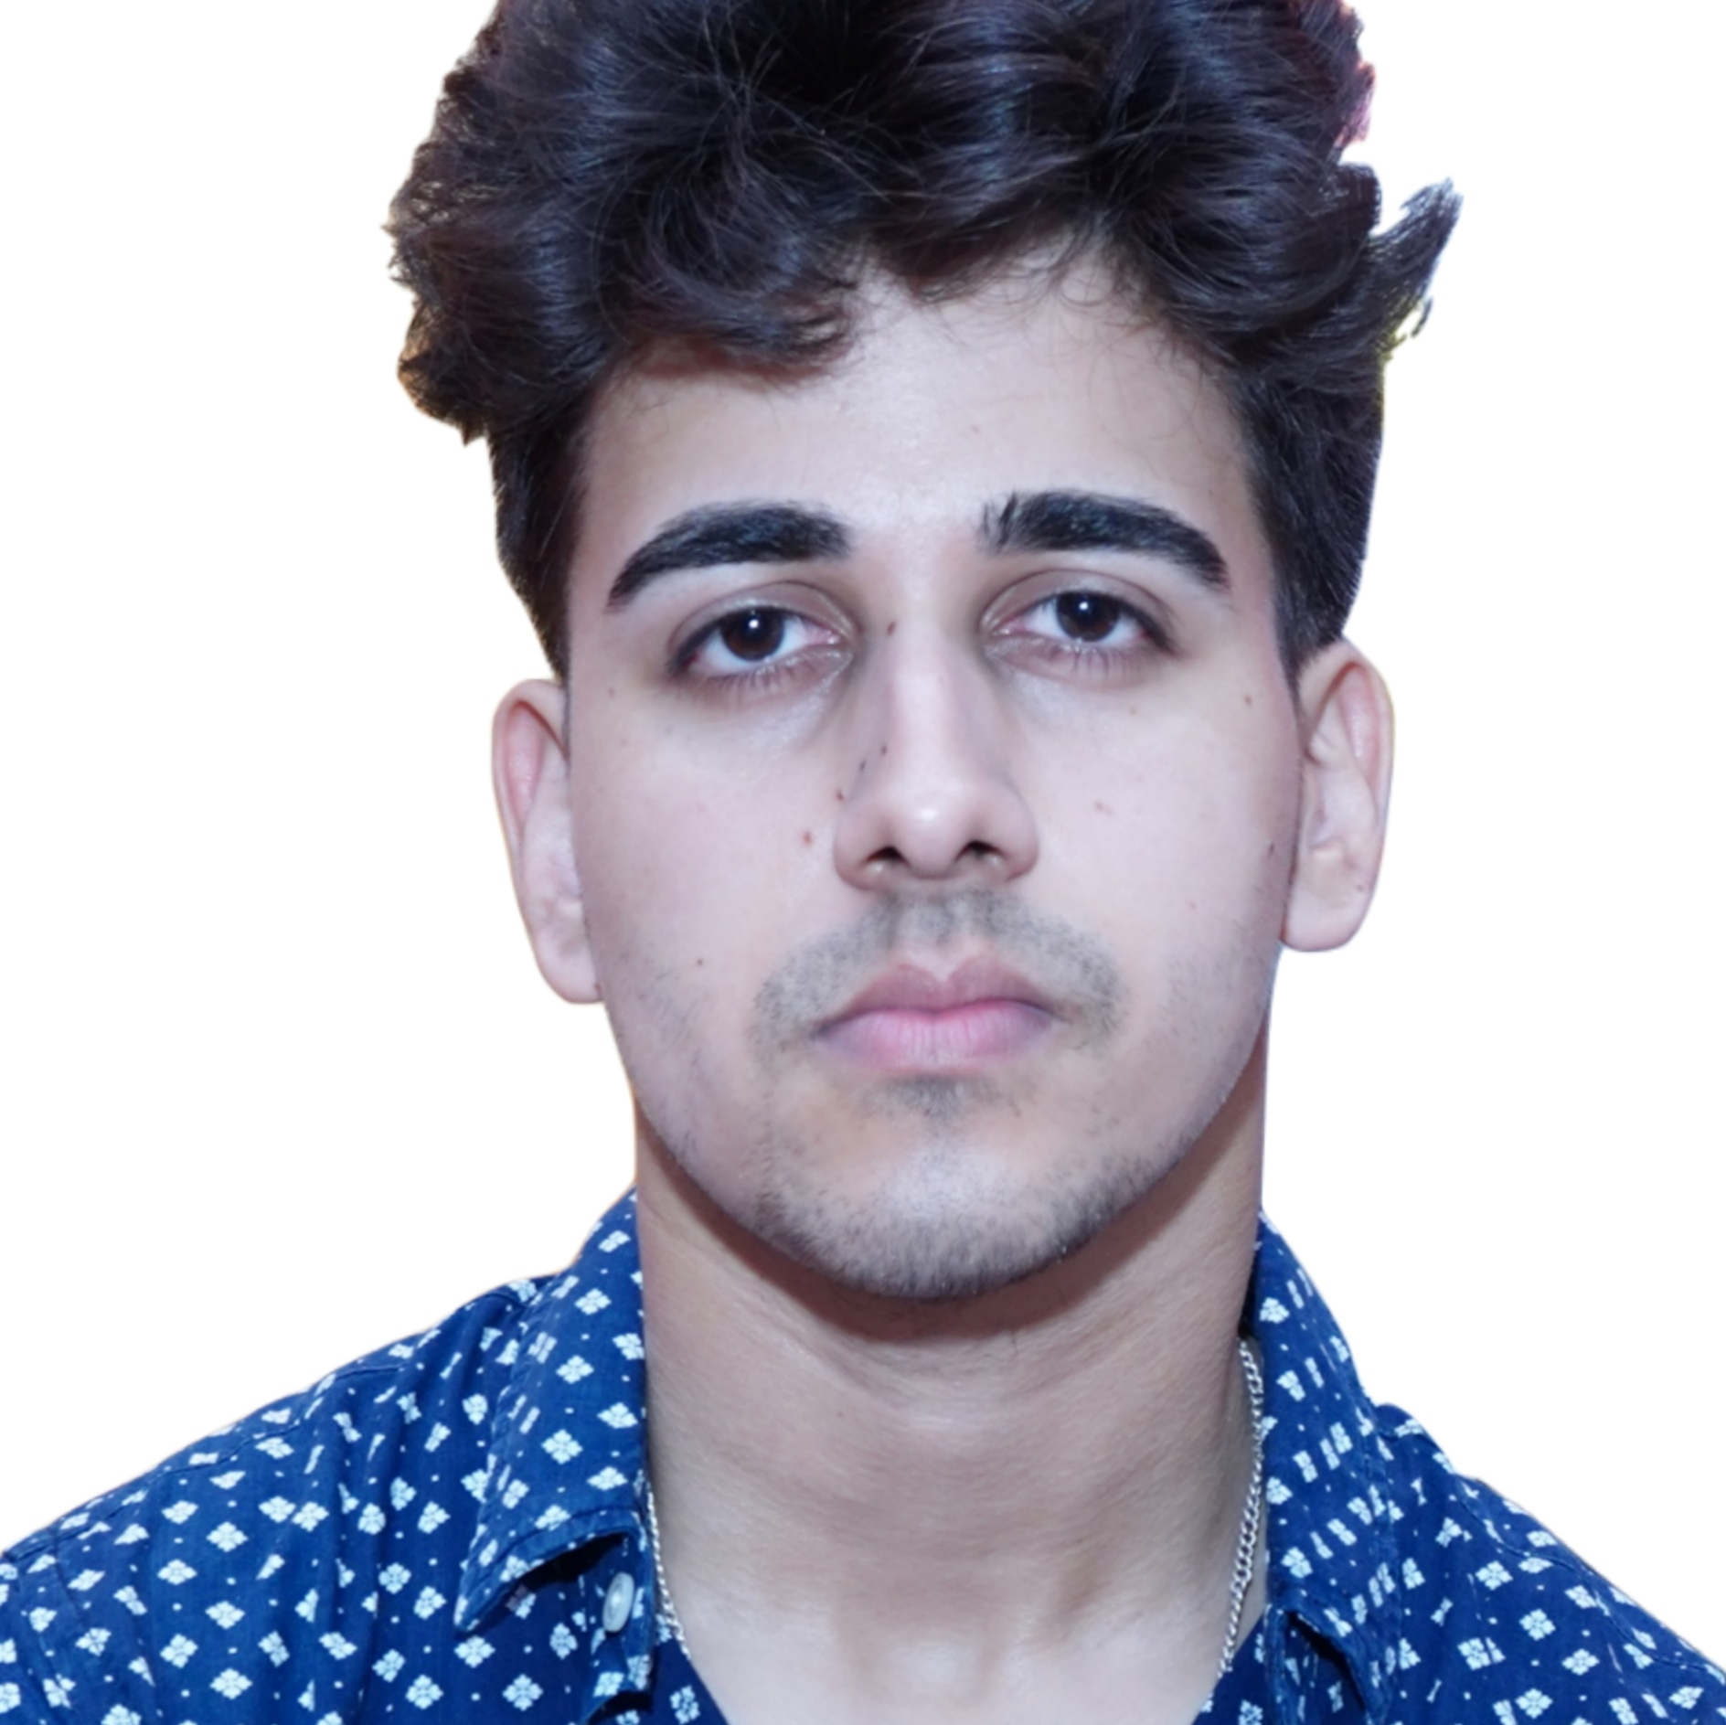


Pranshu Sharma
Bachelor of Engineering
Computer Science : 2015 – 2019
Master of Engineering
Computer Science : 2020 – 2022
Senior Analyst/Software Engineer
Skills
Bangalore
Java 8 /J2EE | Java Basics, OOPS, Generics, Collections, Arrays, Loops, Lambda Exp, Stream API Junit, Mockito, Servlets
Spring core | IOC & Dependency Injection, Autowire
Spring REST | REST controllers, Implementation of GET, POST, PUT & DELETE, Bean Validation & Exception Handling, Testing Services, Controller & Repository layer
Spring Data JPA | Implement DAO layer using spring Data repositories, Transaction Management
Spring Boot Microservices | Spring Boot Starters, annotations
Spring Cloud | Eureka, Netflix Zuul & Config Server
React | Testing using Jasmin & Karma
Angular | Components, Services, Modules, Routing, Forms & Validation, Testing using Jasmine & Karma
Database | MongoDB No Sql Basics My SQL RDS Basics
UI Tech | HTML 5 & CSS 3,JavaScript, TypeScript, Angular
Tools | Git, Postman, Maven, IDE
Add On skills | Communications, Team management. Peer learning
pranshu.a.sharma@capgemini.com
+91 9962946081
A5
Full Stack Developer
Hands on experience in creating microservices with Springboot, Spring Security, Spring Cloud API Gateway, Eureka server, load balancing
Proficient in creating Single page Web Application in Angular with Authentication with jwt, Angular reactive forms, angular routing.
Java Microservice Development knowledge using Spring boot and spring cloud framework on an intermediate level.
Hands on experience with Machine Learning with Python and Deep Learning
Unit testing using Junit, Mockito
Practical understanding of advanced Javascript concepts, Closure, Promise.
Resort Management System Case Study FULL STACK
Completed end to end case study of Resort Management Application along with JWT authentication, REST API architecture along Angular used for user interface.
Bio-Medical Image Segmentation of COVID-19 LESION using U-NET
Made a deep learning Image segmentation Model for covid -19 lesion using modified UNET Architecture with better accuracy.
Check out my work on GitHub

