Slide 1


Vibe Coders
PROMPT-AE-THON 2026
TEAM PRESENTATION
KhetKamai: a WhatsApp-first marketplace that pays farmers for crop residue instead of burning it.
Sparsh Bhardwaj · Aditya Tyagi · Pranshu Garg · Abhay Pathak
CodeChef BVCOE Chapter × Horizon
01 / 06
Notes:
We are Team Vibe Coders from BVCOE. Our project is KhetKamai: turn what you burn into what you earn. It is a WhatsApp-first marketplace that lets a farmer sell paddy straw to processors with one photo, instead of burning it. We have a working prototype that we will show on the How it works slide.

Slide 2
Farmers burn parali because no buyer, price or truck reaches them.
PROMPT-AE-THON 2026
01 — THE PROBLEM
Who
Why it matters
The gap
Small farmers in Haryana and Punjab, like Rajbir: 2 acres, 12 days to sow.
~90 Mt burned in India every year: smog, lost soil nutrients and ₹0 earned.
No visible buyers, no trusted price, and transport costs more than the straw.
CodeChef BVCOE Chapter × Horizon
02 / 06
Notes:
Around 90 million tonnes of crop residue are burned in India every year. Take Rajbir in Kaithal: 2 acres of paddy and only 10 to 20 days before he must sow wheat. Nobody calls to buy his straw, he does not know a fair price, and transport costs more than the straw is worth. So a matchstick is the cheapest option. Burning is not the farmer's choice, it is a market failure.

Slide 3
KhetKamai turns parali into income: one WhatsApp photo to UPI payment.
PROMPT-AE-THON 2026
02 — OUR IDEA
What it does
Who it is for
Why now
AI grades straw from a photo, shows live offers vs mandi, books a pickup.
Farmers on WhatsApp, biogas and paper mills, and rural youth agents.
Stubble burning is banned and fined, and Bio-CNG plants need steady straw.
CodeChef BVCOE Chapter × Horizon
03 / 06
Notes:
KhetKamai works like booking a cab. The farmer sends a photo or a Hindi voice note on WhatsApp. AI checks the residue type and quality, he sees live buyer offers next to the local mandi rate, accepts one, and a local agent picks it up and pays him by UPI on weighing. It serves three users: farmers, processors such as biogas plants and paper mills, and rural youth who work as agents.

Slide 4
What makes us different.
PROMPT-AE-THON 2026
03 — UNIQUENESS AND USP
OUR USP
One WhatsApp photo gets parali graded, priced fairly and paid by UPI.
Zero app, voice-first
Trust built in
Village network
Works on WhatsApp in Hindi now, Haryanvi and Punjabi next. No download needed.
AI grade, mandi-linked price and pay on weighing, checked at the factory scale.
Local agents and clustered pickups cut cost per tonne and grow with every village.
CodeChef BVCOE Chapter × Horizon
04 / 06
Notes:
Our USP: one WhatsApp photo gets the straw graded, fairly priced and paid for by UPI. First, there is no app to download, and it is voice-first in local languages. Second, trust is built in: the AI grade and mandi-anchored price protect the farmer, and the buyer's weighbridge is the final weight, so agents cannot inflate weights. Third, our village agents and clustered routes are hard to copy, because they are built on the ground.

Slide 5
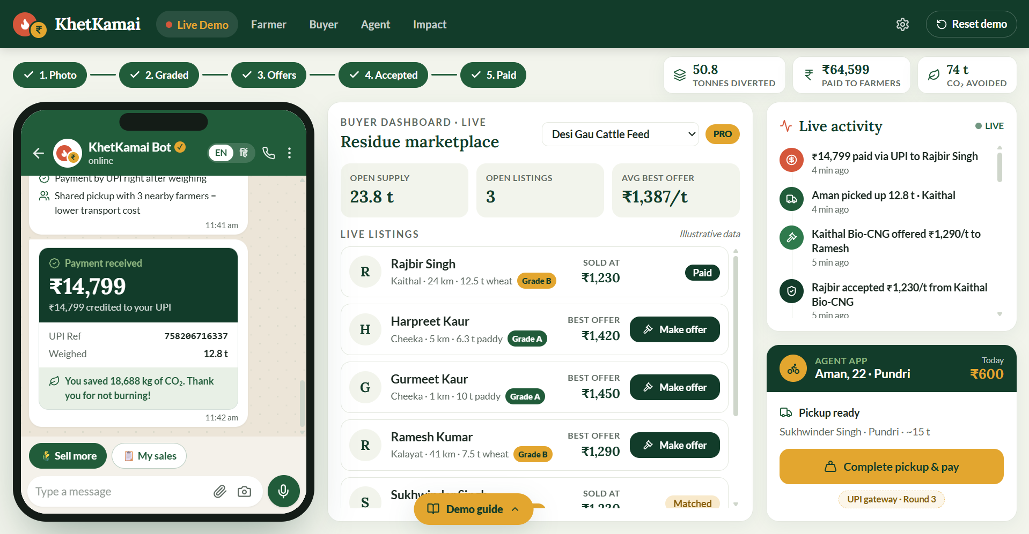
The solution, step by step.
PROMPT-AE-THON 2026
04 — HOW IT WORKS
01
Workflow
Photo + acres on WhatsApp → AI grade → live offers → accept → agent weighs → UPI paid.
02
Key features
AI quality grade, live price vs mandi, Hindi voice, clustered pickups, pay on weighing.
03
Tech stack
Built: React, TypeScript, Leaflet, Web Speech API. Next: WhatsApp API, FastAPI, Supabase.
WORKING PROTOTYPE · LIVE DEMO
Farmer chat, buyer marketplace and agent UPI payout running together on one screen.
CodeChef BVCOE Chapter × Horizon
05 / 06
Notes:
Here is our working prototype. On the left is Rajbir's WhatsApp chat. He sends a photo, says 'mere paas do acre parali hai', and AI grades it. A listing appears in the buyer marketplace in the middle, buyers send offers, and he sees them next to the mandi rate. He accepts, and the agent panel on the right weighs the straw and pays him by UPI. In real life these are three devices: WhatsApp for the farmer, a web dashboard for buyers, a mobile app for agents. We show them side by side for the demo. The buyer pre-pays into our account, and the agent's confirmation releases the farmer's money.

Slide 6
The impact we aim for.
PROMPT-AE-THON 2026
05 — IMPACT AND NEXT STEPS
2,000 t
Same day
500 + 25
Residue saved from burning in the pilot (≈2,900 t CO₂)
Photo to UPI payment in one pickup, before sowing
Farmers earning ₹3–5k more a season, plus youth agent jobs
Next steps: real WhatsApp bot + vision model, live UPI, then a 1-village Kaithal pilot.
CodeChef BVCOE Chapter × Horizon
06 / 06
Notes:
Our pilot targets, which are assumptions: 500 farmers, 2,000 tonnes kept from burning, that is about 2,900 tonnes of CO2, 3 to 5 thousand rupees extra per farmer each season, and 25 youth jobs. This maps to SDG 8 for income and jobs and SDG 9 for linking farmers to clean industry. Next: a real WhatsApp bot and vision model in Round 2, live UPI and buyer dashboard in Round 3, then a one-village pilot with two buyers. Burning isn't a farmer's choice. It's a market failure. We're building the market.

