Slide 1


Vibe Coders
PROMPT-AE-THON 2026
TEAM PRESENTATION
KhetKamai: a WhatsApp-first marketplace that pays farmers for crop residue instead of burning it.
Sparsh Bhardwaj · Aditya Tyagi · Pranshu Garg · Abhay Pathak
CodeChef BVCOE Chapter × Horizon
01 / 06
Notes:
We are Team Vibe Coders from BVCOE. Our project is KhetKamai: turn what you burn into what you earn. It is a WhatsApp-first marketplace that lets a farmer sell paddy straw to processors with one photo, instead of burning it. We have a working prototype that we will show on the How it works slide.

Slide 2
Farmers burn parali because no buyer, price or truck reaches them.
PROMPT-AE-THON 2026
01 — THE PROBLEM
Who
Why it matters
The gap
Small farmers in Haryana and Punjab, like Rajbir: 2 acres, 12 days to sow.
~90 Mt burned in India every year: smog, lost soil nutrients and ₹0 earned.
No visible buyers, no trusted price, and transport costs more than the straw.
CodeChef BVCOE Chapter × Horizon
02 / 06
Notes:
Around 90 million tonnes of crop residue are burned in India every year. Take Rajbir in Kaithal: 2 acres of paddy and only 10 to 20 days before he must sow wheat. Nobody calls to buy his straw, he does not know a fair price, and transport costs more than the straw is worth. So a matchstick is the cheapest option. Burning is not the farmer's choice, it is a market failure.

Slide 3
KhetKamai turns parali into income: one WhatsApp photo to UPI payment.
PROMPT-AE-THON 2026
02 — OUR IDEA
What it does
Who it is for
Why now
AI grades straw from a photo, shows live offers vs mandi, books a pickup.
Farmers, Bio-CNG, 2G ethanol and power plants, and rural youth agents.
Burning is fined, and power plants near Delhi must now burn biomass with coal.
CodeChef BVCOE Chapter × Horizon
03 / 06
Notes:
KhetKamai works like booking a cab. The farmer sends a photo or a Hindi voice note on WhatsApp. AI checks the residue, he sees live buyer offers next to the local mandi rate, accepts one, and a local agent picks it up and pays him by UPI on weighing. Buyers are the industries that need straw: Bio-CNG plants, 2G ethanol refineries like the Panipat plant that uses about 2 lakh tonnes a year, and thermal power plants, which near Delhi must co-fire 5 to 10 percent biomass. Demand exists; collection from small farms is what is missing.

Slide 4
What makes us different.
PROMPT-AE-THON 2026
03 — UNIQUENESS AND USP
OUR USP
One WhatsApp photo gets parali graded, priced fairly and paid by UPI.
Zero app, voice-first
Trust built in
Village network
Works on WhatsApp in Hindi now, Haryanvi and Punjabi next. No download needed.
Buyer pre-pays into escrow, farmer is paid on weighing, factory scale re-checks.
Local agents and clustered pickups cut cost per tonne and grow with every village.
CodeChef BVCOE Chapter × Horizon
04 / 06
Notes:
Our USP: one WhatsApp photo gets the straw graded, fairly priced and paid for by UPI. First, there is no app to download, and it is voice-first in local languages. Second, trust is built in: when the farmer accepts, the buyer pre-pays into our escrow, so his money is safe before the straw leaves the field. The agent's weighing releases the payment, and the factory weighbridge re-checks the weight, so agents cannot inflate it. Third, our village agents and clustered routes are hard to copy, because they are built on the ground.

Slide 5
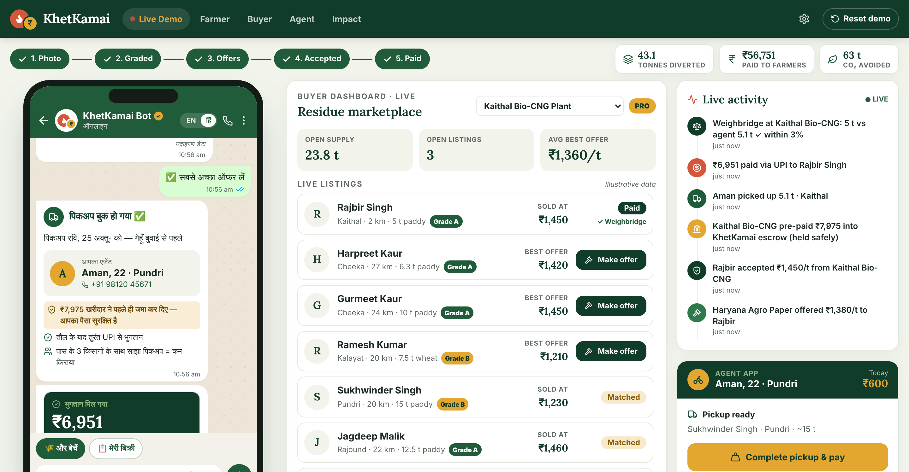
The solution, step by step.
PROMPT-AE-THON 2026
04 — HOW IT WORKS
01
Workflow
Photo + acres on WhatsApp → AI grade → live offers → accept → agent weighs → UPI paid.
02
Key features
AI grade, live price vs mandi, Hindi voice, UPI via escrow, weighbridge check.
03
Tech stack
Built: React, TypeScript, Leaflet, Web Speech API. Next: WhatsApp API, FastAPI, Supabase.
WORKING PROTOTYPE · LIVE DEMO
Escrow locked, farmer paid by UPI, factory weighbridge verified, all on one screen.
CodeChef BVCOE Chapter × Horizon
05 / 06
Notes:
Here is our working prototype. On the left is Rajbir's WhatsApp chat: he sends a photo, says 'mere paas do acre parali hai', and AI grades it. His listing appears in the buyer marketplace in the middle, buyers send offers, and he sees them next to the mandi rate. When he accepts, the buyer pre-pays into escrow, and his chat says his money is already locked and safe. Our agent weighs the straw and taps confirm, which releases the payment to his UPI. Then the truck reaches the factory, and its weighbridge re-weighs the load: here 5 tonnes against the agent's 5.1, within 3 percent, so it is verified. In real life these are three devices: WhatsApp for the farmer, a web dashboard for buyers, a mobile app for agents. We show them side by side for the demo.

Slide 6
The impact we aim for.
PROMPT-AE-THON 2026
05 — IMPACT AND NEXT STEPS
2,000 t
Same day
500 + 25
Residue saved from burning in the pilot (≈2,900 t CO₂)
Photo to UPI payment in one pickup, before sowing
Farmers earning ₹3–5k more a season, plus youth agent jobs
Next steps: real WhatsApp bot + vision model, live UPI, then a 1-village Kaithal pilot.
CodeChef BVCOE Chapter × Horizon
06 / 06
Notes:
Our pilot targets, which are assumptions: 500 farmers, 2,000 tonnes kept from burning, that is about 2,900 tonnes of CO2, 3 to 5 thousand rupees extra per farmer each season, and 25 youth jobs. This maps to SDG 8 for income and jobs and SDG 9 for linking farmers to clean industry. Next: a real WhatsApp bot and vision model in Round 2, live UPI and buyer dashboard in Round 3, then a one-village pilot with two buyers. Burning isn't a farmer's choice. It's a market failure. We're building the market.

