Slide 1
Fault-tolerant control of a quadrotor after complete rotor loss
EE650 · BASICS OF MODERN CONTROL SYSTEMS · PROGRESS REVIEW 1
Residual Koopman MPC, and certified limits on fault-detection delay
Pranshu Kumar · Mudita Jain · Prashant Gupta · Aarush Singh Kushwaha
October 2026
Notes:
Good morning. This is our first progress review after the proposal. I will cover four things: the problem and our two research questions, the simulator and how we validated it against published results, first results on the residual Koopman approach we proposed, and first results on a second question we added: how long fault detection can take before recovery is no longer possible.

Slide 2
Two research questions
RECAP
RQ1 · AS PROPOSED
Residual Koopman MPC
Can a Koopman (EDMDc) model of only the mismatch, built on the known spinning-equilibrium model of Mueller & D'Andrea, predict and control better than the physics model alone or a full-state Koopman model?
RQ2 · ADDED AFTER THE PROPOSAL
Certified detection-delay budget
A fault detector needs 30–130 ms to notice a dead rotor. What is the largest delay for which recovery is guaranteed, and how do the RQ1 controllers change it?
The link: each capture controller (LQR, analytical MPC, residual Koopman MPC) is compared by the detection delay it can tolerate.
Notes:
RQ1 is the question from the proposal we presented: build the known physics of the spinning, failed vehicle into the model, and let a Koopman model learn only what the physics gets wrong. RQ2 is new. While reviewing the literature we found that every recovery method assumes the failure is detected instantly, but real detectors take tens to hundreds of milliseconds. RQ2 asks for a guaranteed bound on that delay, using Lyapunov and LMI tools from this course. The two connect: whichever controller catches the vehicle after detection, we can compare them by the delay they tolerate. Nothing from the proposal was dropped.

Slide 3
What happens when a rotor fails
THE PROBLEM
Healthy flight
Normal controller, four rotors
Rotor fails
t = 0, thrust of rotor 4 lost
Undetected, τ
Healthy controller still flying a 3-rotor vehicle
Capture
Failure controller takes over
Relaxed hover
Steady spin ≈ 19 rad/s, axis tilted
Most recovery methods with a guarantee assume τ = 0.
Stability with a fixed delay is shown for a linear model; a certified maximum delay under thrust limits was not found.
Simha et al. 2017; Al Lawati & Akhtar 2026; Başak & Prempain 2015; Strack van Schijndel et al. 2021
Notes:
When one rotor dies, a quadrotor cannot hover level any more. Mueller and D'Andrea showed it can still fly by spinning steadily about a tilted axis, called the relaxed hover. But there is a gap in time: the fault detector needs some time tau to notice the failure. During that time the normal controller keeps flying a vehicle that has lost a rotor. Only after detection does the failure controller take over and try to capture the vehicle into the spinning state. Most guarantee-based papers assume tau equals zero. Başak and Prempain proved stability for a linear model with a fixed delay, but without thrust limits and without finding the largest tolerable delay. Fast detectors take 30 to 130 milliseconds.

Slide 4
Simulator and vehicle
FOUNDATION
6-DOF rigid body, quaternion attitude, rotor gyroscopic terms
Per-rotor thrust 0.2–3.8 N; a motor can also be stopped
First-order motor lag, 15 ms
Reduced attitude n = Rᵀe₃: the "up" direction seen from the body
RK4 integration; controller at 1–5 ms (zero-order hold)
Truth plants for learning add thrust loss at high spin, inertia error and a different motor lag
Parameter | Value
Mass | 0.50 kg
Arm length | 0.17 m
Inertia Ixx, Izz | 3.2, 5.5 × 10⁻³ kg m²
Thrust coefficient κf | 6.41 × 10⁻⁶ N s²
Torque ratio κτ | 0.0169 m
Yaw drag γ | 2.75 × 10⁻³ N m s
All values from Mueller & D'Andrea, ICRA 2014, Sec. V-A
Notes:
We wrote our own simulator in Python. It is a full six degree of freedom rigid body with the rotor gyroscopic terms from the paper, actuator limits, and motor lag. The key state for the failed vehicle is the reduced attitude n: the vertical direction expressed in body axes. Because the vehicle spins, we control this direction rather than the full attitude. Every vehicle parameter comes from the Mueller and D'Andrea paper, so we can compare against their numbers directly. For the learning experiments we also build "truth" plants with effects the nominal model does not have.

Slide 5
The model matches three published papers
FOUNDATION
Source | What we compared | Result
ICRA 2014 | Two-rotor-loss equilibrium | All published digits (≤ 0.14%)
ICRA 2014 | Three-rotor-loss equilibrium | All published digits (≤ 0.8%)
ICRA 2014 | One-rotor-loss equilibrium | f, r, n_z ≤ 0.5%; pitch rate −6% *
ICRA 2014 | ā and controllability loss (eqs. 28, 39) | Exact
IJRR 2016 | Five failure cases, own implementation | 0–4%; ≤ 0.7% within rounding
Sun et al. 2020 | Bebop 2, two-rotor loss (eq. 60) | Exact
Flight data | Time to spin up to 10 rad/s | 0.80 s vs 0.62 s: model 30% slower
* The paper's own published values do not satisfy its eq. (12); its other two cases match exactly. 45 automated tests also check conservation laws, closed-form solutions and these published numbers.
Notes:
Before trusting any result we checked the simulator against published numbers. The two-rotor and three-rotor-loss equilibria from Mueller and D'Andrea's ICRA paper match every digit they published. The three-rotor case is a strong check because it uses all the gyroscopic terms. For the one-rotor case, thrust, spin rate and tilt match within half a percent, but the pitch rate is six percent lower; we found that the paper's own published values leave a residual in its own equation 12, so that one published case is slightly inconsistent. We also wrote an independent implementation of their more detailed IJRR model and reproduced all five failure cases, and matched a second drone, the Bebop 2, from Sun et al. The one real gap: in flight, the vehicle spun up 30 percent faster than the model predicts. That matters for the delay results later, and we will study its sensitivity.

Slide 6
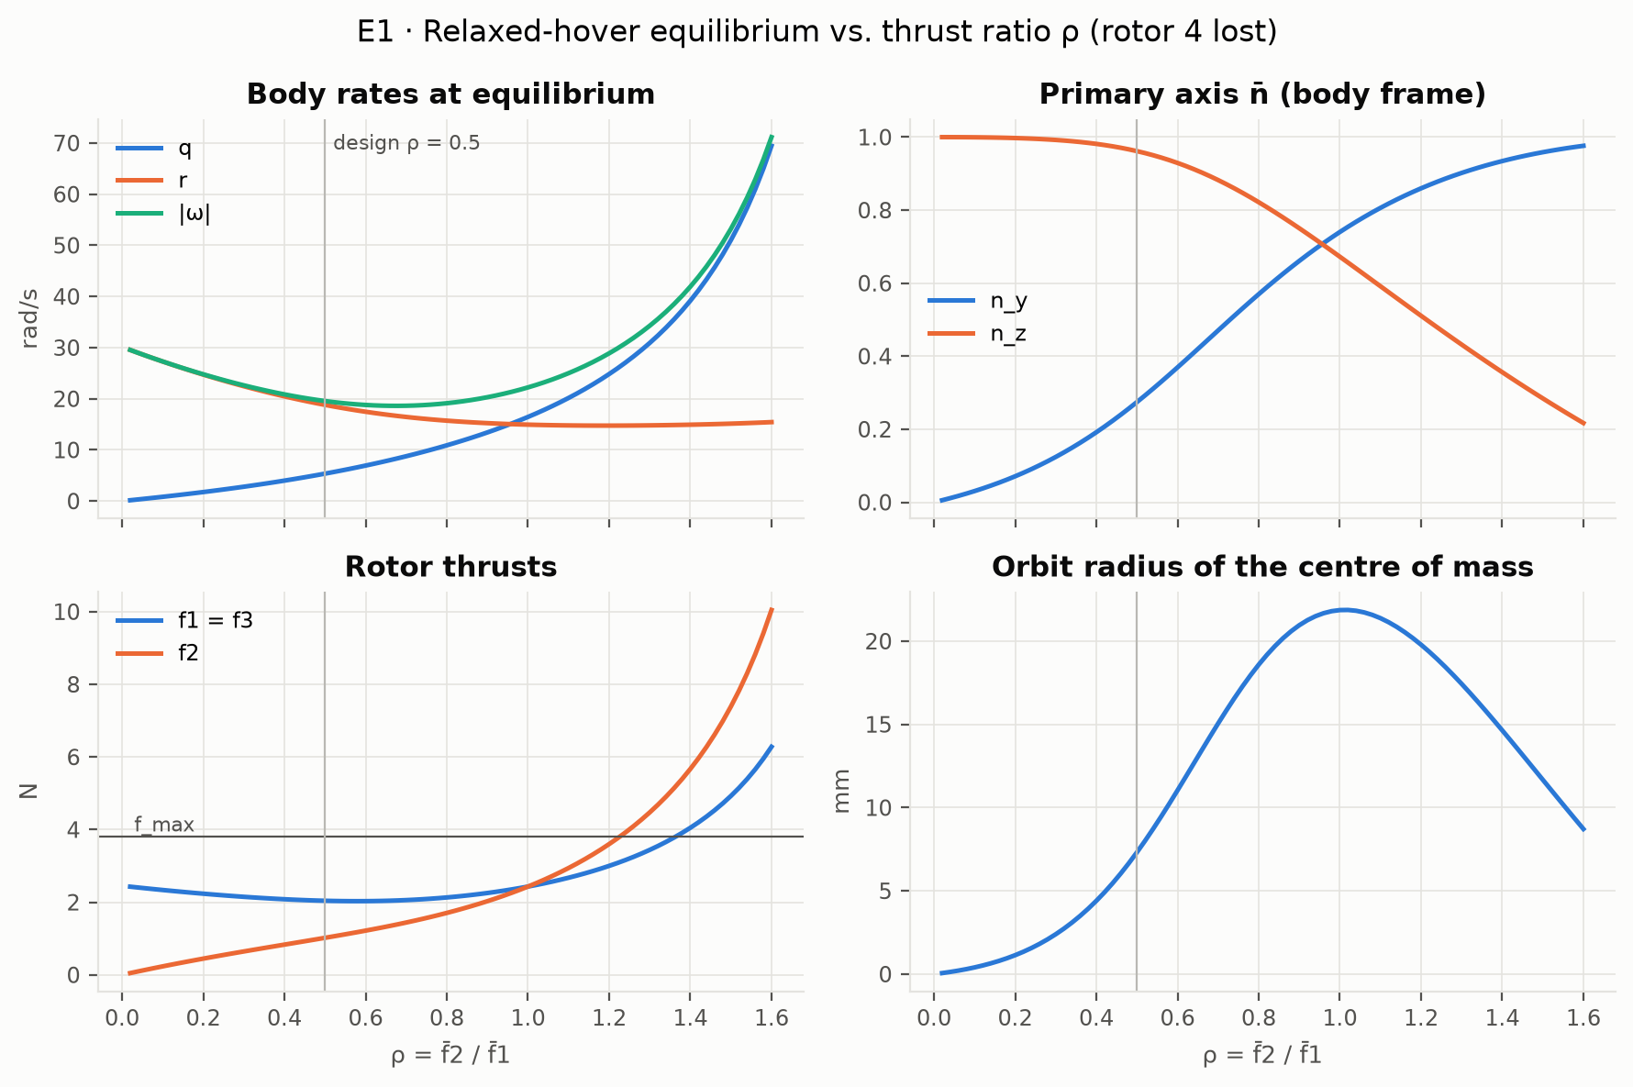
The spinning equilibrium
FOUNDATION
Rotor 4 lost, design ratio ρ = f₂/f₁ = 0.5:
f = (2.04, 1.02, 2.04) N
spin 18.8 rad/s, axis tilted 16°
Thrust, spin rate and tilt match the paper within 0.5%.
The ρ sweep reproduces the paper's Fig. 3 (minimum spin 18.6 vs 19.0 rad/s).
Notes:
This is the equilibrium the failed vehicle must reach. With rotor 4 gone, the two side rotors produce equal thrust and the opposite rotor about half of it. The vehicle then spins at about 19 radians per second about an axis tilted 16 degrees from the body z axis, and the centre of mass moves on a circle of only about 7 millimetres. The figure shows how the equilibrium changes with the thrust ratio; it reproduces the paper's Figure 3.

Slide 7
Linear model: controllable, but what can we observe?
FOUNDATION
7 states (p, q, r, n_x, n_y, z, v_z), inputs f₁, f₂, f₃. Linear and time-invariant in body axes.
Open-loop modes: ±10.1j, ±19.6j, −0.51 and an altitude double integrator.
Controllable: rank 7 of 7; every mode passes the PBH test.
Sensors | Rank | Missing
Gyro | 3 / 7 | tilt, altitude
Gyro + tilt estimate | 5 / 7 | altitude
Gyro + barometer | 7 / 7 | none (weak)
Gyro + tilt + barometer | 7 / 7 | none
The equilibrium is tilted, so vertical acceleration depends on tilt. A barometer alone then reveals the tilt, but about 2,700× more weakly than a tilt sensor (observability Gramian).
Notes:
Linearizing about the spinning equilibrium in body coordinates gives a linear time-invariant model. The open loop has two undamped oscillations, at 10 and 19.6 radians per second, the slow yaw mode, and the altitude double integrator. It is fully controllable from the three rotors, which reproduces the paper's result. On observability: gyros alone cannot see tilt or altitude. A small finding of ours: because the spinning equilibrium is tilted, vertical acceleration depends on tilt to first order, so gyro plus barometer is enough in principle. But the observability Gramian shows it is about 2,700 times weaker than measuring tilt directly, so it is a structural property, not a practical estimator.

Slide 8
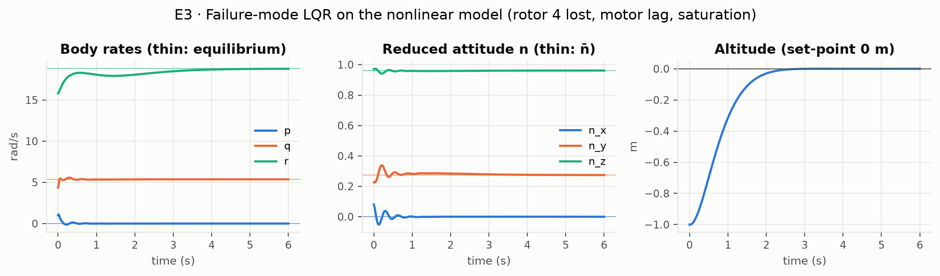
LQR baseline at the spinning equilibrium
FOUNDATION
18 ms
input-delay margin (healthy LQR: 40 ms)
ζ ≈ 0.19
damping of the slowest oscillation
1–4 s
to settle tilt, altitude and spin
Weights from Mueller & D'Andrea, plus motor states and altitude
Notes:
We designed two LQR controllers: a normal hover controller, and a failure-mode controller at the spinning equilibrium using the paper's weights, with motor states and altitude added. On the full nonlinear model with motor lag and thrust limits, the failure controller recovers from a perturbed start: tilt and altitude settle in one to two seconds, the spin rate in about four. One number to note: the failure controller tolerates only about 18 milliseconds of pure input delay, compared with 40 for the healthy one. The slowest oscillation, at the spin frequency, is lightly damped.

Slide 9
Residual Koopman models of the failed vehicle
RESEARCH QUESTION 1 · AS PROPOSED
Learn only what the physics model gets wrong, then use it inside a convex MPC.
Notes:
Now the first research question, the one from our proposal.

Slide 10
Three predictors, same data
RQ1 · SET-UP
Analytical
Mueller & D'Andrea linear model about the spinning equilibrium. No data.
Full-state EDMDc
Learns all the dynamics from data: 55 lifted states (quadratic dictionary).
Residual EDMDc (proposed)
Physics model plus a learned one-step correction e = x_true − x_model, clipped at d_max.
Data: 40 episodes × 4 s at 5 ms, from a truth plant with effects the model lacks (thrust loss at high spin, inertia error, slower motors). Test: 10 new episodes from the same plant (A) and 10 from a different one (B).
Notes:
We compare three predictors on the same data, exactly as proposed. The analytical model is the Mueller and D'Andrea linearization with no learning. Full-state EDMDc learns everything from data with a quadratic dictionary of 55 lifted states. The residual model keeps the physics and learns only the one-step error, clipped to a bound, as in Todde et al. 2026. To avoid learning our own code back, the data come from a "truth" plant with effects the physics model does not have. We test on held-out episodes from the same plant and from a different plant.

Slide 11
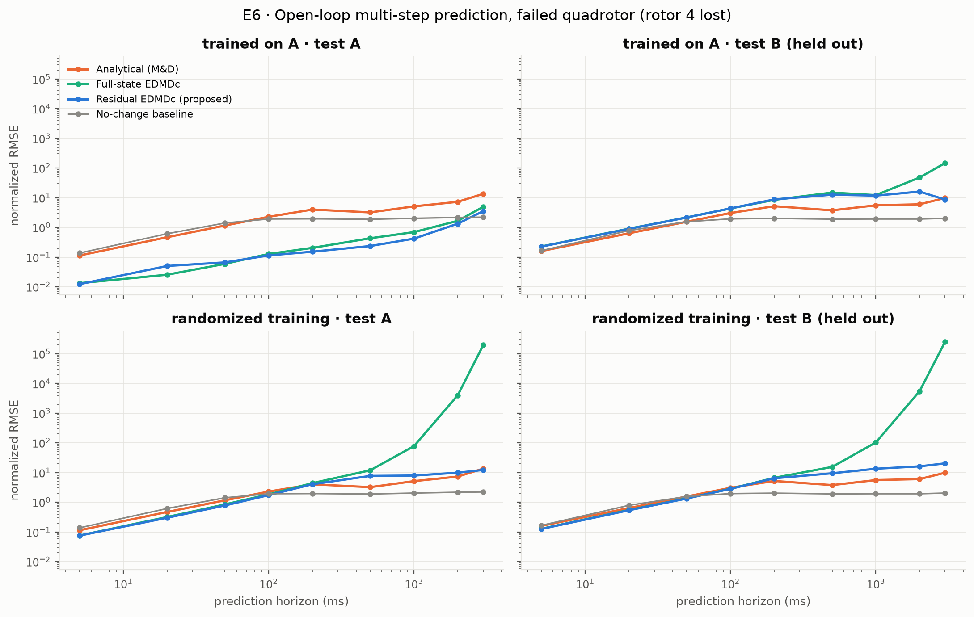
The residual model predicts best
RQ1 · PREDICTION
Error at a 1 s horizon, test family A (normalized RMSE):
Predictor | Error
Residual EDMDc | 0.42
Full-state EDMDc | 0.70
"No change" baseline | 2.0
Analytical model | 5.1
Full-state EDMDc has 4 of 55 eigenvalues outside the unit circle and falls behind "no change" after 2–3 s, as the proposal predicted.
Notes:
Here is the main prediction result. On held-out episodes from the training plant, the residual model has the lowest error at every horizon from 50 milliseconds upward. At one second its error is 0.42, against 0.70 for full-state EDMDc and 5.1 for the analytical model, which is worse than simply assuming nothing changes, because the unmodelled thrust loss makes it drift. Our proposal claimed that full-state EDMDc is unstable; on the failed vehicle we confirm that it has eigenvalues outside the unit circle and that it eventually loses to the no-change baseline, after two to three seconds. Note also that at three seconds even the residual model loses to no-change: long open-loop horizons need feedback, which is why the MPC re-plans every 5 milliseconds.

Slide 12
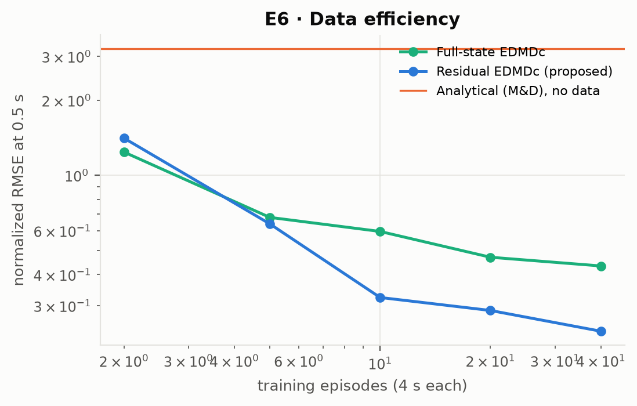
Little data needed, no generalization yet
RQ1 · LIMITS
Data efficiency
With 10 episodes the residual model (0.32) beats the full-state model trained on 40 (0.43), at a 0.5 s horizon.
Generalization fails
On the unseen plant B, both learned models are worse than the physics model alone. Training on randomized plants makes them worse: the unknown parameters cannot be read from one state sample.
Next
Update the residual online with recursive least squares (it is linear in its parameters).
Notes:
Two more results, one good and one bad. Good: the residual model needs much less data. With only 10 short episodes it already beats the full-state model trained on 40. That matters because real failure data are scarce: failed flights tend to end in crashes. Bad: neither learned model generalizes to a plant with different parameters. On the held-out plant both are worse than the physics model alone. And training on many randomized plants did not help; it made them worse, because a static model cannot tell from a single state which vehicle it is on. This motivates our next step: adapt the residual online. Since the residual is linear in its parameters, recursive least squares is a natural, cheap choice.

Slide 13
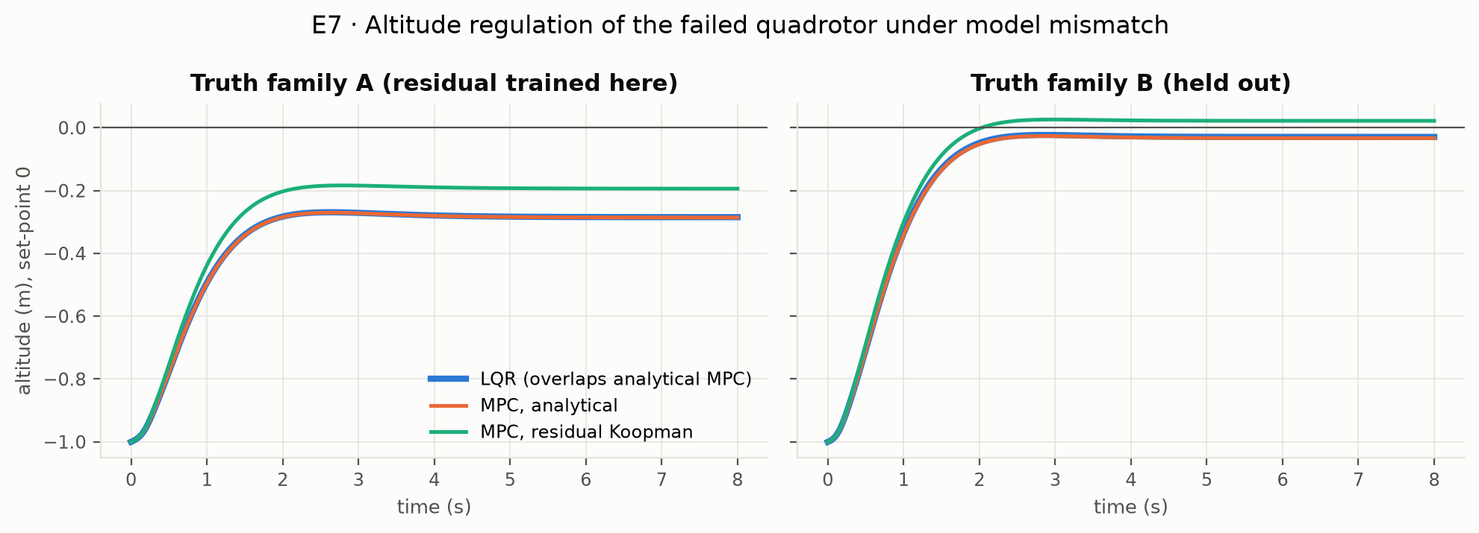
Residual MPC removes a third of the bias
RQ1 · CONTROL
−32%
steady altitude error on plant A (−0.29 → −0.19 m)
≈ 5 ms
per QP (horizon 20 × 5 ms, OSQP)
The residual enters the QP as a measured disturbance, so the problem stays convex (as in Todde et al. 2026, who report 35% in healthy flight). No harm on plant B. As the controller that catches the vehicle after a detection delay, neither MPC beats LQR yet.
Notes:
Now in closed loop. We built a linear MPC on the analytical model, and the same MPC with the residual added as a measured disturbance, evaluated outside the optimization so the QP stays convex. On the training plant, the thrust loss causes a steady altitude error of about 29 centimetres for LQR and analytical MPC. The residual-Koopman MPC cuts it to 19 centimetres, a 32 percent reduction, close to the 35 percent Todde et al. report for healthy flight. Each QP takes about 5 milliseconds. On the held-out plant all three are similar. When we used the MPCs to catch the vehicle after a detection delay, they did not beat LQR. The problem there is that the linear model is not valid far from the spin, not the constraints. The obvious next baseline is integral action, which we will add.

Slide 14
How long can fault detection take?
RESEARCH QUESTION 2 · ADDED
Most recovery methods assume instant detection. Fast detectors take 30–130 ms.
Notes:
The second research question, which we added after the proposal.

Slide 15
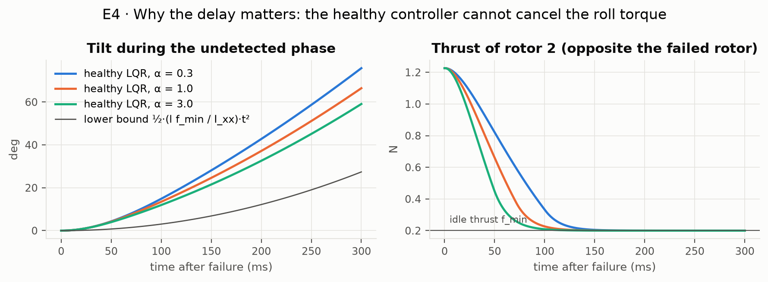
Before detection, nothing stops the roll
RQ2 · WHY DELAY MATTERS
Rotor 2 cannot go below its idle thrust (0.2 N), so the roll acceleration is at least l·f_min / I_xx = 10.6 rad/s² for any healthy-controller tuning. Tilt reaches about 13° at 100 ms and 37° at 200 ms.
Notes:
Why does the delay matter so much? When rotor 4 dies, rotor 2 on the opposite side is no longer balanced, which creates a roll torque. The healthy controller reacts by cutting rotor 2, but a running motor cannot go below its idle thrust. So a roll acceleration of at least 10.6 radians per second squared remains, whatever the tuning. The plot shows three tunings, all above this lower bound. After 100 milliseconds the vehicle is already tilted about 13 degrees, and after 200 about 37.

Slide 16
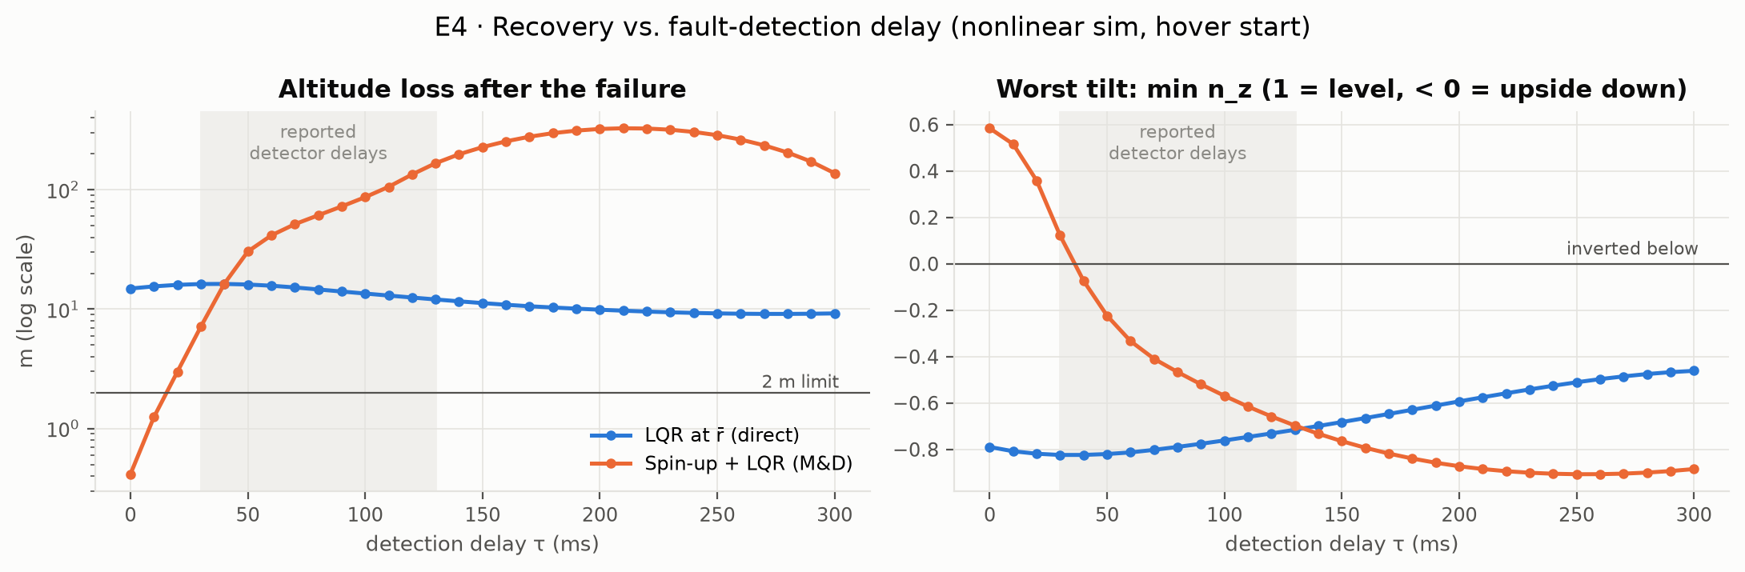
The published strategy tolerates about 10 ms
RQ2 · KEY RESULT
Safe recoveries, 20 random starts:
Delay | Safe
0 ms | 20 / 20
10 ms | 17 / 20
20 ms | 6 / 20
30 ms | 1 / 20
50 ms | 0 / 20
Safe = attitude recovered, altitude loss under 2 m, never upside down (fixed before the runs). At τ = 0 the strategy loses 0.4 m, consistent with the paper's flight. With the looser "attitude recovered" criterion the tolerance is about 40 ms. Our model spins up more slowly than the real vehicle, so these numbers hold for the published model.
Notes:
This is our key result so far for RQ2. We simulate the Mueller and D'Andrea strategy: spin up on two rotors, then switch to the LQR. With instant detection it loses only 0.4 metres of altitude, which agrees with their flight. But with delay, things fall apart quickly: 17 of 20 random starts are safe at 10 milliseconds, 6 at 20, 1 at 30, and none at 50. Real detectors take 30 to 130 milliseconds. Two honest caveats: with a looser criterion, attitude recovered only, the tolerance is about 40 milliseconds; and our model spins up more slowly than the real vehicle did, so we present these numbers as valid for the published model and will study the sensitivity.

Slide 17
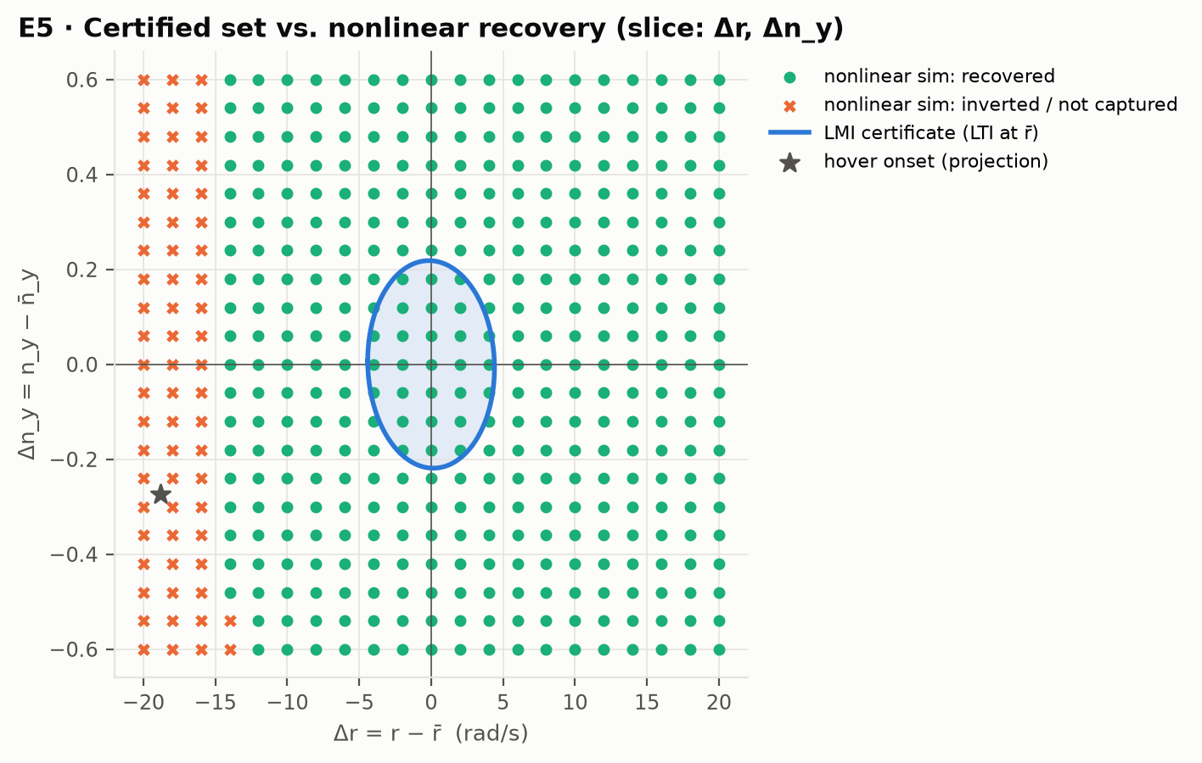
A first LMI certificate, and its limit
RQ2 · FIRST CERTIFICATE
Saturation-aware invariant ellipsoid (Hu–Lin LMIs) for the LQR on the linear model at the spinning equilibrium.
22%
of the way to hover onset, certified
70%
recovered in simulation
The LQR fails only when the spin is near zero, exactly where the hover-onset state lies. Next: a certificate valid over the whole spin-up, treating the yaw rate r as a varying parameter (LPV).
Notes:
To turn the delay question into a guarantee, we need a certified set of states from which the failure controller always recovers despite thrust limits. Our first version uses the Hu and Lin saturation conditions as LMIs on the linear model at the spinning equilibrium. It certifies about 22 percent of the way from the equilibrium to the state right after a failure in hover; simulation shows recovery up to about 70 percent, so it is about three times conservative. The slice shows why: the controller only fails when the spin rate is near zero, but a certificate built at the full spin cannot reach there. That is exactly the gap our next step addresses, by treating the yaw rate as a varying parameter and certifying over the whole spin-up. These are certificates for the linear model; the nonlinear gap is measured by simulation.

Slide 18
Plan for the remaining weeks
NEXT STEPS
Weeks | RQ1 · Residual Koopman | RQ2 · Delay budget
1–2 | MPC on the full-state Koopman model; integral-action MPC baseline | Read Stephan 2018 and Lanzon 2014; certificate over the spin-up (LPV in r)
3–4 | Online residual adaptation (recursive least squares) | Reachable set of the undetected phase; first certified delay budget τ*
5–6 | Air-relative thrust in the truth plant; residual trained on spin-up data | Trade study incl. yaw-drag and thrust-model sensitivity; τ* per controller
7–8 | Ablations and write-up | Simulation check of the certified τ*; final report
Main risk: a certificate over the whole spin-up may be infeasible or too conservative. Fallbacks: a parameter-dependent Lyapunov function, or a chain of nested ellipsoids.
Notes:
Here is the plan for the rest of the semester, in two parallel tracks. For RQ1 we still owe the second controller from the proposal, MPC on the full-state Koopman model, plus the classical integral-action baseline, then online adaptation to fix the generalization problem. For RQ2 the next step is the certificate over the whole spin-up, then the reachable set of the undetected phase, which together give the certified delay budget. The main risk is that the spin-up certificate is infeasible or too conservative; we have two fallbacks ready.

Slide 19
Where we stand
SUMMARY
1
The simulator matches three published papers. Known gap: the real vehicle spins up about 30% faster.
2
RQ1: the residual Koopman model predicts best, needs less data and cuts the MPC altitude bias by a third, but does not yet generalize to an unseen vehicle.
3
RQ2: the published recovery tolerates about 10 ms of detection delay; detectors need 30–130 ms. Certifying the spin-up is next.
Questions?
Notes:
To summarize. Our simulator is validated against three papers, with one known gap to flight data. For the question in our proposal, the residual Koopman model is the best predictor, needs less data, and improves MPC, but it does not yet generalize, and we have a concrete plan for that. For the question we added, the published recovery strategy tolerates only about 10 milliseconds of detection delay in simulation, well below what real detectors need, which is the gap our certified delay budget will address. Thank you, we are happy to take questions.

