Slide 1
Fault-tolerant control of a quadrotor after complete rotor loss
EE650 · BASICS OF MODERN CONTROL SYSTEMS · PROGRESS REVIEW
Residual Koopman MPC, and certified limits on fault-detection delay
Pranshu Kumar · Mudita Jain · Prashant Gupta · Aarush Singh Kushwaha
October 2026
Notes:
Good morning. This is our progress review after the proposal. I will cover four things: the problem and our aim, the simulator and how we validated it against published results, first results on the residual Koopman approach we proposed, and first results on how long fault detection can take before recovery is no longer possible.

Slide 2
One aim, two connected parts
AIM
MODEL AND CONTROL · AS PROPOSED
Residual Koopman MPC
Can a Koopman (EDMDc) model of only the mismatch, built on the known spinning-equilibrium model of Mueller & D'Andrea, predict and control better than the physics model alone or a full-state Koopman model?
TIMING · ADDED AFTER THE PROPOSAL
Certified detection-delay budget
A fault detector needs 30–130 ms to notice a dead rotor. What is the largest delay for which recovery is guaranteed, and how does the capture controller change it?
The link: each capture controller (LQR, analytical MPC, residual Koopman MPC) is compared by the detection delay it can tolerate.
Notes:
Our project has one aim with two parts. The first part is the approach from the proposal we presented: build the known physics of the spinning, failed vehicle into the model, and let a Koopman model learn only what the physics gets wrong, then use it inside MPC. The second part concerns timing. While reviewing the literature we found that recovery methods with guarantees assume the failure is detected instantly, but real detectors take tens to hundreds of milliseconds. We therefore also ask for a guaranteed bound on that delay, using Lyapunov and LMI tools from this course. The two parts connect: whichever controller catches the vehicle after detection, we can compare them by the delay they tolerate. Nothing from the proposal was dropped.

Slide 3
What happens when a rotor fails
THE PROBLEM
Healthy flight
Normal controller, four rotors
Rotor fails
t = 0, thrust of rotor 4 lost
Undetected, τ
Healthy controller still flying a 3-rotor vehicle
Capture
Failure controller takes over
Relaxed hover
Steady spin ≈ 19 rad/s, axis tilted
Most recovery methods with a guarantee assume τ = 0.
Stability with a fixed delay is shown for a linear model; a certified maximum delay under thrust limits was not found.
Simha et al. 2017; Al Lawati & Akhtar 2026; Başak & Prempain 2015; Strack van Schijndel et al. 2021
Notes:
When one rotor dies, a quadrotor cannot hover level any more. Mueller and D'Andrea showed it can still fly by spinning steadily about a tilted axis, called the relaxed hover. But there is a gap in time: the fault detector needs some time tau to notice the failure. During that time the normal controller keeps flying a vehicle that has lost a rotor. Only after detection does the failure controller take over and try to capture the vehicle into the spinning state. Most guarantee-based papers assume tau equals zero. Başak and Prempain proved stability for a linear model with a fixed delay, but without thrust limits and without finding the largest tolerable delay. Fast detectors take 30 to 130 milliseconds.

Slide 4
Simulator and vehicle
FOUNDATION
6-DOF rigid body, quaternion attitude, rotor gyroscopic terms
Per-rotor thrust 0.2–3.8 N; a motor can also be stopped
First-order motor lag, 15 ms
Reduced attitude n = Rᵀe₃: the "up" direction seen from the body
RK4 integration; controller at 1–5 ms (zero-order hold)
Truth plants for learning add thrust loss at high spin, inertia error and a different motor lag
Parameter | Value
Mass | 0.50 kg
Arm length | 0.17 m
Inertia Ixx, Izz | 3.2, 5.5 × 10⁻³ kg m²
Thrust coefficient κf | 6.41 × 10⁻⁶ N s²/rad²
Torque ratio κτ | 0.0169 m
Yaw drag γ | 2.75 × 10⁻³ N m s/rad
All values from Mueller & D'Andrea, ICRA 2014, Sec. V-A
Notes:
We wrote our own simulator in Python. It is a full six degree of freedom rigid body with the rotor gyroscopic terms from the paper, actuator limits, and motor lag. The key state for the failed vehicle is the reduced attitude n: the vertical direction expressed in body axes. Because the vehicle spins, we control this direction rather than the full attitude. Every vehicle parameter comes from the Mueller and D'Andrea paper, so we can compare against their numbers directly. For the learning experiments we also build "truth" plants with effects the nominal model does not have.

Slide 5
The model matches three published papers
FOUNDATION
Source | What we compared | Result
ICRA 2014 | Two-rotor-loss equilibrium | All published digits (≤ 0.14%)
ICRA 2014 | Three-rotor-loss equilibrium | All published digits (≤ 0.8%)
ICRA 2014 | One-rotor-loss equilibrium | f, r, n_z ≤ 0.5%; pitch rate −6% *
ICRA 2014 | ā and controllability loss (eqs. 28, 39) | Exact
IJRR 2016 | Five failure cases, own implementation | Body rates within 4%
Sun et al. 2020 | Bebop 2, two-rotor loss (eq. 60) | Exact
Flight data | Spin-up to 10 rad/s at the flight thrust (2.95 N) | 0.65 s vs 0.62 s in flight (4%)
* The paper's own published values do not satisfy its eq. (12); its other two cases match exactly. 46 automated tests also check conservation laws, closed-form solutions and these published numbers.
Notes:
Before trusting any result we checked the simulator against published numbers. The two-rotor and three-rotor-loss equilibria from Mueller and D'Andrea's ICRA paper match every digit they published. The three-rotor case is a strong check because it uses all the gyroscopic terms. For the one-rotor case, thrust, spin rate and tilt match within half a percent, but the pitch rate is six percent lower; we found that the paper's own published values leave a residual in its own equation 12, so that one published case is slightly inconsistent. We also wrote an independent implementation of their more detailed IJRR model and reproduced all five failure cases within 4 percent, and matched a second drone, the Bebop 2, from Sun et al. Finally, against flight data: with the thrust the flight actually used, read from their Figure 4, our model spins up to 10 radians per second in 0.65 seconds, against 0.62 in flight. The spin-up time depends strongly on that thrust, so the delay results later are shown for two thrust values.

Slide 6
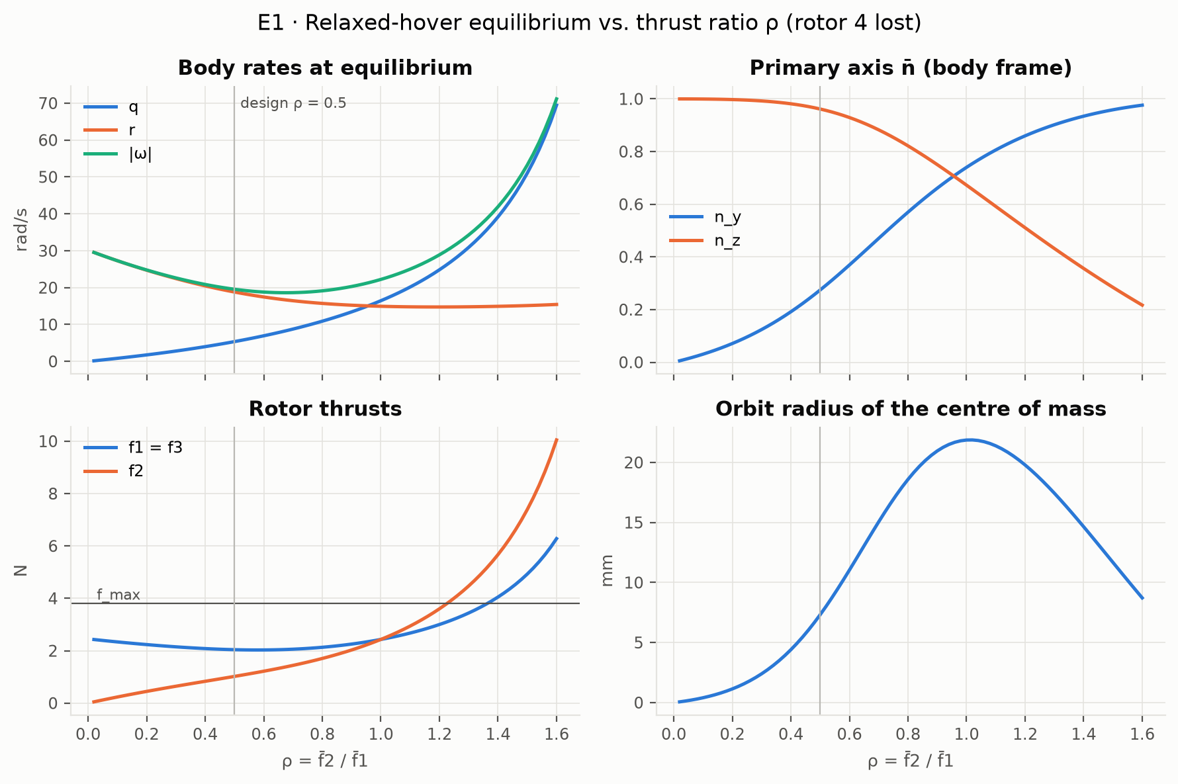
The spinning equilibrium
FOUNDATION
Rotor 4 lost, design ratio ρ = f₂/f₁ = 0.5:
f = (2.04, 1.02, 2.04) N
spin 19.6 rad/s, axis tilted 16°
Thrust, spin rate and tilt match the paper within 0.5%.
The ρ sweep reproduces the paper's Fig. 3 (minimum spin 18.6 vs 19.0 rad/s).
Notes:
This is the equilibrium the failed vehicle must reach. With rotor 4 gone, the two side rotors produce equal thrust and the opposite rotor about half of it. The vehicle then spins at about 19.6 radians per second about an axis tilted 16 degrees from the body z axis, and the centre of mass moves on a circle of only about 7 millimetres. The figure shows how the equilibrium changes with the thrust ratio; it reproduces the paper's Figure 3.

Slide 7
Linear model: controllable, but what can we observe?
FOUNDATION
7 states (p, q, r, n_x, n_y, z, v_z), inputs f₁, f₂, f₃. Linear and time-invariant in body axes.
Open-loop modes: ±10.1j, ±19.6j, −0.51 and an altitude double integrator.
Controllable: rank 7 of 7; every mode passes the PBH test.
Sensors | Rank | Missing
Gyro | 3 / 7 | tilt, altitude
Gyro + tilt estimate | 5 / 7 | altitude
Gyro + barometer | 7 / 7 | none (weak)
Gyro + tilt + barometer | 7 / 7 | none
The equilibrium is tilted, so vertical acceleration depends on tilt. A barometer alone then reveals the tilt, but about 2,700× more weakly than a tilt sensor (observability Gramian).
Notes:
Linearizing about the spinning equilibrium in body coordinates gives a linear time-invariant model. The open loop has two undamped oscillations, at 10 and 19.6 radians per second, the slow yaw mode, and the altitude double integrator. It is fully controllable from the three rotors, which reproduces the paper's result. On observability: gyros alone cannot see tilt or altitude. A small finding of ours: because the spinning equilibrium is tilted, vertical acceleration depends on tilt to first order, so gyro plus barometer is enough in principle. But with realistic sensor noise the observability Gramian shows it is about 2,700 times weaker than measuring tilt directly, so it is a structural property, not a practical estimator.

Slide 8
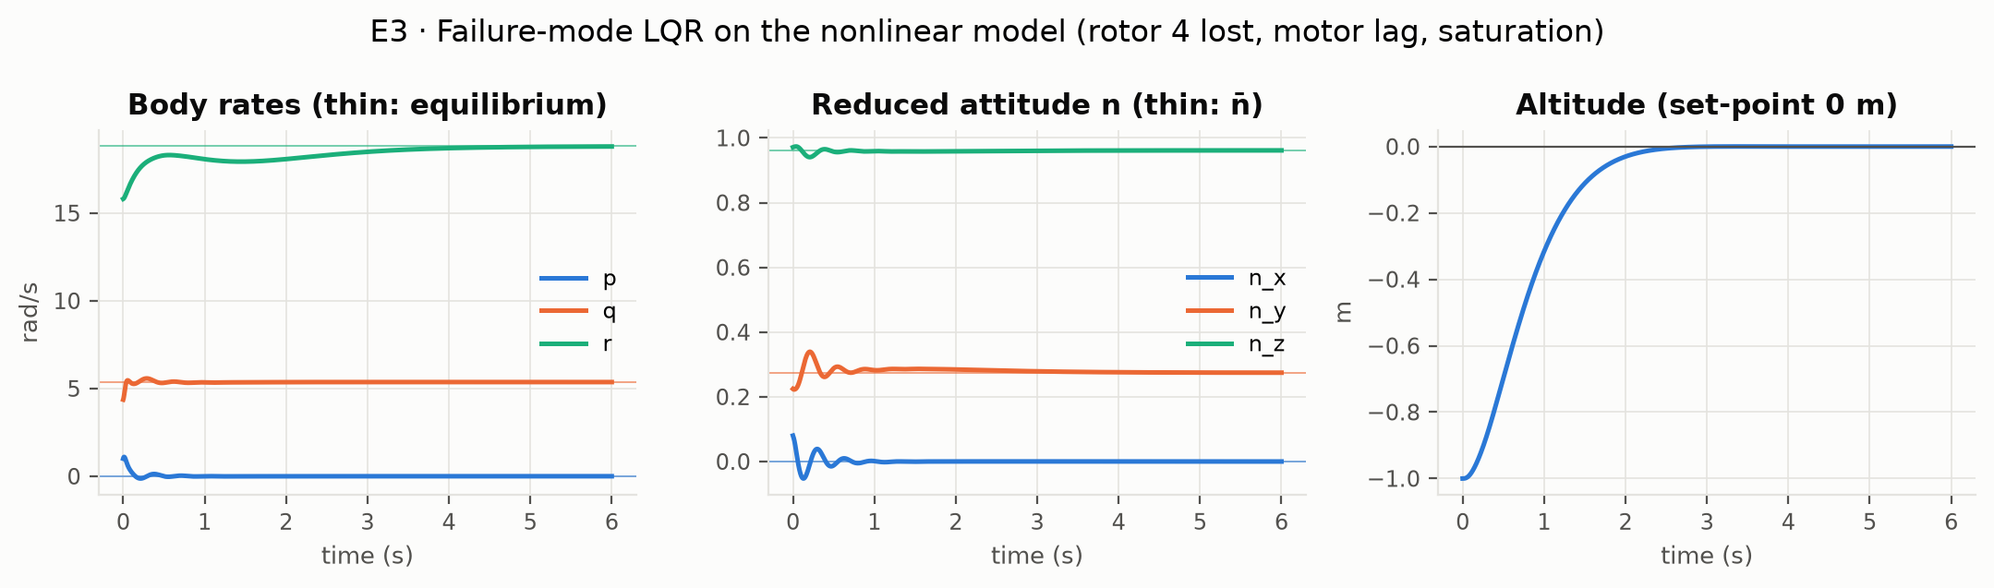
LQR baseline at the spinning equilibrium
FOUNDATION
18 ms
input-delay margin (healthy LQR: 40 ms)
ζ ≈ 0.19
damping of the least-damped mode
1.8–2.5 s
to settle altitude, tilt and yaw rate
Weights from Mueller & D'Andrea, plus motor states and altitude
Notes:
We designed two LQR controllers: a normal hover controller, and a failure-mode controller at the spinning equilibrium using the paper's weights, with motor states and altitude added. On the full nonlinear model with motor lag and thrust limits, the failure controller recovers from a perturbed start: the altitude settles in 1.8 seconds, the tilt in 2.1 and the yaw rate in 2.5. One number to note: the failure controller tolerates only about 18 milliseconds of pure input delay, compared with 40 for the healthy one. The least-damped mode is the oscillation at the spin frequency, with a damping ratio of about 0.19.

Slide 9
Residual Koopman models of the failed vehicle
PART 1 · AS PROPOSED
Learn only what the physics model gets wrong, then use it inside a convex MPC.
Notes:
Now the first part: learning only the mismatch of the physics model.

Slide 10
Three predictors, same data
SET-UP
Analytical
Mueller & D'Andrea linear model about the spinning equilibrium. No data.
Full-state EDMDc
Learns all the dynamics from data: 55 lifted states (quadratic dictionary).
Residual EDMDc (proposed)
Physics model plus a learned one-step correction e = x_true − x_model, clipped at d_max.
Data: 40 episodes × 4 s at 5 ms, from a truth plant with effects the model lacks (thrust loss at high spin, inertia error, slower motors). Test: 10 new episodes from the same plant (A) and 10 from a different one (B).
Notes:
We compare three predictors on the same data, exactly as proposed. The analytical model is the Mueller and D'Andrea linearization with no learning. Full-state EDMDc learns everything from data with a quadratic dictionary of 55 lifted states. The residual model keeps the physics and learns only the one-step error, clipped to a bound, as in Todde et al. 2026. To avoid learning our own code back, the data come from a "truth" plant with effects the physics model does not have. We test on held-out episodes from the same plant and from a different plant.

Slide 11
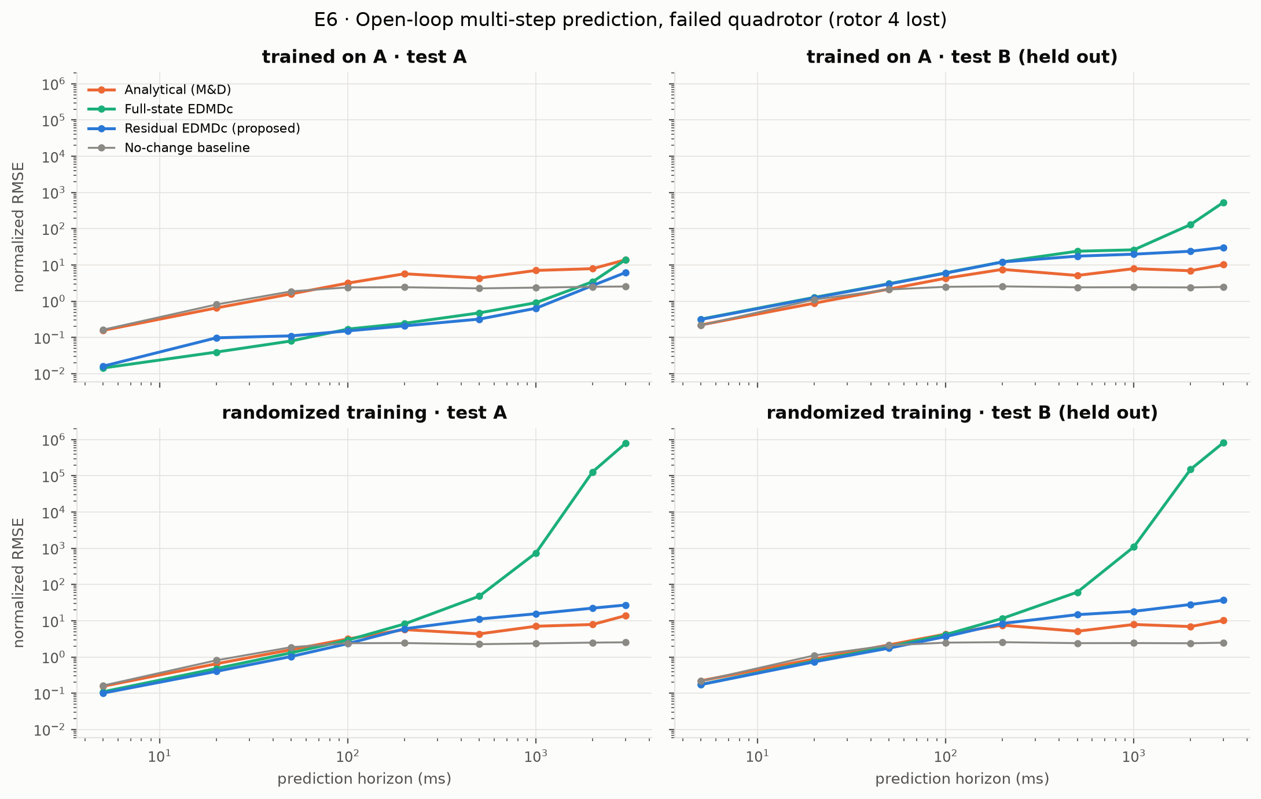
From 100 ms on, the residual model predicts best
PREDICTION
Error at a 1 s horizon, test family A (normalized RMSE):
Predictor | Error
Residual EDMDc | 0.64
Full-state EDMDc | 0.91
"No change" baseline | 2.38
Analytical model | 7.09
Below 100 ms the full-state model is slightly better. It has 4 of 55 eigenvalues outside the unit circle and falls behind "no change" by 2 s, as the proposal predicted.
Notes:
Here is the main prediction result. On held-out episodes from the training plant, the residual model has the lowest error at every horizon from 100 milliseconds upward; at shorter horizons the full-state model is slightly better. At one second the residual error is 0.64, against 0.91 for full-state EDMDc and 7.1 for the analytical model, which is worse than simply assuming nothing changes, because the unmodelled thrust loss makes it drift. Our proposal claimed that full-state EDMDc is unstable; on the failed vehicle we confirm that it has eigenvalues outside the unit circle and that it falls behind the no-change baseline by two seconds. At two seconds even the residual model is behind no-change: long open-loop horizons need feedback, which is why the MPC re-plans every 5 milliseconds.

Slide 12
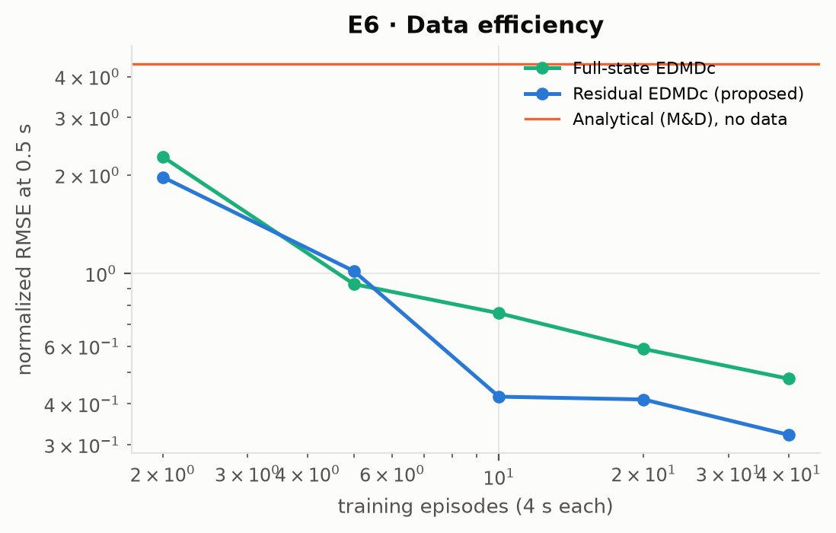
Little data needed, no generalization yet
LIMITS
Data efficiency
With 10 episodes the residual model (0.42) beats the full-state model trained on 40 (0.48), at a 0.5 s horizon.
Generalization fails
On the unseen plant B, both learned models are worse than the physics model alone. Training on randomized plants helps on B only up to about 100 ms and hurts on A: the unknown parameters cannot be read from one state sample.
Next
Update the residual online with recursive least squares (it is linear in its parameters).
Notes:
Two more results, one good and one bad. Good: the residual model needs less data. With only 10 short episodes it already beats the full-state model trained on 40. That matters because real failure data are scarce: failed flights tend to end in crashes. Bad: neither learned model generalizes to a plant with different parameters. On the held-out plant both are worse than the physics model alone. Training on randomized plants helps the residual model on the new plant only up to about 100 milliseconds, and makes both models worse on the training plant, because a static model cannot tell from a single state which vehicle it is on. This motivates our next step: adapt the residual online. Since the residual is linear in its parameters, recursive least squares is a natural, cheap choice.

Slide 13
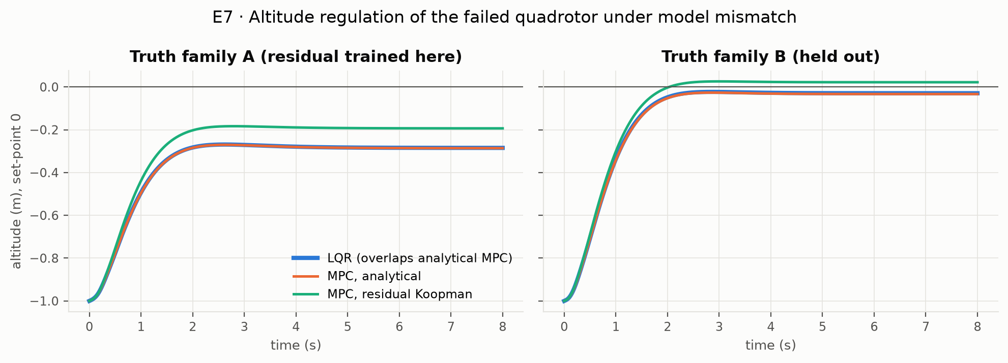
Residual MPC removes a third of the bias
CONTROL
−32%
steady altitude error on plant A (−0.29 → −0.19 m)
0.7 ms
solver time per step (horizon 20 × 5 ms, OSQP)
The residual enters the QP as a measured disturbance, so the problem stays convex (as in Todde et al. 2026). It helps for every mismatch effect of plant A, but on plant B without its thrust loss the error grows by 47%. After a detection delay, LQR is safe up to 10 ms and both MPCs only without delay.
Notes:
Now in closed loop. We built a linear MPC on the analytical model, and the same MPC with the residual added as a measured disturbance, evaluated outside the optimization so the QP stays convex. On the training plant, the mismatch causes a steady altitude error of about 29 centimetres for LQR and analytical MPC. The residual-Koopman MPC cuts it to 19 centimetres, a 32 percent reduction, and it helps for each separate mismatch effect of that plant. On the held-out plant it helps overall, but when we remove that plant's thrust loss it makes the error 47 percent larger, which is the generalization problem again. The solver needs under a millisecond per step; our modelling layer adds overhead, so a real-time version would call the solver directly. When we used the MPCs to catch the vehicle after a detection delay, they did not beat LQR: LQR was safe up to 10 milliseconds, the MPCs only without delay. The likely reason is that the linear model is not valid far from the spin. The obvious next baseline is integral action, which we will add.

Slide 14
How long can fault detection take?
PART 2 · ADDED AFTER THE PROPOSAL
Most recovery methods assume instant detection. Fast detectors take 30–130 ms.
Notes:
The second part: how long can fault detection take?

Slide 15
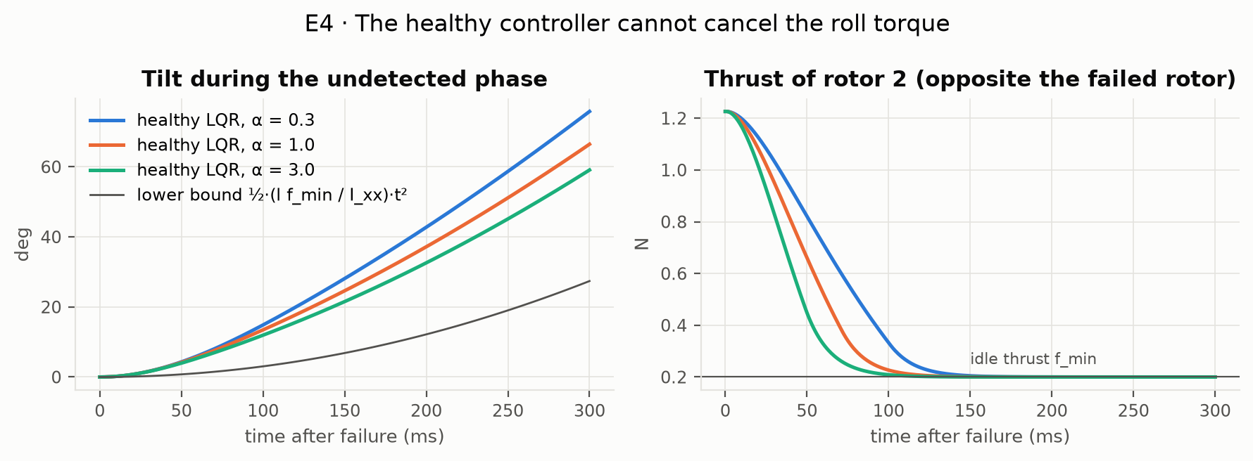
Before detection, nothing stops the roll
WHY DELAY MATTERS
Rotor 2 cannot go below its idle thrust (0.2 N), so the roll acceleration is at least l·f_min / I_xx = 10.6 rad/s² for any healthy-controller tuning. Tilt reaches about 13° at 100 ms and 37° at 200 ms.
Notes:
Why does the delay matter so much? When rotor 4 dies, rotor 2 on the opposite side is no longer balanced, which creates a roll torque. The healthy controller reacts by cutting rotor 2, but a running motor cannot go below its idle thrust. So a roll acceleration of at least 10.6 radians per second squared remains, whatever the tuning. The plot shows three tunings, all above this lower bound. After 100 milliseconds the vehicle is already tilted about 13 degrees, and after 200 about 37.

Slide 16
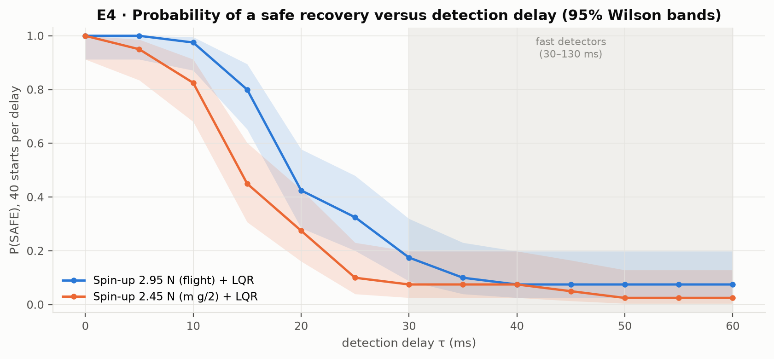
Safe recovery is likely only below about 12 ms
KEY RESULT
P(safe), 40 random starts per delay:
Delay | 2.95 N | 2.45 N
0 ms | 1.00 | 1.00
10 ms | 0.97 | 0.82
15 ms | 0.80 | 0.45
20 ms | 0.42 | 0.28
30 ms | 0.17 | 0.07
2.95 N: flight spin-up thrust (Fig. 4 of the paper); 2.45 N = mg/2.
Safe = attitude recovered, altitude loss under 2 m, never upside down (fixed before the runs). With no delay the vehicle climbs 0.40 m and loses only 0.03 m, like the flight. P(safe) falls below 0.5 at 19 ms (14 ms at mg/2); for attitude capture alone, at 52 ms. Fast detectors need 30–130 ms.
Notes:
This is our key result so far on timing. We simulate the Mueller and D'Andrea strategy: spin up on two rotors, then switch to the LQR. For each delay we run 40 random pre-failure states and count the safe recoveries; the bands are 95 percent confidence intervals. With the thrust used in flight and instant detection, the vehicle climbs 40 centimetres and loses only 3 centimetres below its start, like their flight. With delay, things fall apart quickly: the probability of a safe recovery drops below 0.9 at about 12 milliseconds and below one half at about 19. With the lower, hover-neutral thrust these numbers are 7 and 14 milliseconds. Real detectors take 30 to 130 milliseconds. If we only ask for the attitude to be recovered, ignoring the altitude loss, the 50 percent point is at 52 milliseconds. These numbers hold for this strategy and model; nonlinear controllers in the literature have recovered with 100 milliseconds or more.

Slide 17
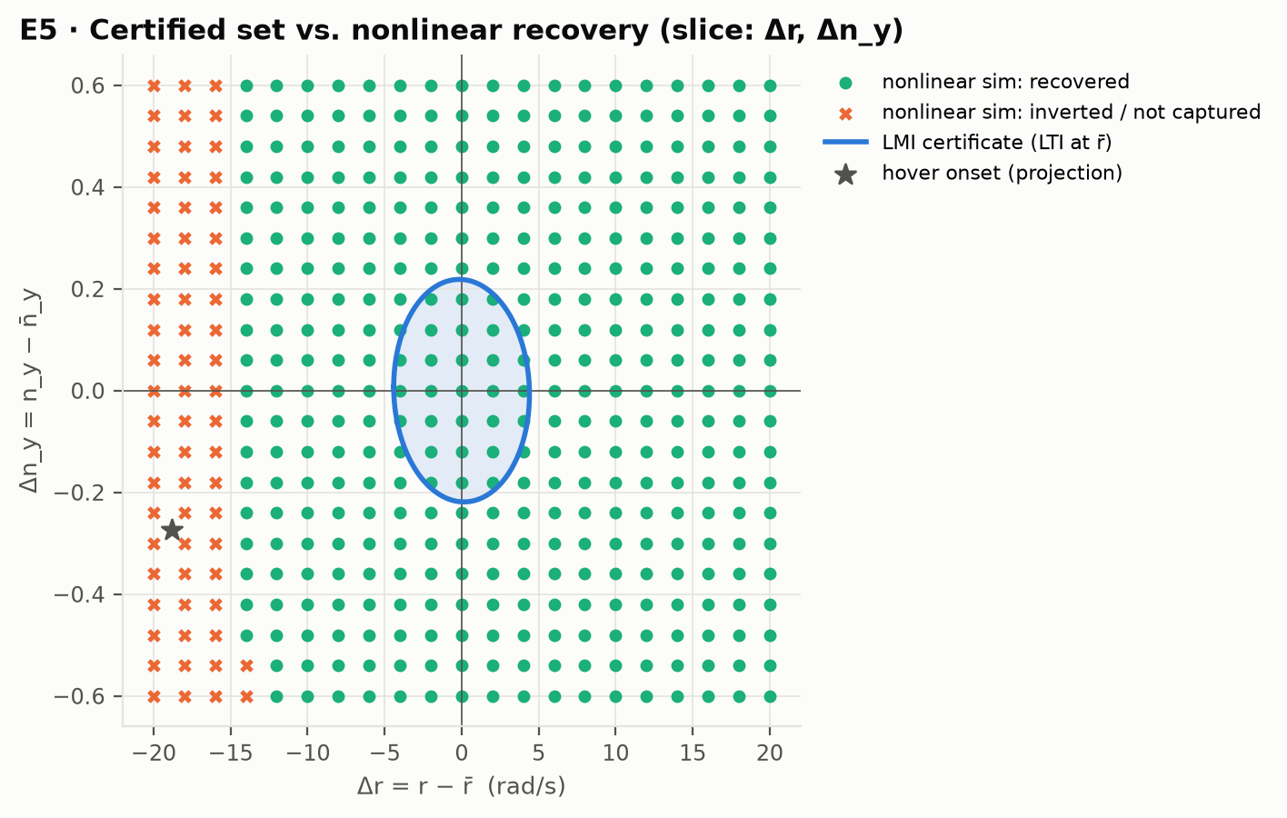
A first LMI certificate, and its limit
FIRST CERTIFICATE
Saturation-aware invariant ellipsoid (Hu–Lin LMIs) for the LQR on the linear model at the spinning equilibrium.
22%
of the way to hover onset, certified
70%
recovers in simulation
The LQR fails only at spin rates of 4.8 rad/s or less, which is where the hover-onset state lies. Next: a certificate valid over the whole spin-up, treating the yaw rate r as a varying parameter (LPV).
Notes:
To turn the delay question into a guarantee, we need a certified set of states from which the failure controller always recovers despite thrust limits. Our first version uses the Hu and Lin saturation conditions as LMIs on the linear model at the spinning equilibrium. It certifies about 22 percent of the way from the equilibrium to the state right after a failure in hover; simulation shows recovery up to 70 percent, so it is about three times conservative. The slice shows why: the controller only fails at spin rates of about 5 radians per second or less, but a certificate built at the full spin cannot reach there. That is exactly the gap our next step addresses, by treating the yaw rate as a varying parameter and certifying over the whole spin-up. These are certificates for the linear model; the nonlinear gap is measured by simulation.

Slide 18
Plan for the remaining weeks
NEXT STEPS
Dates | Learning the mismatch | Detection-delay budget
12–18 Oct | MPC on the full-state Koopman model; integral-action MPC baseline | Read the remaining key papers; certificate over the spin-up (LPV in r)
19–25 Oct | Online residual adaptation (recursive least squares) | Reachable set of the undetected phase; first certified delay budget τ*
26–31 Oct | Air-relative thrust in the truth plant | Sensitivity of τ* to spin-up thrust, idle thrust and motor lag; presentation 31 Oct
1–13 Nov | Certificate for the residual-Koopman loop if time allows | Final simulations; journal-style report due 13 Nov
Main risk: a certificate over the whole spin-up may be infeasible or too conservative. Fallbacks: a parameter-dependent Lyapunov function, or a chain of nested ellipsoids.
Notes:
Here is the plan for the remaining weeks, up to the final presentation on 31 October and the final report on 13 November. On the learning side we still owe the second controller from the proposal, MPC on the full-state Koopman model, plus the classical integral-action baseline, then online adaptation to fix the generalization problem. On the timing side the next step is the certificate over the whole spin-up, then the reachable set of the undetected phase, which together give the certified delay budget. The main risk is that the spin-up certificate is infeasible or too conservative; we have two fallbacks ready.

Slide 19
Where we stand
SUMMARY
1
The simulator matches three published papers and the flight spin-up time within 4%.
2
The residual Koopman model predicts best from 100 ms on, needs less data and cuts the MPC altitude bias by a third, but does not yet generalize to an unseen vehicle.
3
The published recovery is safe with probability above 0.9 only up to about 12 ms of detection delay; detectors need 30–130 ms. Certifying the spin-up is next.
Questions?
Notes:
To summarize. Our simulator is validated against three papers and against the flight spin-up time. The residual Koopman model is the best predictor from 100 milliseconds on, needs less data, and improves MPC, but it does not yet generalize, and we have a concrete plan for that. On timing, the published recovery strategy is safe with high probability only for detection delays up to about 12 milliseconds in simulation, well below what real detectors need, which is the gap our certified delay budget will address. Thank you, we are happy to take questions.

