Slide 1



SMART INDIA HACKATHON 2026
TITLE PAGE
Problem Statement ID – 26169
Problem Statement Title – AI-Based Virtual Camera Tracking System for Coarse Alignment of Mobile FSOC Terminals
Theme – Smart Automation
PS Category – Software
Team ID – —
Team Name – ZeroDrift
The problem in one line: a mobile laser (FSOC) terminal must find, verify and continuously point at its partner's beacon with hair-thin accuracy — ISRO asks for this coarse-alignment brain, proven entirely in software.

Slide 2
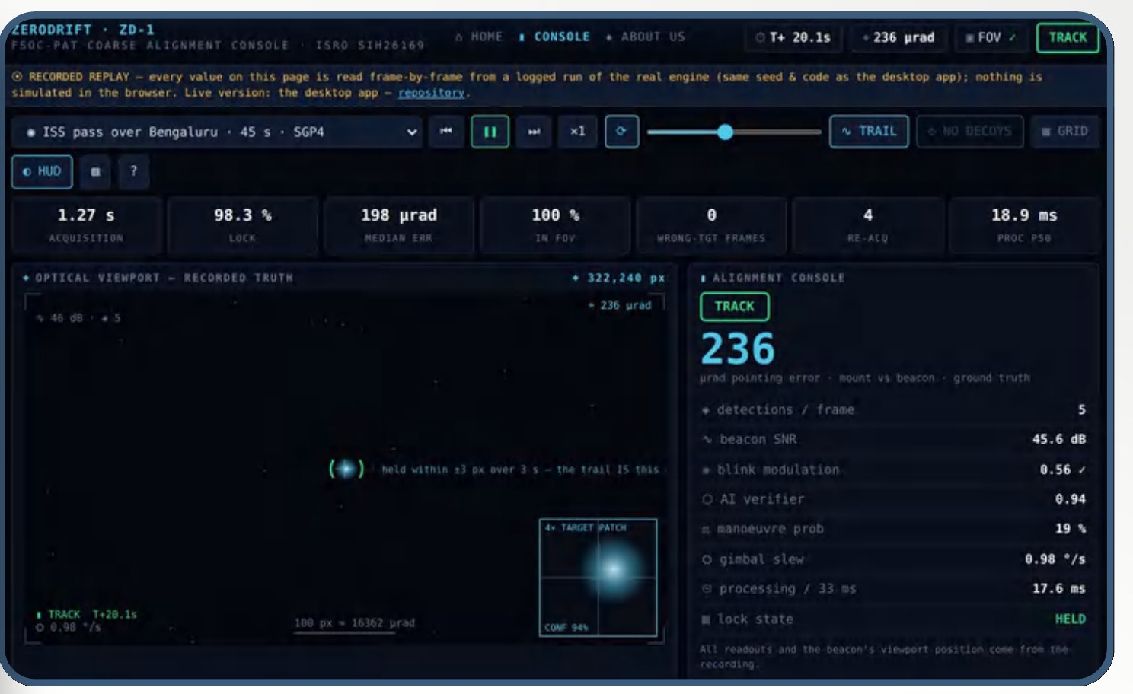
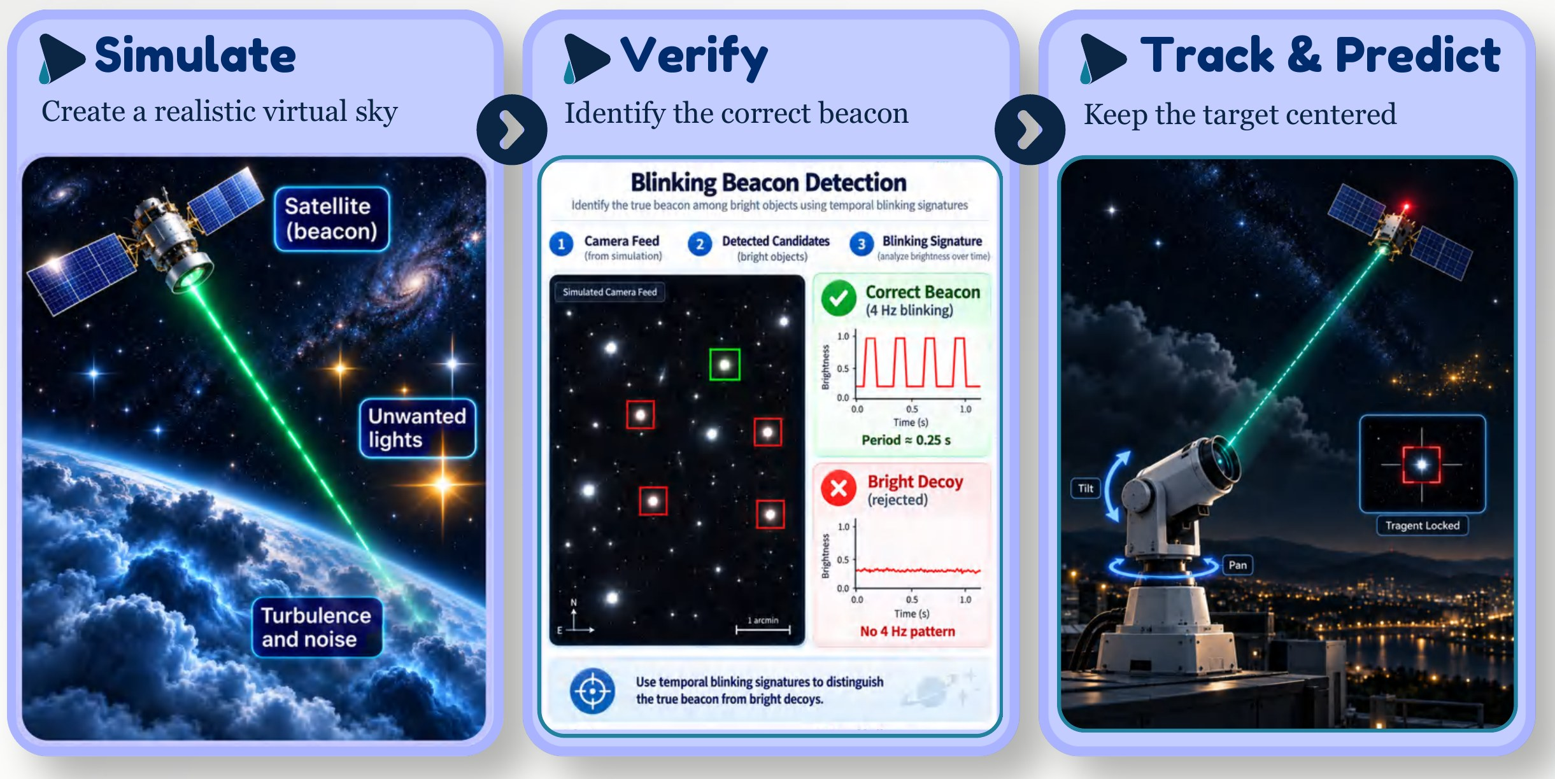
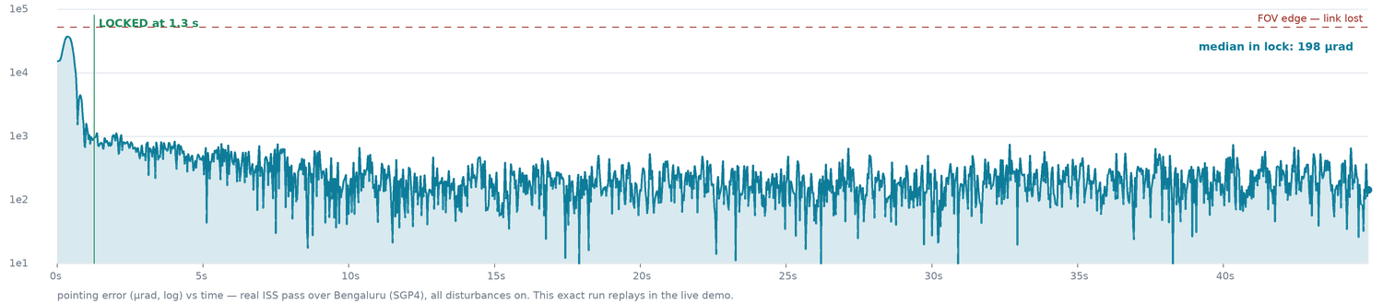
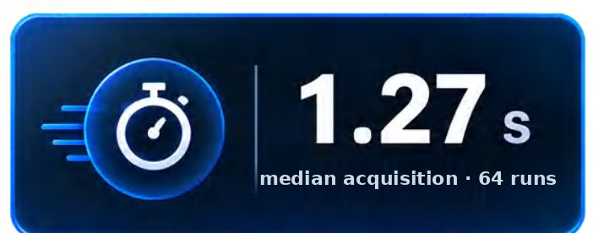
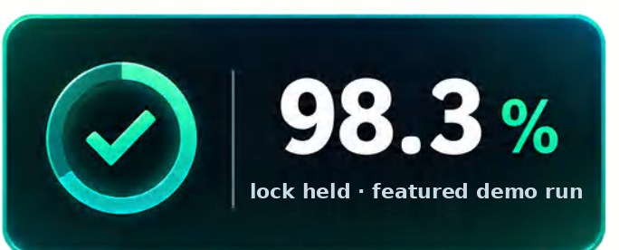
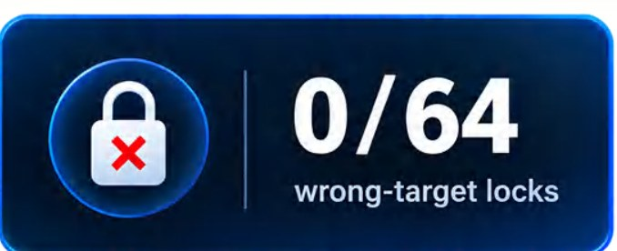
IDEA TITLE
ZeroDrift
Proposed Solution (Describe your Idea/Solution/Prototype)
Detailed explanation of the proposed solution
How it addresses the problem
Innovation and uniqueness of the solution
Problem in one line: find the partner's blinking beacon among stars and glints, verify it, and hold it centred to micro-radian accuracy — automatically, in software.
Our answer — the eyes & neck of a laser terminal: simulate the sky · verify the beacon · track & predict. Built, measured, live.
Our console locked on the beacon — the exact view the live demo link opens
Measured: median 198 µrad in lock · in-FOV 100% · the live-demo run

Slide 3
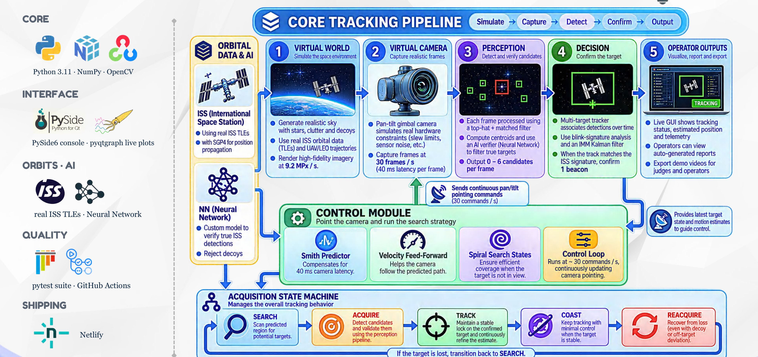
TECHNICAL APPROACH
ZeroDrift
Technologies to be used (e.g. programming languages, frameworks, hardware)
Methodology and process for implementation (Flow Charts/Images/ working prototype)

Slide 4
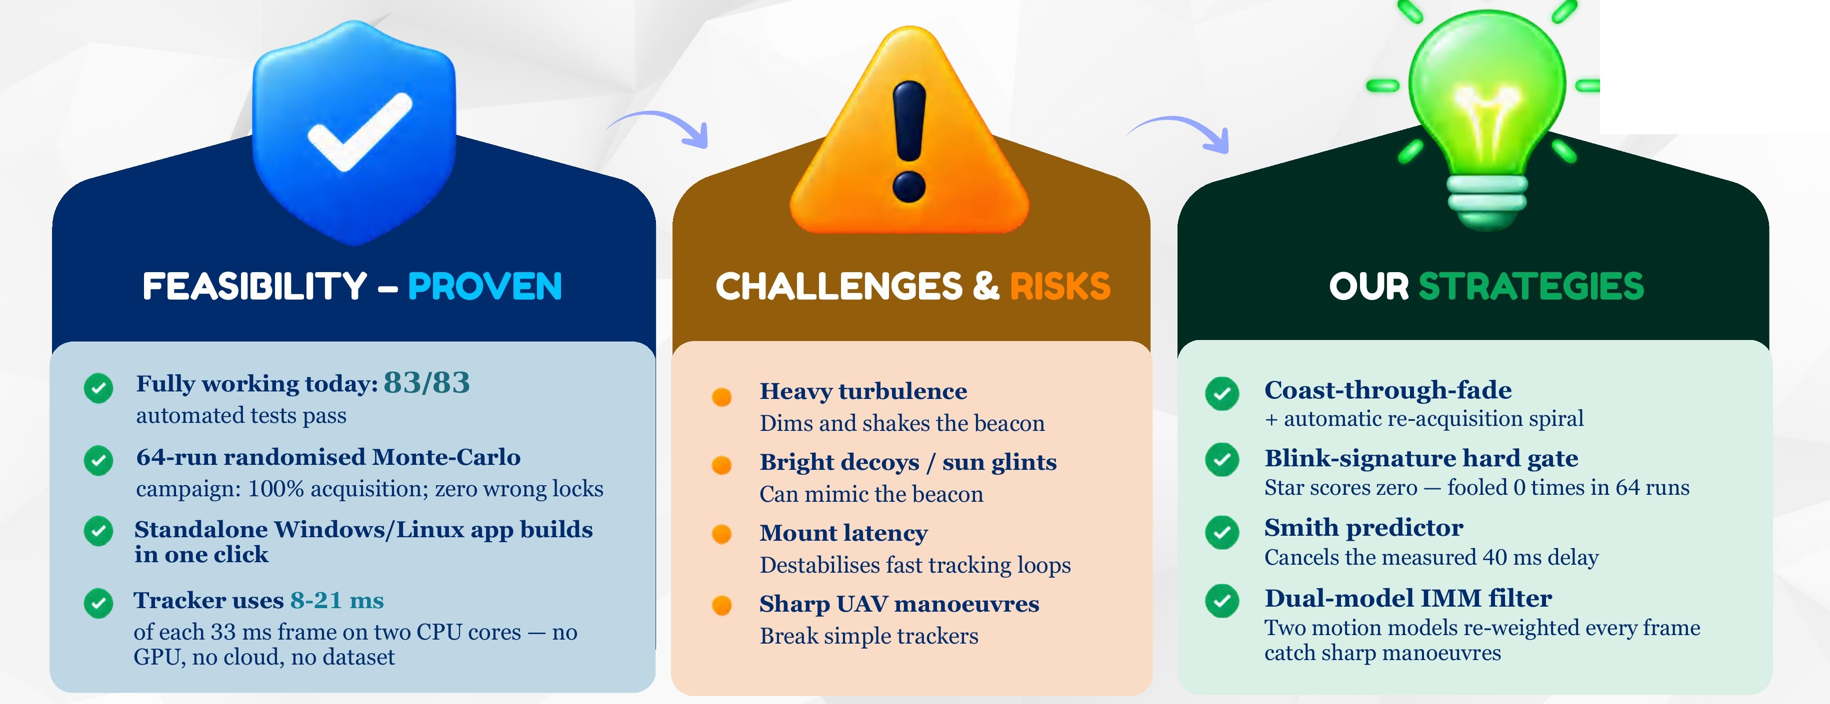
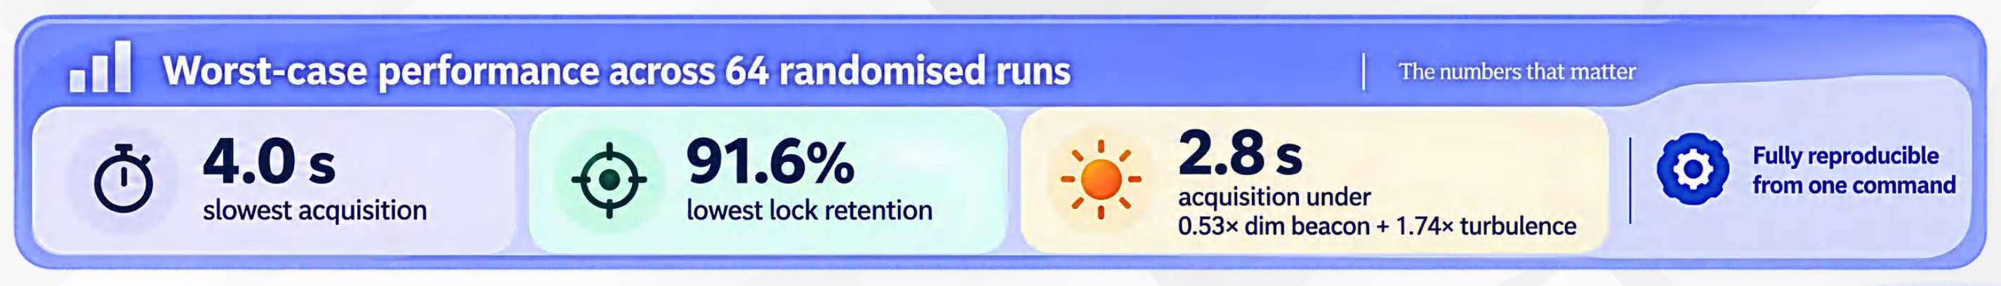
FEASIBILITY AND VIABILITY
ZeroDrift
Analysis of the feasibility of the idea
Potential challenges and risks
Strategies for overcoming these challenges
Worst case, 64 runs → never a wrong lock, never a failed acquisition.
Reproducible: every number regenerates from one command.

Slide 5
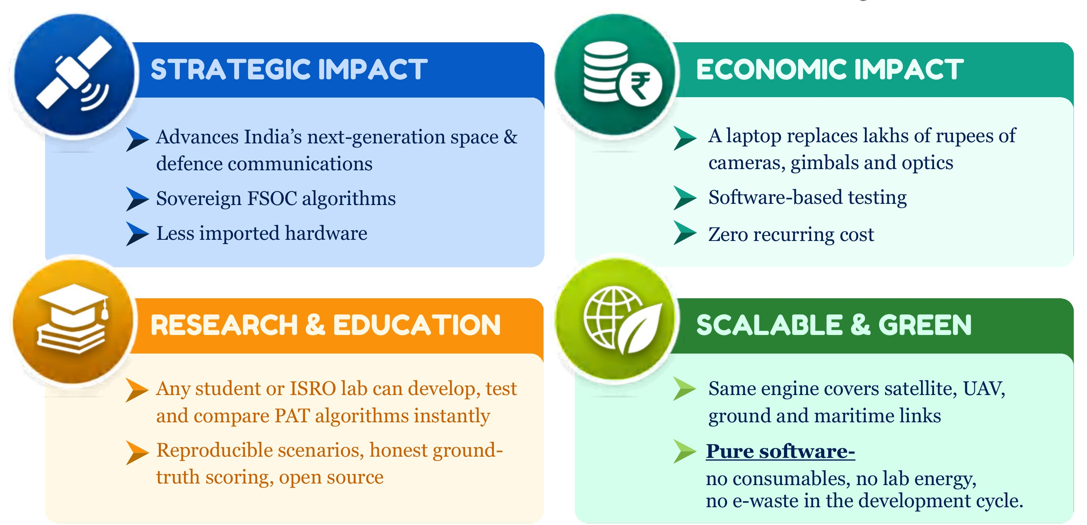
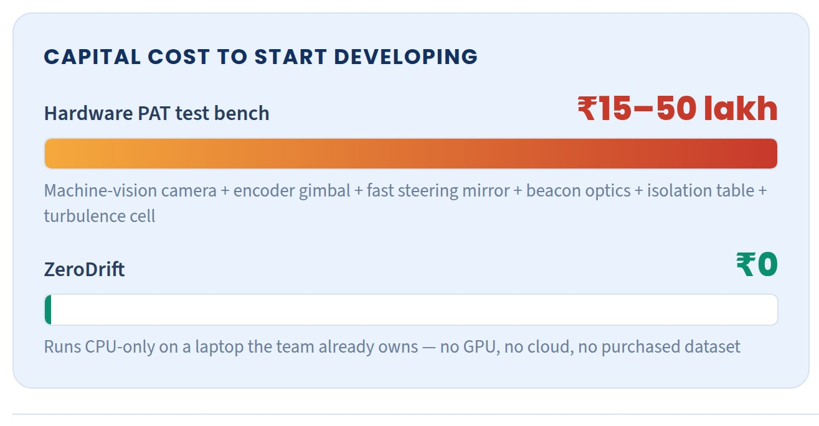
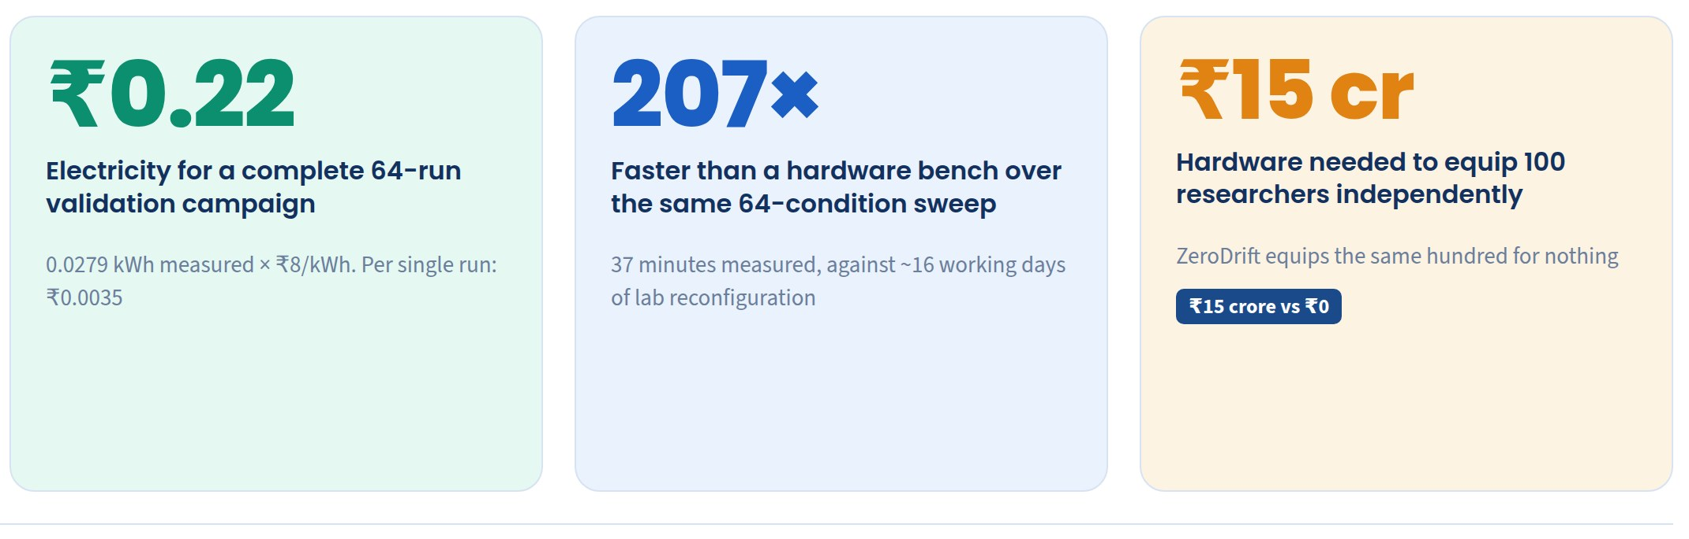

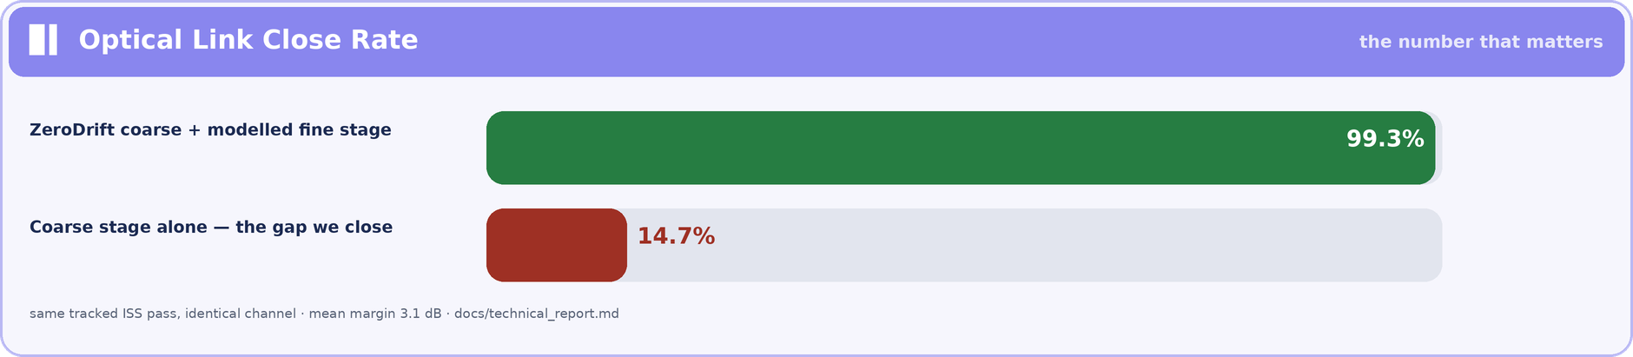
IMPACT AND BENEFITS
ZeroDrift
Potential impact on the target audience
Benefits of the solution (social, economic, environmental, etc.)
ECONOMIC FEASIBILITY — the arithmetic that removes the cost barrier

Slide 6
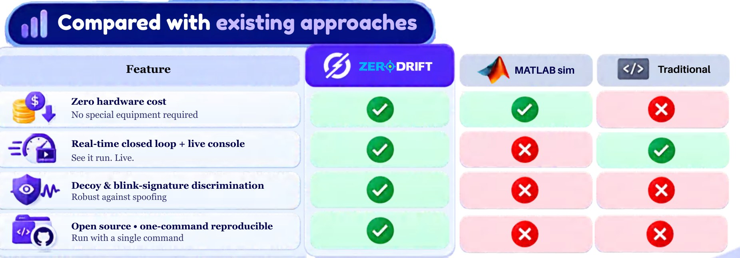

RESEARCH AND REFERENCES
ZeroDrift
Details / Links of the reference and research work
Research foundations
Our work — open and verifiable
Kaymak et al., “A Survey on Acquisition, Tracking and Pointing Mechanisms for Mobile FSO,” IEEE Comm. Surveys & Tutorials, 2018. [link]
Kaushal & Kaddoum, “Optical Communication in Space: Challenges and Mitigation Techniques,” IEEE CS&T, 2017. [link]
Blackman & Popoli, Design and Analysis of Modern Tracking Systems — IMM filtering, CFAR detection. [link]
Bar-Shalom et al., Estimation with Applications to Tracking and Navigation — Kalman/IMM theory. [link]
Smith, O.J.M., “Closer Control of Loops with Dead Time” — the Smith predictor, 1957. [link]
Vallado & Crawford, “SGP4 Orbit Determination” — AIAA 2008; real ISS TLE propagation. [link]
Andrews & Phillips, Laser Beam Propagation through Random Media — turbulence & scintillation. [link]
Repository: github.com/pranshukesavmishra/SIH-2026
Live demo (replay console): zerodrift-fsoc-pat.netlify.app
Inside: 5,500+ documented lines · 83 automated tests · 6 validated scenarios · Monte-Carlo logs · technical report · user manual · demo video.
Reproducible: every figure regenerates from one command; every random draw is logged and replayable.
Compared with existing approaches
Why ZeroDrift wins on this problem
✓ All six mandatory deliverables already exist today
✓ Judged numbers, honestly measured against hidden ground truth
✓ AI where it earns its place — benchmarked against classical methods

