Slide 1

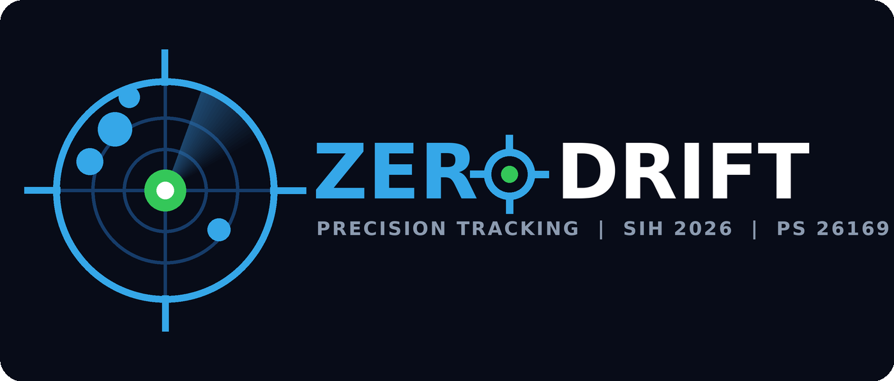
SMART INDIA HACKATHON 2026
TITLE PAGE
Problem Statement ID – 26169
Problem Statement Title – AI-Based Virtual Camera Tracking System for Coarse Alignment of Mobile FSOC Terminals
Theme – Smart Automation
PS Category – Software
Team ID – —
Team Name – ZeroDrift

Slide 2
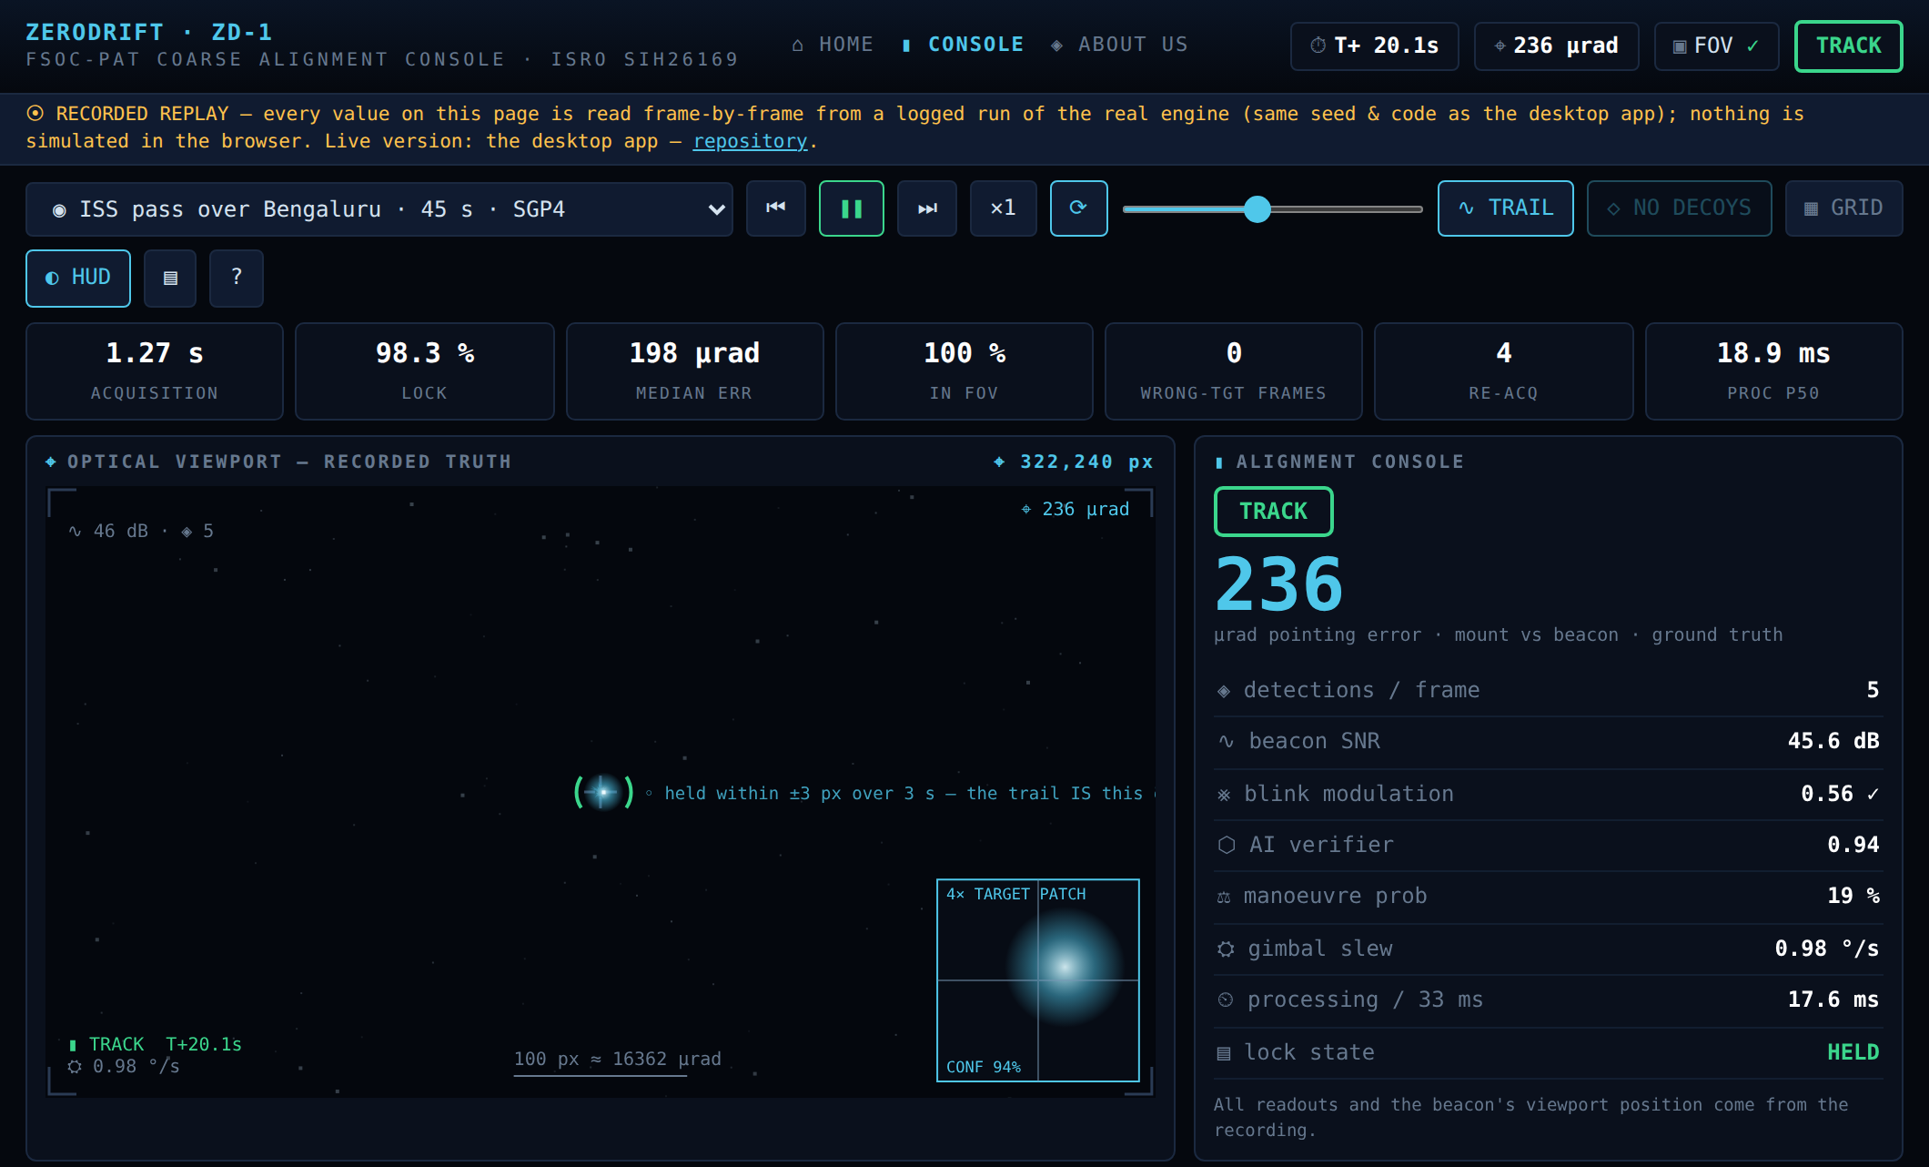
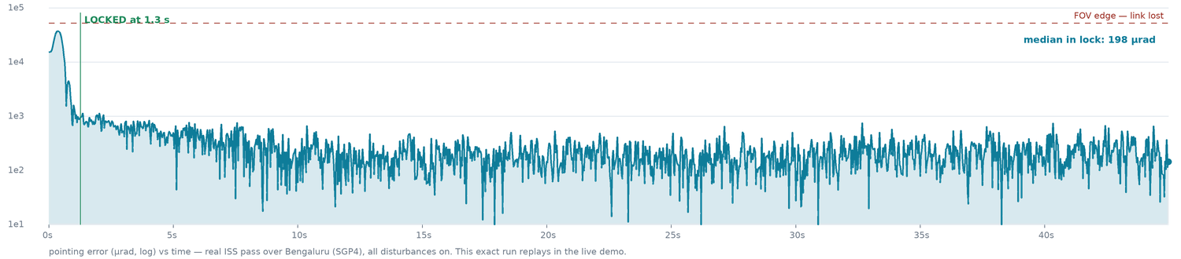
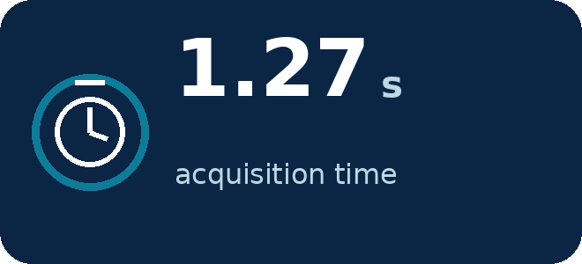
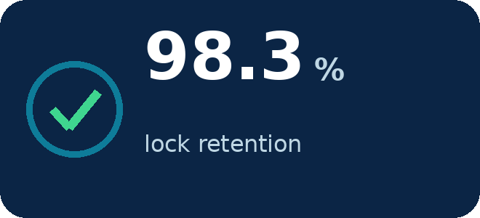
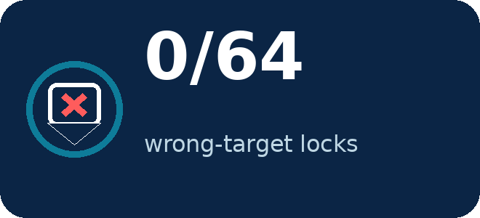
IDEA TITLE
ZeroDrift
Proposed Solution (Describe your Idea/Solution/Prototype)
Detailed explanation of the proposed solution
How it addresses the problem
Innovation and uniqueness of the solution
The eyes and neck of a laser communication terminal
The problem, simply: laser links beam huge data — but only while both terminals point at each other with hair-thin accuracy through shaking, wind and orbital motion. ISRO wants this ‘pointing brain’ proven in software, without costly optics.
Our solution: a virtual test-range — a physics-true sky with stars, clutter, turbulence and a moving blinking beacon — and an AI-assisted tracker that finds it, proves its identity, and steers a virtual camera to keep it centred.
Why it never locks the wrong light: the beacon blinks at an agreed 4 Hz. A star or sun-glint can be brighter, but it cannot blink right — impostors score zero and are rejected.
Smart where it matters: predicts 40 ms ahead to cancel mount delay, rides through blink gaps on a motion model; a self-trained neural verifier double-checks every lock.
Already built: GUI console, standalone app, hosted replay console, 73 automated tests — every number here is measured, not projected.
Our console locked on the beacon — the same view the live demo link opens
Measured: median 198 µrad in lock · in-FOV 100% · the live-demo run

Slide 3
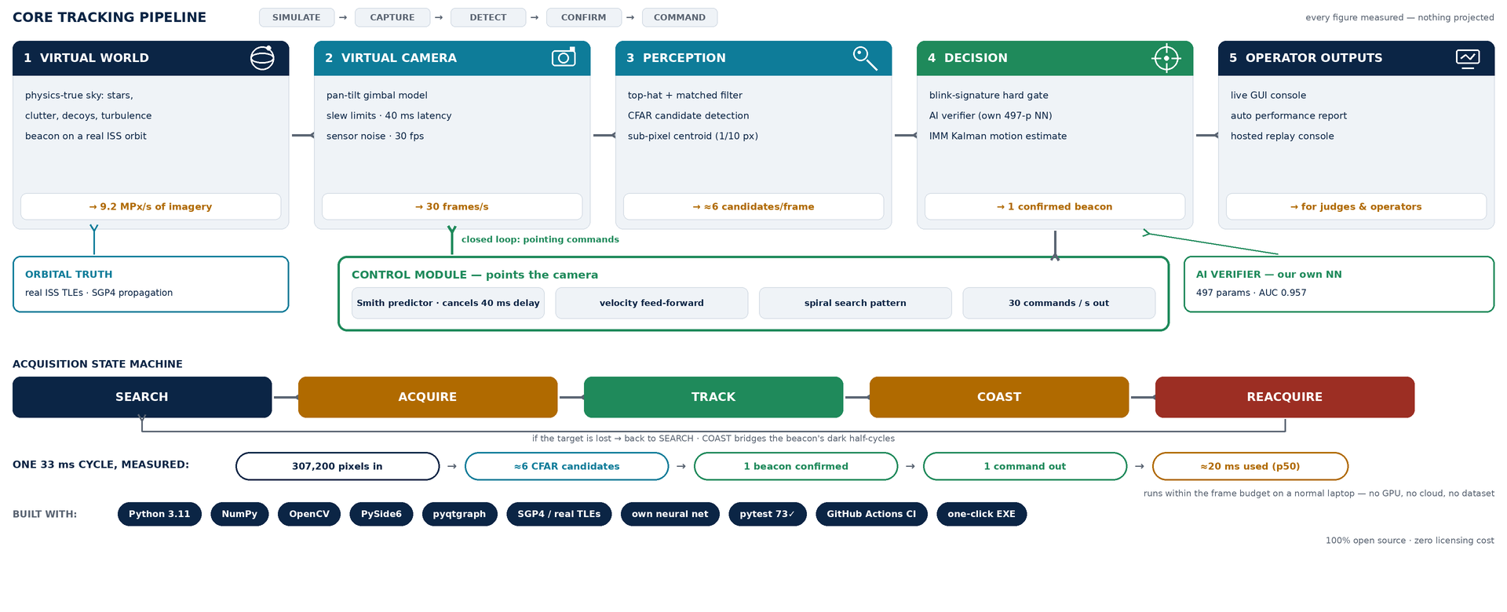
TECHNICAL APPROACH
ZeroDrift
Technologies to be used (e.g. programming languages, frameworks, hardware)
Methodology and process for implementation (Flow Charts/Images/ working prototype)

Slide 4
FEASIBILITY AND VIABILITY
ZeroDrift
Analysis of the feasibility of the idea
Potential challenges and risks
Strategies for overcoming these challenges
FEASIBILITY — PROVEN
CHALLENGES & RISKS
OUR STRATEGIES
• Fully working today: 73/73 automated tests pass
• 64-run randomised Monte-Carlo campaign: 100% acquisition, zero wrong locks
• Standalone Windows/Linux app builds in one click
• Tracker uses 8–21 ms of each 33 ms frame on two CPU cores — no GPU, no cloud, no dataset
• Heavy turbulence dims and shakes the beacon
• Bright decoys / sun glints can mimic the beacon
• Mount latency destabilises fast tracking loops
• Sharp UAV manoeuvres break simple trackers
• Coast-through-fade + automatic re-acquisition spiral
• Blink-signature hard gate: a star scores zero — fooled 0 times in 64 runs
• Smith predictor cancels the measured 40 ms delay
• Dual-model IMM filter — two motion models re-weighted every frame catch sharp manoeuvres
Worst case across all 64 randomised runs: slowest acquisition 4.0 s, lowest lock retention 91.6%; even a 0.53×-dim beacon under 1.74× turbulence acquired in 2.8 s. Every number regenerates from one command — fully reproducible.

Slide 5
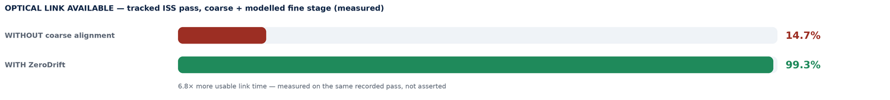
IMPACT AND BENEFITS
ZeroDrift
Potential impact on the target audience
Benefits of the solution (social, economic, environmental, etc.)
STRATEGIC
Advances India's next-generation space & defence communications — FSOC pointing algorithms developed sovereignly, without importing optical test benches.
ECONOMIC
A laptop replaces lakhs of rupees of cameras, gimbals and optics — the entire develop–test–validate cycle for FSOC pointing runs in pure software, at zero recurring cost.
RESEARCH & EDUCATION
Any student or ISRO lab can develop, test and compare PAT algorithms instantly — reproducible scenarios, honest ground-truth scoring, open source.
SCALABLE & GREEN
Same engine covers satellite, UAV, ground and maritime links. Pure software — no consumables, no lab energy, no e-waste in the development cycle.
Target audience: ISRO / IN-SPACe optical-communication teams, DRDO, IITs & engineering colleges, and India's growing space-tech startups.

Slide 6
RESEARCH AND REFERENCES
ZeroDrift
Details / Links of the reference and research work
Research foundations
Our work — open and verifiable
Kaymak et al., “A Survey on Acquisition, Tracking and Pointing Mechanisms for Mobile FSO,” IEEE Comm. Surveys & Tutorials, 2018. [link]
Kaushal & Kaddoum, “Optical Communication in Space: Challenges and Mitigation Techniques,” IEEE Comm. Surveys & Tutorials, 2017. [link]
Blackman & Popoli, Design and Analysis of Modern Tracking Systems — IMM filtering, CFAR detection, track management. [link]
Bar-Shalom et al., Estimation with Applications to Tracking and Navigation — Kalman/IMM theory. [link]
Smith, O.J.M., “Closer Control of Loops with Dead Time” — the Smith predictor, 1957. [link]
Vallado & Crawford, “SGP4 Orbit Determination” — AIAA 2008; real ISS TLE propagation. [link]
Andrews & Phillips, Laser Beam Propagation through Random Media — turbulence & scintillation models. [link]
Repository: github.com/pranshukesavmishra/SIH-2026
Live demo (replay console): zerodrift-fsoc-pat.netlify.app
Inside: full source (5,000+ lines, documented) · 73 automated tests · 6 validated scenarios · Monte-Carlo campaign logs · technical report · user manual · demo video.
Reproducibility: every figure in this deck regenerates from one command; every random draw is logged and replayable.
Compared with existing approaches
 | ZeroDrift | MATLAB sim | HW testbed
Zero hardware cost | ✓ | ✓ | ✗
Real-time closed loop + live console | ✓ | ✗ | ✓
Decoy & blink-signature discrimination | ✓ | ✗ | ✗
Open source · one-command reproducible | ✓ | ✗ | ✗
Why ZeroDrift wins on this problem
✓ All six mandatory deliverables already exist today
✓ Judged numbers, honestly measured against hidden ground truth
✓ AI where it earns its place — benchmarked against classical methods

