Slide 1



SAGAR INSTITUTE OF RESEARCH AND TECHNOLOGY
DEPARTMENT OF COMPUTER SCIENCE & ENGINEERING
Project Title
”AI Driven MCQ Quiz Generator (Shuffle Based) ”
Team Members : Under the Supervision of :
1. Pranshu Mishra Prof. Amit Sengar
2. Priyaranjan Singh
MINOR PROJECT ID : MIN12

Slide 2
LIST OF CONTENTS
Introduction
Problem Statement
Objective
Proposed Methodology
Abstract
Literature Survey
Execution Plan
Application of the proposed work
Conclusion
References
MINOR PROJECT ID : MIN12
DEPARTMENT OF COMPUTER SCIENCE & ENGINEERING, SIRT

Slide 3
INTRODUCTION
Today’s students rely heavily on quick practice tools for exam preparation, especially multiple-choice questions. But manually creating MCQs is time-consuming, repetitive, and often lacks variation.
The AI Driven MCQ Quiz Generator solves this by using artificial intelligence to automatically generate fresh, unique, and topic-relevant MCQs within seconds.
This system helps students revise faster, teachers prepare tests efficiently, and ensures that learning becomes more interactive, adaptive, and personalized.
MINOR PROJECT ID : MIN12
DEPARTMENT OF COMPUTER SCIENCE & ENGINEERING, SIRT

Slide 4
PROBLEM STATEMENT
• Teachers spend unnecessary time creating MCQs manually.
• Students depend on limited fixed-question practice sets.
• No automatic system exists to generate topic-wise, difficulty-based MCQs instantly.
• Many quiz platforms repeat the same old questions, reducing learning effectiveness.
• There is a need for a tool that creates new, diverse, and accurate MCQs automatically using AI.
MINOR PROJECT ID : MIN12
DEPARTMENT OF COMPUTER SCIENCE & ENGINEERING, SIRT

Slide 5
OBJECTIVE
• To design an AI-based system that automatically generates MCQs from any given topic or text.
• To provide students with unlimited practice questions with different difficulty levels.
• To help teachers create quizzes, assignments, and tests quickly.
• To generate accurate options, correct answers, and explanations using AI.
• To develop a fast, user-friendly, and reliable quiz-generation platform.
MINOR PROJECT ID : MIN12
DEPARTMENT OF COMPUTER SCIENCE & ENGINEERING, SIRT

Slide 6
PROPOSED METHODOLOGY
Input Layer
User selects a subject, topic, or uploads study text.
2. AI Processing Layer
AI model analyzes the content → extracts key concepts → forms MCQs. • Question generation • Option creation • Correct answer identification • Explanation creation
3. Quiz Generation Layer
System prepares a complete MCQ set with: • Questions • Options • Answer key • Explanations
4. Output Layer
MCQs shown to the user or exported as PDF/quiz file.
MINOR PROJECT ID : MIN12
DEPARTMENT OF COMPUTER SCIENCE & ENGINEERING, SIRT

Slide 7
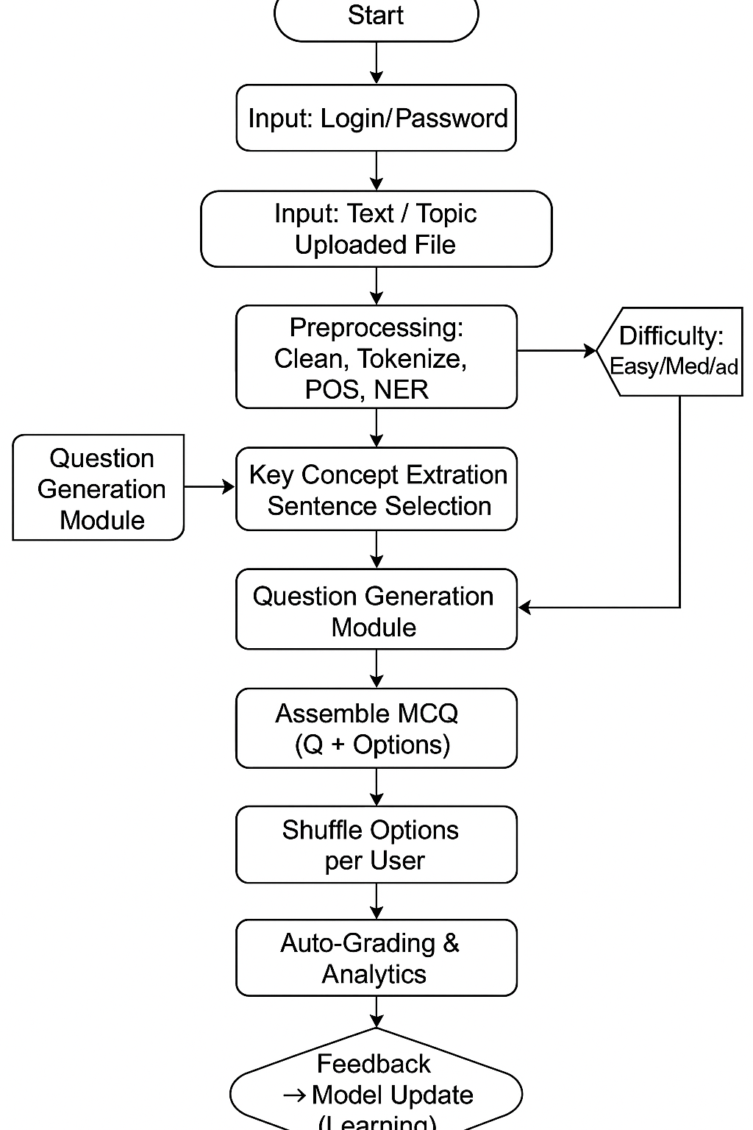
TECHNICAL ARCHITECTURE
MINOR PROJECT ID : MIN12
DEPARTMENT OF COMPUTER SCIENCE & ENGINEERING, SIRT

Slide 8
ABSTRACT
The AI Driven MCQ Quiz Generator is a smart system designed to automatically generate multiple-choice questions using artificial intelligence. It analyzes input text or topic keywords and produces high-quality MCQs with correct answers and explanations. This helps both students and teachers by saving time and increasing learning efficiency. The system aims to modernize education by providing unlimited, diverse, and accurate quiz content.
MINOR PROJECT ID : MIN12
DEPARTMENT OF COMPUTER SCIENCE & ENGINEERING, SIRT

Slide 9
LITERATURE REVIEW
Year | Reference | Result | Limitations | Conclusion
2024 | Shalini & Priyadharshini, Automated Question Generation (IEEE) | NLP + DL generate MCQs effectively | Distractors sometimes irrelevant; high model cost | Transformer-based QG effective but needs refinement
2023 | Soni & Singh, AI-Based Exam System (IJRET) | MCQ generation + shuffle per user | No adaptive difficulty; shuffle limited | Improve fairness; future adaptive models
2022 | Bhattacharya et al., BERT Quiz Generator (Springer) | High-accuracy MCQs using BERT. | Heavy computation, complex grammar | Domain-tuned models needed
MINOR PROJECT ID : MIN12
DEPARTMENT OF COMPUTER SCIENCE & ENGINEERING, SIRT

Slide 10
2021 | Ahmed & Kumar, AI Question Generator (IJCTT) | Auto MCQ + shuffled options | Limited question types | Add analytics + descriptive support
2020 | Chaware et al., AI-NLP MCQ Generator (IRJET) | Keyword extraction + synonyms | Predictable options, no difficulty level | Strong base; requires advanced NLP

Slide 11
EXECUTION PLAN
Phase 1: Foundation & Design
Define clear workflows for chat, intervention, and counselor booking
Create user personas to design a friendly and comfortable UI
Build Flutter screens with wellness-friendly color psychology
Create database schema for users, sessions, and counselor calendars
Phase 2: Backend Core Development
Implement API endpoints using FastAPI
Add JWT-based secure authentication
Build appointment scheduling logic
Implement rules for emergency escalation when a student shows critical distress signals
MINOR PROJECT ID : MIN12
DEPARTMENT OF COMPUTER SCIENCE & ENGINEERING, SIRT

Slide 12
EXECUTION PLAN
Phase 1: Requirement & Design • UI design • Topic selection page • Database structure
Phase 2: Backend Development • API creation • MCQ generation logic • AI model integration
Phase 3: AI Integration • Implement question-generation model • Add difficulty-level logic • Test MCQ accuracy
Phase 4: Testing & Finalization • Validate generated questions • Improve UI • Prepare final deployment
MINOR PROJECT ID : MIN12
DEPARTMENT OF COMPUTER SCIENCE & ENGINEERING, SIRT

Slide 13
APPLICATION OF THE PROPOSED WORK
• Students → Practice unlimited MCQs.
• Teachers → Create quick tests and assignments.
• Coaching Institutes → Generate large question banks.
• Competitive exam aspirants → Fresh questions for practice.
• Colleges → Use for internal quizzes, labs, and exams.
MINOR PROJECT ID : MIN12
DEPARTMENT OF COMPUTER SCIENCE & ENGINEERING, SIRT

Slide 14
CONCLUSION
The AI Driven MCQ Quiz Generator provides a modern, fast, and intelligent way to produce high-quality MCQs. It saves time, reduces manual effort, and ensures fresh question sets every time. The system supports both teachers and students, making learning more interactive, adaptive, and efficient. This project demonstrates how AI can transform the traditional approach to question creation in education.
MINOR PROJECT ID : MINXXXXX
DEPARTMENT OF COMPUTER SCIENCE & ENGINEERING, SIRT

Slide 15
REFERENCES
https://thesai.org/Downloads/Volume15No1/Paper_3-Automatic_MCQs_Generation_using_NLP.pdf -2025
https://ieeexplore.ieee.org/document/10013345 - 2024
https://link.springer.com/article/10.1007/s10639-023-11928-8 -2023
https://link.springer.com/article/10.1007/s10639-023-11928-8 - 2022
MINOR PROJECT ID : MIN12
DEPARTMENT OF COMPUTER SCIENCE & ENGINEERING, SIRT

Slide 16
Thank You
MINOR PROJECT ID : MIN12
DEPARTMENT OF COMPUTER SCIENCE & ENGINEERING, SIRT

