Slide 1
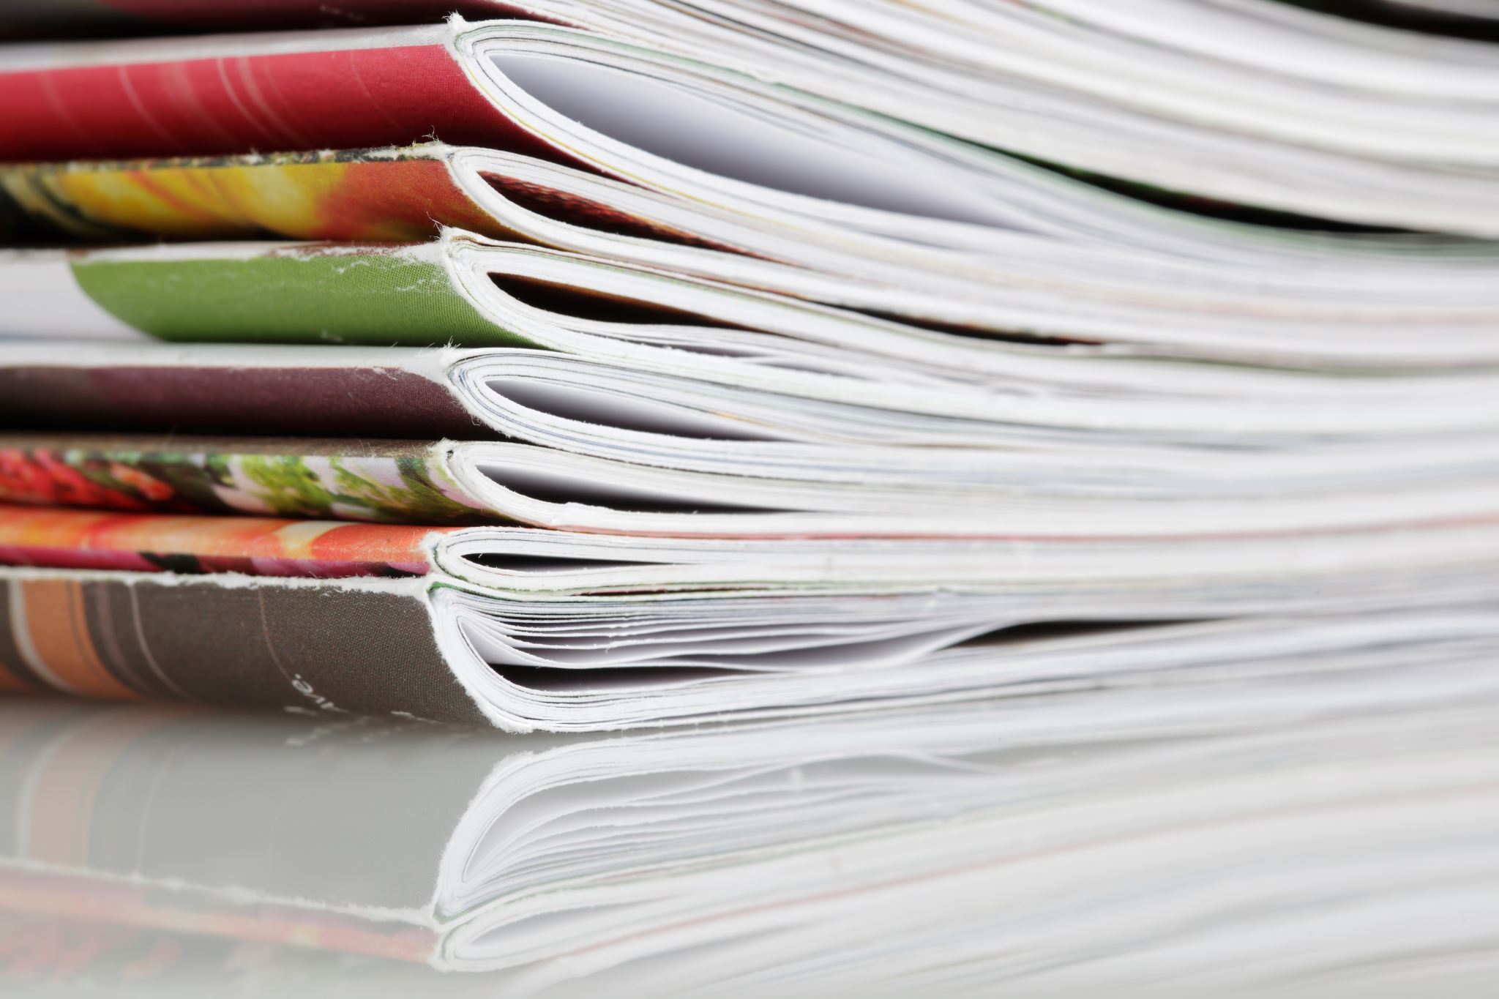

Advance Learning from our: E-Library
By team Unity

Slide 2

Let's Unites
Abhishek khore (Leader maintain core coding part)
Brajesh Rajput (wire Frame Designer)
Chhotelal Bakoriya ( Designed About us section ,Footer section &Content Selection)
Radhika joshi ( Design login Page forCustomer Review & helped in Content and Image Selection)
Radhika Choubey ( fresher)
Aman Meena: ( fresher)

Slide 3
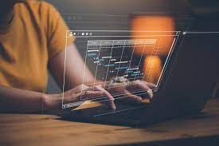

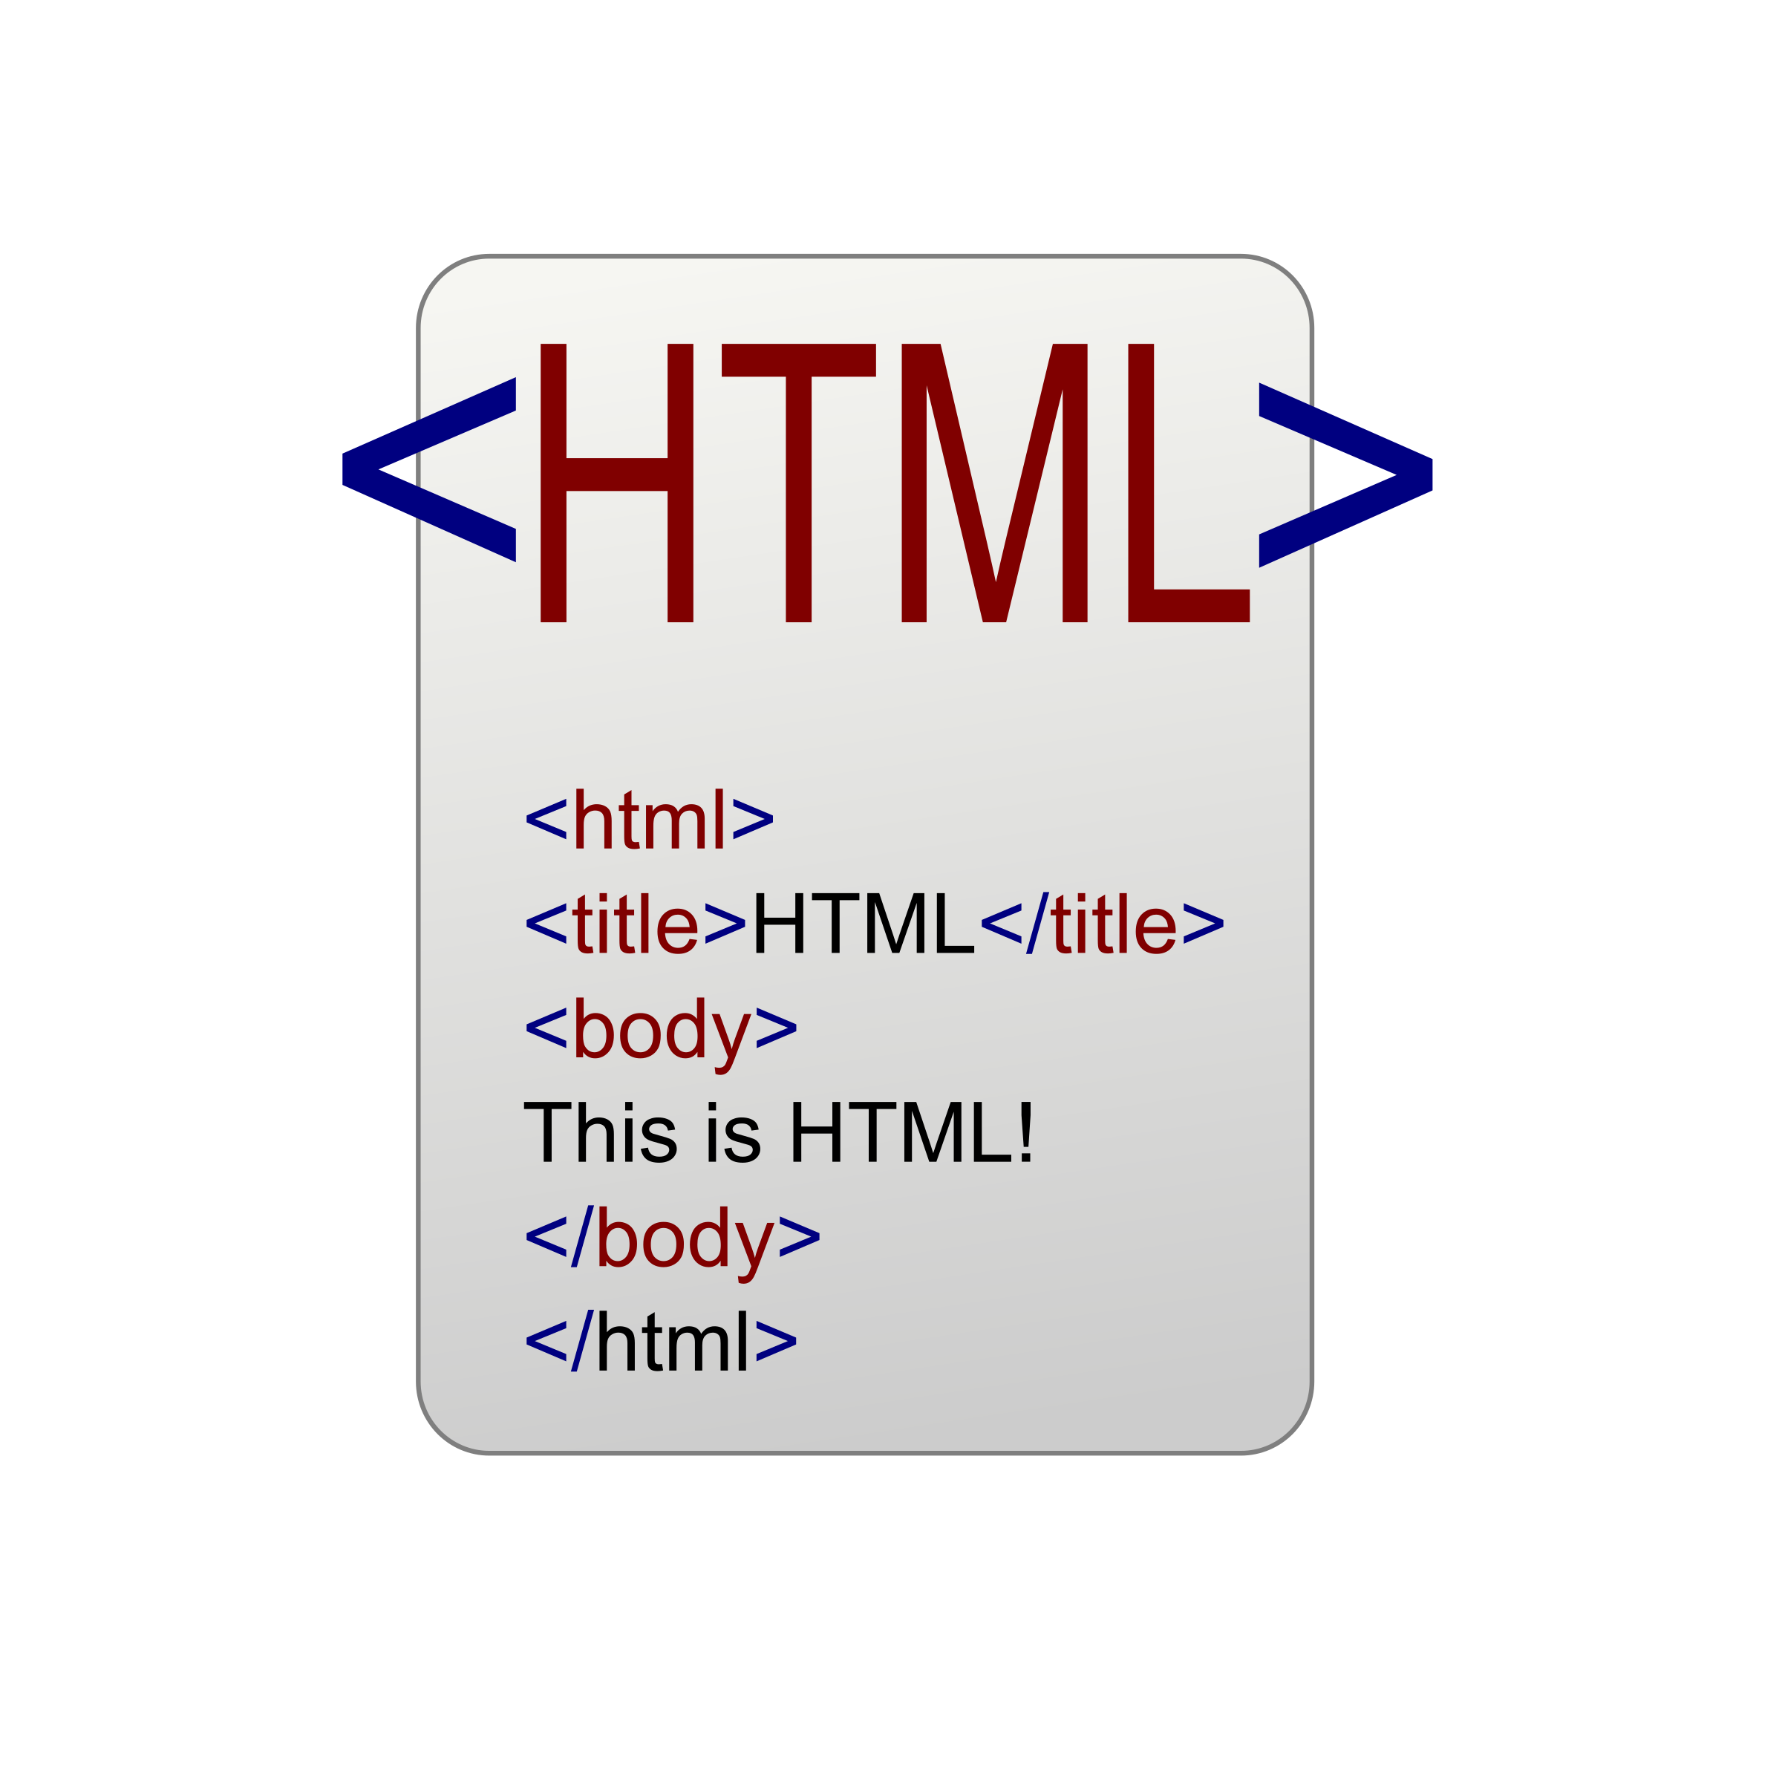
Technologies we used :
Html
CSS

Slide 4
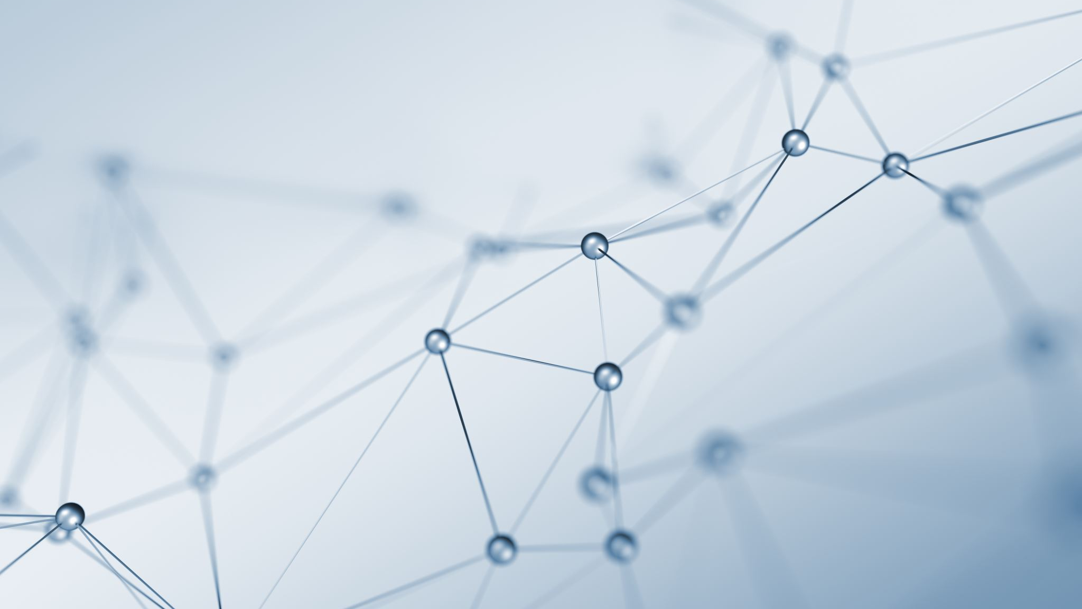
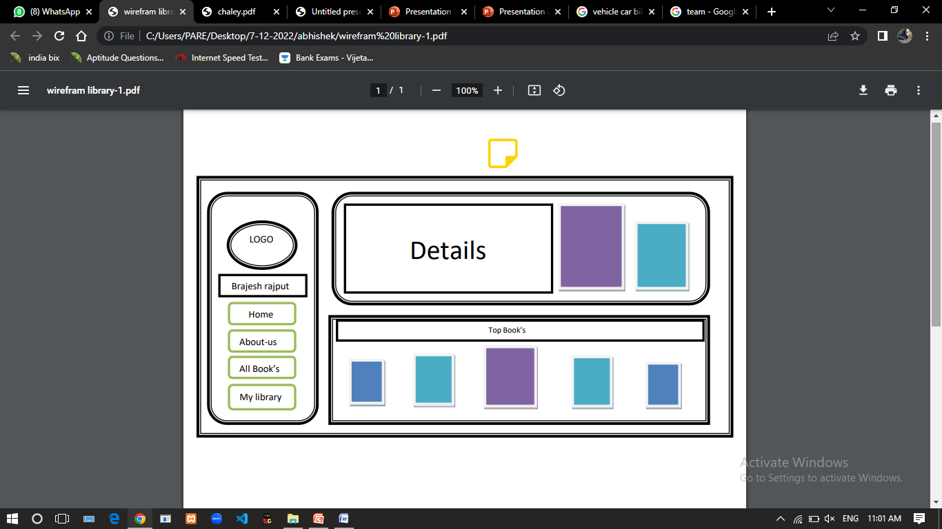
WIRE FRAME

Slide 5

E-Library
E- library
Digital libraries Provide the Students withthe convenience of learning at their own.Comfort.
Students can access and read the library. Materials at anytime and anywhere using their preferred devices..
When it comes to desiving purpose and meaning. out of the books you read, libraries can. help with that too.
when we consider the storage capacity. of digital document and its maintained then it can be easily realize that the cost of Fechonologies is much more less than that of traditional libraries.

Slide 6


