Slide 1
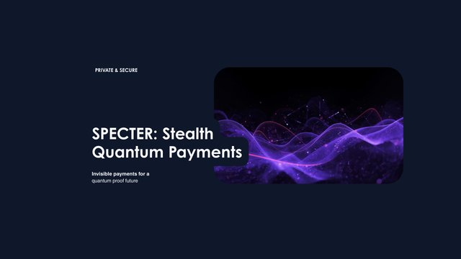
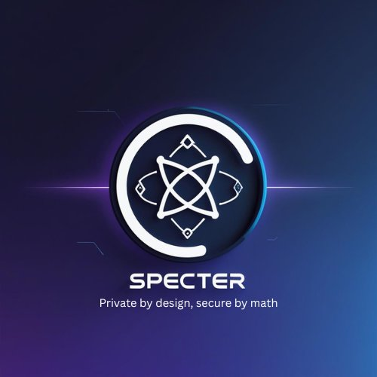
SPECTER
Post-Quantum Stealth Address Protocol
Invisible payments for a quantum-proof future
NIST FIPS 203
ERC-5564 Compatible
Multi-Chain
github.com/pranshurastogi/SPECTER

Slide 2


The Problem
Ethereum's privacy crisis has two dimensions
TODAY: ZERO PRIVACY
TOMORROW: QUANTUM THREAT
Every transaction is publicly visible on-chain
Sending to a known address permanently links sender ↔ recipient
Umbra & Railgun use classical secp256k1 — already at theoretical risk
$300M+ processed by Umbra, all on public infrastructure
Shor's algorithm breaks secp256k1 — every existing privacy protocol
20% chance of cryptographically-relevant quantum computers by 2030 (Metaculus)
Ethereum Foundation declared post-quantum resistance a TOP priority
"Resist saying 'let's delay quantum-resistance to the last moment'" — Vitalik, Dec 2025
Zero existing protocols address BOTH problems simultaneously.

Slide 3




SPECTER: The Solution
One protocol. Two threats eliminated.
Post-Quantum
Cryptography
True On-Chain
Privacy
Multi-Chain
Ready
ML-KEM-768 (NIST FIPS 203) — the official post-quantum key encapsulation standard. NIST Level 3: 128-bit quantum, 192-bit classical security.
Every payment goes to a unique one-time stealth address. Observers cannot link payments to recipients. ERC-5564 compatible as schemeId 2.
Ethereum + L2s (Arbitrum, Base, Optimism) + Solana. Rust codebase compiles to WASM for browser wallets. First PQ protocol on Solana.
99.6%
~430KB
9
FIPS 203
Scanning Efficiency
Rust Codebase
Modular Crates
NIST Standard

Slide 4
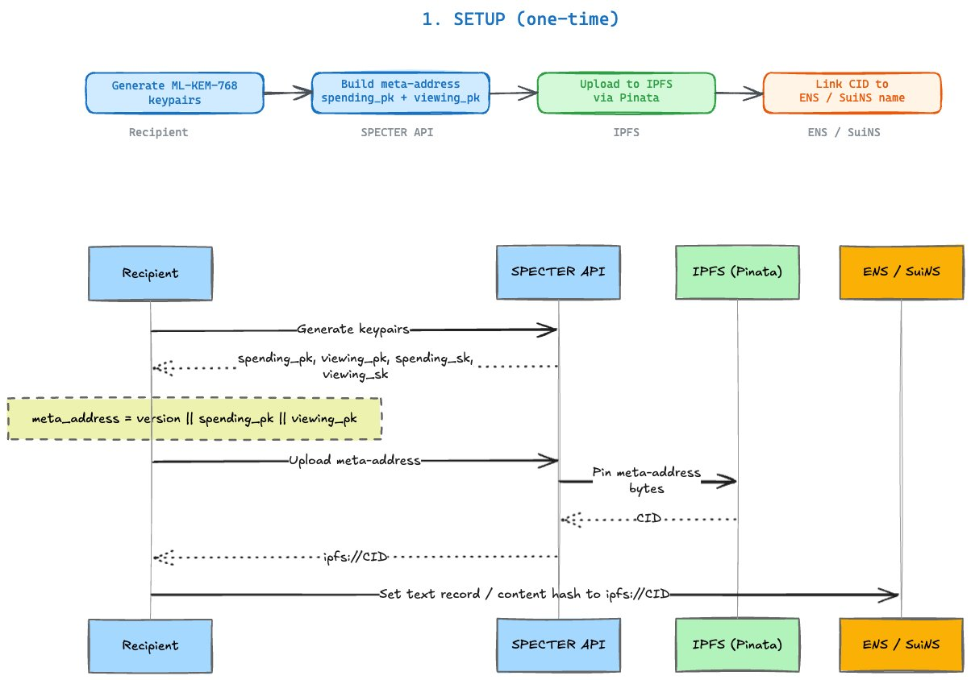
How SPECTER Works — Phase 1: Setup
One-time registration. Zero recurring overhead.

Slide 5
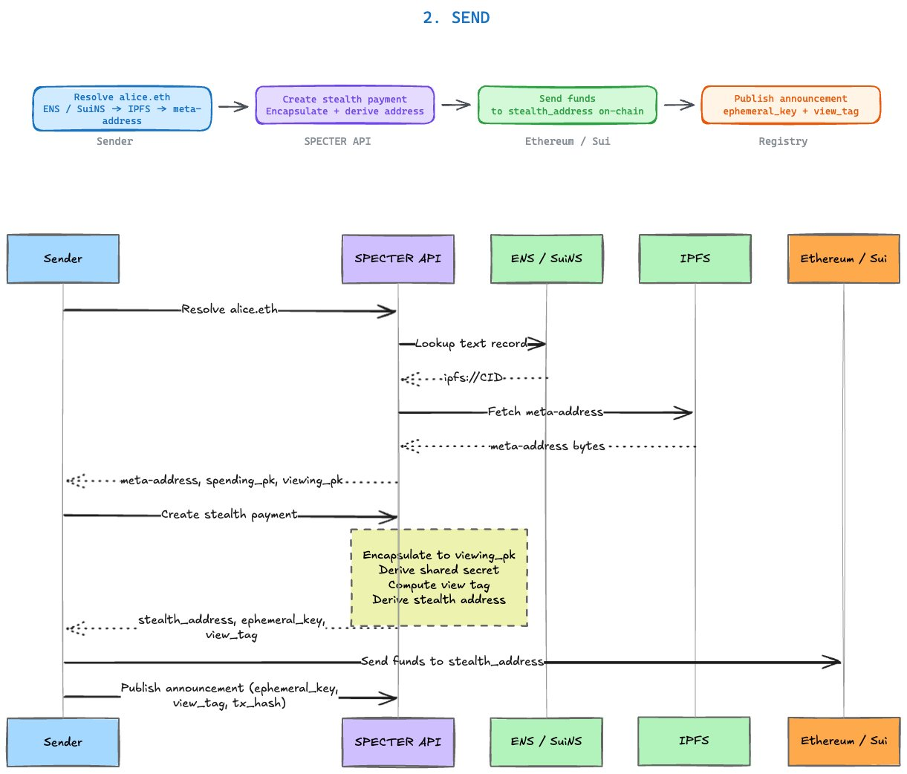
How SPECTER Works — Phase 2: Send
Sender derives a one-time stealth address — recipient never exposed.

Slide 6
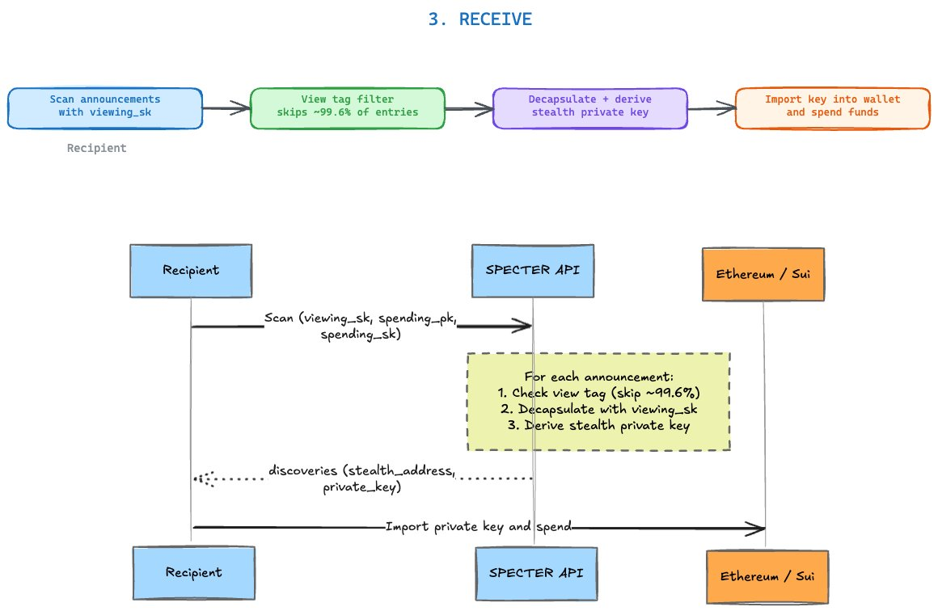
How SPECTER Works — Phase 3: Receive
View tags eliminate 99.6% of work before any decryption.

Slide 7

ML-KEM-768: NIST-Standardized Post-Quantum Crypto
FIPS 203 — the only approved key encapsulation standard
KEY PARAMETERS
NIST Level 3
192-bit
Component | Size | Purpose
Public Key | 1,184 bytes | Encapsulation key
Secret Key | 2,400 bytes | Decapsulation key
Ciphertext | 1,088 bytes | In announcement
Shared Secret | 32 bytes | Address derivation
Security Level
Classical Security
128-bit
FIPS 203
Quantum Security
Standardized Aug 2024
Zeroize on drop
Constant-time comparisons
No unsafe code
Domain-separated hashes

Slide 8
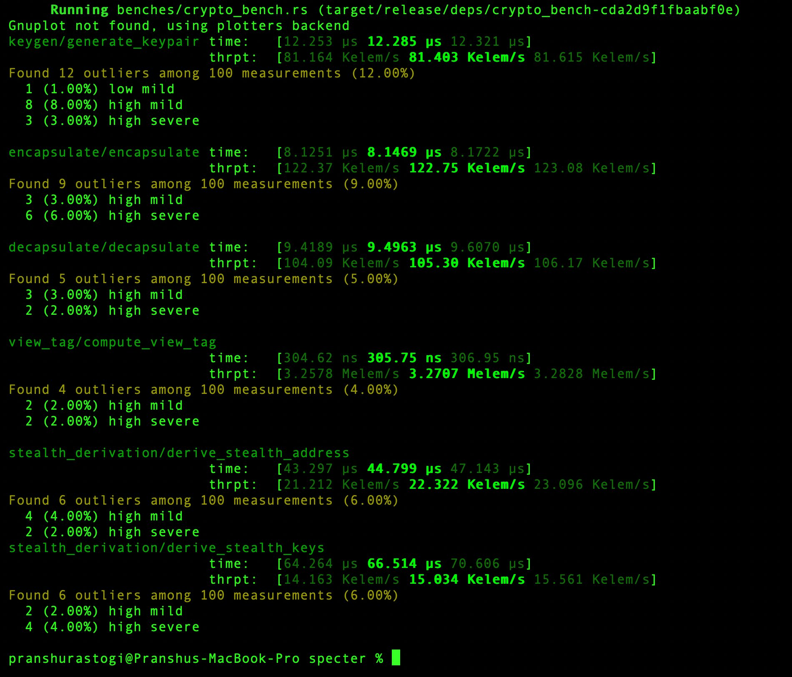
Real-World Performance Benchmarks
Measured on actual hardware — not estimates
12 µs
8 µs
Key Generation
Encapsulation
9.5 µs
306 ns
Decapsulation
View Tag Compute
44 µs
~1.5 s
Stealth Address Derive
Scan 100k Announcements

Slide 9
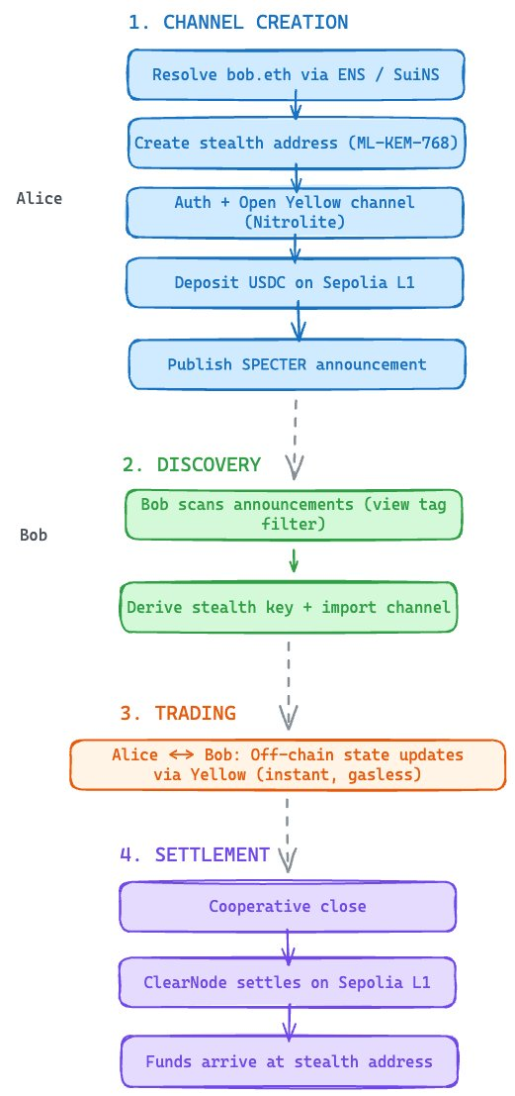

SPECTER × Yellow Network
Private State Channel Trading — Post-Quantum Protected

Slide 10
Yellow Network: Off-Chain State Channel Trading
ClearPort protocol — peer-to-peer state channels at scale
HOW YELLOW WORKS
THE PRIVACY GAP
Participants lock collateral in on-chain state channels
Trades execute OFF-CHAIN via signed state updates — zero gas per trade
Only channel open & final settlement touch the blockchain
EIP-712 signed session keys for authentication
Instant finality ideal for high-frequency trading
Channel ENDPOINTS (addresses) are visible on-chain
Opening a channel reveals: WHO is trading with WHOM
Settlement transactions permanently link all parties
Institutional traders cannot expose strategy — alpha = money
No quantum resistance in current state channel design
SPECTER adds a quantum-safe stealth privacy layer to Yellow — solving both gaps at once.

Slide 11
SPECTER × Yellow: Full Integration Flow
Stealth addresses as anonymous, quantum-safe channel endpoints
1
CHANNEL CREATION
Alice resolves bob.eth via ENS → fetches ML-KEM-768 meta-address. Creates stealth address, opens Yellow channel (Nitrolite), deposits USDC on Sepolia. Publishes SPECTER announcement.
2
DISCOVERY
Bob scans SPECTER announcements using view tag filter (skips 99.6%). Decapsulates matching announcement → derives stealth key → imports channel.
3
TRADING
Alice ↔ Bob: off-chain state updates via Yellow (instant, gasless). No on-chain footprint during active trading. Quantum-safe throughout.
4
SETTLEMENT
Cooperative close → ClearNode settles on Sepolia L1. Funds arrive at stealth address. Entire session: unlinkable.

Slide 12



specter-yellow Crate — Technical Architecture
Full Rust implementation · 58 KB · WebSocket + state channel management
YellowClient
// Create a private trading channel
WebSocket client with full auth flow, session management
let client = YellowClient::new(
config, address, priv_key
);
client.authenticate().await?;
// Open private channel
let ch = client
.create_private_channel(
"bob.eth",
"USDC",
10_000,
).await?;
// Discover incoming channels
let chs = client
.discover_private_channels(
&wallet,
).await?;
Session Keys
EIP-712 signed session key creation & verification
Channel Ops
Create, fund, resize, close state channels
Private Discovery
Scan announcements with SPECTER viewing keys
Settlement Logic
On-chain settlement with private withdrawal addresses

Slide 13

Why Yellow Network Needs SPECTER
Privacy is the missing piece for institutional DeFi adoption
Institutional Adoption
Counterparty Privacy
Hedge funds & market makers cannot expose trading strategies on-chain. SPECTER removes this barrier — making Yellow viable for institutional capital.
Without SPECTER, channel endpoints reveal WHO trades with WHOM. With SPECTER, endpoints are one-time stealth addresses — permanently unlinkable.
Quantum-Safe by Default
Minimal Cost Impact
As Yellow scales to institutional volumes, its security must be future-proof. ML-KEM-768 protects all channel participants against quantum adversaries.
Yellow already cuts gas 99%+ via off-chain trading. SPECTER's stealth overhead applies only at channel open/close — fractions of a cent.
First post-quantum privacy layer for state channel trading — anywhere.

Slide 14
Competitive Landscape
SPECTER is the only post-quantum privacy protocol
Protocol | Cryptography | Post-Quantum | Multi-Chain | Yellow
Umbra | secp256k1 (ECDH) | ❌ | ❌ ETH only | ❌
Railgun | zk-SNARKs | ❌ | Limited | ❌
Aztec | zk-SNARKs | ❌ | Building L2 | ❌
Cloak | secp256k1 (Solana) | ❌ | Solana only | ❌
Arcium | Classical MPC | ❌ | Building | ❌
SPECTER ✦ | ML-KEM-768 (NIST) | ✅ NIST L3 | ✅ ETH+SOL+L2 | ✅ Native
No existing protocol is post-quantum. SPECTER is first.

Slide 15
Vitalik's Wishlist — We're Building It
6 unbuilt features from his Apr/Nov/Dec 2025 roadmap. We're delivering all of them.
One Address Per App
Privacy-Preserving Keystore
Proof Aggregation
"The most practical way to remove public links between all activity across different apps." — Vitalik, Apr 2025
App-specific stealth meta-addresses, all from one master seed.
Verification keys should be private by default. SPECTER: ML-KEM encrypted keystore contracts with zero-knowledge ownership proofs.
"Proof aggregation could reduce costs while enhancing privacy." Batch announcements: 95%+ gas reduction at 100 transactions.
Quantum-Safe AA Wallet
Send-to-Self Privacy
Quantum Migration Path
"Moving to upgradeable wallets makes it easier to swap signature schemes." — Vitalik, Nov 2025
First PQ AA wallet using ML-DSA-65 (FIPS 204).
"Send-to-self transfers should be privacy-preserving by default." Relayer-routed stealth self-transfers — zero visible link.
"Once you send a tx, your public key is revealed." — Vitalik, Dec 2025
Register your PQ identity now, before quantum threat materialises.

Slide 16
Roadmap
From working Rust codebase to audited mainnet
Phase 0
NOW ✅
Phase 1
Weeks 1–4
Phase 2
Weeks 4–8
Phase 3–4
Weeks 8–20
ML-KEM-768 crypto core
View tags (99.6% efficiency)
ENS + IPFS integration
Yellow Network crate
REST API + CLI
Solidity announcer + registry
Sepolia testnet live
One Address Per App (OAPA)
Send-to-self privacy module
Quantum-safe AA wallet (ML-DSA-65)
EIP draft — ERC-5564 schemeId 2
Solana MVP crate
EF ESP grant application
Proof aggregation (95% gas cut)
Security audit (4–6 weeks)
Mainnet: ETH + Solana + Arbitrum
ERC-4337 integration

Slide 17
Funding Strategy & Traction Goals
Grant-first. Infrastructure-grade, open source.
GRANT TARGETS
6-MONTH TARGETS
Ethereum Foundation ESP
$50K – $200K
Testnet transactions
1,000+
Solana Foundation
$25K – $100K
Registered meta-addresses
1,000+
EF Academic Grants
$50K – $100K
Developer integrations
3+
Chains deployed
3 (ETH + SOL + 1 L2)
Optimism RPGF
Variable
Security audit completed
✅
Gitcoin Grants
$5K – $50K
EIP draft submitted
✅
$300M+
$83M
0
Umbra TVL Processed
Railgun TVL
PQ Competitors

Slide 18


Thank You
Private by design, secure by math.
github.com/pranshurastogi/SPECTER
ERC-5564 schemeId 2 (Draft)
ML-KEM-768 · NIST FIPS 203

