Slide 1
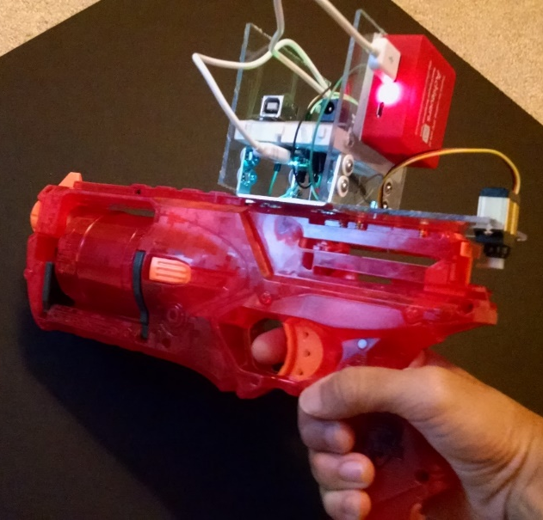

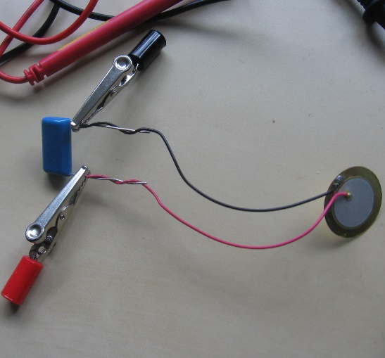
Intelli-Gun
Piezoelectric Energy Conversion
AppBuild.r

Slide 2



BotWorks Personal Recall Notifier
Dabkick
Scry Analytics

Slide 3
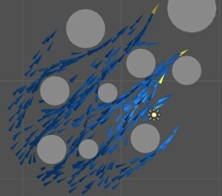


Stanford Summer Institutes
Berkeley Business Academy
Boids Technology

Slide 4




AYSO Mobile Application
DECA
Global Innovation Challenge

Slide 5



Conrad Awards
Synopsys Science and Engineering Fair
AP Scholar

Slide 6

National Merit

