Slide 1
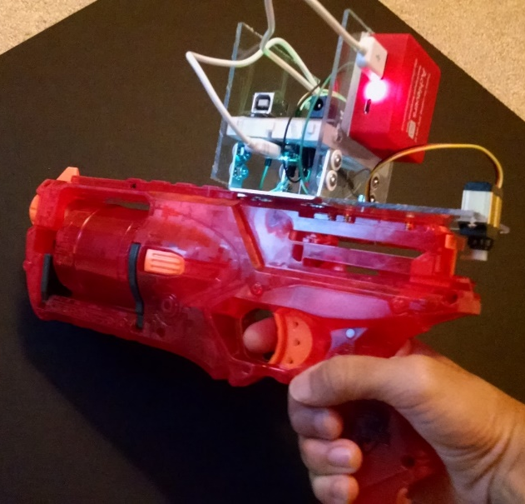

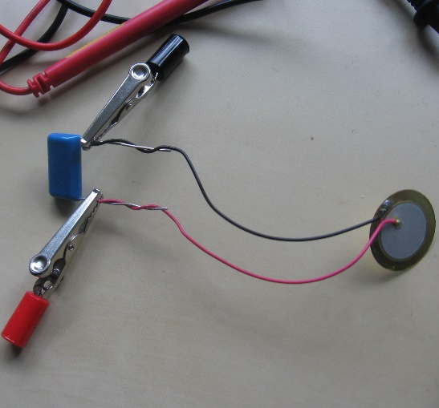
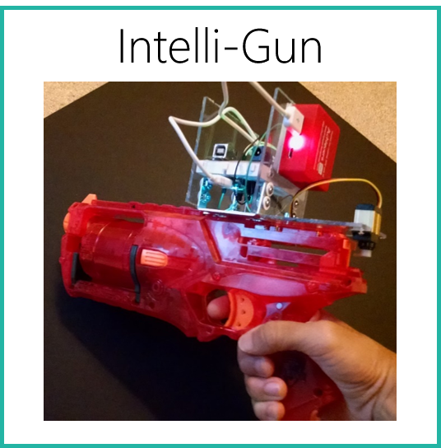
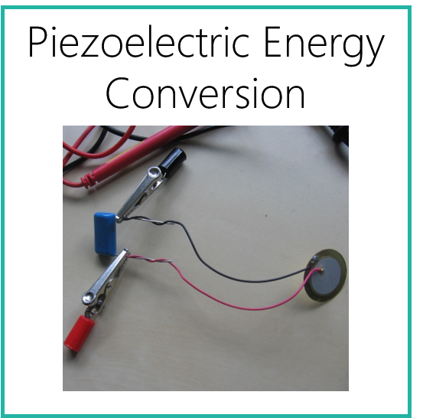

Intelli-Gun
Piezoelectric Energy Conversion
AppBuild.r

Slide 2





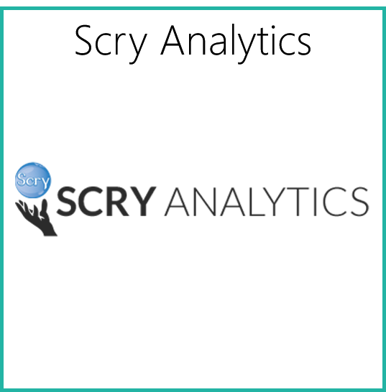
BotWorks Personal Recall Notifier
Dabkick
Scry Analytics

Slide 3
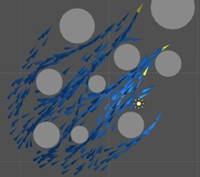




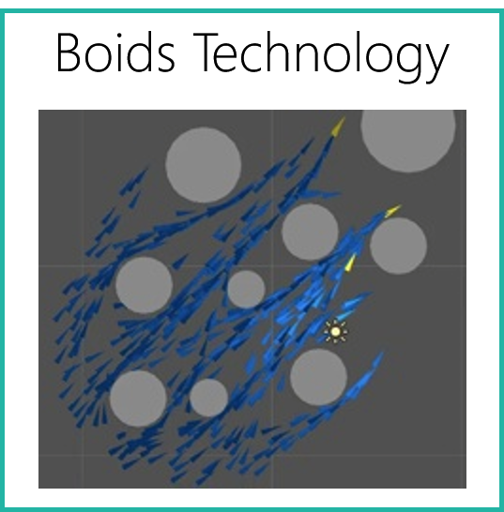
Stanford Summer Institutes
Berkeley Business Academy
Boids Technology

Slide 4




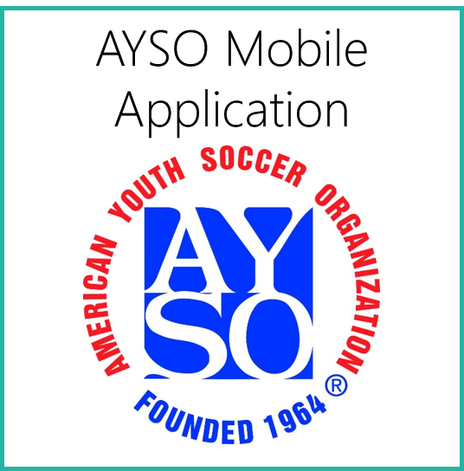


AYSO Mobile Application
DECA
Global Innovation Challenge

Slide 5




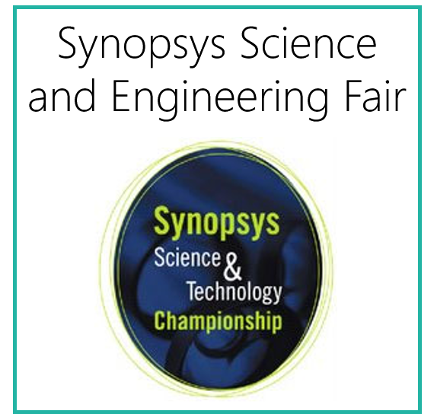

Conrad Awards
Synopsys Science and Engineering Fair
AP Scholar

Slide 6


National Merit
This is a paragraph in 18 point Calibri font. Say hello to the world for me. My program canst say it faster than your program canst. Why am I talking like Shakespeare now? Nobody knows.

