Slide 1
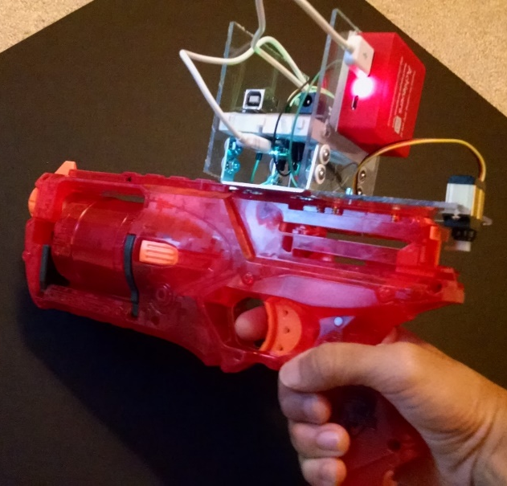


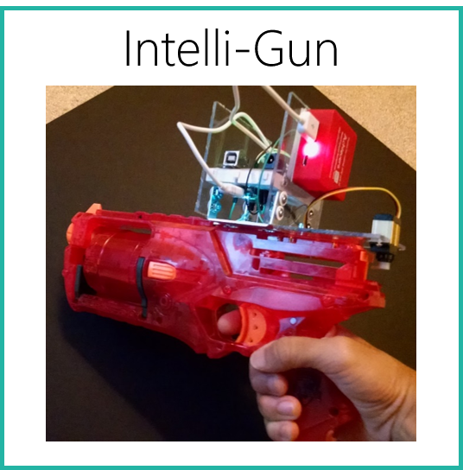


Intelli-Gun
BotWorks Personal Recall Notifier
Stanford Summer Institutes

Slide 2
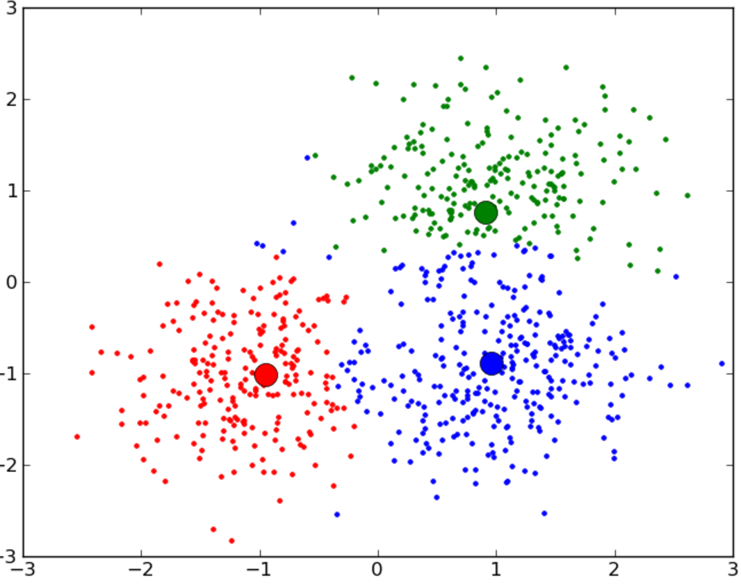


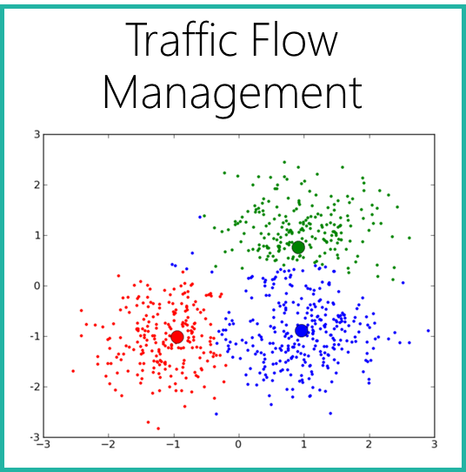
Berkeley Business Academy
Traffic Flow Management

Slide 3
I built a model that was trained with local traffic metrics, clustered drivers with similar destinations and driving styles together using a k-means algorithm, and redirected each cluster along a unique route away from the popular but congested main routes for more efficient vehicle traffic management. This project won the IBM Award for Computing at the 2016 Santa Clara Valley Science and Engineering Fair
I modified a toy gun to model my idea for a smart gun which is automatically disabled when it is near a school. I used the Arduino Uno and Spark Core WiFi module to control a lock on a personal firearm when near a school WiFi signal using UUIDs to detect the gun’s proximity to the school. This project won 2nd Place Engineering at the 2015 Santa Clara Valley Science and Engineering Fair.
This device uses information from your receipt to collect details about the food items you bought, such as the manufacturer, producer, processor, etc. It connects to federal databases and updates regularly with information about recalls and safety issues specifically related to the foods you bought. It then alerts you in case of a recall. It was granted a provisional patent and is currently patent pending. Visit our website at www.botworks.co.nr
At the Berkeley Business Academy during the summer of 2014, I conducted a case study with my team of Apple’s progress in innovation. We made a case for why Apple’s continued innovation model puts it ahead of competitors and made suggestions on certain improvements. We presented our findings to members of UC Berkeley SCET.
At Stanford Summer Institutes 2015, I took courses in Artificial Intelligence under renowned professors on areas of classification, gradient descent, computational biology, speech recognition, adversarial search, and more. I also completed a final project that uses the Sphinx speech recognition library to only allow certain users into a room, controlled by a speech activated lock.

