Slide 1
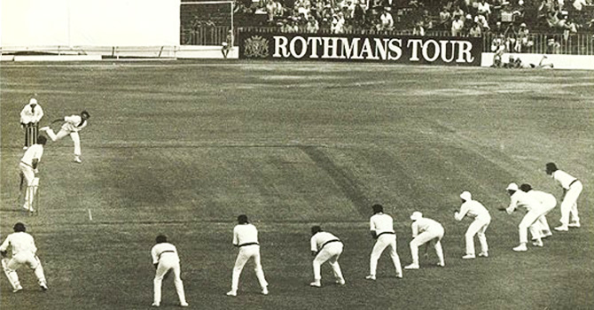
Bowling Performance Predictor in Test Cricket
Prantik Ghosh
LinkedIn: www.linkedin.com/in/prantik-ghosh-899701106/
Github: github.com/prantik-ghosh/bowling_performance_predictor_in_test_cricket.git

Slide 2
Motivation
The outcome of a cricket match is very hard to predict
An individual player’s performance is even harder to gauge
Although batters often get the limelight, in test cricket, a bowler’s contribution is absolutely paramount
Ability to predict a bowler’s performance will give coaches/captains better acumen to pick the bowling squad more efficiently

Slide 3
Data Retrieval
Match wise data for years from 2000 to 2017 downloaded from the web with the following information:
Bowler information – name, country, bowler type (pace/spin), bowling arm
Bowling statistics – overs bowled, runs conceded, wickets taken, etc.
Other information – date, opposition, ground, home or away

Slide 4
Feature Engineering
Following features were extracted from the base data:
Bowler’s performance in each of the last 5 years (Average #wickets captured per match)
Bowler’s “popularity” in each of the last 5 years (#matches played)
Bowler-opposition interaction
Bowler-home/away interaction
Bowling type-opposition interaction
Bowling type-ground interaction

Slide 5
Target (Grouping by Player)
The idea was to fit the model on individual matches a player will play and then sum those up to provide a prediction for the total number of wickets the bowler will capture in the entire year.

Slide 6
Setting up the Baseline
Last year’s performance is generally a very good indicator of a player’s current year’s performance
Average number of wickets taken per match is a straightforward measure of performance
Hence, the baseline for each player is set to be the average number of wickets taken per match in the previous year multiplied with the number of matches in the current year.

Slide 7
Cross validation
Because of the time-series type nature of the data, regular cross-validation was not possible. So, I used a rolling fixed width (6 year) window to train a model and then use it to predict for next year. There were 6 such training and validation sets and then finally one training and test data for the final testing.
Purpose | Training Data (year range) | Test/Validation (year)
Validation set 1 | 2005-2010 | 2011
Validation set 2 | 2006-2011 | 2012
Validation set 3 | 2007-2012 | 2013
Validation set 4 | 2008-2013 | 2014
Validation set 5 | 2009-2014 | 2015
Validation set 6 | 2010-2015 | 2016
Final Testing | 2011-2016 | 2017

Slide 8
Model Fitting Strategy
Try linear regression, grid searched random forest, and grid searched gradient boosting decision tree models
Try different subsets of the features
Calculate training scores (Explained Variance and Mean Squared Error) for all different sets of training and validation data
Compare performance to pick the winning model

Slide 9
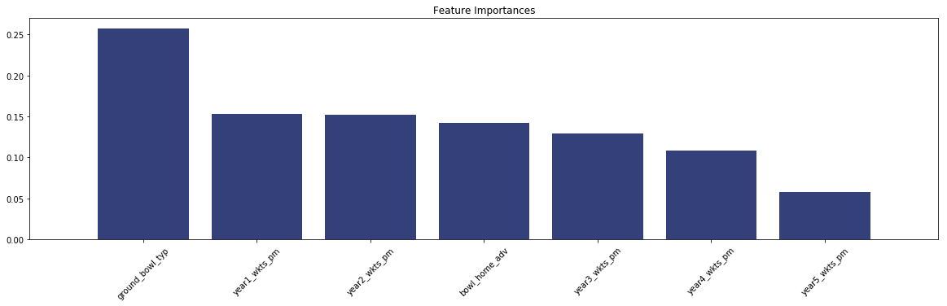
Results: Feature Importance
All the different models clearly showed that the features involving #matches played, bowler-opposition interaction and bowling type-opposition interaction are not important. The only significant features are the following:
Bowler’s past performance
Bowler-home/away interaction
Bowling type-ground interaction
The final model run revealed the following feature importances:

Slide 10
Results: Model Selection
All three models (Linear Regression, Random Forest, Gradient Boosted Trees) delivered best test score for some validation set or other.
Gradient boosting did slightly better on average.
Gradient boosting model’s score was always close to the best model when it was not the best.
Gradient Boosting Decision Tree Regressor is chosen as the winning model!

Slide 11
Results: Train/Test score anomaly
In all the models, training score was much better than test score including the winning gradient boosting model.
Trying to under-fit the models didn’t work; it brought down both training and test scores.
Conclusion: The training and the validation data are not identically distributed because of the time-series nature of the data.

Slide 12
Final Prediction Results
The optimized Gradient Boosting model, when trained on 2011-2016 data and tested on 2017 data returned the following scores:
An Explained Variance of 81.4% against a Baseline Explained Variance of 65.9%
A Mean Squared Error (MSE) of 30.2 against a Baseline MSE of 59.9
These results are in line with what we have seen in the validation sets

Slide 13
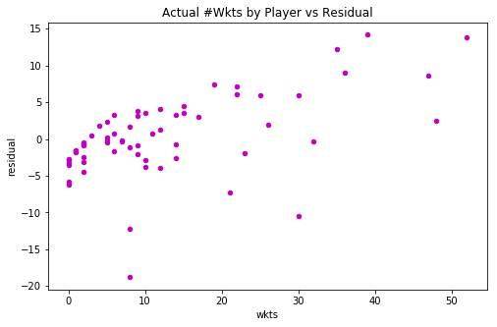
Residual Plot Diagram
Following residual plot diagram shows actual number of wickets taken vs the residual (difference between actual and predicted)

Slide 14
Next Steps
Consider bowler subtype (What kind of spinner? A leg-break, an off-break, a left-arm-orthodox or a Chinaman bowler?)
Consider weather data and how it would interact with bowler type.
Perhaps consider domestic performance for those bowlers who are new to test cricket.

Slide 15
Questions?
Prantik Ghosh
LinkedIn: www.linkedin.com/in/prantik-ghosh-899701106/
Github: github.com/prantik-ghosh/bowling_performance_predictor_in_test_cricket.git

