Slide 1

Perignon Time
Discovering Excellence, Unveiling Precision

Slide 2
About ME
PRANTIK DATTA
BE – Comp Engg
Application Consultant – CG (Sep’17-Mar’20)
Data Analyst Domain (Py, SQL)– upskilled Mar’20 (COVID-phase)
DA (Marketing) Intern (Excel) – CSPL (Sep’20)
MSc in Web and Data Science, Germany (Apr 21)
Working Student DA (Py, SQL, PowerBI) – IABG (23-24)

Slide 3

Problem statement
Observed Decline : Notable decrease in customer satisfaction in mall stores versus flagship stores
Context : Impact on brand perception and sales
Goal : Identify root causes and propose actionable improvements

Slide 4
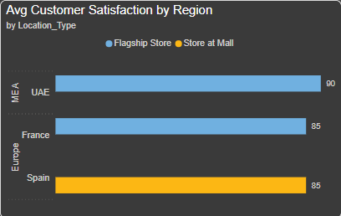
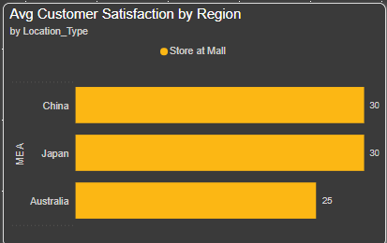
CSAT - Location and Store Types
TOP 3 COUNTRIES
BOTTOM 3 COUNTRIES
TOP 3: UAE (90%), France (85%), Spain (85%)
BOTTOM 3: China (40%), Japan (35%), Australia (25%)
Significant gap between best and worst (65% difference)
Clear regional performance patterns emerging
Notes:
Investigate Asia-Pacific underperformance
Replicate UAE flagship store best practices
Analyze Spain's successful mall model
Standardize regional training programs

Slide 5
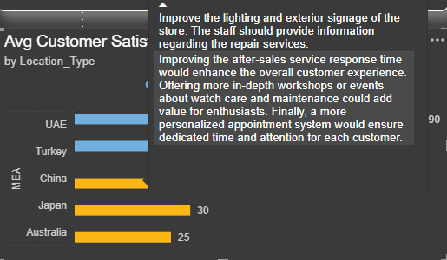
CSAT - Location and Store Types
Key Issues Identified
Location and Signage
After-Sales Service
Customer Experience
Product Information and Services
Notes:
Difficulty in locating the shop within the mall.
Lack of clear and prominent signage.
Slow response time to customer inquiries and requests.
Lack of personalized service and attention.
Chaotic atmosphere within the store.
Underwhelming overall experience, not meeting luxury brand standards.
Limited information provided about repair services.
Lack of workshops or events on watch care and maintenance.

Slide 6
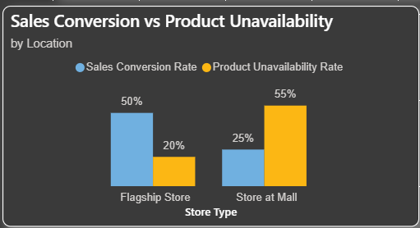
Performance Comparison
Flagship: 50% conversion vs 20% unavailability
Mall: 25% conversion vs 55% unavailability
Clear inverse relationship between availability and sales
35% difference in unavailability rates between locations
Notes:
Implement real-time inventory tracking
Establish cross-store stock transfers
Optimize mall store inventory levels
Create fast-track restocking system

Slide 7
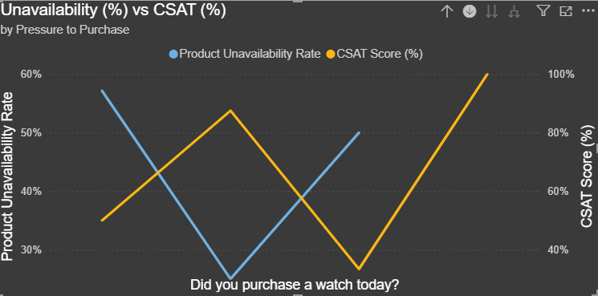
Sales Performance and Conversion
Direct correlation found: Higher product unavailability leads to lower customer satisfaction
Mall stores showing higher unavailability rates vs flagship stores
CSAT scores peak (100%) when products are readily available
Notes:
Implement real-time inventory tracking
Enable cross-store product transfers
Enhance staff training on alternatives
Create digital product catalogs

Slide 8
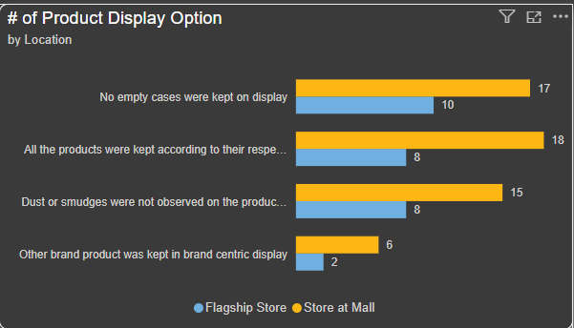
Product Display Options
Mall stores consistently show higher numbers across all display metrics
Biggest gap in brand-centric displays (6 vs 2)
Both store types maintain strong basic display standards
Mall stores demonstrate more rigorous display management
Notes:
Standardize flagship store display protocols
Implement mall store best practices
Enhance display monitoring system
Train flagship staff on display management

Slide 9
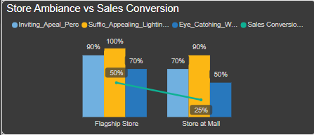
Store AMBIANCE vs SALES CONVERSION
Flagship stores significantly outperform mall stores in ambiance metrics
Notable gap in sales conversion: 50% (Flagship) vs 25% (Mall)
Store environment directly impacts conversion rates
Notes:
Upgrade mall store lighting systems
Enhance window display standards
Implement flagship store design elements
Standardize visual merchandising

Slide 10
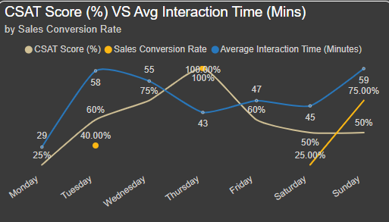
Customer Interaction Correl to (csat%)
Midweek (Wed-Thu): Best CSAT scores (75-100%)
Weekends: Longer interactions but lower satisfaction
Monday: Shortest interactions (29 mins) with lowest CSAT (25%)
Optimal day: Thursday (100% CSAT, 43 mins)
Notes:
Enhance Monday service quality
Optimize weekend interactions
Implement mid-week best practices

Slide 11
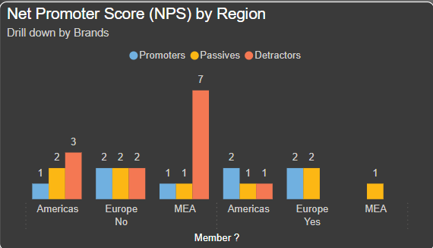
Customer Loyalty and NPS Analysis
Membership significantly impacts NPS scores across regions
MEA region shows highest detractor rate among non-members (7)
Member customers generally show better satisfaction levels
Europe maintains most consistent scores across member/non-member segments
Notes:
Launch targeted membership drive in MEA
Enhance member benefits communication
Implement regional-specific engagement strategies
Focus on passive customer conversion

Slide 12
looking forward to HEARING from YOU
Prantik Datta | prantikdatta@gmail.com | DASHBOARD

