Slide 1
Game Development
Armanur Rahman Pranto
ID:17101090
Noor Hasna
ID:17101093

Slide 2
What is video game development?

Slide 3
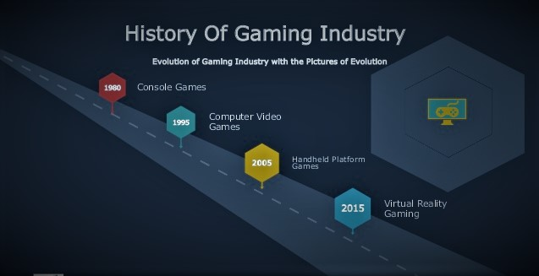
What is video game development?

Slide 4
What is video game genres?
Games are often classified into genres, which purport to define games in terms of having a common style or set of characteristics as defined in terms of perspective,gameplay,interaction,objective etc.

Slide 5
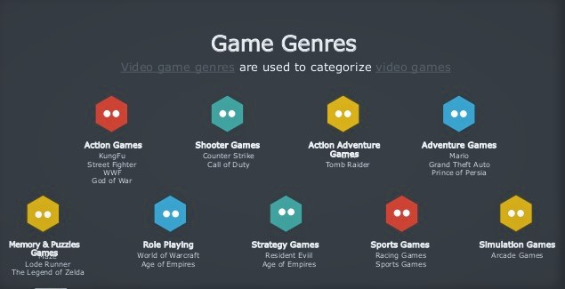
Slide Title
Make Effective Presentations
Using Awesome Backgrounds
Engage your Audience
Capture Audience Attention

Slide 6
Game development industry careers
Game designer
Game director
Game producer
Game artist
Game sound engineer
Game programmer
Game visuals
Game tester

Slide 7
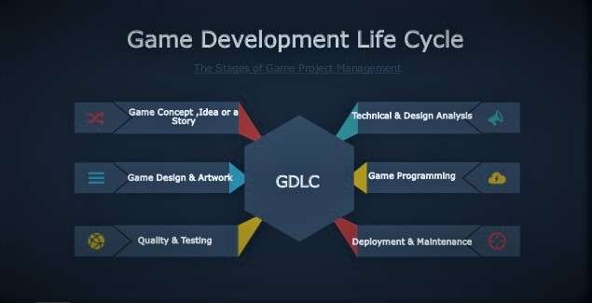
Slide Title
Make Effective Presentations
Using Awesome Backgrounds
Engage your Audience
Capture Audience Attention

Slide 8
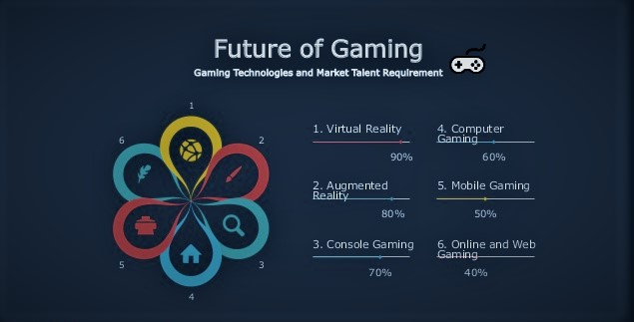
Slide Title
Product A
Product B
Feature 1
Feature 2
Feature 3
Feature 1
Feature 2
Feature 3

Slide 9
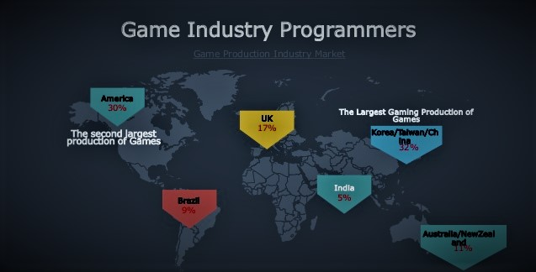
Slide Title
Product A
Product B
Feature 1
Feature 2
Feature 3
Feature 1
Feature 2
Feature 3

Slide 10
Game development process
Pre-production.
Pitch
GDD
Project plan
Production.
Game design.
Game art.
Programming.
Audio production
Postproduction.
Maintenance.
Customer service.
Update

Slide 11
Game engines
Unity.
Visual3D Game Engine.
Unreal Engine 3.
Game studio.
GameMaker Studio.

Slide 12
What are the roles in the video games industry ?
Producer.
Publisher.
Development team.

Slide 13
Game developer needed skills
Math.
Physics.
Ai.
Programming skills.
Graphics.
Algorithms.
Data structure.
Problem solving.
Networking.
Passion.

Slide 14
What skills you need to be game designer?
Creativity.
Practicality.
Problem solving.
Analytical attitude.
Communication skills.
Group working.

Slide 15
What skills you need to be game artists?
2D Artists:
2D paint package.
2D vector graphics package.
3D Artists and Animators:
3D package.
Specialist 3D animation package.
2D/Traditional animation package.
Game studios animation.

Slide 16
What skills you need to be game tester?
Bug tracking software skills.
Communication skills.
Team player.
Attention to details.

Slide 17
Whare to get a job in the video game industry?
Gaming company.
Indie game.

Slide 18
Publishing my game
FPS Multiplayer Game.
Tic Tac Toe.

Slide 19
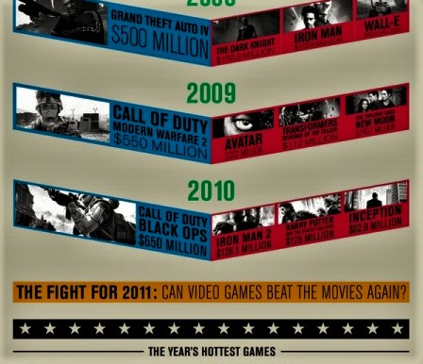
Game VS Movie
FPS Multiplayer Game.
Tic Tac Toe.

Slide 20
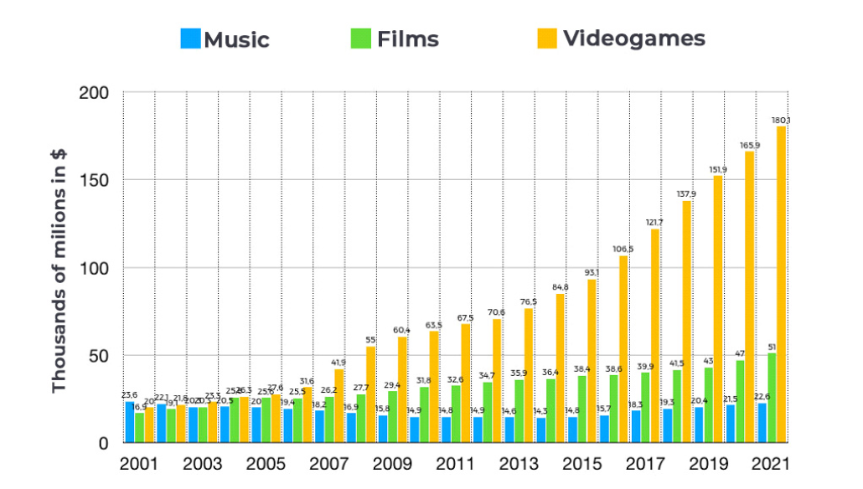
Compare
Product A
Product B
Feature 1
Feature 2
Feature 3
Feature 1
Feature 2
Feature 3

Slide 21
Game over

