Slide 1
Project Outsourcing Planning using Monte Carlo Simulation
IS 590PR Final Project
By Saurav Yadav and Pranali Mane

Slide 2

Background
Outsourcing is the business practice of hiring a party outside a company to perform services
It was started as a practice in 1989
Inspired from State Farm
Getting an estimate of the capacity of an organization based on it’s resources, it can plan better

Slide 3
Scenarios
Monte Carlo Simulation
Scenario 1
Scenario 2
Fixed Number of Employees
Fixed Number of Projects
Number of employees will be fixed
The result of the simulation will be the number of projects a company can do
Helps in estimating the number of projects that will need to be outsourced
Number of projects will be fixed
Number of employees to be hired will be the result of the simulation
Helping in planning the number of employees to be hired to achieve goals

Slide 4
Assumptions Variables
One employee will work only on one project at a time
Project Duration (12 – 20 weeks)
Total 30 employees
Project Sensitivity (2 – 12 weeks)
50 working weeks in a year
Team size (3 – 7 members)
Projects in queue are considered incomplete
Priority (1 – 5)

Slide 5
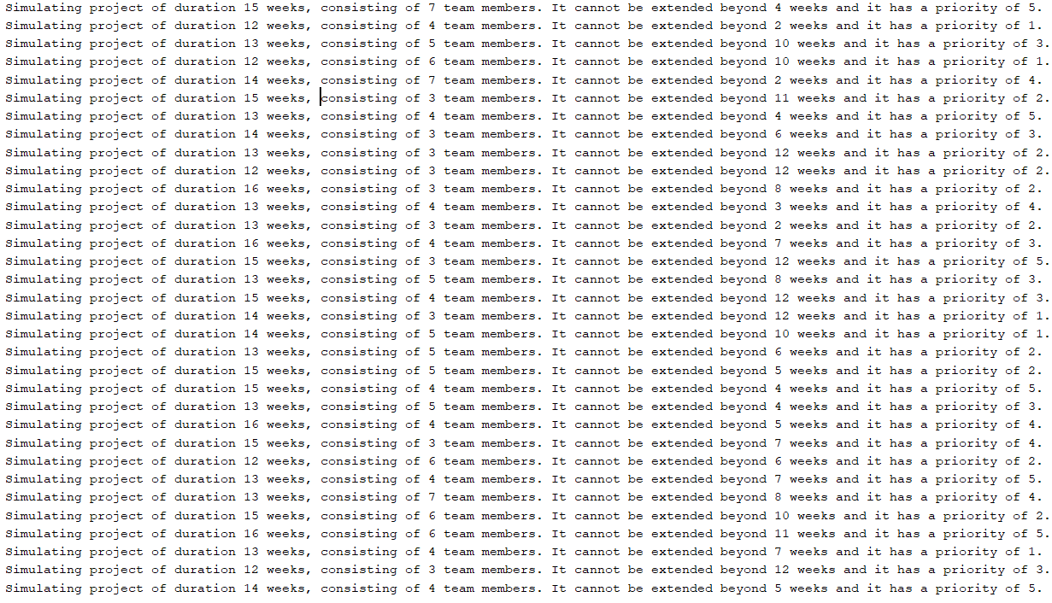
Working of Scenario 1: Fixed Employees

Slide 6
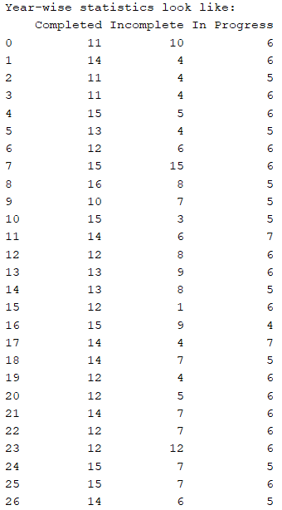
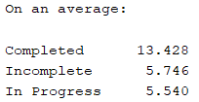
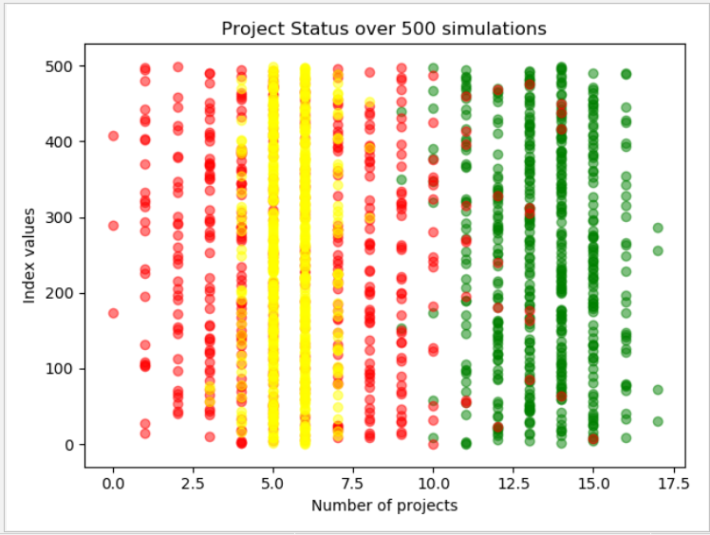
Output
Based on above and similar outputs, an organization can take necessary actions

Slide 7
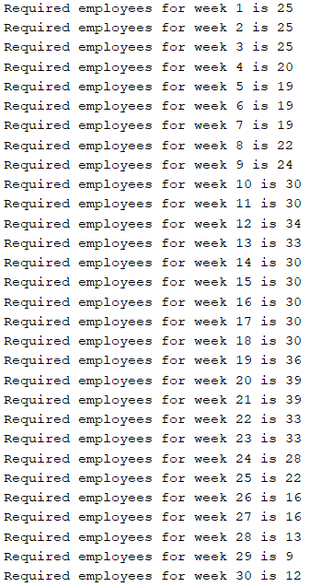
Working of Scenario 2: Fixed Projects

Slide 8
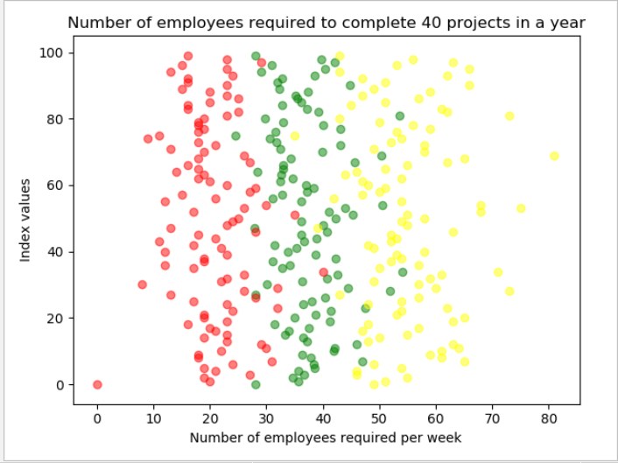
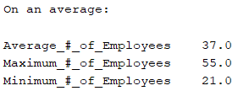
Output
Based on above and similar outputs, an organization can take necessary actions

Slide 9
Limitations & Possible Improvements
How can the program be improved and made more real-world like?
Variables
More variables can be considered to make the simulation more real-world
Employee Variability
Employees can be differentiated based on their skills and experience
Project Breakdown
Projects can be broken down into tasks to further improve the accuracy of simulations

Slide 10
THANK YOU

